Slide 1
Welcome to Queens College CUNY Service Corps
Cohort 9 - FWS Student Timesheet Instructions

Slide 2
1. All FWS CUNY Service Corps Students will receive a link to their Timesheet via Qmail.
Each Pay Periods are composed of Week 1 and Week 2.

Slide 3
2. Every two weeks, we will send reminders when your timesheets are due.
Student must complete entering their hours by Thursday 12:00 PM, Noon.
By Thursday 12:00 PM - your timesheets will be locked and sent to your Placement Site Supervisor for the verification process.
After 12:00 PM, the Pay Period will be locked. Once a Pay Period is locked, you will not be able to enter hours.

Slide 4
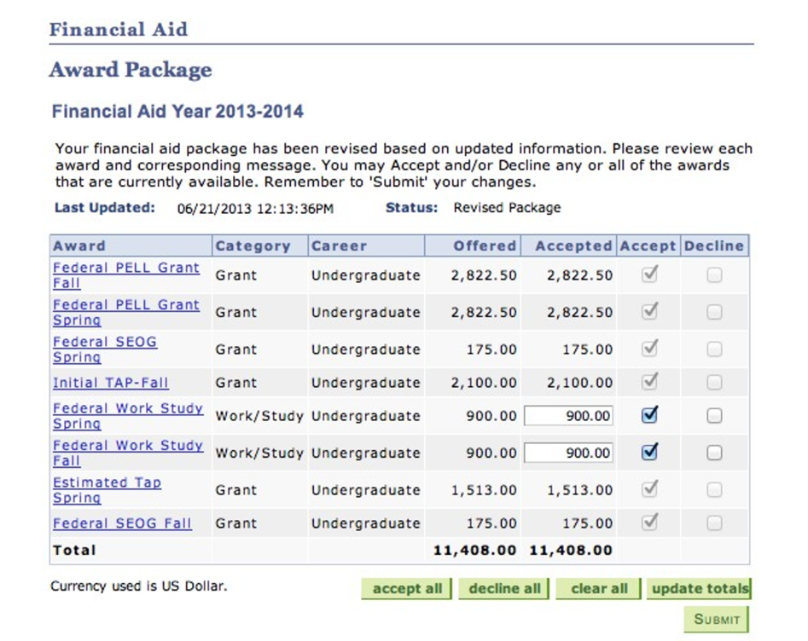
3. Total Work Budget Hours
From the Federal Work Study Award, your total budget work hours for the program will be based on your hourly pay rate, $17 an hour
Your stipend award is on your CUNYFirst, and any money left over will transfer to your Spring 2022 stipend.

Slide 5
FWS Student must enter their hours based on the specific day.
TIME IN: The time student started working.
TIME OUT: The time student stops working for the day.

Slide 6
3. If a student takes a lunch break, they can enter their remaining hours in the second Time IN section.

Slide 7
5. Your timesheets will be sent to your placement site supervisor for approval.
If your supervisor finds any discrepancies with your entered work hours, they will contact us to resolve the issue.

Slide 8
6. When your timesheet is approved, the CUNY Service Corps Queens College team will sign your timesheet and send it to Financial Aid Work Study.
We will CC you in the Email so you have a copy of your signed timesheet that we submit to Federal Work Study Queens College.

Slide 9
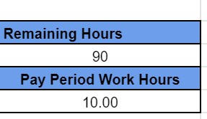
What are the Maximum Hours we can work Per Week?
Each Pay Period consist of two weeks. You can do a maximum of 20 hours per week.
Always keep track of your remaining hours and hours your worked during that pay period.

Slide 10
Can we work during Holidays or when the College is closed?
Students may not work during holidays list below:
If you have any questions, please contact Campus Manager, Taruna Sadhoo - Taruna.Sadhoo@qc.cuny.edu

Slide 11
What if I forget to submit my timesheet?
Your paycheck for that certain pay period will be delayed. You will have to submit it in the next following pay period due date which takes two weeks.

Slide 12
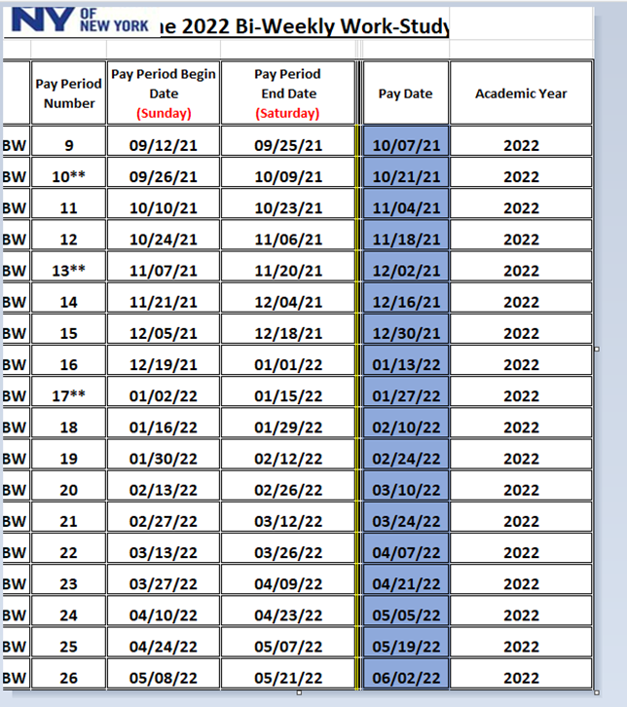
When will I receive my paycheck?
Please check the link below for the Payroll Dates :
https://drive.google.com/file/d/1nKI6CrYYhsj-smcOQ068OJEzx0vDbw19/view?usp=sharing
If you submit your timesheet on time, please check the “Paycheck Issued Dates” column.
You will receive your paycheck by mail or direct deposit, depending on your choice when submitting Federal Work Study documents. Please contact qcworkstudy@qc.cuny.edu

Slide 13
Questions?
If you have any questions, feel free to contact us:
ServiceCorps@qc.cuny.edu
www.qc.cuny.edu/servicecorps

