Slide 1
Learning Action Plan
CUNY Service Corps (Cohort 9)

Slide 2
Knowledge
Example:
Writing Prompt
During my service this year I will increase my knowledge/understanding of issues facing NYC immigrants by completing one informational interview with an administrator at my placement during the fall semester to acquire more information about the challenges non-profits serving immigrants face.
What knowledge area will you increase during your service year? Please include how you will achieve this goal.

Slide 3
Skills
Writing Prompt
Example:
During my service this year I will improve my presentation skills by signing up for a PowerPoint workshop this fall and creating ONE PowerPoint per semester in relation to my work at my site with support and guidance from my site supervisor.
What is ONE skill you want to gain/increase/improve during your service year? Please include a concrete example of how you will achieve this goal?

Slide 4
Civic Engagement
Writing Prompt
Example:
During my service this year I will increase my understanding and commitment to NYC’s immigrant communities by researching obstacles faced by DACA youth and identifying resources, actions, and groups that support DACA youth.
What community or demographic population will you increase your understanding and commitment to during your service year? Please include how you will achieve this goal.

Slide 5
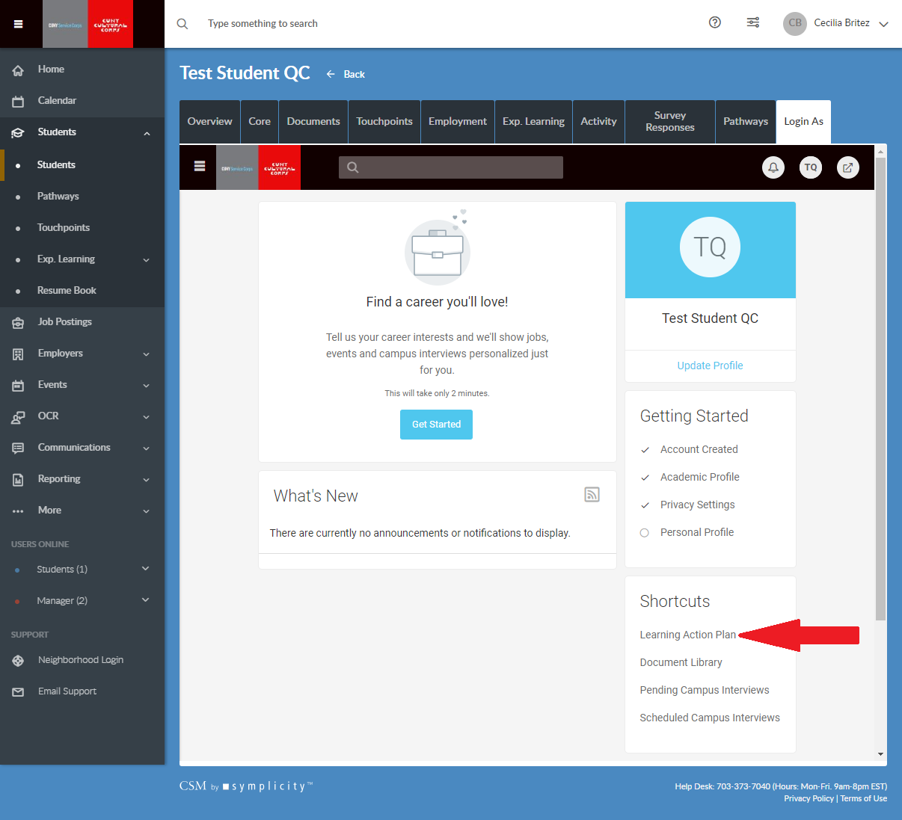
How to submit your Learning Action Plan
- Click on Learning Action Plan

Slide 6
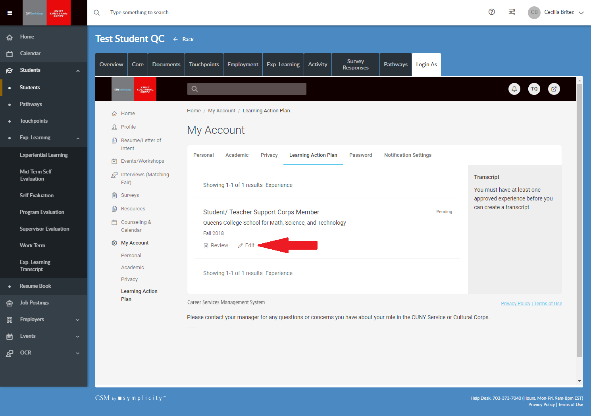
How to submit your Learning Action Plan
- Click on Edit

Slide 7
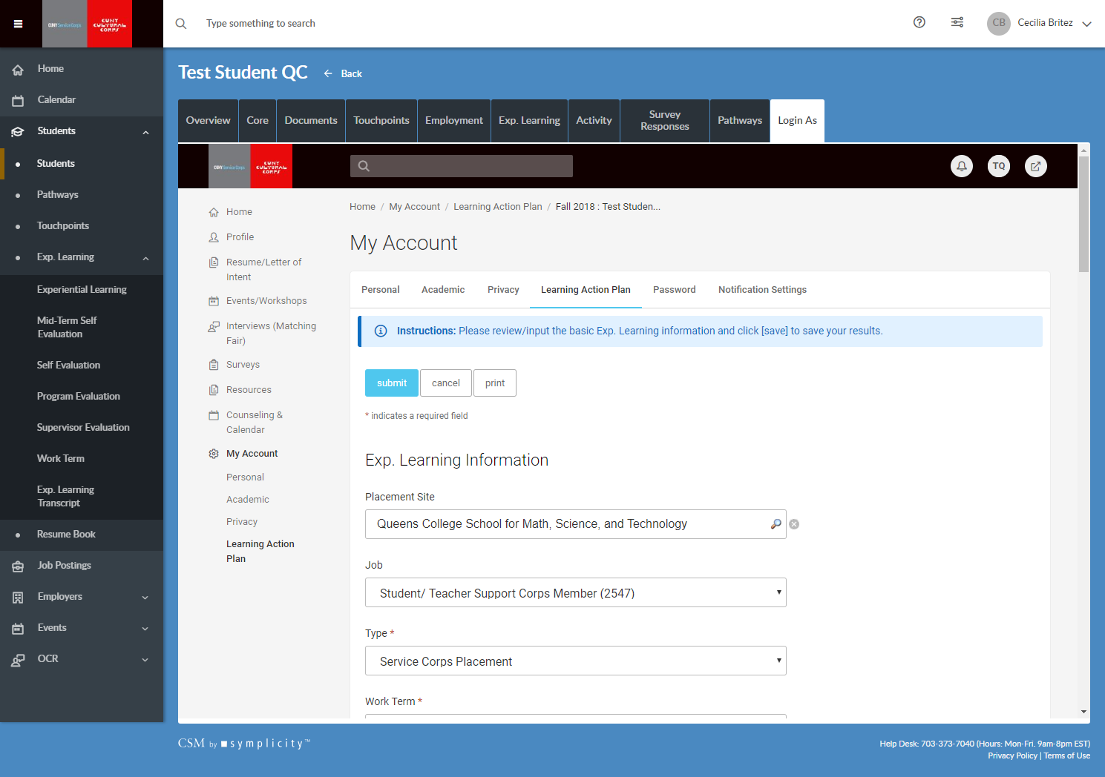
Fill out required information
Be sure to include your work schedule.

Slide 8
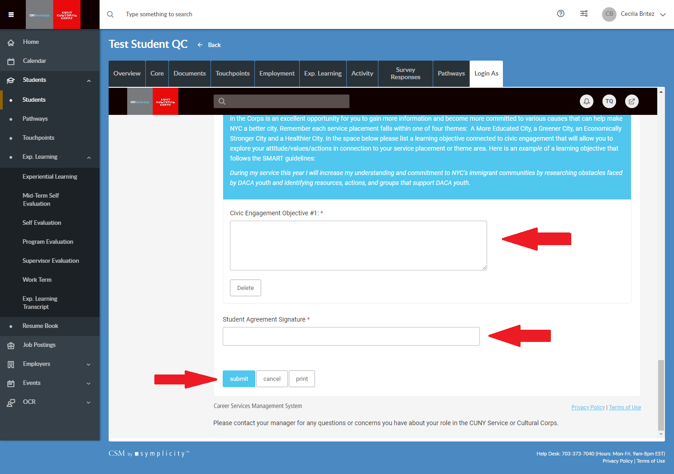
Submitting your learning Action Plan
- Using the instructions and examples, write your own LAP for the three different objectives.
- Sign electronically
- Submit

Slide 9
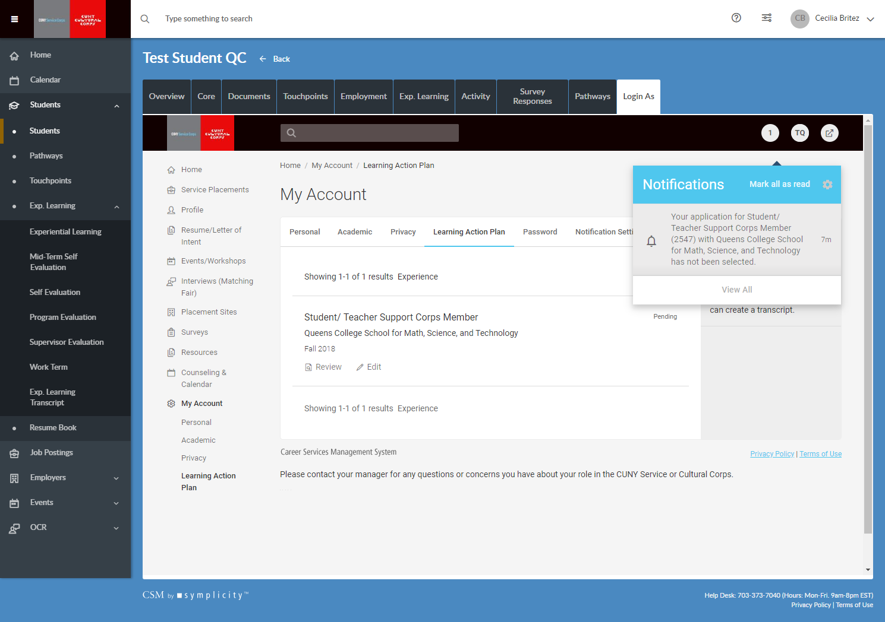
Followup
- If your LAP is denied for some reason, you will be sent an email asking you to edit your LAP. (Will also show in your notifications on Symplicity)
- Please follow the link in your email ASAP, make edits to your LAP and resubmit before Friday, March 19th deadline.
- If you do not receive an email by April 1st, you can assume that your LAP was approved.

