Slide 1
Welcome to the CUNY Service Corps
Cohort 9 - RF Timesheet Instructions

Slide 2
1. Go to https://www.rfcuny.org/RFWebsite/

Slide 3
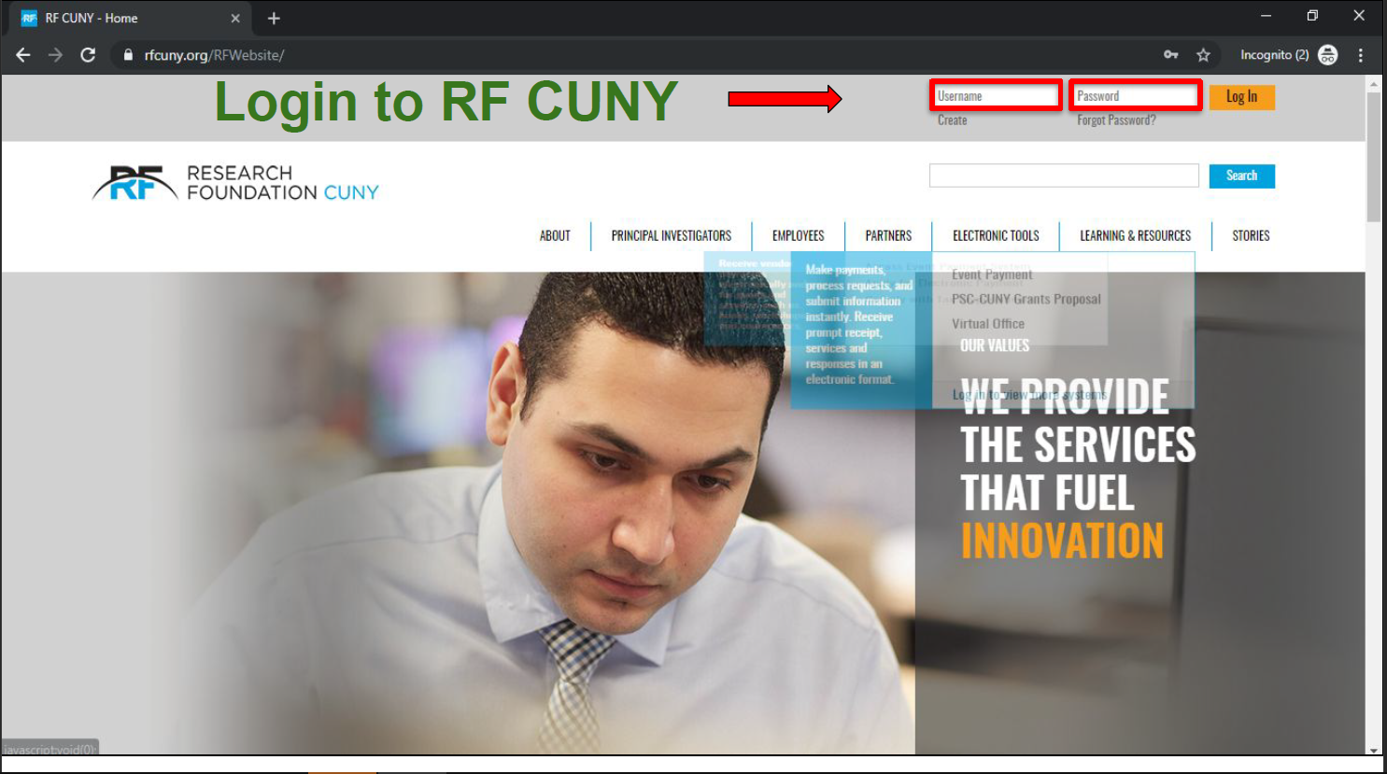
2. Login using the information provided to you by RF CUNY
a. Username: 6-digit code
b. Password:

Slide 4
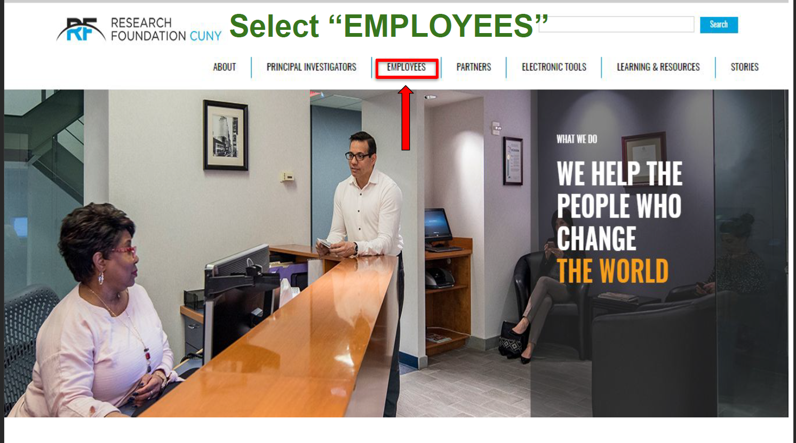
3. Click ‘Employees’

Slide 5
4. Select ‘MANAGING ONLINE TIMESHEETS, PAYSTUBS, AND E-W2’

Slide 6
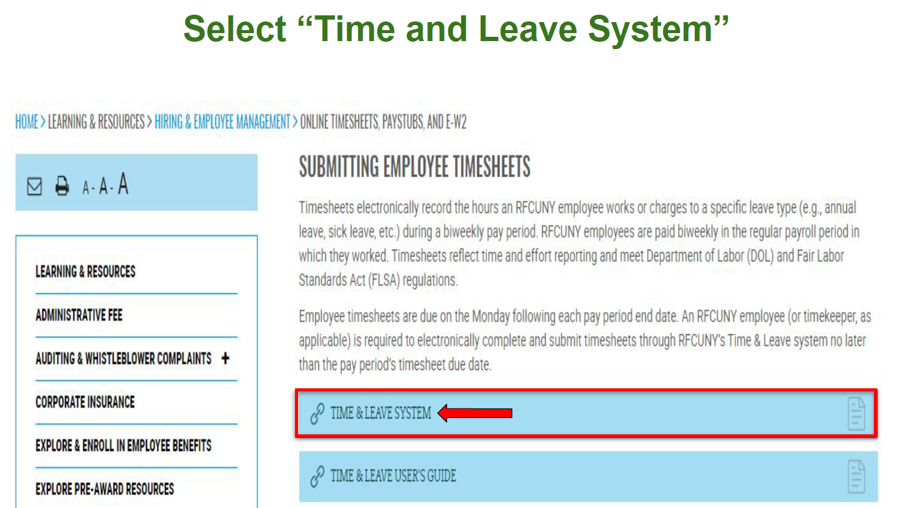
5. Select ‘Time and Leave System’

Slide 7
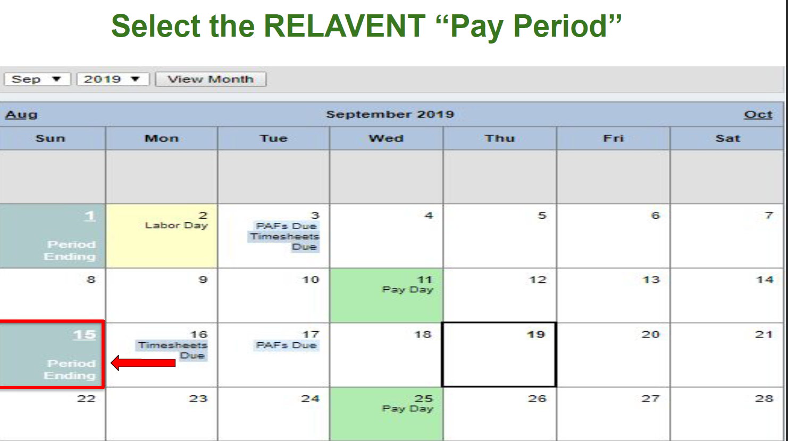
6. Select the the current pay period

Slide 8
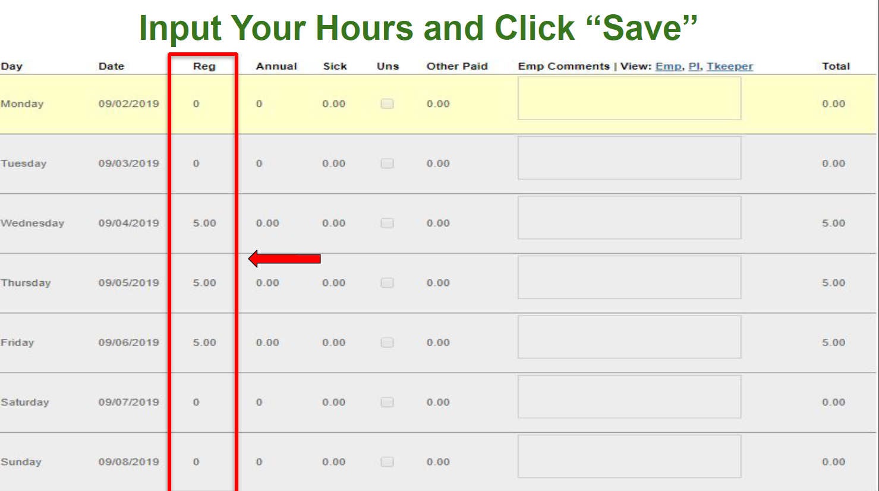
7. Fill out the appropriate time slots with hours worked. Please note “TW” in the comments section indicating you teleworked those hours, meaning you worked remotely.
8. Click ‘Save

Slide 9
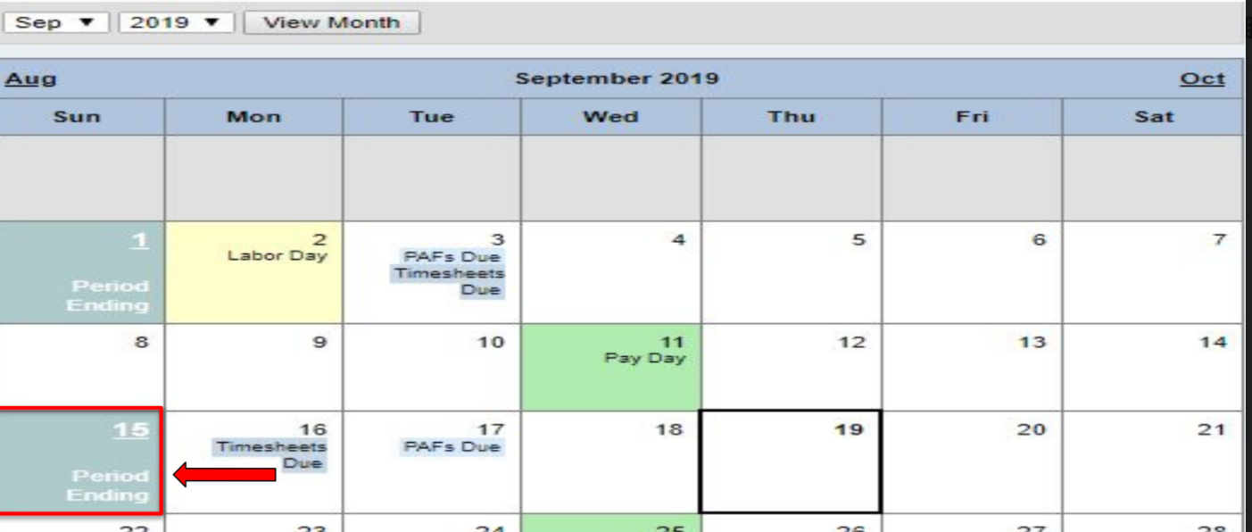
How many hours can we do per pay period?
A student can do a maximum of 38 hours per pay period. Each pay period consist of two weeks, therefore a student can do a maximum of 19 hours per week.

Slide 10
Payroll & Timesheet Submitting Timesheet Overview:
1. Go to https://www.rfcuny.org/RFWebsite/
2. Login using the information provided to you by RF CUNY
a. Username: 6-digit code
b. Password:
3. Click ‘Employees’
4. Select ‘MANAGING ONLINE TIMESHEETS, PAYSTUBS, AND E-W2’
5. Select ‘Time and Leave System’
6. Select the the current pay period
7. Fill out the appropriate time slots with hours worked
8. Click ‘Save

Slide 11
WHEN ARE TIMESHEETS DUE?
Timesheets need to be submitted on the following Sundays listed within the “Period Ending” section: https://www.rfcuny.org/RFWebsite/electronic-tools/calendar/
If you have any questions, feel free to contact us:
ServiceCorps@qc.cuny.edu
www.qc.cuny.edu/servicecorps

