Slide 1
MSFT Teams Training
CUNY Service Corps | Cohort 8
Notes:
Introduce ourselves. Who we are, what we do.

Slide 2
Teams for Mobile Devices
Notes:
Neslie.

Slide 3
Join From Your Phone

Slide 4
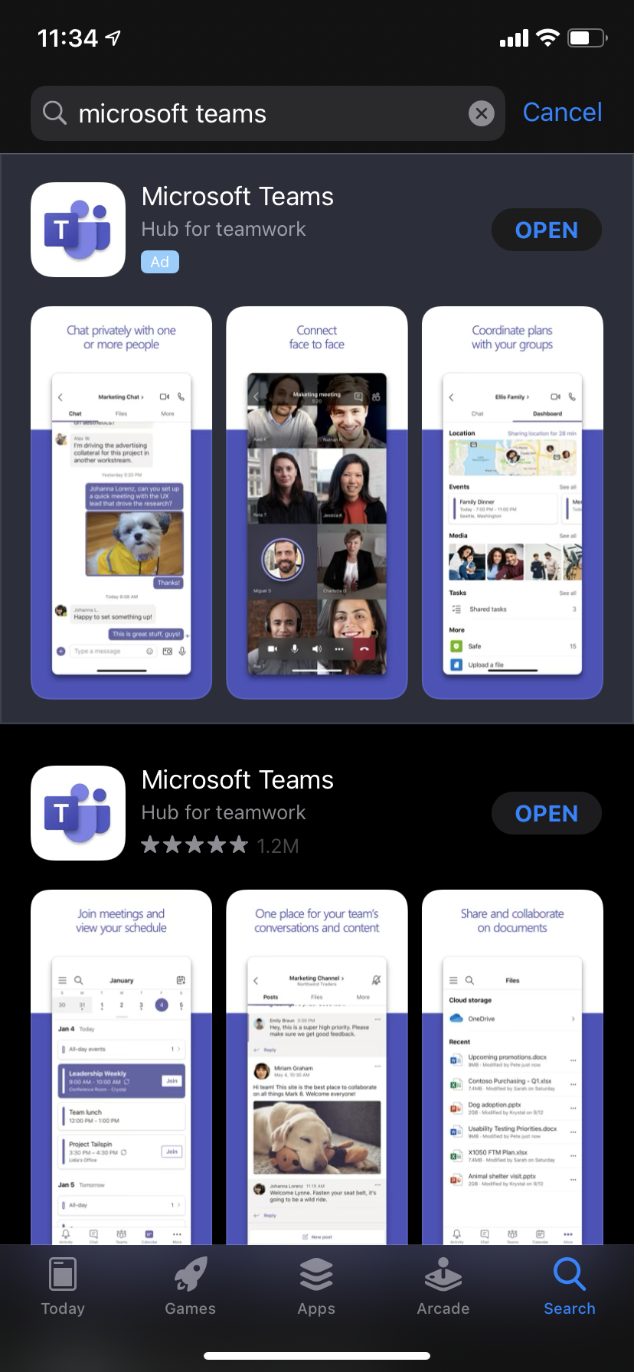
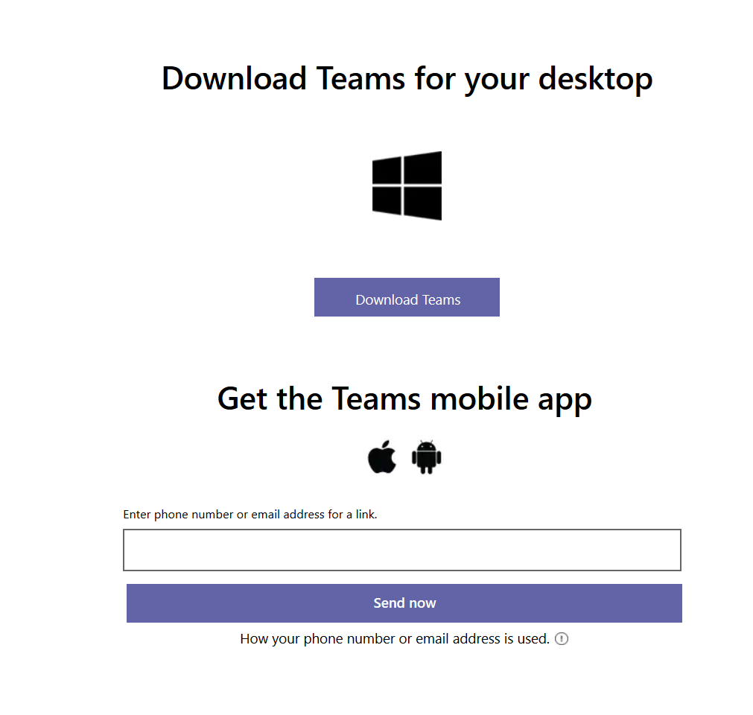
Downloading Teams for Mobile Devices
Download the Window’s, iOS or Android version of Microsoft Teams. Please use this link to download Microsoft Teams. If the link does not work, manually copy the following link in the URL bar of your browser: https://www.microsoft.com/en-us/microsoft-365/microsoft-teams/group-chat-software
After you click the link, scroll down until you see an option to download Teams as shown in the images on the right:
Notes:
Neslie.

Slide 5
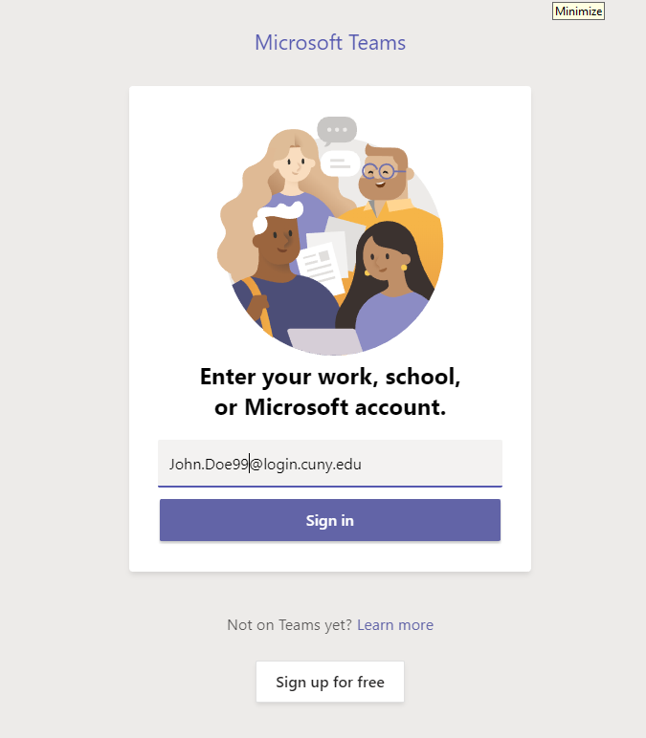
Sign In Via CUNYFirst
After you download and install the application, you will see something that looks like the picture below:
Then, Sign in with your CUNYFirst Account. Your cunyfirst account is the same account that you use for black board. It’ll look something like first_name.last_name ##@login.cuny.edu
For example, john.smith80@login.cuny.edu
For further instructions to access your CUNYFirst account, please check out this guide by QC Training & Technology Solutions.
Notes:
Neslie.

Slide 6
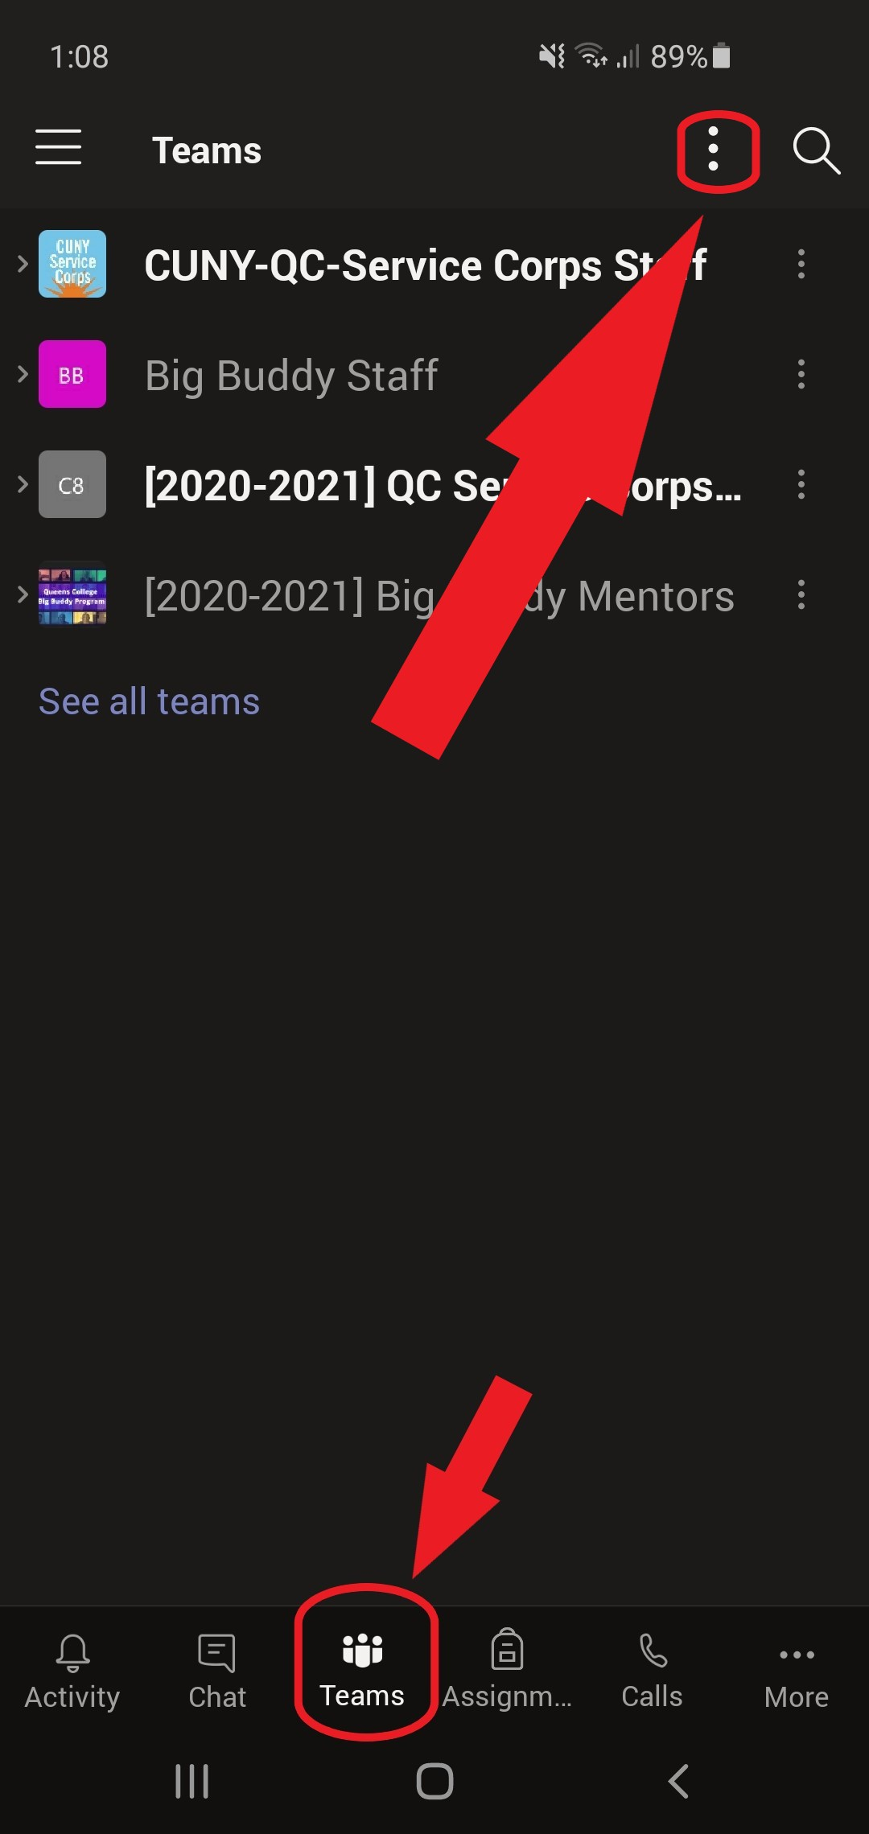
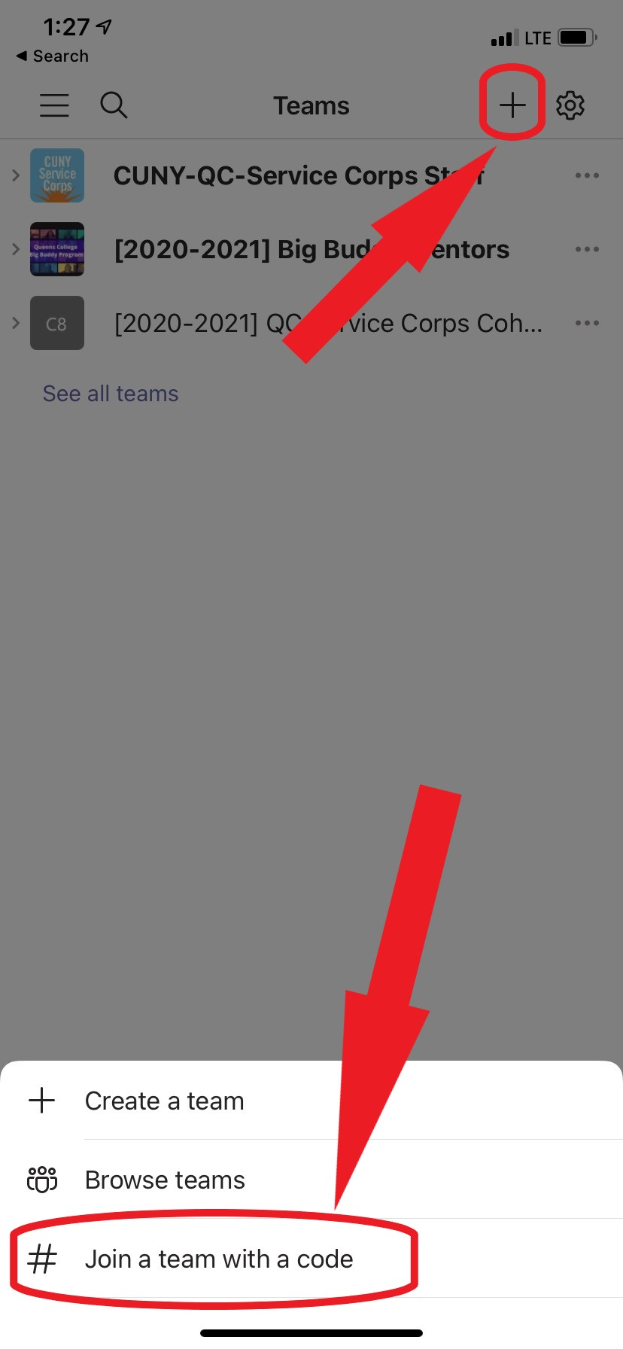
Joining Teams From Your Phone
Make sure you’re on the ‘Teams’ tab at the bottom.
Click on the “Kebab Menu” at the top right.

Slide 7
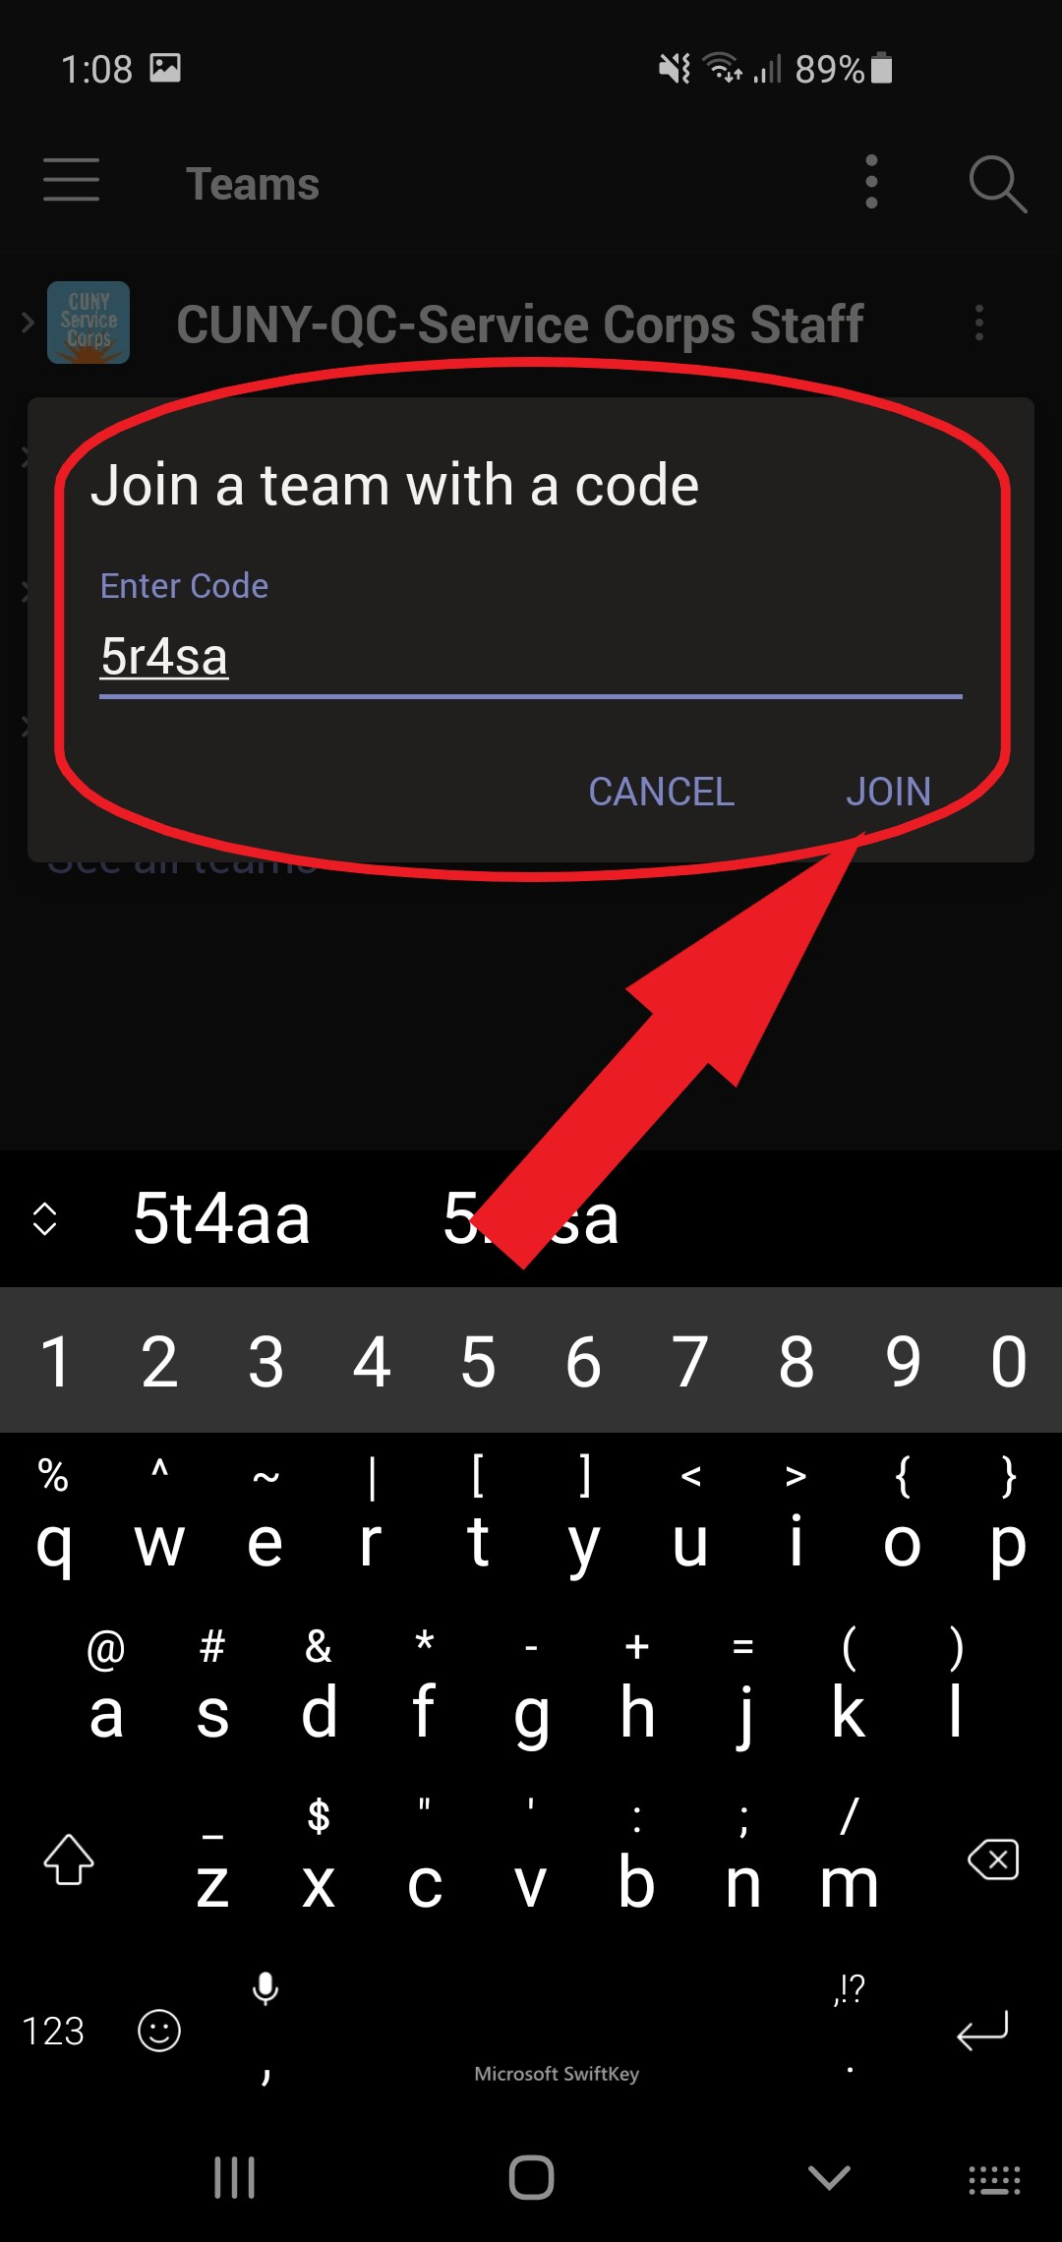
Enter the Code
Enter the code and then select “JOIN”
MSFT Team Code:
5ha5q7t
Notes:
Muneeb.

Slide 8
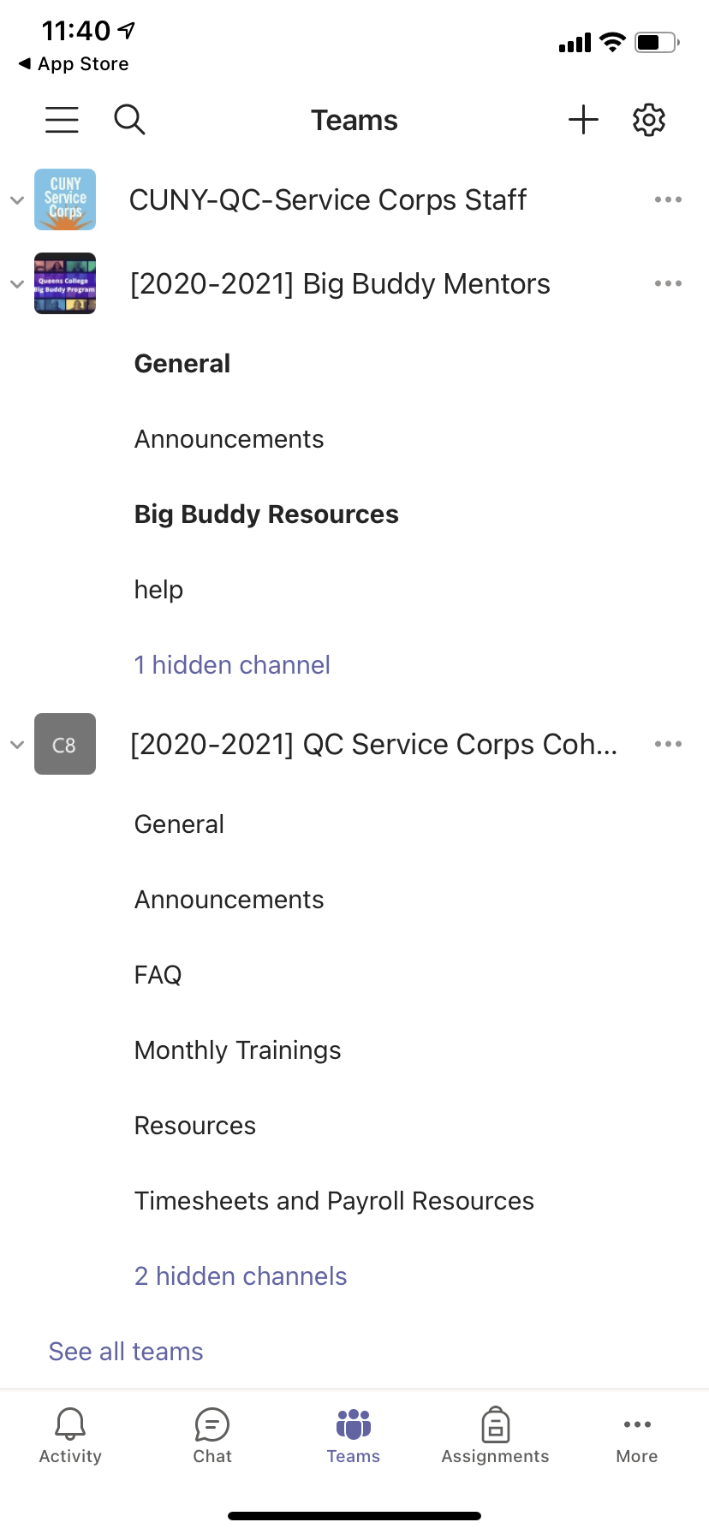
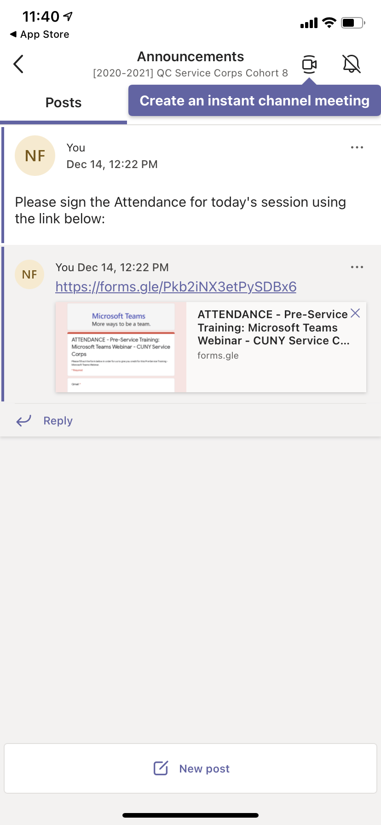
Attendance
Click Announcements Tab
Click the Link Directing to the Attendance Form

Slide 9
Attendance - Keyword for the Day
Check your email for the Keyword

Slide 10
Teams for Desktop
Notes:
Muneeb

Slide 11
Join from your Computer

Slide 12
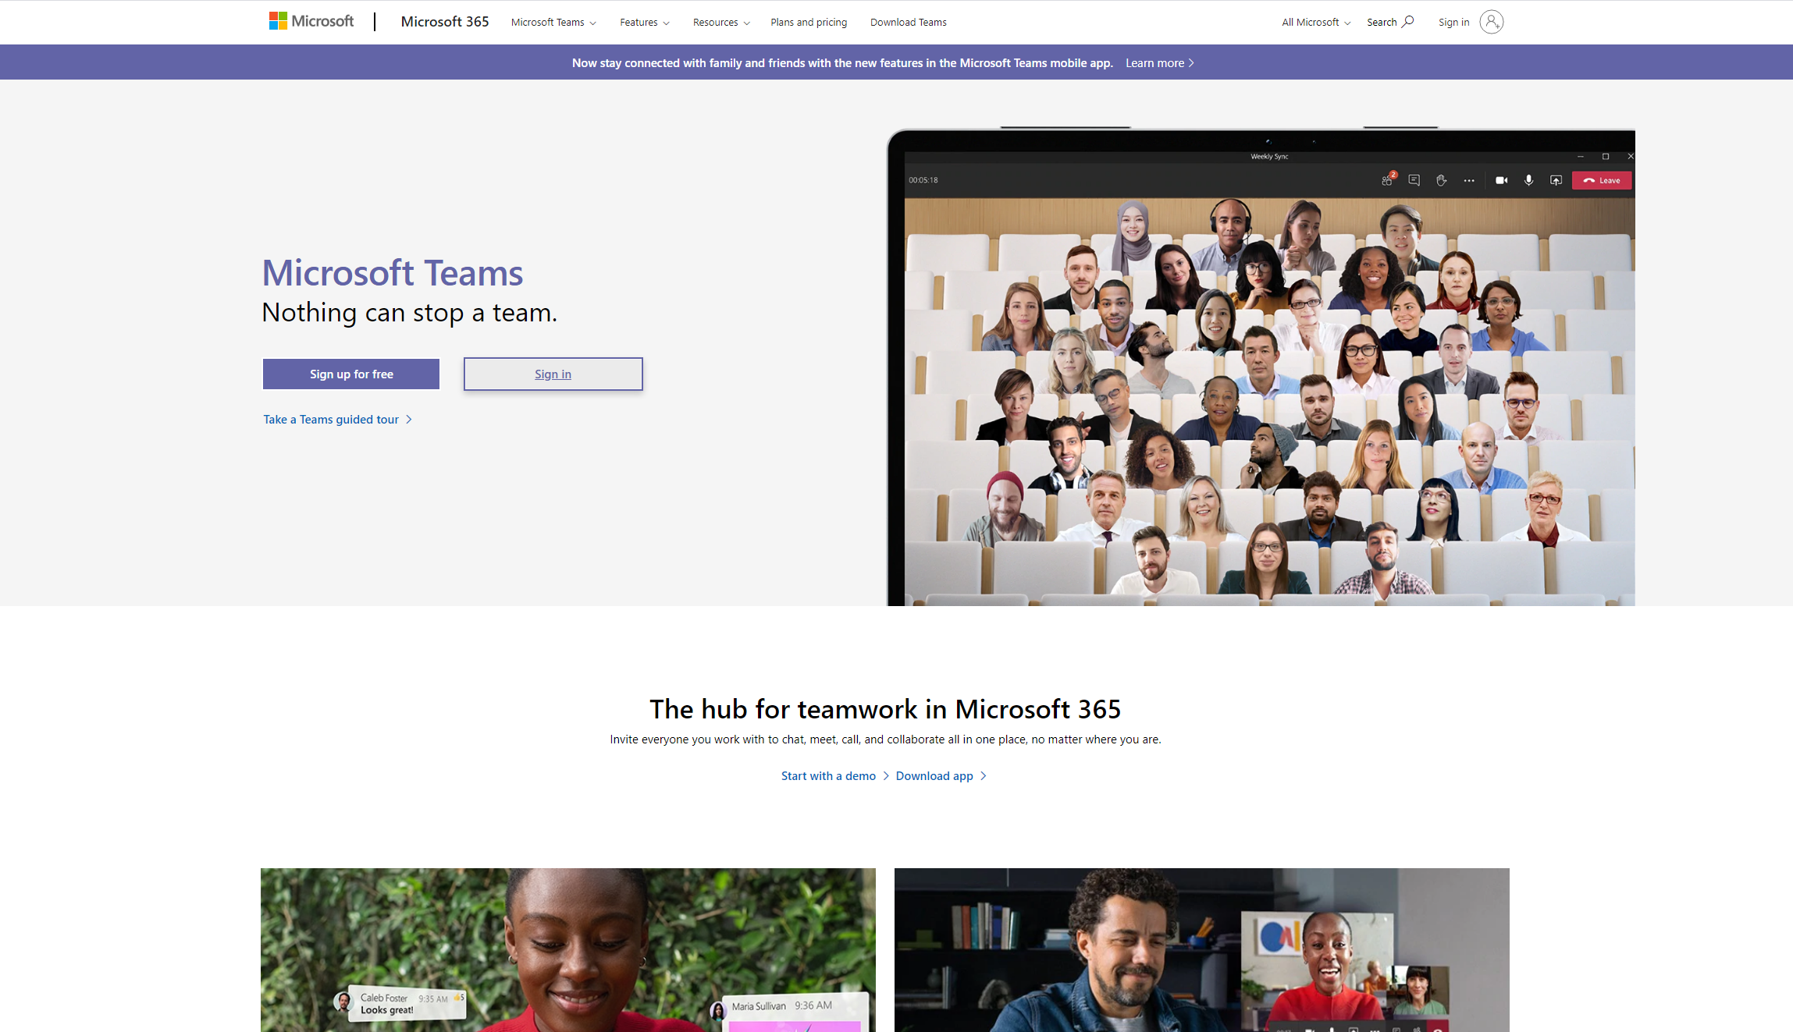
Getting Started with Teams for Desktop
Go to Google Chrome, Microsoft Edge or Firefox any type of web browser. Please use this link to go directly to Microsoft Team. If the link does not work, manually copy the following link in the URL bar of your browser: https://www.microsoft.com/en-us/microsoft-365/microsoft-teams/group-chat-software
After you click the link, you will see the picture on the right.
Then, click sign in.
Notes:
Muneeb

Slide 13
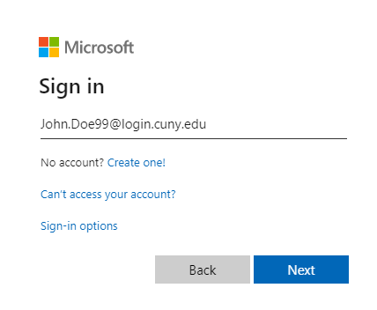
Sign In Via Your CUNYFirst Account
Click on next.
After you do that, you will see the picture on the right.
Then, Sign in with your CUNYFirst Account.
Note: Your cunyfirst account is the same account that you use for black board. It looks something like first_name.last_name ##@login.cuny.edu. For further instructions to access your CUNYFirst account, please check out this guide by QC Training & Technology Solutions.
Notes:
Muneeb

Slide 14
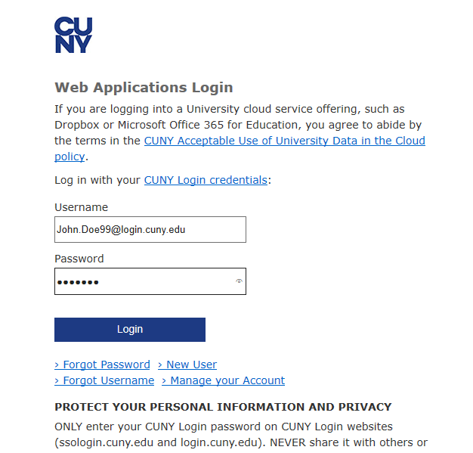
Sign In Via CUNYFirst (cont.)
Re-sign in your CUNY Web Application Login.
Notes:
Muneeb

Slide 15
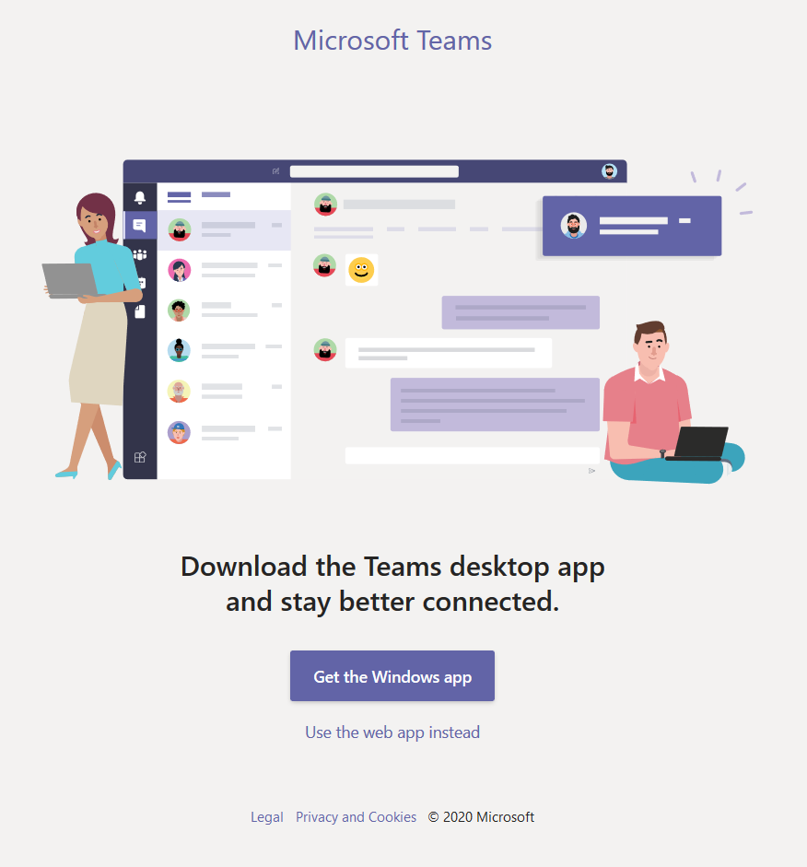
Downloading the Application
After you finish the sign with your CUNYFirst , you will see the picture on the right.
Click on Get the Windows App to install Teams on your computer.
Alternatively, you can use the web app instead.
Notes:
Muneeb

Slide 16
Joining Via Team’s Code
MSFT Team Code:
5ha5q7t

Slide 17
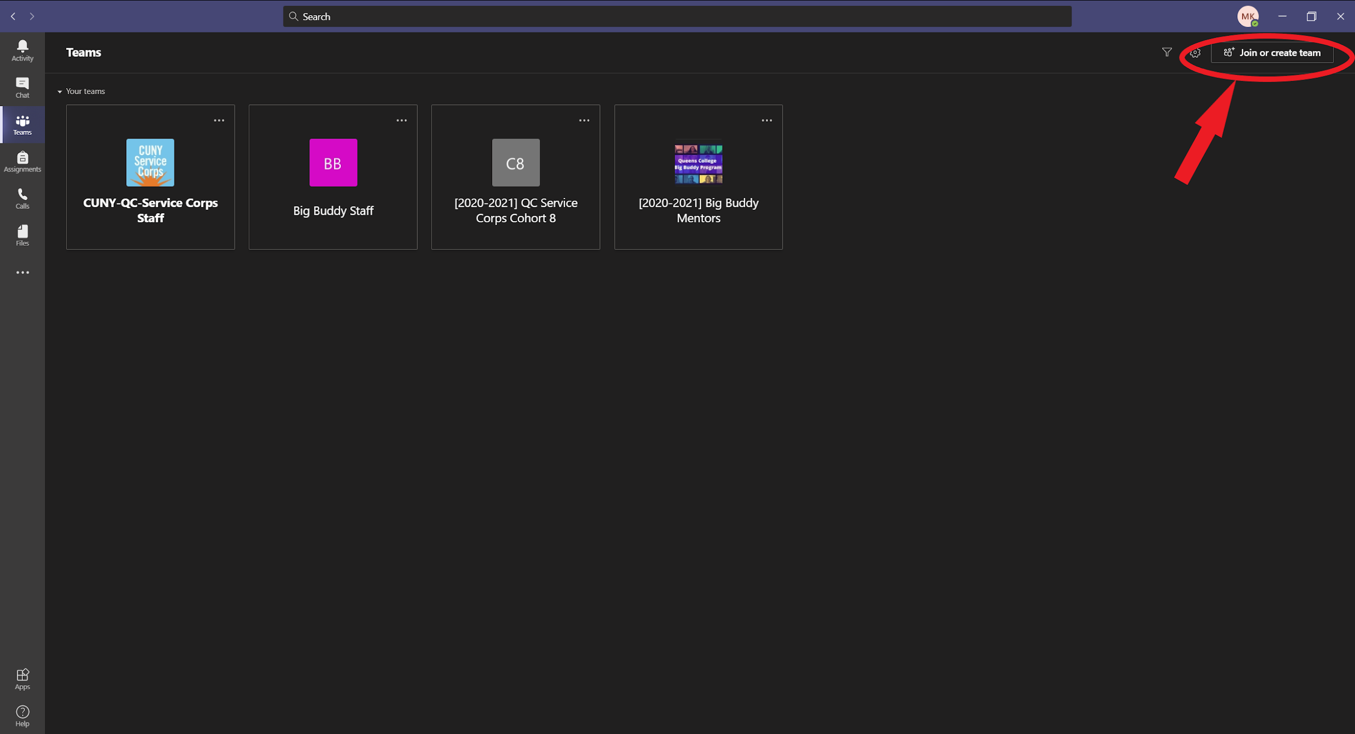

Slide 18
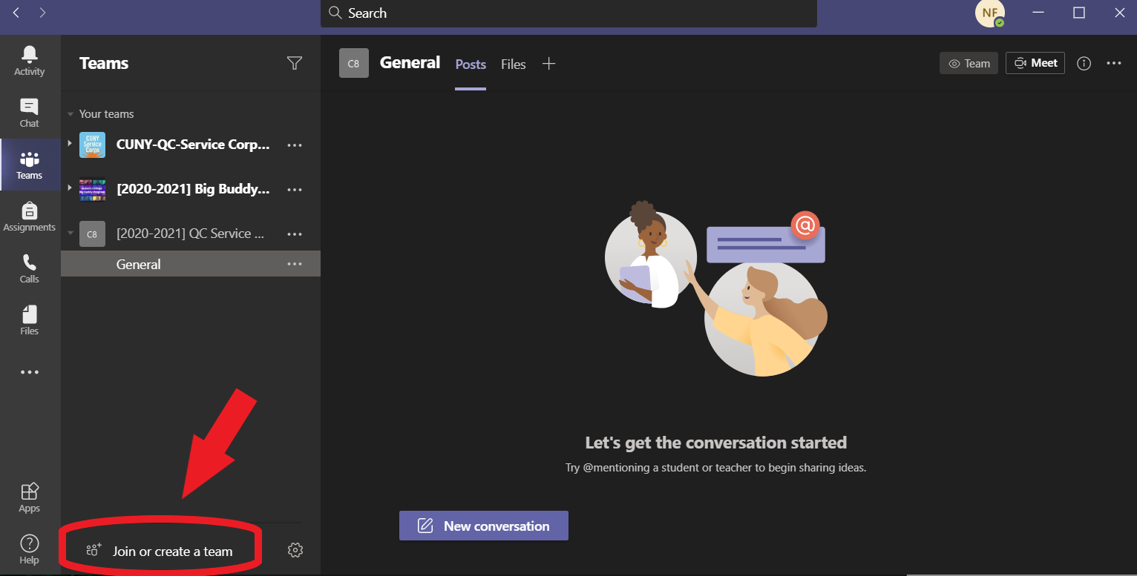

Slide 19
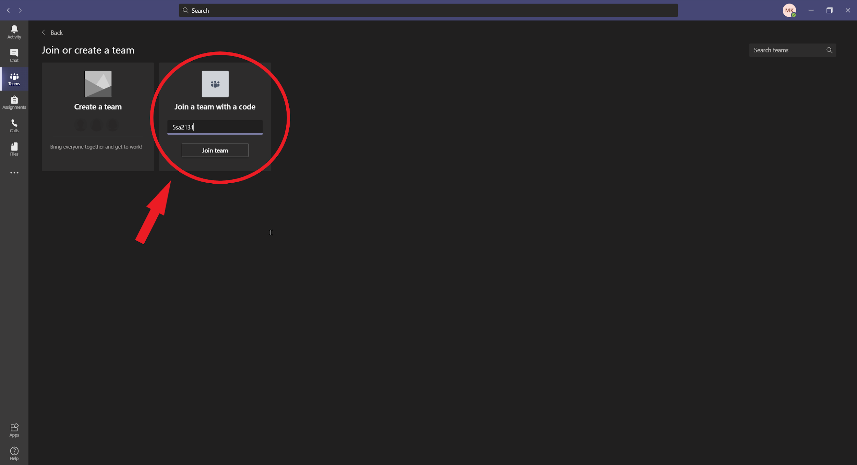
MSFT Team Code:
5ha5q7t

Slide 20
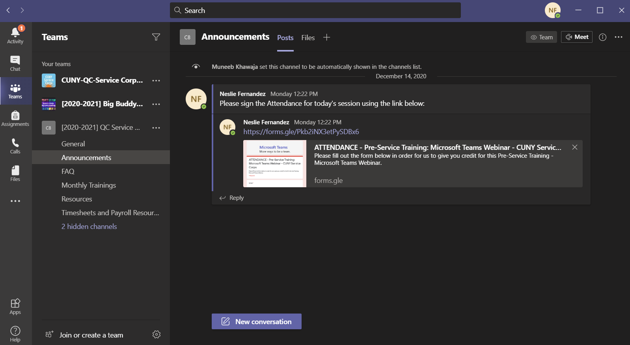

Slide 21
Attendance - Keyword for the Day
Check your email for the Keyword

Slide 22
Welcome to Teams. Time to join ours.

Slide 23
Service Corps
Teams Policy

Slide 24
How will teams be used?
Reminders and updates for events will be posted on teams.
We’ll generally send an email for important events and updates in addition to an announcement on MSFT Teams.
During Monthly Trainings, teams may used to facilitate group work sessions.
To maintain a line of direct communication between you and Service Corps staff.
Any resources shared with you such as training materials, recordings, calendars etc. will be made available on Teams.

Slide 25
How often should I check and use teams?
Check teams at least two to three times a week. We recommend setting aside some time on Mondays and Fridays.
Respond to any messages within 48 hours. You can expect the same from the staff.
Note: We highly recommend downloading and installing teams on both your phone and computer.

Slide 26
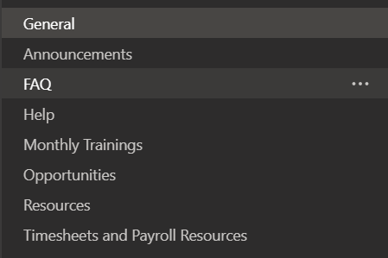
Quick Overview of Channels
General: Feel free to use this for conversations.
Announcements: All announcements and reminders will posted here.
FAQ: Frequently Asked Questions.
Help: Ask any questions here.
Monthly Trainings: For resources related to Monthly Trainings.
Opportunities: Career Development, Job Opportunities etc.
Resources: Recordings, Calendars etc.
Timesheet and Payroll Resources: Payroll calendar, timesheet reminders, guides etc.

Slide 27
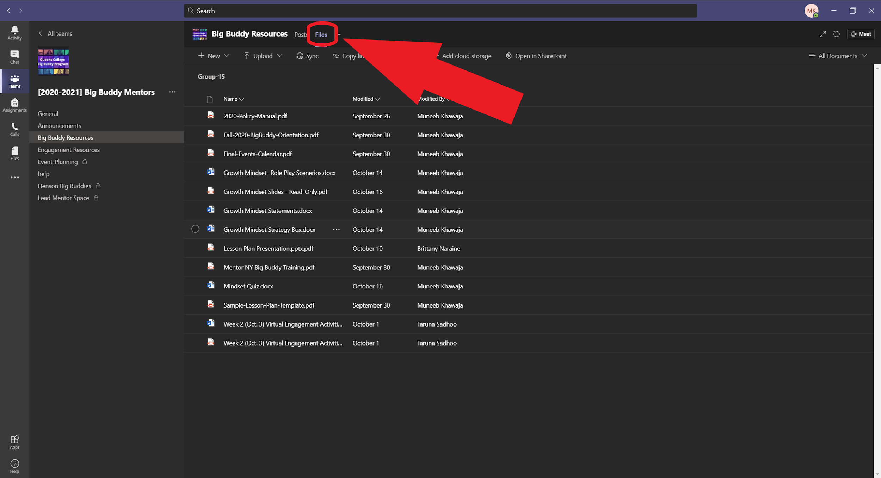
Accessing Files and Resources in a Channel

Slide 28
Code of Ethics

Slide 29
Harassment:
Harassment includes:
Offensive comments related to gender, gender identity and expression, sexual orientation, disability, mental illness, neuro(a)typicality, physical appearance, body size, race, or religion
Unwelcome comments regarding a person’s lifestyle choices and practices, including those related to food, health, parenting, drugs, and employment.
Deliberate misgendering or use of ‘dead’ or rejected names
Gratuitous or off-topic sexual images or behavior in spaces where they’re not appropriate
Simulated physical contact (e.g. textual descriptions like “hug” or “backrub”) without consent or after a request to stop.
Threats of violence
Incitement of violence towards any individual, including encouraging a person to commit suicide or to engage in self-harm
Deliberate intimidation
Sustained disruption of discussion
Unwelcome sexual attention
Continued one-on-one communication after requests to cease
Publication of non-harassing private communication
Reporting
If you are being harassed, notice that someone else is being harassed, or have any other concerns, please contact the staff immediately.

