Slide 1

Cyberbullying and Online Harassment
You are not alone

Slide 2
Office of Compliance & Diversity Programs
Sharon Shulman, Esq.,
Chief Diversity Officer & Director, Interim
Title IX Coordinator
Sharon.Shulman@qc.cuny.edu
Nancy Schick, Esq.
Compliance & Diversity Training Specialist
Nancy.Schick@qc.cuny.edu
Office: 718-997-5888
Fax: 718-997-5770
Email: TitleIX@qc.cuny.edu

Slide 3
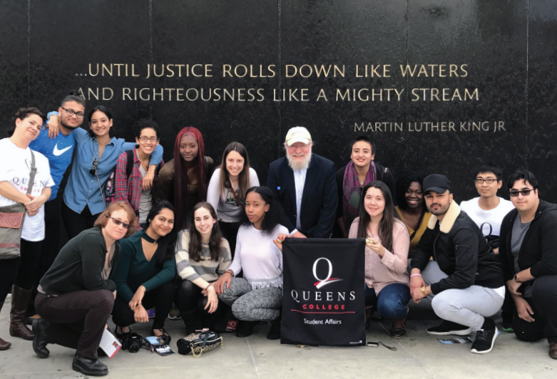

Slide 4
Socially distant, but not alone.
Discrimination and sexual harassment can occur electronically.
Don’t get too comfortable when you are studying or working from home.
Notify the Office of Compliance & Diversity Programs of any issues requiring intervention.
Resources:
Notice of Non-Discrimination
Office of Compliance & Diversity Programs

Slide 5

Someone you once dated constantly messages you, asking where you are, who you are with, or what you are doing
A classmate with a crush on you gets angry when you don’t respond right away
A former friend leaves you messages that scare you or make you feel bad about yourself
Someone accesses your social media or other online accounts without your permission
An ex-partner posts embarrassing or sexual information, photos, or videos of you online without your permission
Online Harassment Examples

Slide 6

A video meeting attendee forgot to turn off her camera and went to the bathroom publicly
Hackers joined unsecured video meetings solely to write racist and sexist comments in the Chat section or post offensive materials
A non-CUNY student got up late for class and joined the video classroom before he puts clothes on
Another classmate shared on social media a video capture the naked classmate, and it went viral worldwide
People Who Got Too Comfortable

Slide 7
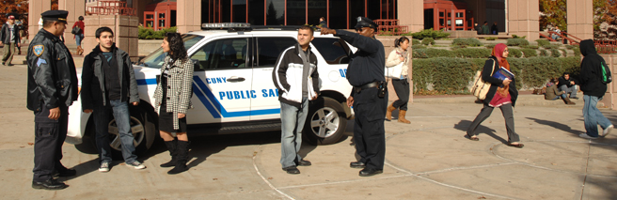
Protect yourself and others
Use anti-spyware software
Don’t give out your passwords
Block phone numbers that are used to harass you
Cover your device’s camera lens when not in use
Don’t accept friend requests on social media from people you don’t know and trust
Save evidence of harassment (e.g., voicemail, email, and text messages; screen captures; photos; videos; documents)
Don’t share embarrassing information, video, or photos

Slide 8

Talk to us
Office of Compliance and Diversity Programs
Student Counseling Center

Slide 9
Thank You!
Nancy Schick Esq., Compliance and Diversity Training Specialist
nancy.schick@qc.cuny.edu

