Slide 1
Where-When-What Prompts
Step 1: Present an Image (or video or object)
Step 2: Discuss: What assumptions can you make about… • where this photo was taken? • when this photo was taken? • what is happening in the photo? Students state assumptions and explain reasoning behind assumptions
The focus of this routine is to use what we know (or can infer) to make reasonable assumptions.
This routine can follow a mathematization image routine or stand by itself.
If following a “what do you notice/wonder” routine, you can say that assumptions are decisions you make to “answer your wonderings.”
Responses to questions of where, when, and what are usually not mathematical, but they lead to information that is necessary to create a mathematical model.

Slide 2
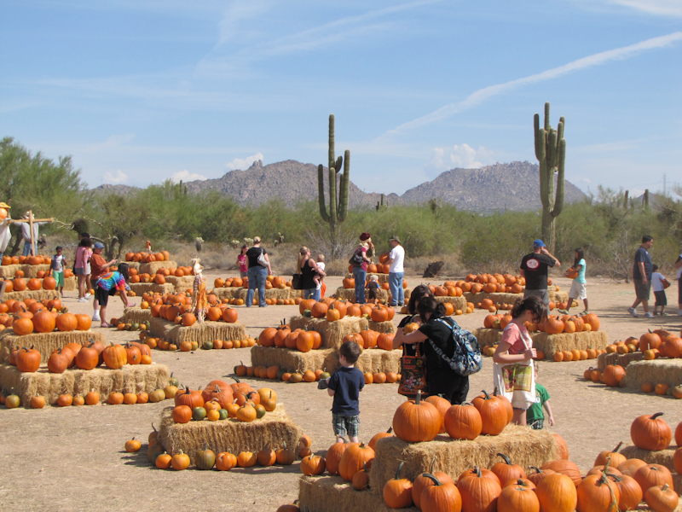
What assumptions can you make about… • where this photo was taken? • when this photo was taken? • what is happening in the photo?
What makes you so sure of your assumptions?

Slide 3
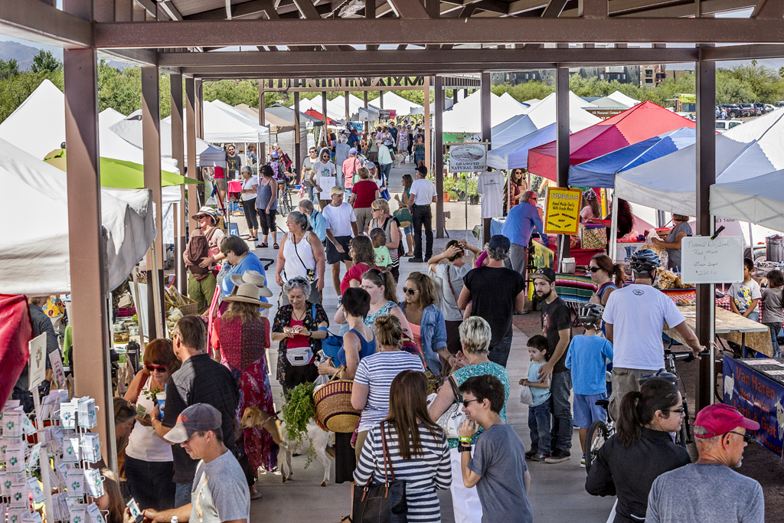
What assumptions can you make about… • where this photo was taken? • when this photo was taken? • what is happening in the photo?
What makes you so sure of your assumptions?

Slide 4
What assumptions can you make about… • where this photo was taken? • when this photo was taken? • what is happening in the photo?
What makes you so sure of your assumptions?

Slide 5
Hiking Tumamoc Hill
Pablo is hiking Tumamoc Hill.
It usually takes him 40 minutes to get to the top.
How long will the entire hike take?

Slide 6
Hiking Tumamoc Hill
What do you need to know or think about to figure this out?
What assumptions do you need to make?
Come up with two assumptions that are reasonable and two that are not reasonable.
Share with another group.
Pablo is hiking Tumamoc Hill.
It usually takes him 40 minutes to get to the top.
How long will the entire hike take?

Slide 7
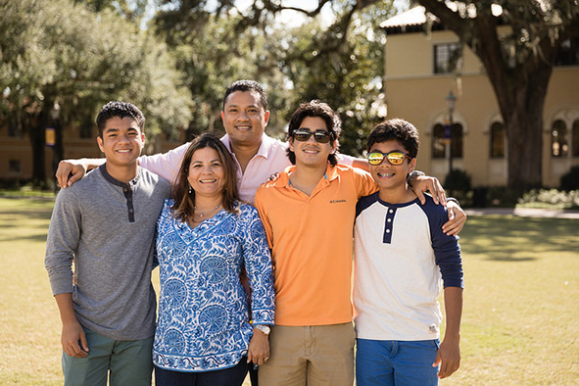
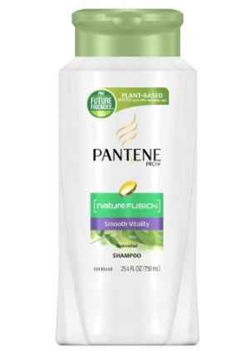
Sharing a Shampoo Bottle
This family buys one large bottle of shampoo to share. How long do you think the bottle will last?

Slide 8
Sharing a Shampoo Bottle
What do you need to know or think about to figure this out?
What assumptions do you need to make?
Come up with two assumptions that are reasonable and two that are not reasonable.
Share with another group.
This family buys one large bottle of shampoo to share.
How long do you think the bottle will last?

