Slide 1
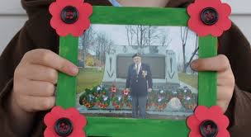
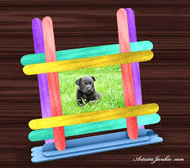
Making
Picture Frames!

Slide 2
http://wikiarts.pbworks.com/w/page/14204855/Dia%20de%20los%20Muertos%20Open%20House
What do you notice? What do you wonder?

Slide 3
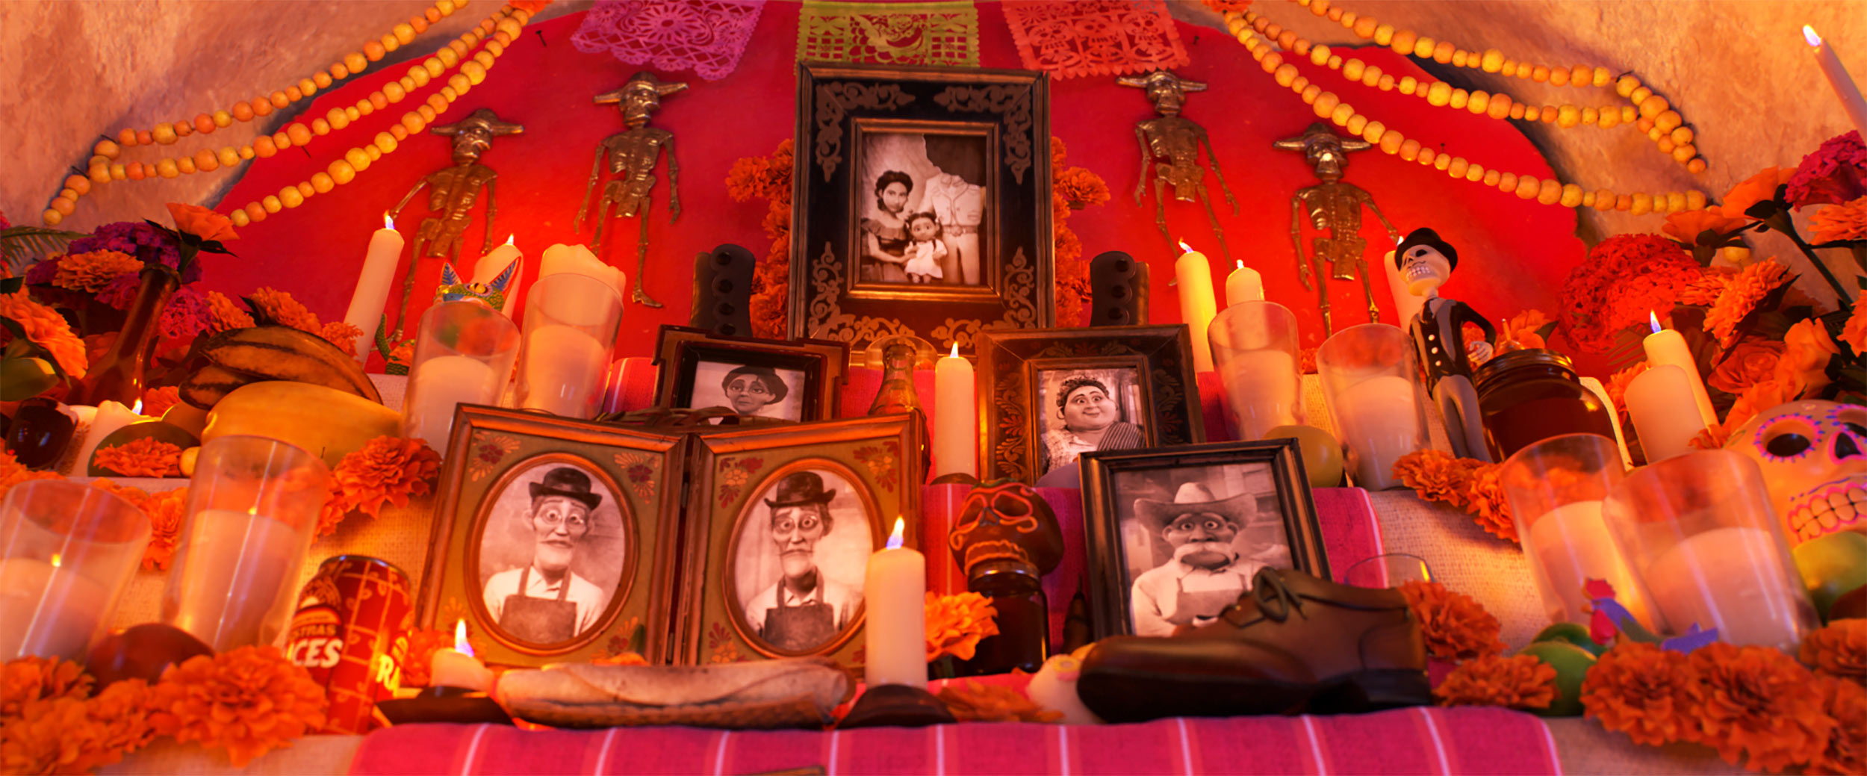
ALTERNATE IMAGE: What do you notice? What do you wonder?

Slide 4
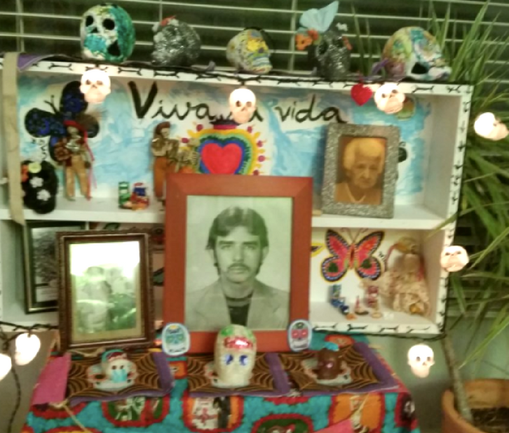
Displays to Honor Family and Friends
Do you make this kind of display at home? At your school? In your community?
Have you ever seen this kind of display here in Tucson?
What is often included in a display to honor ones we love like relatives, friends, pets and community members?

Slide 5
We are going to make Picture Frames to Create a Class Display to Honor our Loved Ones.
Notes:
OPTIONAL QUESTION:
What do you know about making picture frames from popsicle sticks?

Slide 6
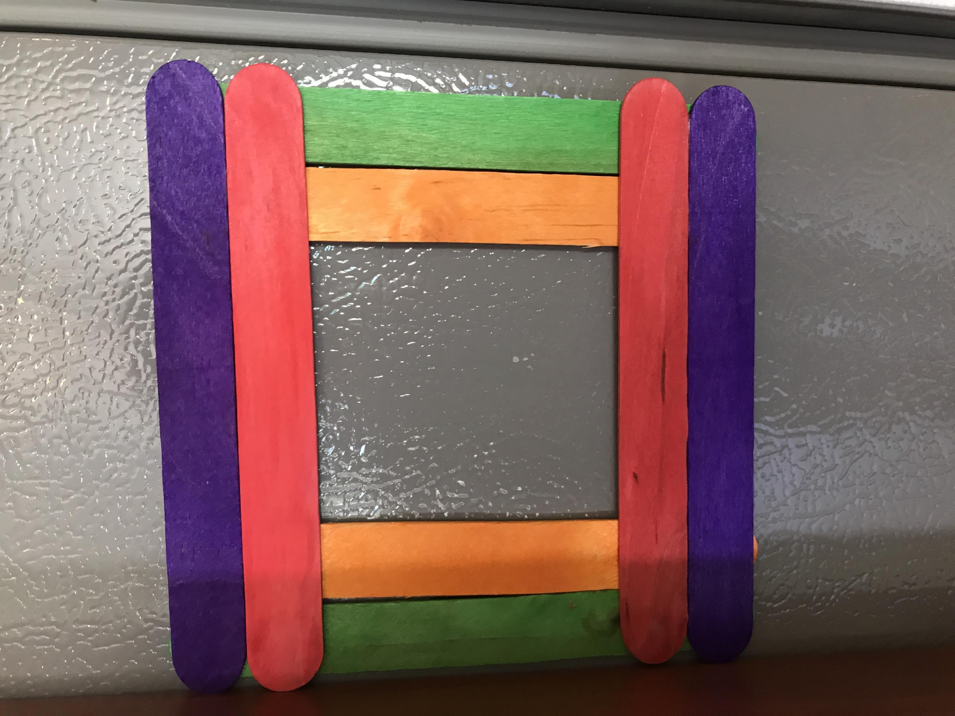
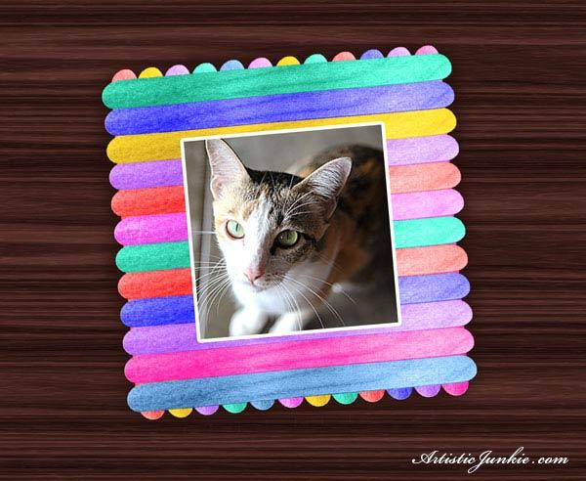
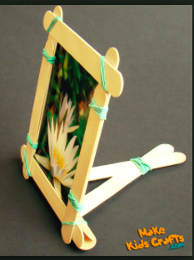
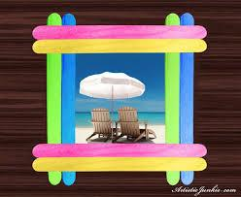
What do you notice about these frames? How are they different?
Notes:
Differences that students might notice:
Different kinds of popsicle sticks; different size popsicle sticks
Different number of popsicle sticks for each frame
(this question gets kids to start thinking about the frames mathematically -- mathematization)

Slide 7
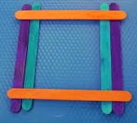
Different Kinds of Frames
4 Stick Frame
8 Stick Frame
6 Stick Frame

Slide 8
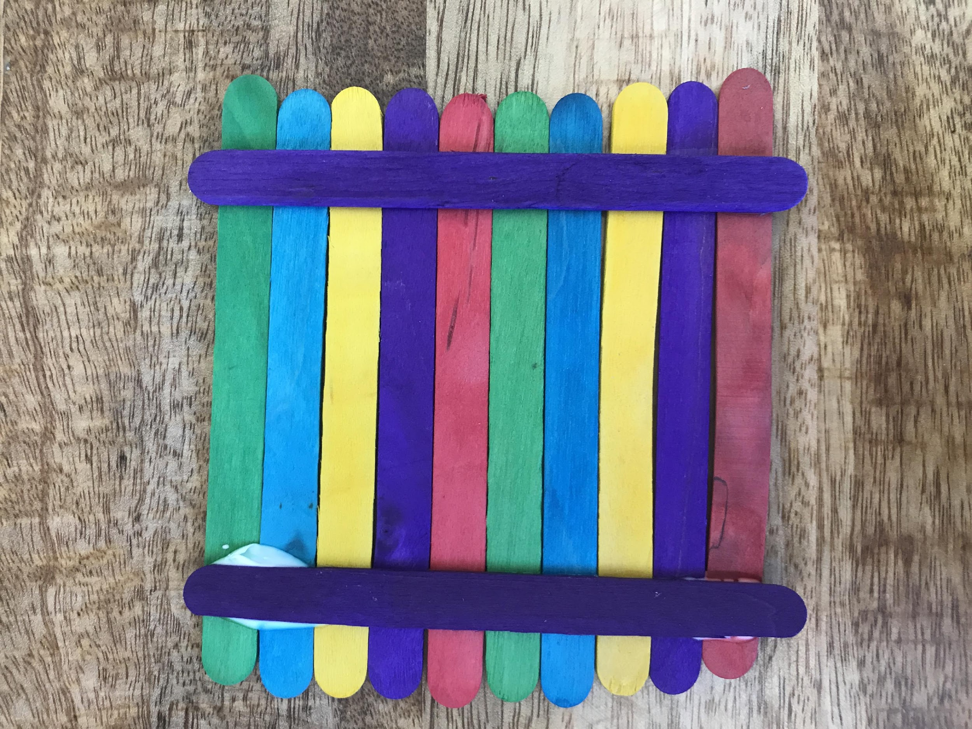
Frames with Vertical Sticks
Front Back

Slide 9
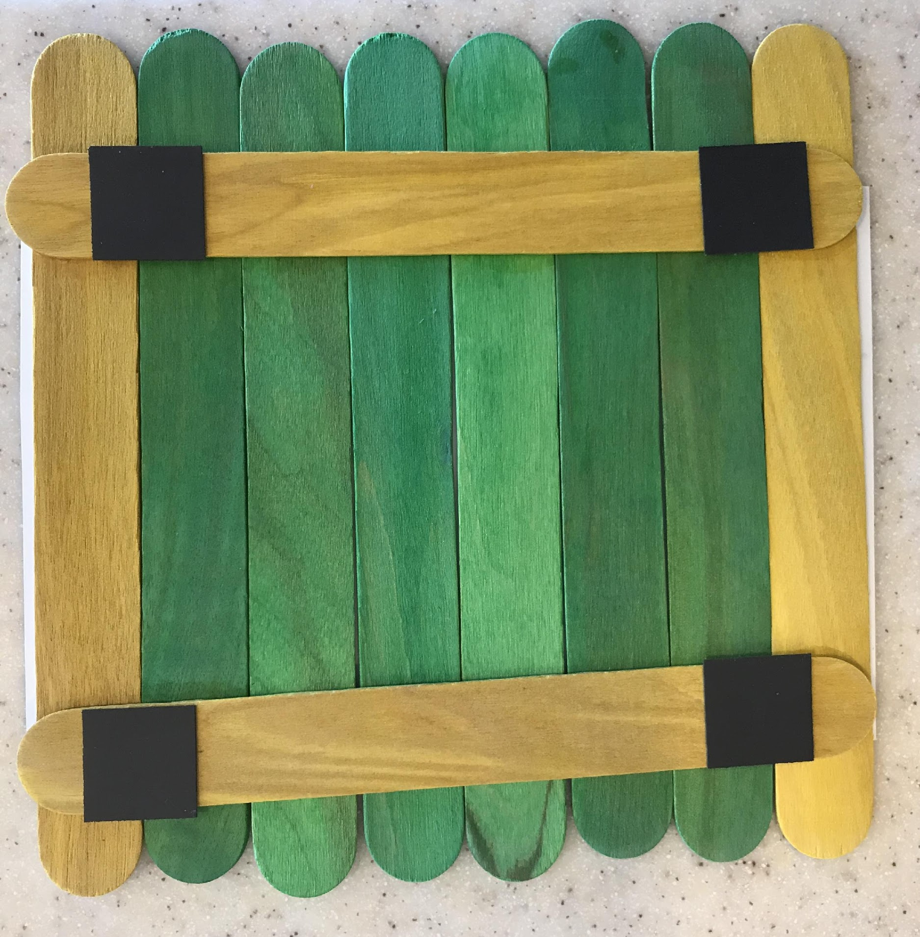
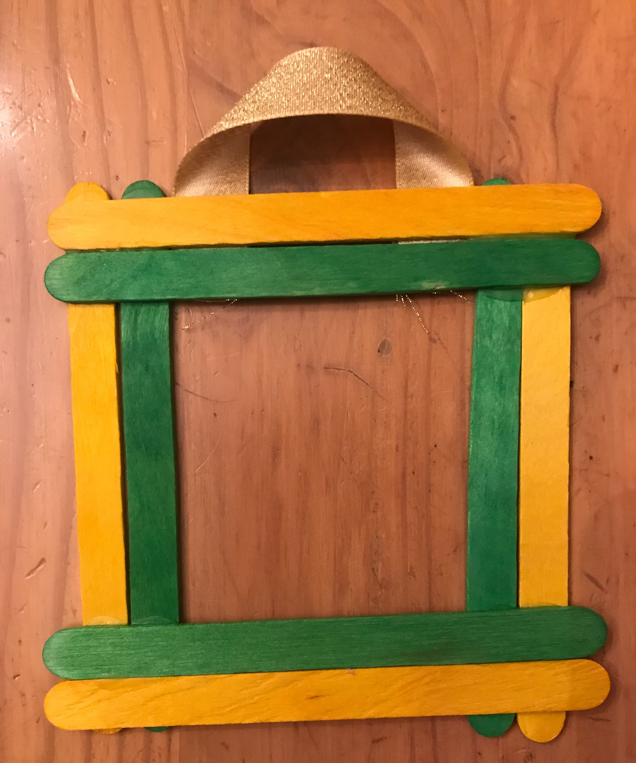
Frames with Magnets Frames with Ribbon

Slide 10
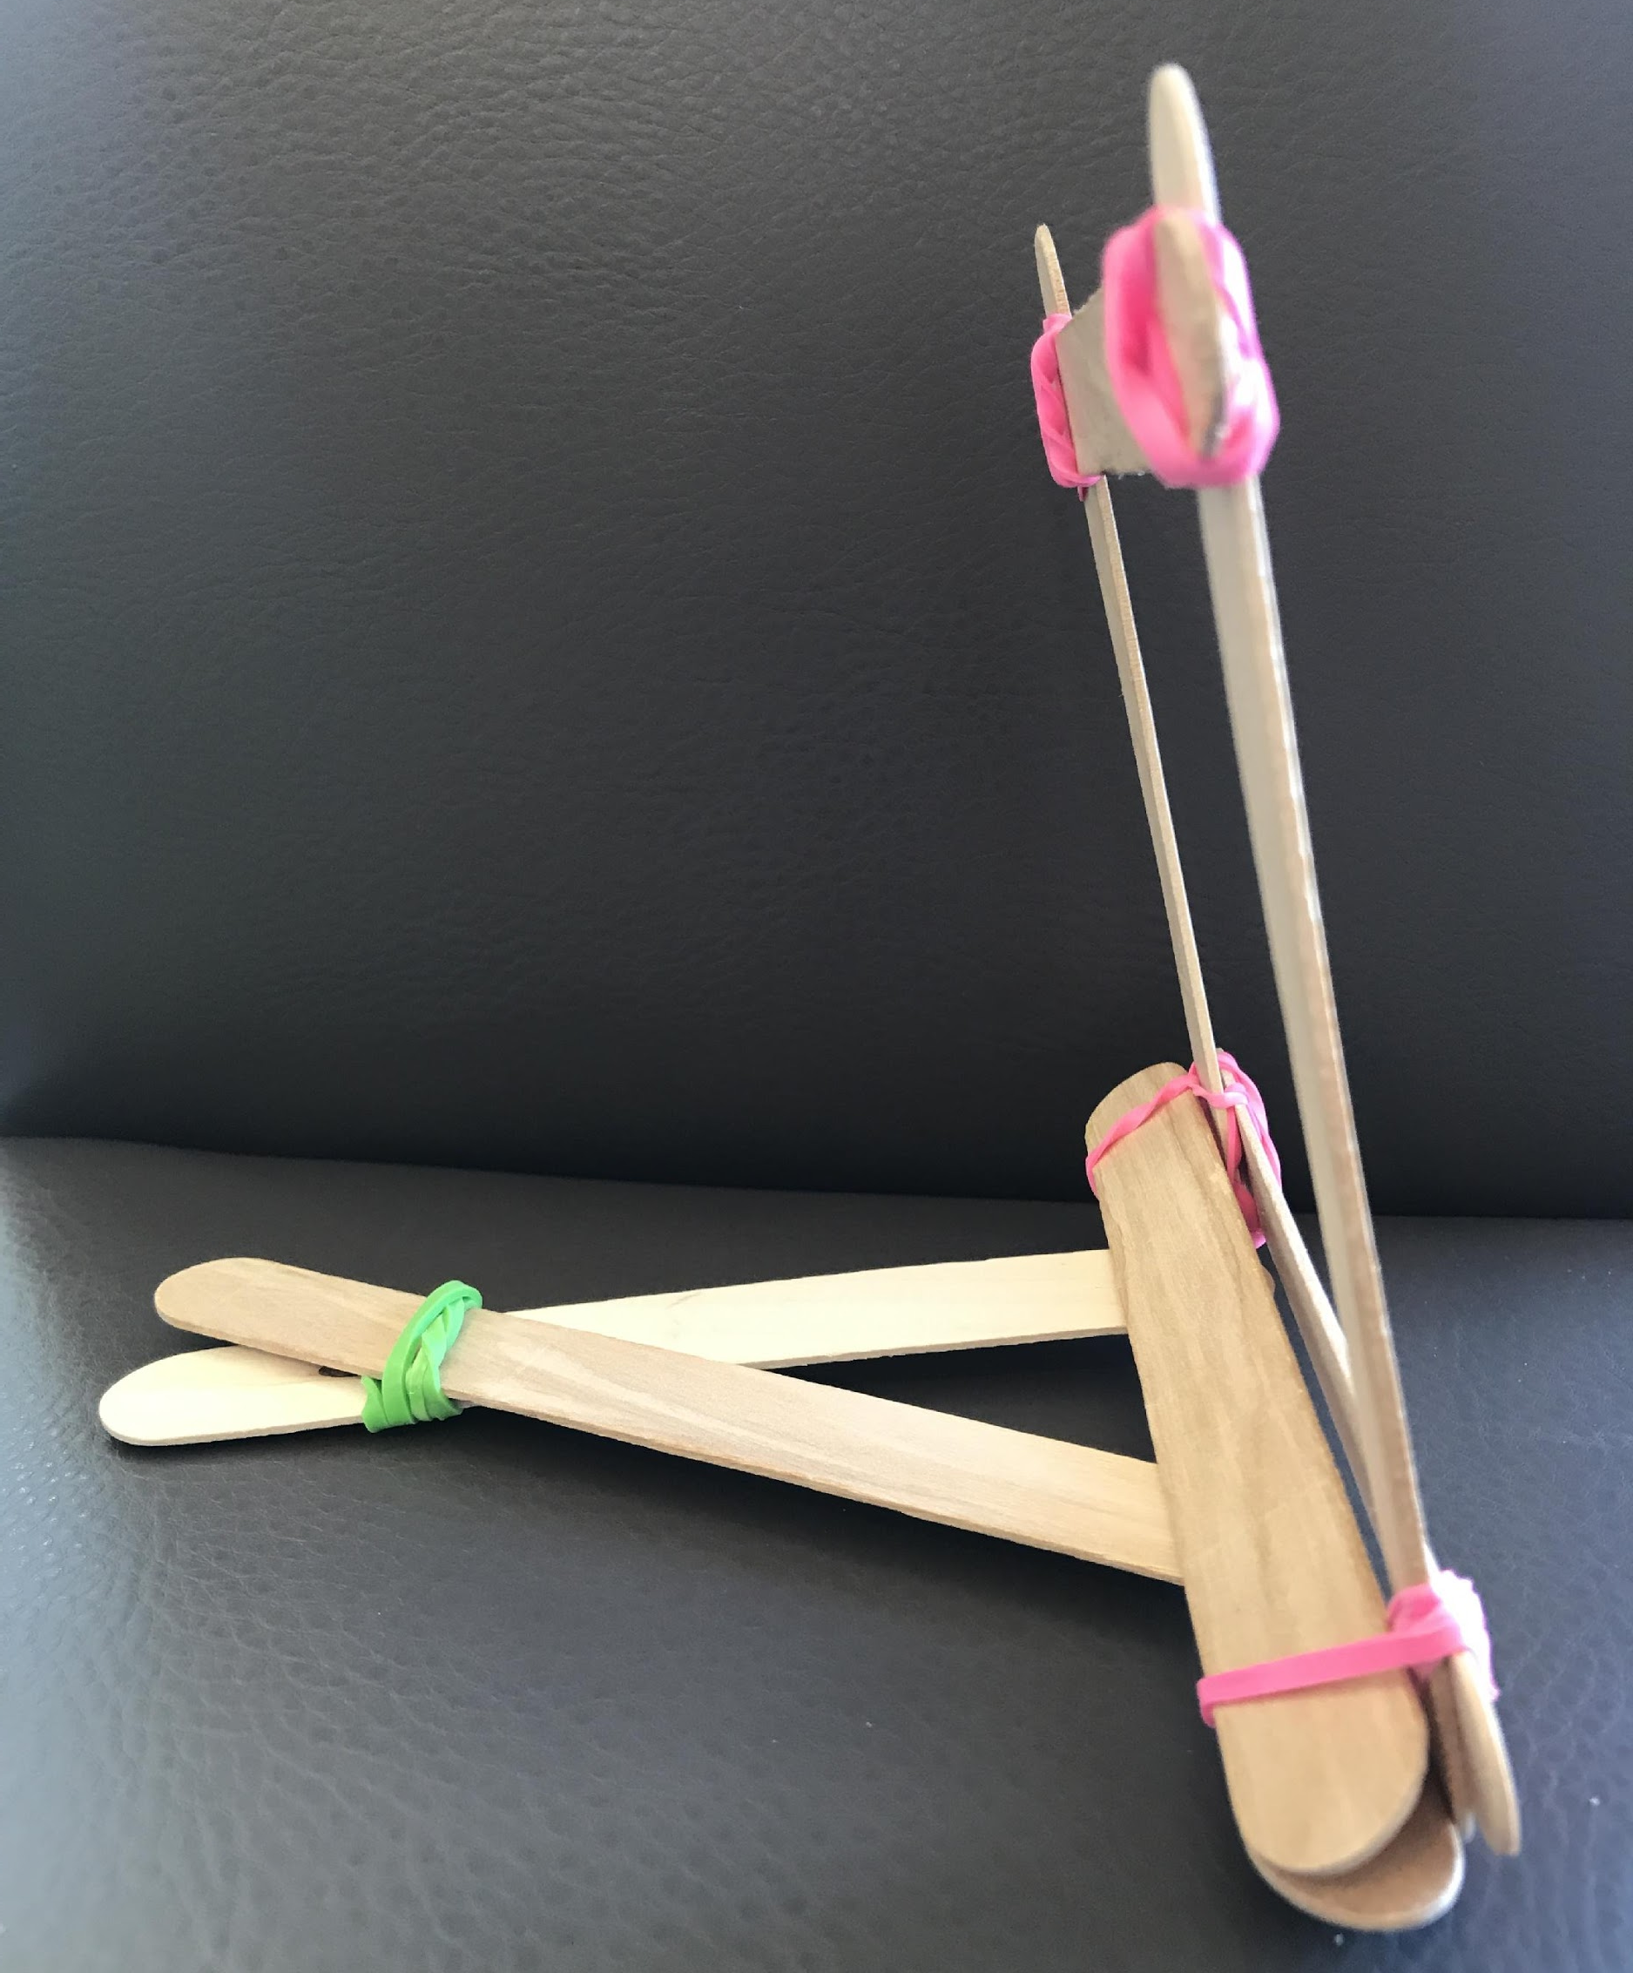
Frames with Rubberbands
Front (4 sticks for front) Side (4 sticks for the stand)

Slide 11
1) Decide what kind of frame or frames we should make. 2) Make a plan that shows how many packages of popsicle sticks you will need to so that everyone in our class can make at least one picture frame for our class display. We want to have enough popsicle sticks, but not many leftovers. 3) Extension: Show what other materials we need to hang or stand the frames (rubber bands, ribbon, magnets)
TASK: Our class is going to make picture frames for a class display to honor our loved ones and important people in our community.

Slide 12
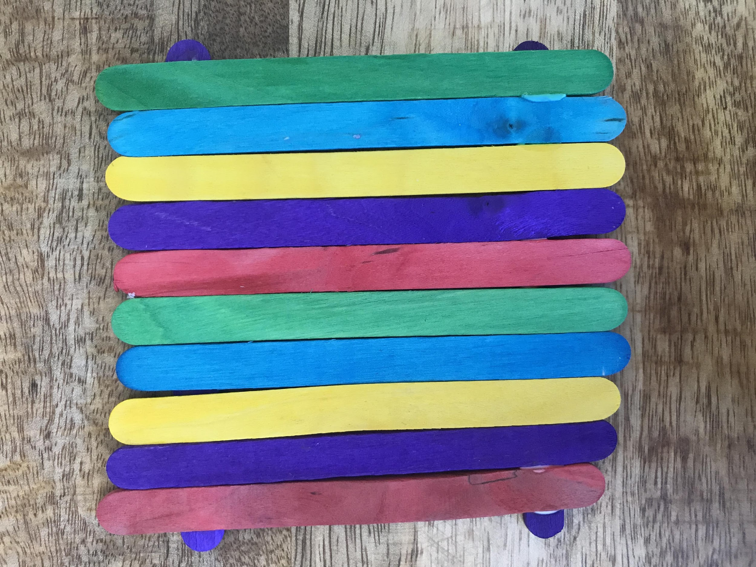
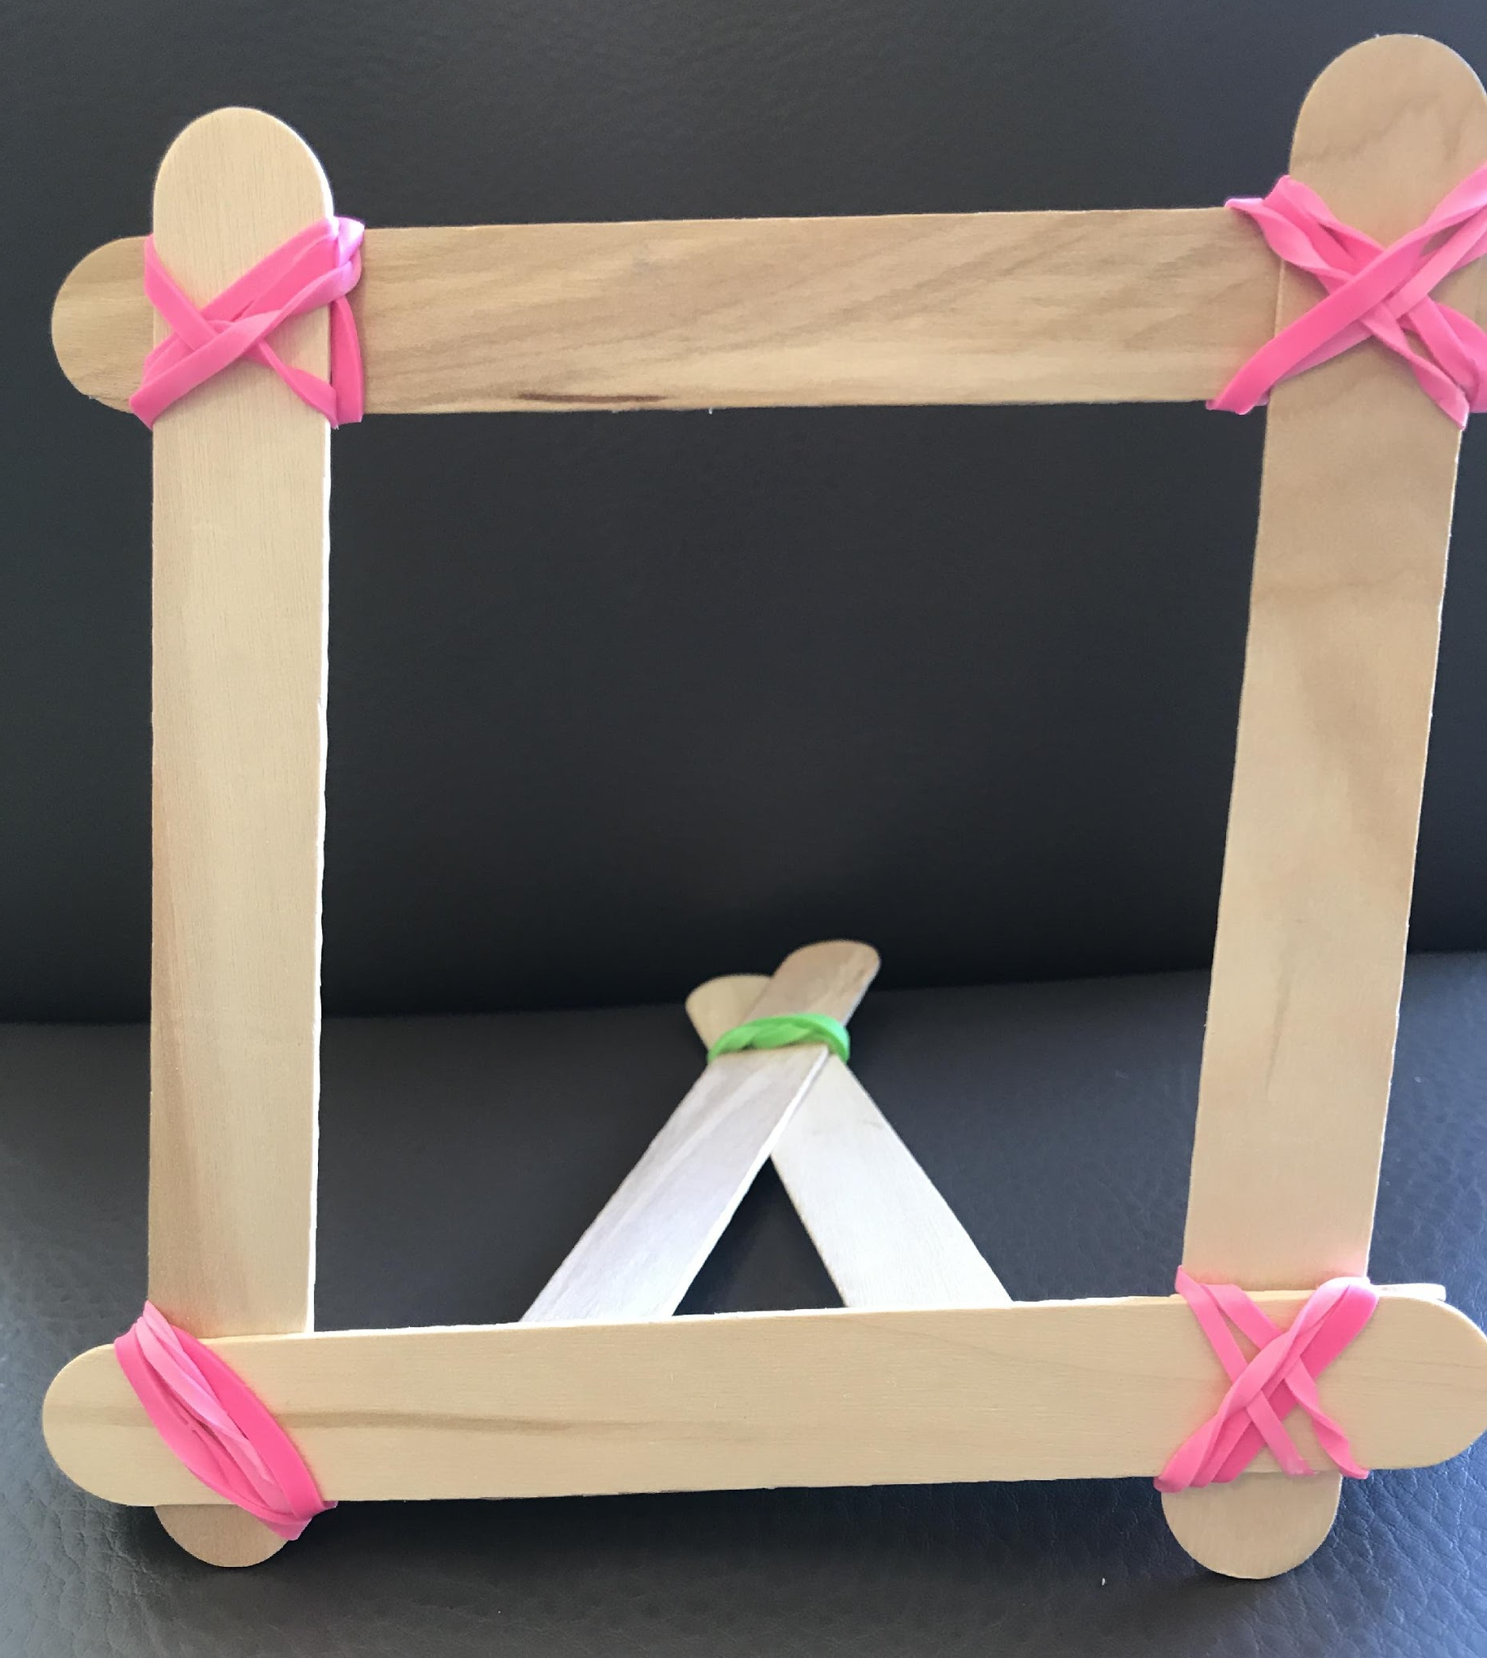
Making Picture Frames: ONE Frame Design
Decide what kind of frame we should make for our class display.
Use the popsicle sticks to plan your frame. Make a quick sketch.
Figure out how many popsicle sticks you need to make 1 frame.
Number of Plain Jumbo Sticks
Number of Multi-color Sticks
Figure out what other materials you need for 1 frame.

Slide 13
Making Picture Frames: Two Frame Designs
Select 2 kinds of frames we should make for our class display.
Use the popsicle sticks to plan your frames. Make a quick sketch.
Figure out how many popsicle sticks you need to make 1 of each frame.
Number of Plain Jumbo Sticks
Number of Multi-color Sticks
Figure out what other materials you need for 1 of each frame.

Slide 14
Check-In: Quick Share of Frame Designs

Slide 15
How many packages of popsicle sticks do you need so that every student in your class can make at least one picture frame (using your design(s) for the class display?
What do we KNOW that could help us? | What do we need to know? | What do we need to decide? What assumptions do we need to make?

Slide 16
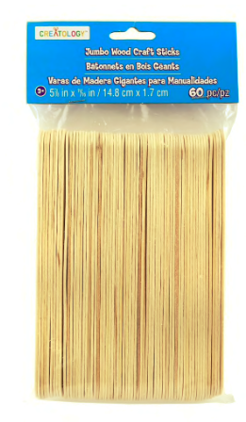
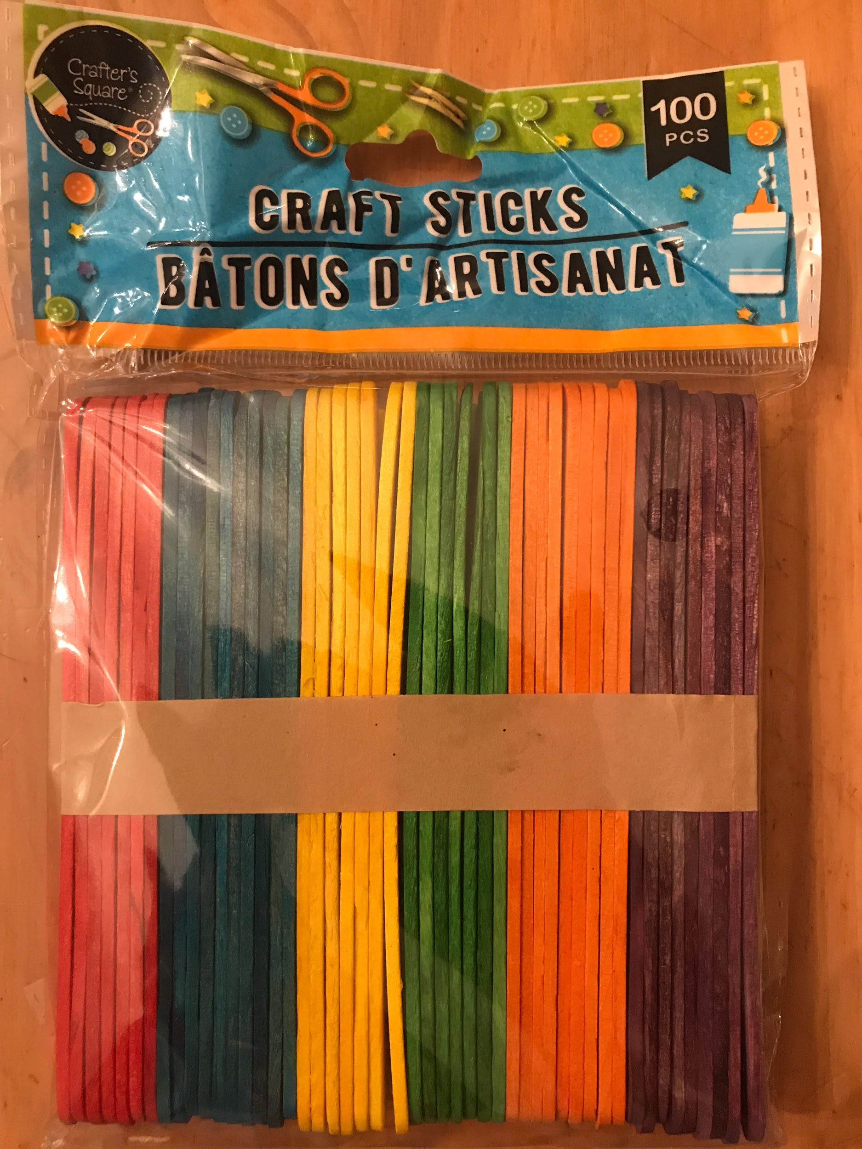
Packages of Popsicle Sticks
60 plain jumbo sticks 100 multi-colored sticks

Slide 17
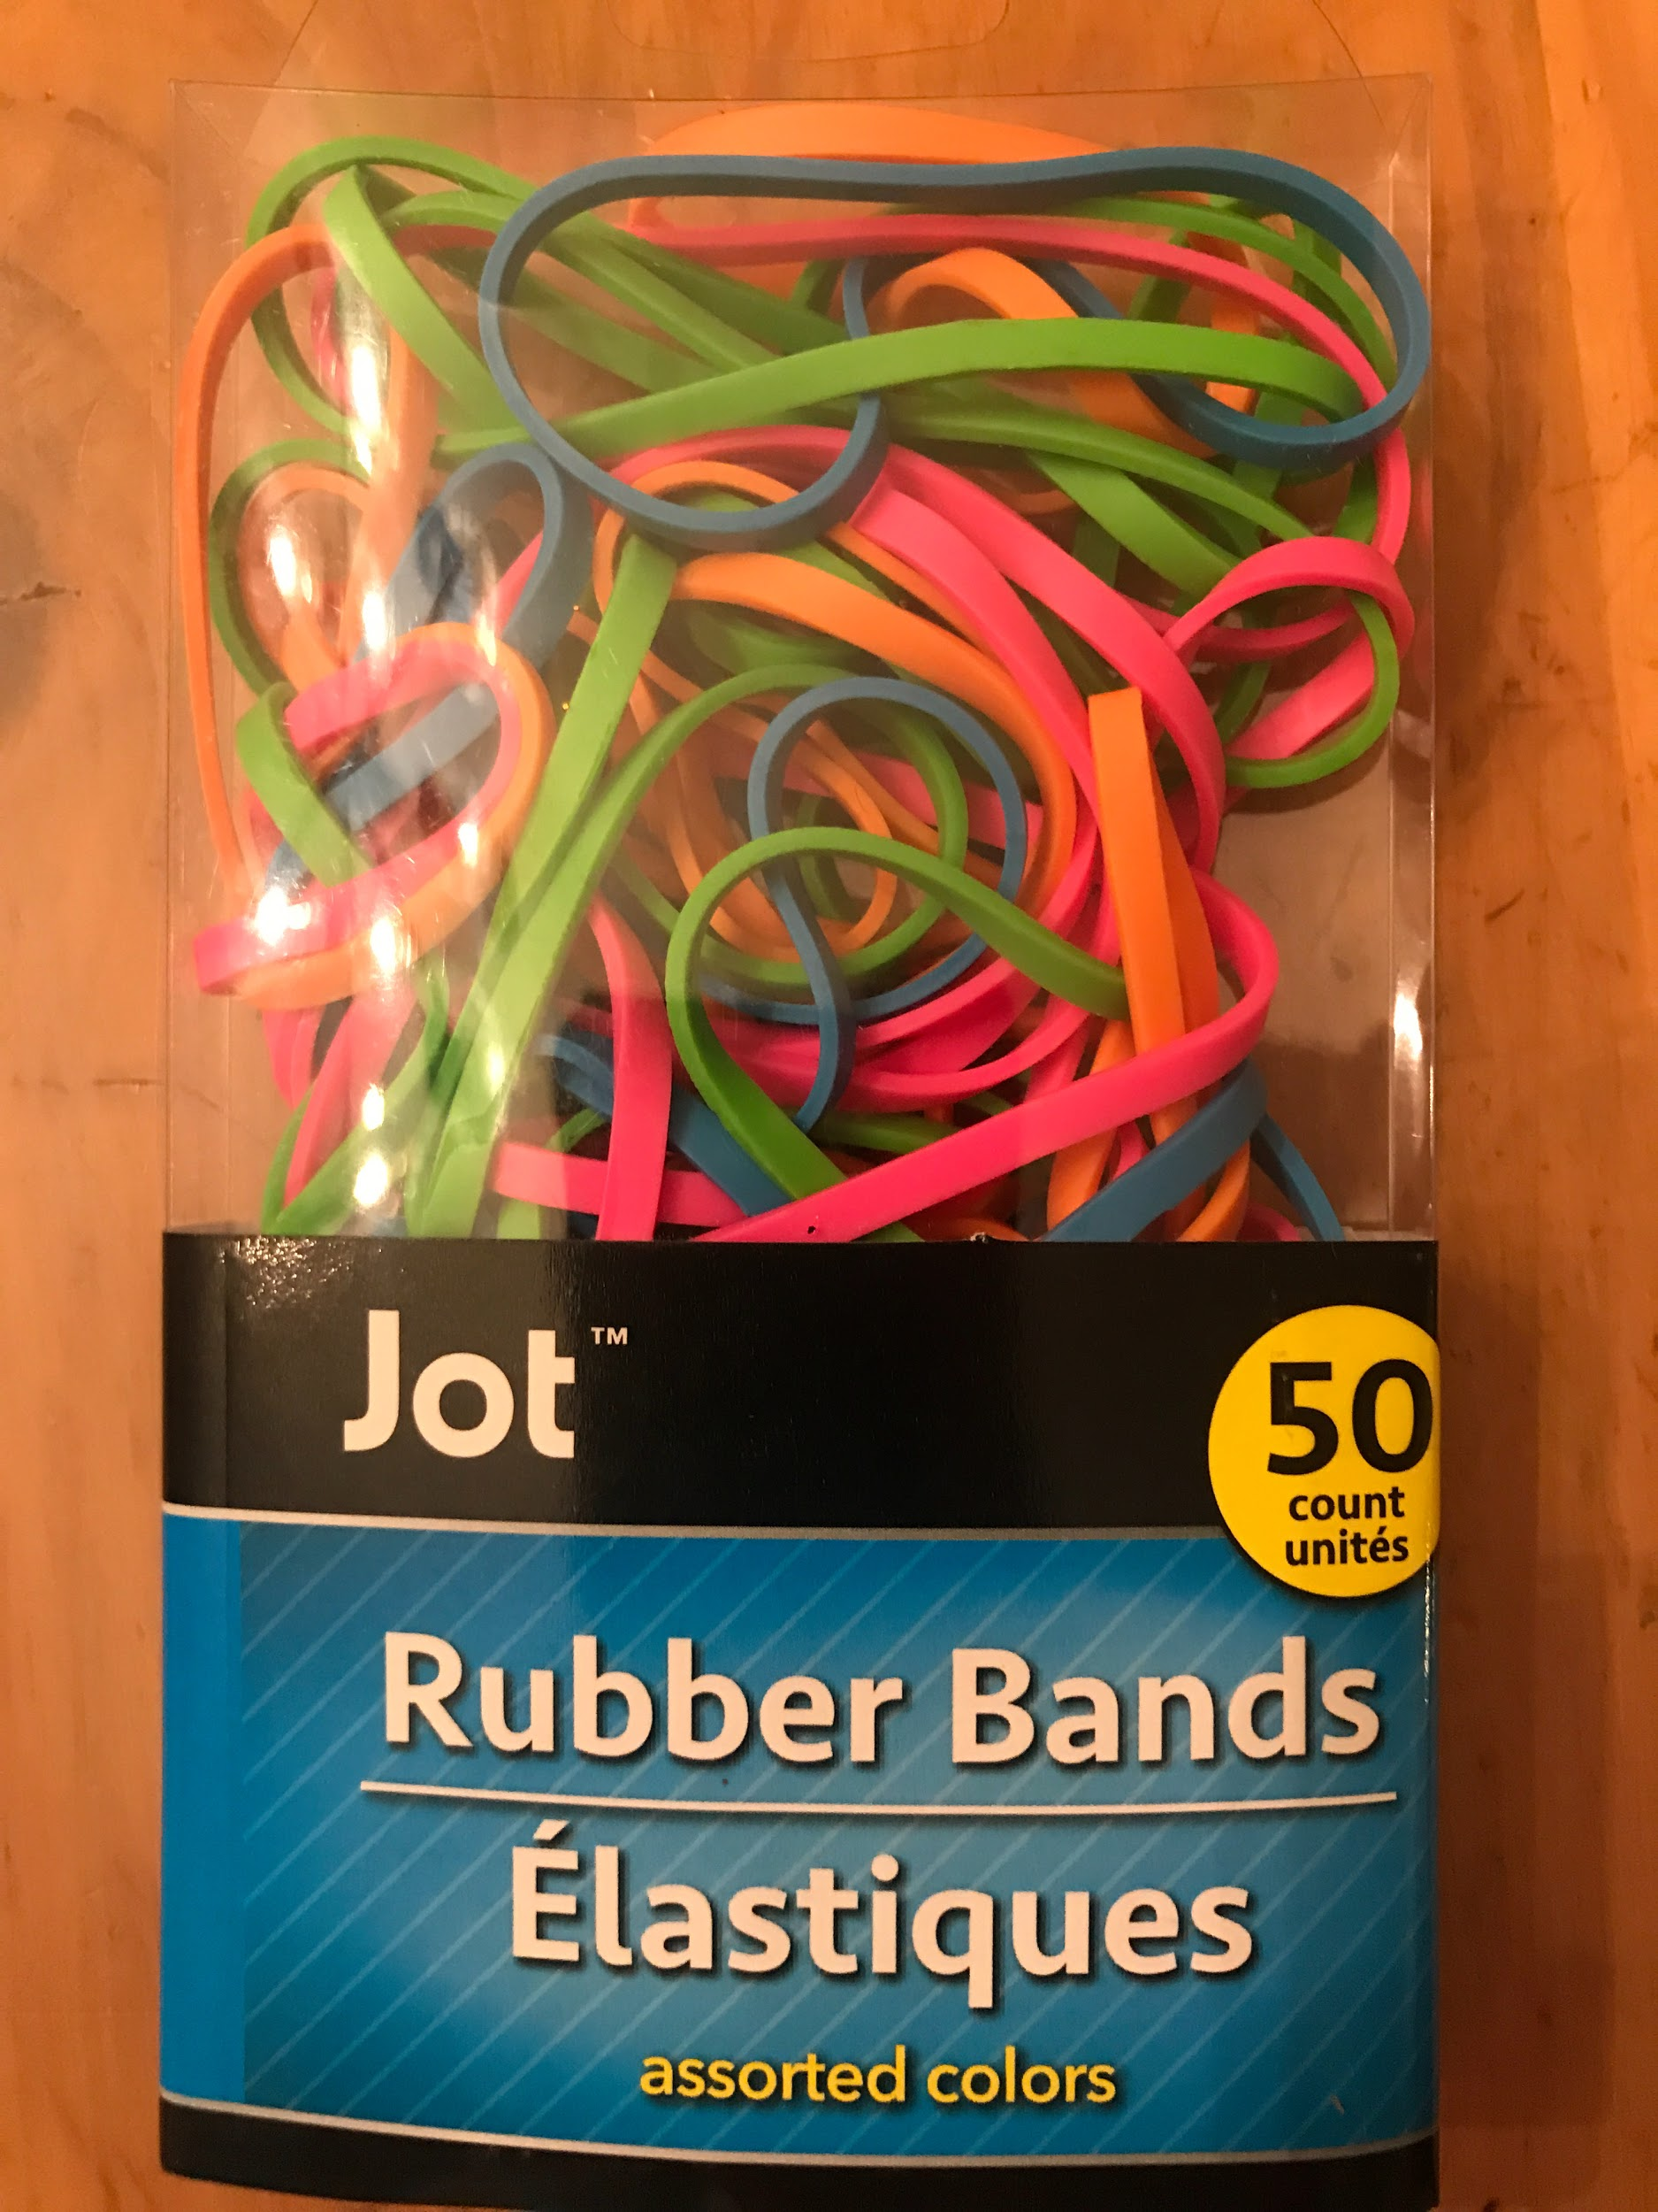
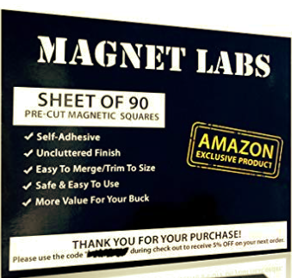
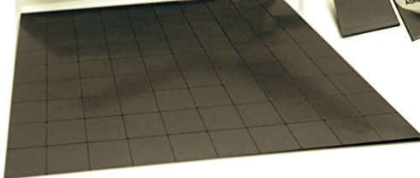
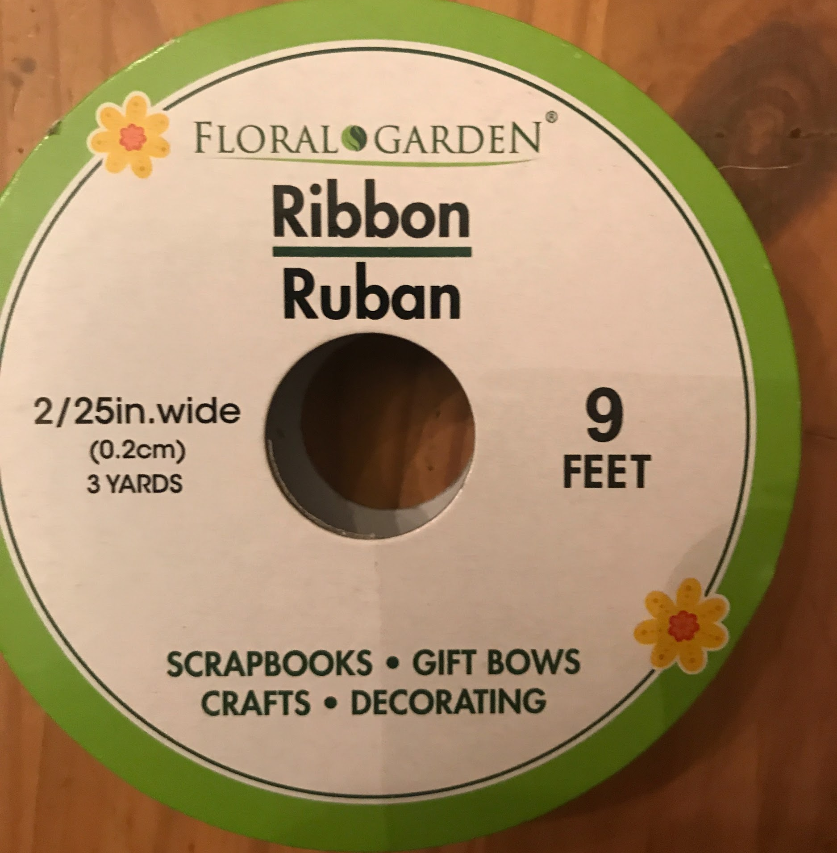
Other Materials
Rubber bands (50 per package)
Magnets (90 per package)
Ribbon for hanging (9 feet per spool)

Slide 18
Making Picture Frames: CLASS DISPLAY (one frame design)
Your plan should show:
assumptions and decisions important to your plan
which frame the class should make
how many frames the class should make
the number of packages of each type of popsicle stick needed for all the frames
how many popsicle sticks you will have leftover
how much of other materials are needed for all the frames
Use pictures, numbers, equations and words to show that your plan will work.
Explain how another group could use your plan to make picture frames for their Honor display.

Slide 19
Making Picture Frames: CLASS DISPLAY (two frame designs)
Your plan should show:
assumptions and decisions important to your plan
which frames the class should make
how many of each frame the class should make
the number of packages of each type of popsicle stick needed for all the frames
how many popsicle sticks you will have leftover
how much of other materials are needed for all the frames
Use pictures, numbers, equations and words to show that your plan will work.
Explain how another group could use your plan to make picture frames for their Honor display.

Slide 20
Group Work Time

Slide 21
Sharing and Comparing Plans
Group (sketch your frames) |  | Number of Sticks for 1 frame | Number of Frames | Number of Sticks in all | Number of Packages | Number of sticks leftover
 | Plain Jumbo Sticks
 | Multicolor Sticks
 | Plain Jumbo Sticks
 | Multicolor Sticks

Slide 22
Representing Plans with Models

Slide 23
Comparing Plans
How are our plans different?
How are our plans similar?
What is your recommendation?
What materials do we need to make frames for our class display?

Slide 24
Making a Recommendation
Write a letter that describes the materials needed for making the picture frames for the class display.
Be clear so that the person knows how much material to order.

Slide 25
OPTIONAL TOOL FOR STUDENT POSTERS
Assumptions and Decisions | Show how many packages of each kind of popsicle stick are needed to make all the picture frames in your plan.
Sketch your frame. How many popsicle sticks are needed for 1 frame? What other materials are needed? | Show how much of other materials are need to make all the picture frames in your plan.

