Slide 1
Congratulations on your acceptance to Queens College for Fall 2025!
New Transfer Student Advising Presentation (Self-Guided)
Please review the contents of this presentation carefully so that you are prepared for your advising session with an academic advisor.

Slide 2
Online Advising Presentation Goals & Objectives
Academic Advising at Queens College ─ A Shared Model​
Overview of your Queens College Bachelor’s Degree​
Academic Policies & Procedures​
Resources for Queens College Students​
"Must have" Electronic Accounts ​
– CAMS, CUNYfirst”, QMail (Office 365) and QC Navigate​
How to Prepare for your advising session

Slide 3
Academic Advising at Queens College
A Shared Model
Your Academic Advisor in the Academic Advising Center
Overview of your Queens College Bachelor’s Degree​
Academic Policies & Procedures​
Resources for Queens College Students​
"Must have" Electronic Accounts ​
– CAMS, CUNYfirst”, QMail (Office 365) and QC Navigate​
How to Prepare for your advising session
Your Faculty Advisor in the Respective Academic Department
Detailed understanding of the Academic Discipline
Departmental Policies & Procedures
Course Content, Requirements, and Expectations
Career & Academic Discussions
Undergraduate Research & Graduate Study Goals

Slide 4
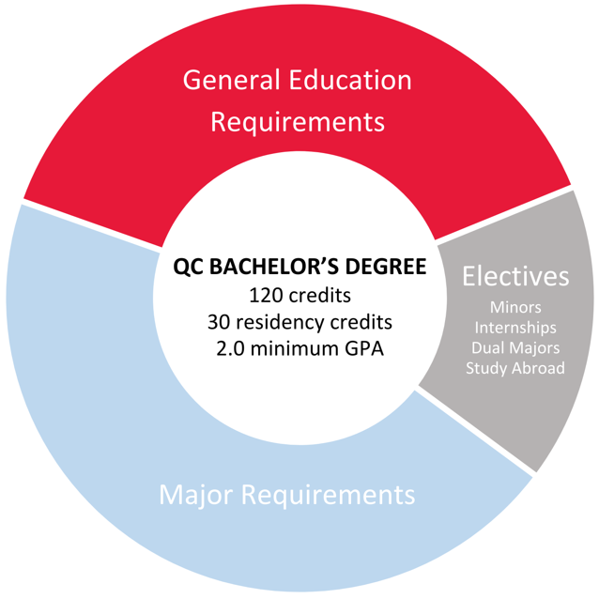
Your QC Bachelor’s Degree
An Overview

Slide 5
Your QC Bachelor’s Degree Residency Requirements
120 credit minimum if you are transferring in 90 or fewer​ credits.​
At least 30 credits must be done in residency at Queens College​ for transfers with 91 or more transfer credits. ​
Minimum of one Writing Intensive course in residency. ​
Your major {and minor} at Queens might have additional ​residency requirements. Consult with your faculty advisor.

Slide 6
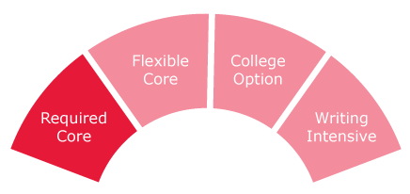
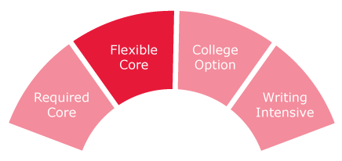
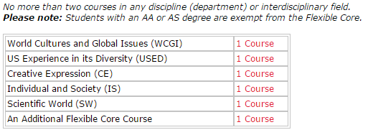
QC Core Requirements (CUNY Pathways)
The Required Core
The Flexible Core
Cannot use Pass/No Credit Grading Option for any courses applying to QC Core Requirements.
Courses can be found:
Academic Advising Degree Requirements
Pathways - General Education at Queens College

Slide 7
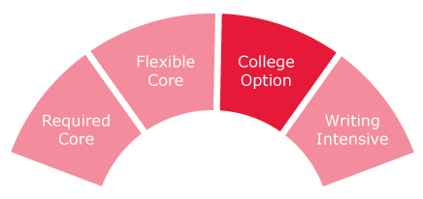
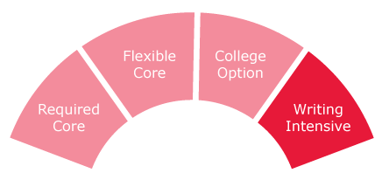
QC Core Requirements (CUNY Pathways)
The College Option
Writing Intensive Requirement
Students must complete two Writing-Intensive "W" courses.
At least one "W" must be completed in residency at QC.
English 110 is a prerequisite for all "W" courses.
“W” courses can overlap with QC Core requirements or, if available, major and/or minor requirements. Discuss with an advisor.
Cannot use Pass/No Credit Grading Option for any courses applying to QC Core Requirements.
Courses can be found:
Academic Advising Degree Requirements
Pathways - General Education at Queens College

Slide 8
Already have an AA or AS Degree?
If you have earned an Associate of Arts Degree (AA) or Associate of Science Degree (AS) from any U.S. institution, you are considered to have met the following requirements:
Required Core
Flexible Core
College Option Science
Additional College Option
To fulfill your remaining General Education requirements, you only need Literature, Language and one Writing Intensive Unit, which can be fulfilled by taking a Literature course with a “W” following the course number (example: Comparative Literature 101W) OR a “W” course in your major or minor (if available).
Please note that these exemptions do not apply to AAS and AOS degree holders.

Slide 9
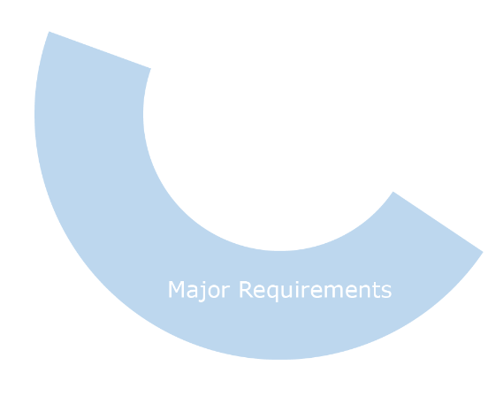
The QC Bachelor’s Degree
The Major & Electives
Electives
The Major
Majors vary in the number of credits and courses required.
At Queens College, the total number of credits in a major can range from 31 credits to 79 credits.
Some majors have entrance requirements and/or an application process.
Most majors have maintenance and graduation criteria.
See Academic Program Maps on Advising Center’s website.
Visit departmental websites for more information.
If you transfer in 90 or fewer credits, you must reach at least 120 credits (minimum 30 credits in residency).
If you transfer in 91 or more credits, you must complete a minimum of 30 credits in residency and will need to exceed 120 credits.
If your transfer credits, plus your remaining QC Core and major requirements do not add up to 120 credits (with 30 credits in residency) elective credits are needed.
Consider an internship, minor, or study abroad as options!
Cannot use Pass/No Credit Grading Option for any courses applying to the major, but can apply to electives.

Slide 10
Major Information
Information on Declaring Your Major
Declaring Your Major
When you speak with your academic advisor, you will learn the process for declaring the particular major in which you are interested.
Please note that you must declare your major by your 60th completed credit. This is required by CUNY and Financial Aid.
The Fall 2025 deadline is Monday, September 1, 2025.
Students who have completed 60 or more transfer credits who do not declare their majors by the deadline are in jeopardy of losing their NYS TAP award.
Majors with Entrance Criteria
The Queens College programs listed below have entrance criteria, pre-requisites, and/or application requirements. If you are not yet ready to apply, advisors will discuss options with you.
Aaron Copland School of Music
BFA in Studio Art
Business Administration (Corporate Finance, International Business, or Actuarial Studies)
Communication Sciences and Disorders (Speech Pathology)
Drama,Theatre & Dance
Elementary/Childhood Education
Neuroscience
Nutrition and Dietetics
Secondary Education

Slide 11
Get Ready to Register!
Fall registration opens May 1.
You do not have to wait until your Transfer Advising Session to register for classes.
Register now via Schedule Builder and then discuss your choices during your Transfer Advising Session.

Slide 12
Get a Head Start with Summer Session!
New transfers may get a head start with Summer 2025 classes!
Summer Sessions are a great way to make progress toward your degree and stay in compliance with NYS TAP (and other Financial Aid) and the NYS Excelsior Scholarship!
2025 Summer Session Dates Take up to a maximum of 15 credits Summer Session 1 – (4 Weeks) │June 2 to June 26 Summer Session 2 – (4 Weeks) │July 7 to July 30 Summer Session 3 – (7 Weeks) │ June 30 – August 18
If you wish to take classes during Summer 2025, complete the Transfer Summer Request Form
For session information, please refer to the Summer Session Program.
For Summer tuition information, please refer to the Bursar.

Slide 13
Complete Your Transfer File
Submit final transcripts and score reports to the Undergraduate Admissions Office. Visit the website for information on document submission of:
Advanced Placement (AP)
Advanced International Certificate of Education Program (AICE)
College Level Examination Program (CLEP)
Defense Language Proficiency Tests (DLPT)
International Baccalaureate (IB)
NYS Seal of Biliteracy
For comprehensive information on transferring credits please see the CUNY – Credit for Prior Learning website.
CUNY College Now credits (but not grades) will automatically be applied to your QC record.
Undergraduate Admissions Office
Admissions@qc.cuny.edu
Jefferson Hall, Room 105 │ 718-997-5600

Slide 14
Decisions That Affect Financial Aid
Full time credits required each semester (ideally 15 credits per semester, minimum 12 per semester)
Courses must apply towards your declared major, minor, General Education requirements, or necessary electives as applicable.
Do not repeat courses taken previously. Discuss with an advisor and check your credit evaluation.
Last day to add Fall 2025 course(s) for Financial Aid Certification – Monday, September 1, 2025
Major declaration deadline – Monday, September 1, 2025
Maintain acceptable GPA (min. of 2.0) & demonstrate “Satisfactory Academic Progress" (SAP)
When in doubt, ask an advisor!
*If major requires entrance criteria/an application please consult with a department advisor.
The Excelsior Scholarship, in combination with other student financial aid programs, allows students
to attend a CUNY college tuition–free.
Please visit www.hesc.ny.gov/excelsior for eligibility requirements and more information.
APPLY TODAY!!! (See HESC website for details and deadline)

Slide 15
The Billing Process
Once you are registered for courses your tuition bill will be generated. You will receive an email to your QC email account (Office 365) informing you of the bill due date, which is based on your initial date of registration.
Please note: Tuition Bills are not mailed to your home.
View your tuition bill and applied Financial Aid in your Self-Service/Student Service Center page on CUNYfirst.
You are held financially and academically responsible once you are registered for classes. Should your intention change to attend QC, you must drop your classes. Non-payment will not drop your classes.
Late fees will be assessed when adding/swapping courses after the semester has begun.
For payment due dates, liability schedule and payment options,
please visit the Bursar Website.

Slide 16
QC Technology: Accounts & Access
QC Technology: Accounts & Access
All students entering Queens College must claim their “QC Username” account through the College’s “CAMS” system. This allows for access to campus computers, Wi-Fi on campus, obtaining your college ID card, as well as other college web-based applications.
Register for classes, view and pay your tuition bill, check final grades, sign-up for CUNY Alert, use Blackboard, Degree Works, e-Permit, as well as other services.
Your Queens College Student Email Account, aka Qmail”. This account is used for all official college correspondence.
Note: Same Username and Password at CUNYfirst.
Download the QC Navigate App. Schedule an appointment with an advisor, see an up-to-date class schedule and your appointment, connect to resources and MUCH MORE!
Information Technology – Help Desk
Helpdesk@qc.cuny.edu Dining Hall, 151 │718-997-4444

Slide 17
Your Next Steps
The next step in the enrollment process is to review and complete the 10 Steps Before Your Transfer Advising Session on the Transfer Advising webpage. You will learn about our academic offerings, degree options and campus resources.
Be prepared for your one-on-one appointment with an academic advisor to create your first semester programming and begin discussion on your academic planning
If you have not received an Invitation to sign-up, please contact the New Student phone line at 718.997.5573 and leave a message. Someone will return your call promptly.
We are here to help make your transition to Queens College smooth and successful, and we look forward to meeting you.

