Slide 1
Show me the money
JOBs - Where are they?
For Computer Science and Math majors

Slide 2

Banking - quants
Advertising - big data
Healthcare - bioinformatics
Transportation - optimization
Energy - simulations and modeling

Slide 3
Grunt TAsk for Years
Clean-up and test
What will they do in those Jobs?

Slide 4
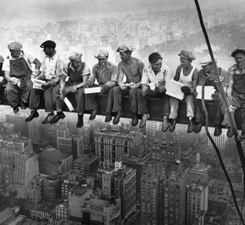
Starting the next 50 years
The job no one else wants
Clean up the mess
Testing and QA
Routine stuff
Culture tolerance
Temper the ego

Slide 5
How to get the JOb?
Skills and Knowledge

Slide 6
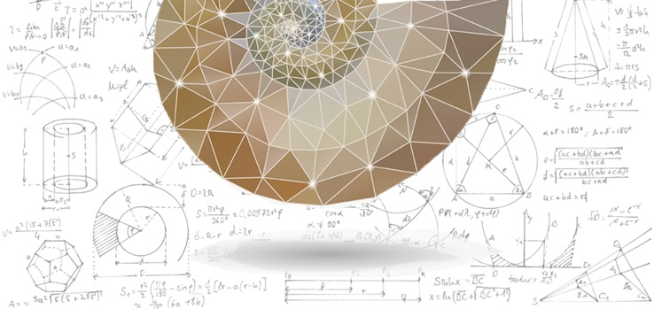
Master one thing better than your peers
then share it with everyone.
Find people who know it better than you,
then repeat.
Einstein is a Brand first and a Brain second

Slide 7
What can the Faculty do?
How to Prepare the Students?

Slide 8

Understand Business
How does it function and create value?

Slide 9
Curriculum for Industry Readiness
Integrating Theory with Practice

Slide 10

Problem framing
Fit for use
Tools Skills
Practice to mastery
Theory
Build/extend tools
Share solutions
REal World project
over 4 years as a team

Slide 11
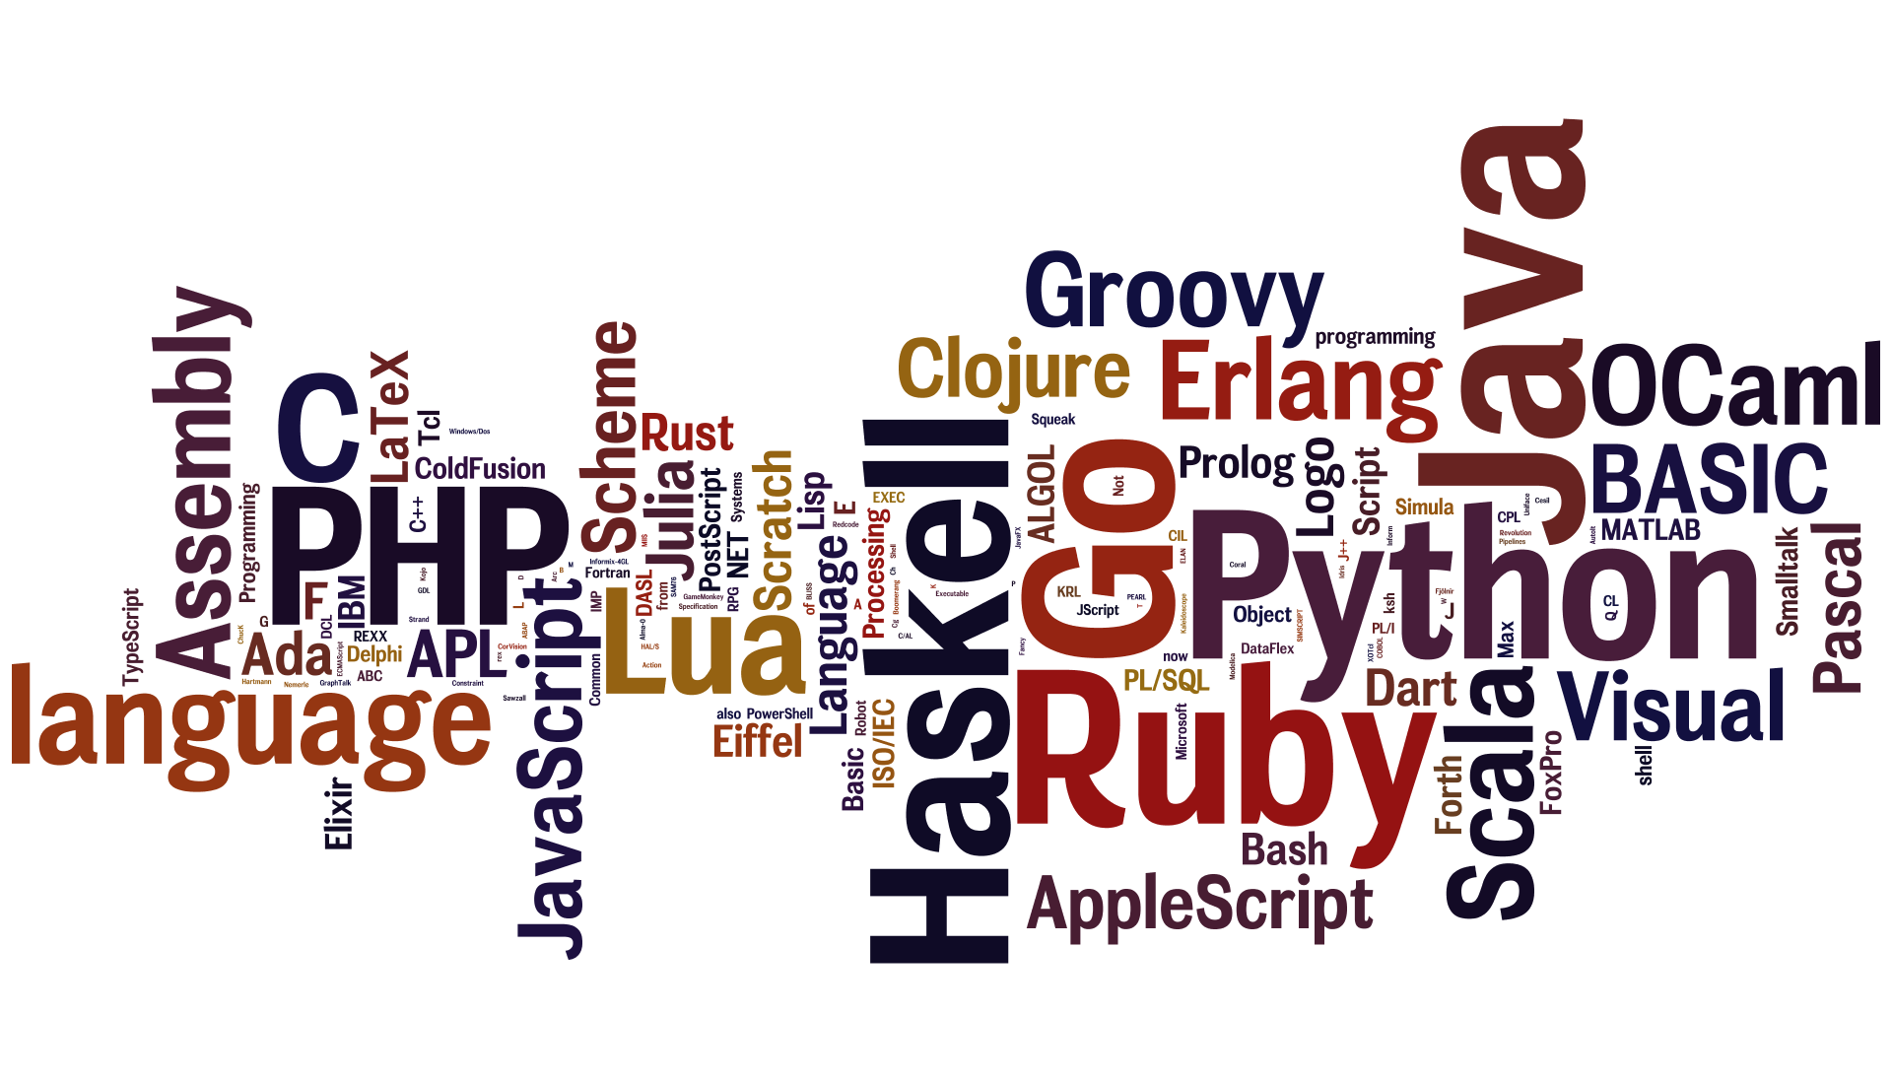
Polygot programming
Learn to think multi-paradigm

Slide 12

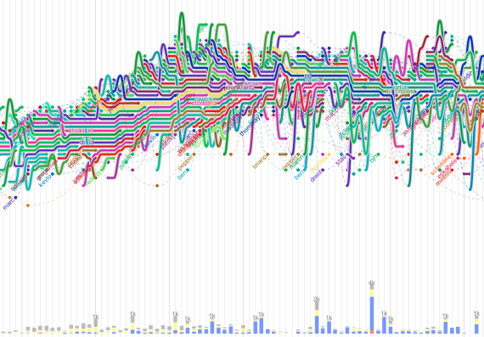
Literate Programming
Visualizing and using software metrics

Slide 13
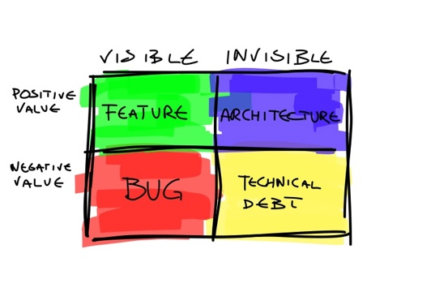
Economics of Technical Debt
of Legacy Software

Slide 14

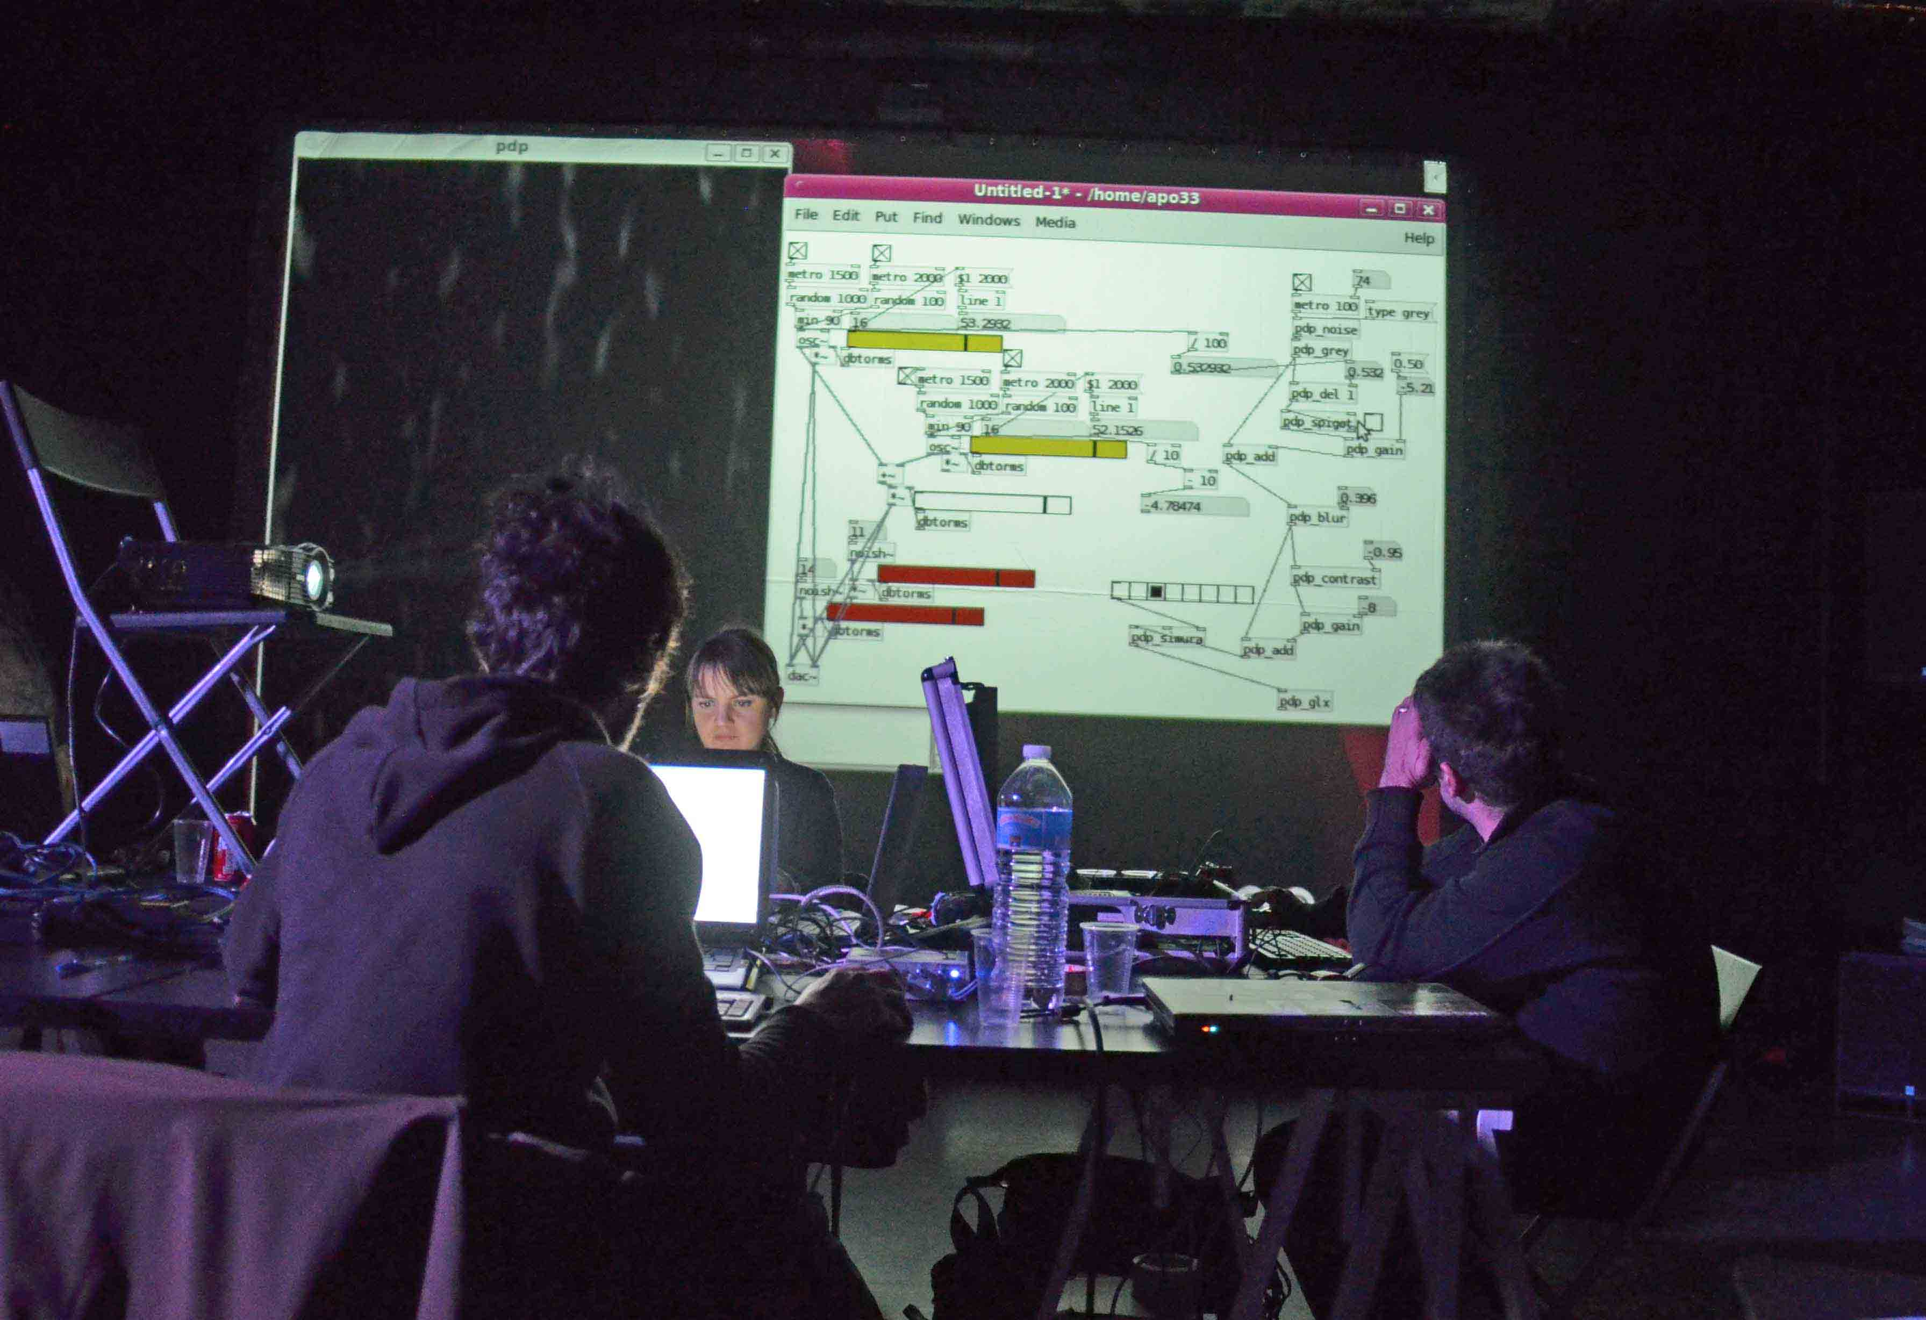
Live CODING performance

Slide 15

Supercomputing simulation
Tesla Nvidia CUDA

Slide 16
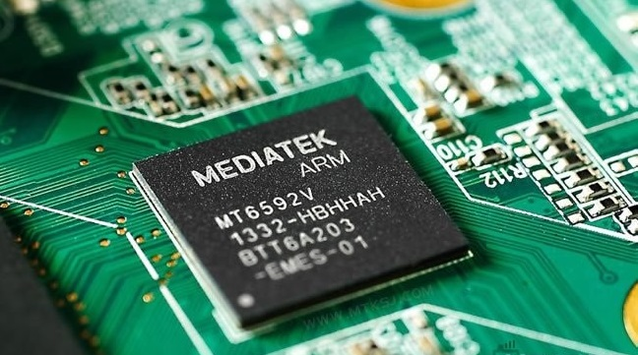

IoT Tools
Frameworks
Cyber Security
Infrastructure
Platforms

Slide 17
1. DEBUGGINg
2. Optimization
Two essential skills that are scarce

Slide 18
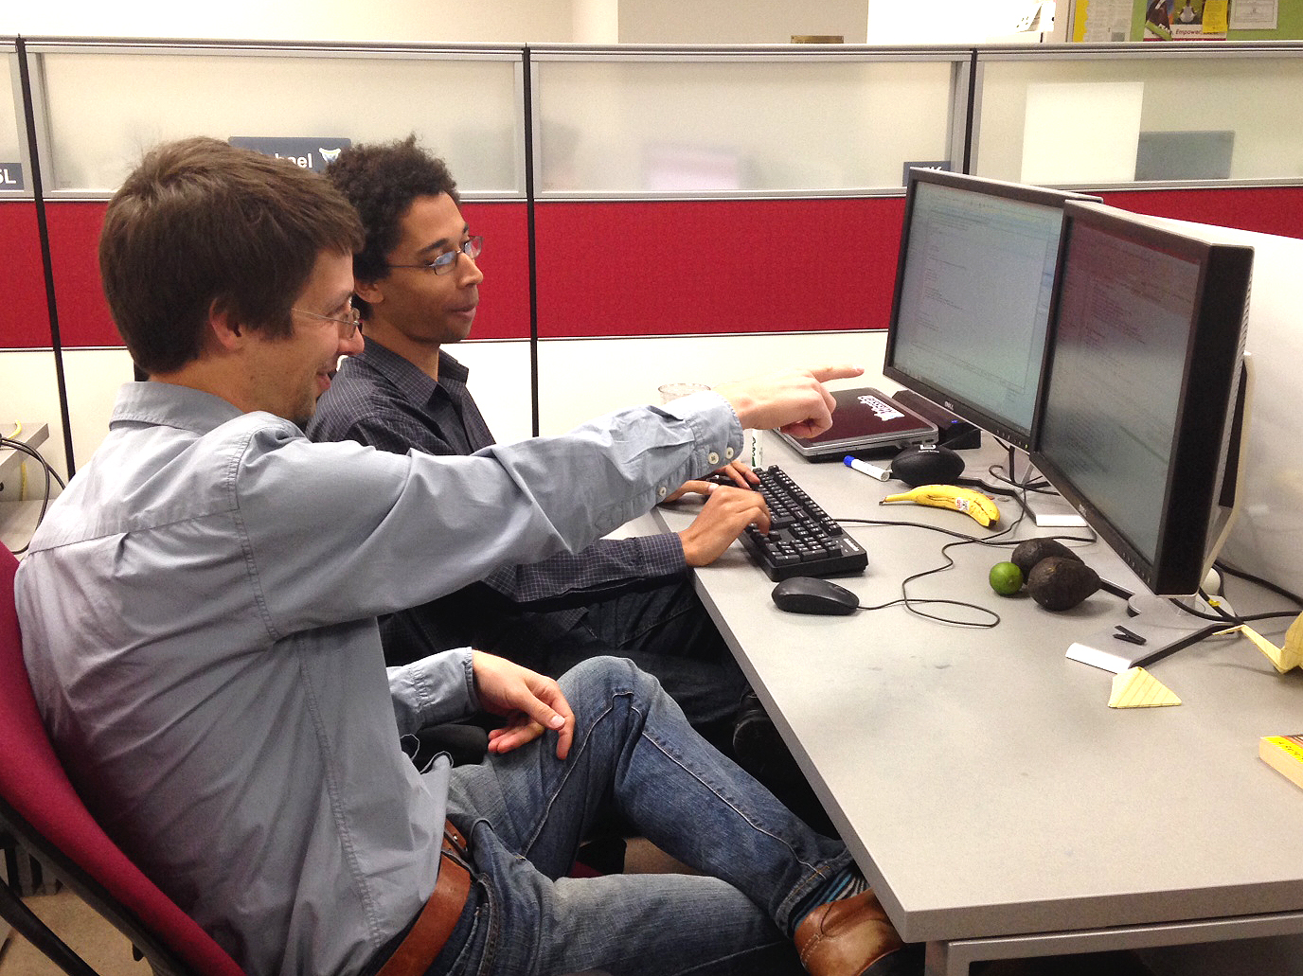
Process-lean/agile
Social construction with peer programming

Slide 19
Global Competition
Millions of Web/App developers
Programming is a commodity
Programming was co'opted by corp interest
Top talent remains scarce
Technology as fashion
New value created by entrepreneurs, not technocrats

Slide 20



has a degree
but no job
In the future everyone
becomes an entrepreneur

