Slide 1

The evolution and upcoming challenges in undergrad CS programs
Jim Kurose
School of Computer Science
University of Massachusetts
Amherst MA USA
(as of Jan. 5, 2015: 23 days and counting ….)

Slide 2
Overview
The evolving undergrad curriculum at UMass
  BS, + IT minor, revised BS, + BA, + Informatics
Booming enrollments nationwide!
  anecdotal data
  meeting the challenges
You ain’t seen nothing yet: the coming boom

Slide 3
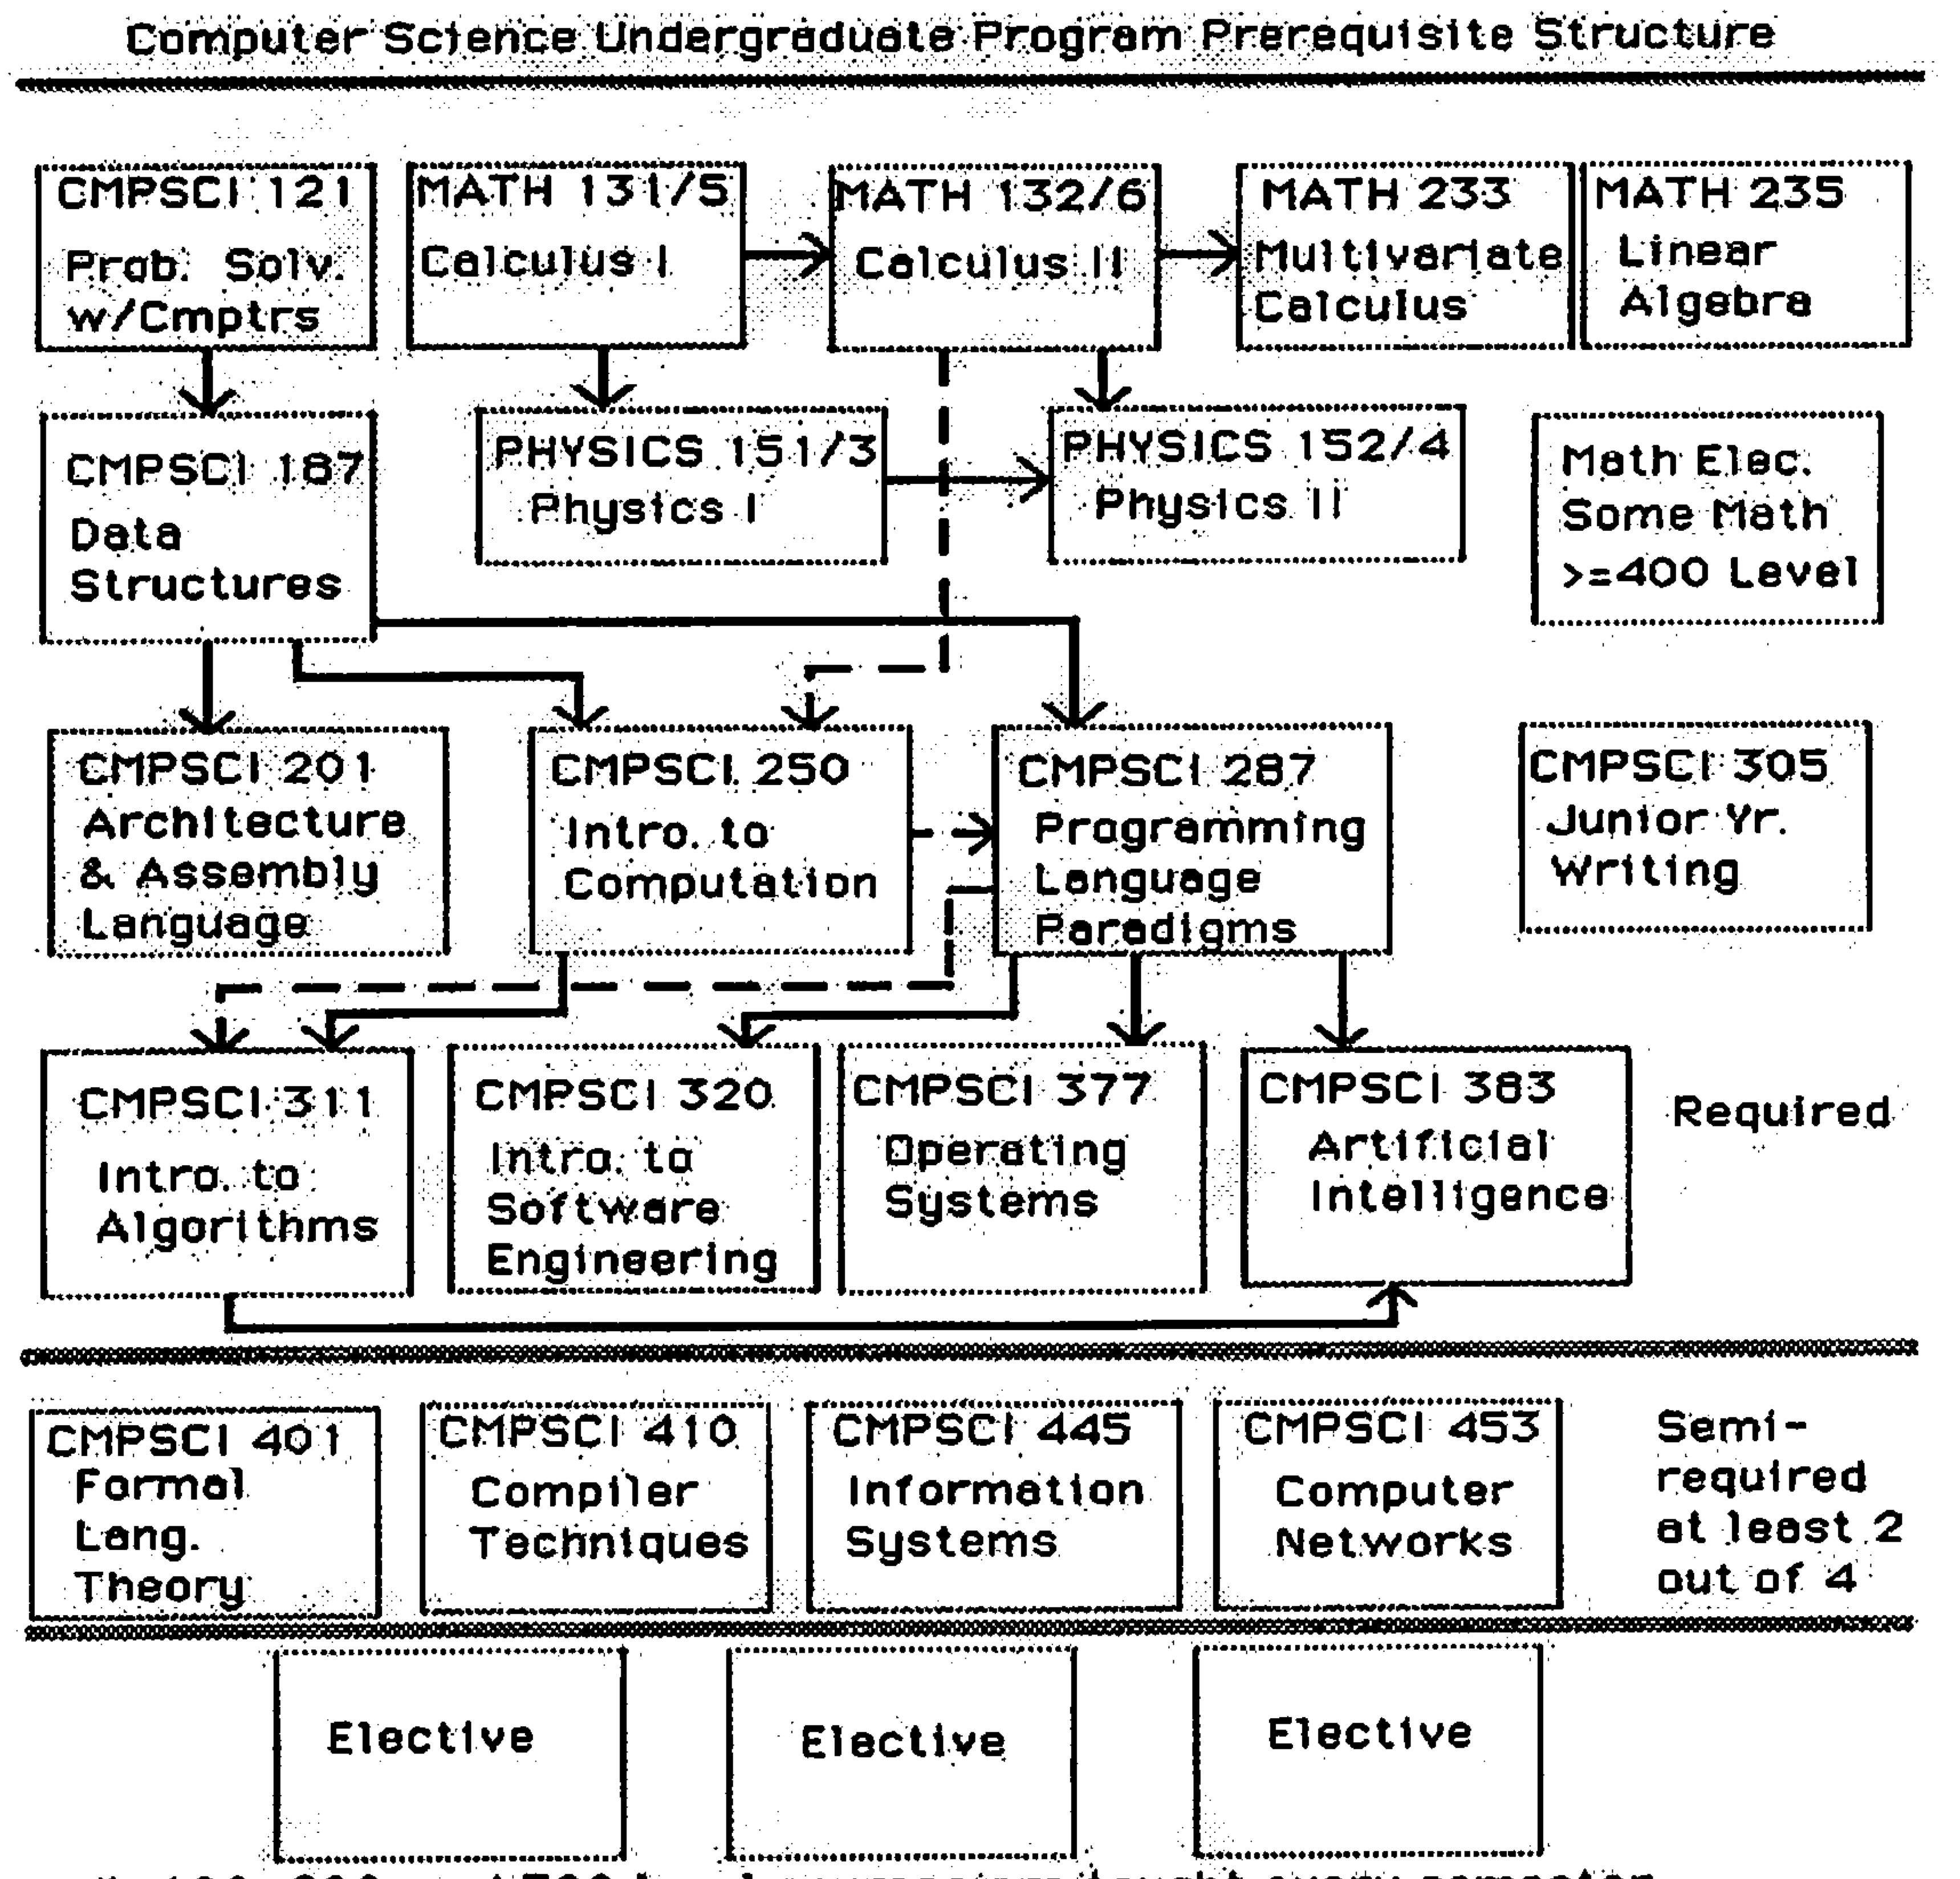
UMass CS curriculum: ~1982 – 2003
CS1
CS2
Disc
Math
Arch
PL
Alg.
SE
OS
AI
Formal
Lang.
Comp.
Info
Sys.
Net.
3 electives

Slide 4
UMass CS curriculum: ~1982 – 2003
traditional, deeply “technical” BS
more or less unchanged for 20+ years
served our students well, given the “times”
~ 80 credits required (120 total to graduate)
  engineering versus liberal arts debate
CS1
CS2
Disc
Math
Arch
PL
Alg.
SE
OS
AI
Formal
Lang.
Comp.
Info
Sys.
Net.
3 electives

Slide 5
2002: Cross-campus IT minor
Massachusetts BHE initiative (led by UMass CS)
goal: “ensures that students have technical training, understand the human dimensions of IT, and understand how IT impacts … their fields”
intentionally led/administered outside of CS
six courses: over four areas:
  Foundations
  Technical
  Broadened Inquiry
  Elective
66 courses
23 departments

Slide 6
Circa 2004: revised BS
CS1
CS2
“cores”
Programming
Methodology
Intro. to
Computation
Comp.
Systems
Principles
Reasoning
Under Uncertainty
General CS
Software Engineering
Security and Privacy
Robotics, Vision, Graphics
AI
Architecture
Networking
Software Systems
Theory Computation
Search and Data Mining
+8 courses in
concentration
area:

Slide 7
Observation: revised CS BS
still deeply “technical” BS
more flexibility for student to follow interest
  faculty got over “area X (my area) is central to CS”
~ 85 credits required (120 total to graduate)
  engineering versus liberal arts debate continues

Slide 8
Circa 2011: BA in CS
goal: greater flexibility (fewer CS requirements) for students
  double majors
  more “liberal artsy”
requirements: CS1, CS2, 3-of-4 core courses, 5 CS electives, 4-course outside concentration
  ~55 required CS/Math credits

Slide 9
2013: new Informatics UG major
goal: students learn design, application, use, and impact of computational principles, technology
six technical core courses:
  CS1, CS2
  Intro. Informatics (CS principles), Informatics Math., Networked World, Usability
Technical tracks (8-9 courses in track)
  multimedia
  data science
  … more under development

Slide 10
Overview
The evolving undergrad curriculum at UMass
  BS, + IT minor, revised BS, + BA, + Informatics
Booming enrollments nationwide!
  anecdotal data
  meeting the challenges
You ain’t seen nothing yet: the coming boom
slides adapted from E. Lazowska (U. Washington), E. Roberts (Stanford), J. Kurose (U. Massachusetts), “Tsunami or Sea Change? Responding to the Explosion of Student Interest in Computer Science,” CRA Snowbird Conference,” http://lazowska.cs.washington.edu/Snowbird.pdf

Slide 11
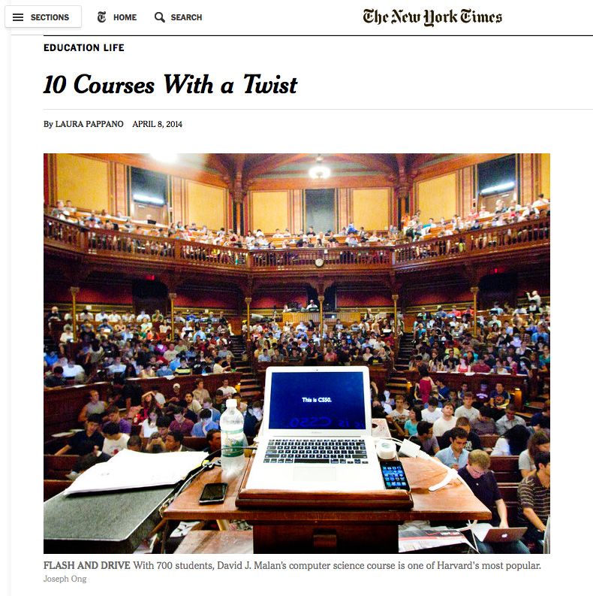
Introductory course enrollments are exploding
Harvard

Slide 12
Demand for the major is increasing
800
University of Massachusetts
600
number of CS majors
400
200
1980
2014

Slide 13
We’re all seen cycles in demand
800
University of Massachusetts
600
number of CS majors
400
200
1980
2014
… and an often heard admin response: “CS enrollments are always cyclic”

Slide 14

But this time, it truly feels different
Students are figuring out that every 21st century citizen needs to have facility with “computational thinking” – problem analysis and decomposition (stepwise refinement), abstraction, algorithmic thinking, algorithmic expression, stepwise fault isolation (debugging), modeling – driving introductory course demand
  Programming is the hands-on, inquiry-based way that we teach computational thinking and the principles of computer science

Slide 15

Students are figuring out that computer science is not Dilbert – it’s an intellectually exciting, highly creative and interactive, “power to change the world” field

Slide 16
Students are figuring out that a lot of the STEM jobs are in computer science
Data from the spreadsheet linked at http://www.bls.gov/emp/ep_table_102.htm

Slide 17
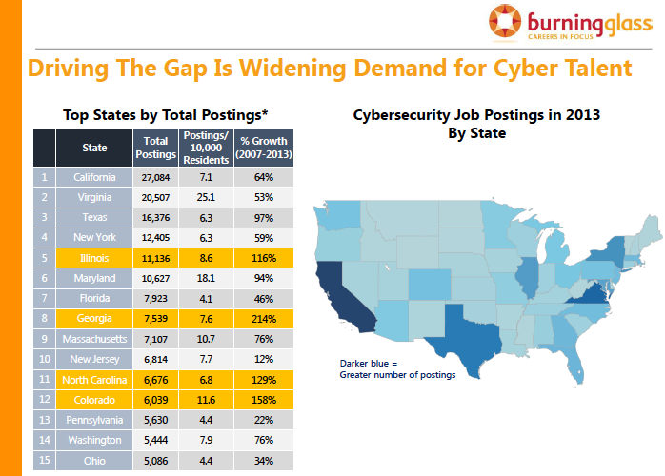

Slide 18
So what? … Steps forward?
from anecdotes to empirical data: how is it different this time around?
  which institutions?
  majors versus minors versus interested non-majors?
  what is motivating students?
  what are students doing with a CS degree?
ACM, CRA, NSF roles?
“coping” with exploding enrollments

Slide 19
Coping with increasing enrollments
Task Force on Scaling the School (TFOSS):
understand administrative staff challenges
additional instructors (we 3have full time instructors)
support for graduate students developing re-usable course projects, homework
undergraduate “TA” positions
blue ribbon AFR-related group to lead faculty discussion about reward structure
support recorded lectures, on-line classes

Slide 20
Overview
The evolving undergrad curriculum at UMass
  BS, + IT minor, revised BS, + BA, + Informatics
Booming enrollments nationwide!
  anecdotal data
  meeting the challenges
You ain’t seen nothing yet: the coming boom

Slide 21
The pipleline: lots of progress, activity
NSF CISE/EHR K-12 programs
  CS10K: 10,000 teachers by 2017
  new CS AP courses, backed with teaching materials
intense industry interest: Google, Microsoft, ….
state interest: moves to have CS count towards state math/science requirements
    NYC: 120 teachers teaching CS principles (100 hours training each)
  code.org:
  Hour of Code: 70M have tried it! (including Obama, Biden)
  goal: work with 25K teachers

Slide 22

The pipleline: lots of progress, activity

Slide 23
One question!
What will we (universities) do when growing K-12 pipeline feeds into our institutions?
  numbers of students?
  breadth of computational interests?
Are we prepared to meet their needs?

Slide 24
Summary
The evolving undergrad curriculum at UMass
  BS, + IT minor, revised BS, + BA, + Informatics
Booming enrollments nationwide!
  anecdotal data
  meeting the challenges
You ain’t seen nothing yet: the coming boom

