Slide 1

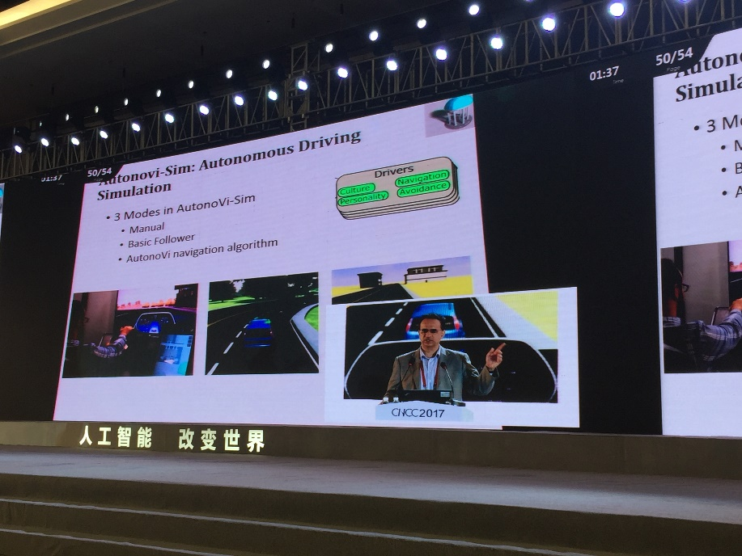
A Discussion of
Computer Science Research Directions
Bobby Schnabel
CEO, ACM
CUNY Computer Science Faculty, Nov. 3, 2017

Slide 2
Outline
The Evolution of Computer Science Research, Part I
Transformation of Computing to a Socio-Technical Field
The Evolution of Computer Science Research, Part II
(Some) Emerging Areas of Computer Science Research
Two Broader, Related Topics to Think About
  How Computing Impacts Other Industries
  Technology and the Future of Work
Discussion - Throughout

Slide 3
The Evolution of Computer Science
Prog Lang
Op Sys
Theory

Slide 4
Graphics
Databases
Security
Prog Lang
Op Sys
Theory
Soft Eng
Sci Comp
HCI AI

Slide 5
BIO Health
Graphics
Databases
Prog Lang
Op Sys
Theory
Security
Enter
tain
ment
Media
Soft Eng
Sci Comp
HCI AI
Transportation

Slide 6
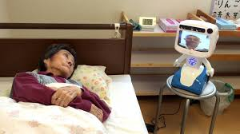
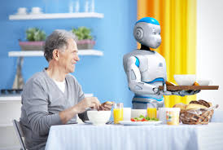
Transformation of computing from a technical field to a socio-technical field
A discipline which initially and for many decades was overwhelmingly technical is becoming increasingly integrated with human and societal issues
  Transition started decades ago with personal computers
  Accelerated by use of computing for basic human activities such as social networking, health/elder care, autonomous vehicles, …

Slide 7
Ethics
BIO Health
BIO Health
Graphics
Graphics
Sociology
Anthropology
Databases
Databases
Prog Lang
Op Sys
Theory
Security
Prog Lang
Op Sys
Theory
Security
Enter
tain
ment
Entertain-
ment
Media
Media
Soft Eng
Sci Comp
Local
Cultures
Soft Eng
Sci Comp
Psychology
HCI AI
HCI AI
Transportation
Transportation
Law

Slide 8
Ethics
Data Science
BIO Health
BIO Health
Graphics
Graphics
Statistics
Sociology
Anthropology
Databases
Databases
Prog Lang
Op Sys
Theory
Security
Prog Lang
Op Sys
Theory
Security
Enter
tain
ment
Entertain-
ment
Media
Media
Soft Eng
Sci Comp
Local
Cultures
Soft Eng
Sci Comp
Psychology
HCI AI
HCI AI
Transportation
Transportation
Law

Slide 9
Some “Emerging” Areas of Computer Science Research
Quantum computing & communication
New “conventional” architectures
Augmented & virtual reality
Deep neural nets, including theory
Robotics – fine grain manipulation
Intelligent ML (without training sets)
Human identification and motion recognition
“Big Optimization” – optimizing AI / ML models
High performance computing – data / simulation
Intelligent cybersecurity
Social Intelligence
Digital Preservation
Ethics and AI

Slide 10
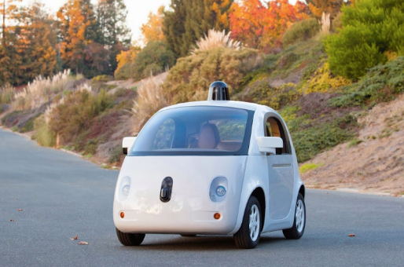
Disruptive Impacts of Computing Advances – Example: Autonomous, Accident Free Vehicles
Industries seriously impacted:
Driving Careers (taxi, truck, bus)
Auto repair
Auto insurance
Parking garages
Driver-training schools
Steel
Entertainment
Other interesting examples: smart homes, drones, healthcare, …

Slide 11
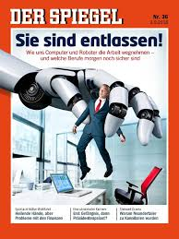
Technology and the Future of Work
Some endangered jobs (indicative range):
  Finance (analysis, insurance, accounting, cashier)
  Drivers (truck, taxi)
  Manufacturing
  Construction (bricklaying, roofing, …)
  Line cooks
  Paralegal
Global impact, varying estimates, high %
Will new jobs arise to replace, or will there be a need for universal basic income, or …?

