Slide 1
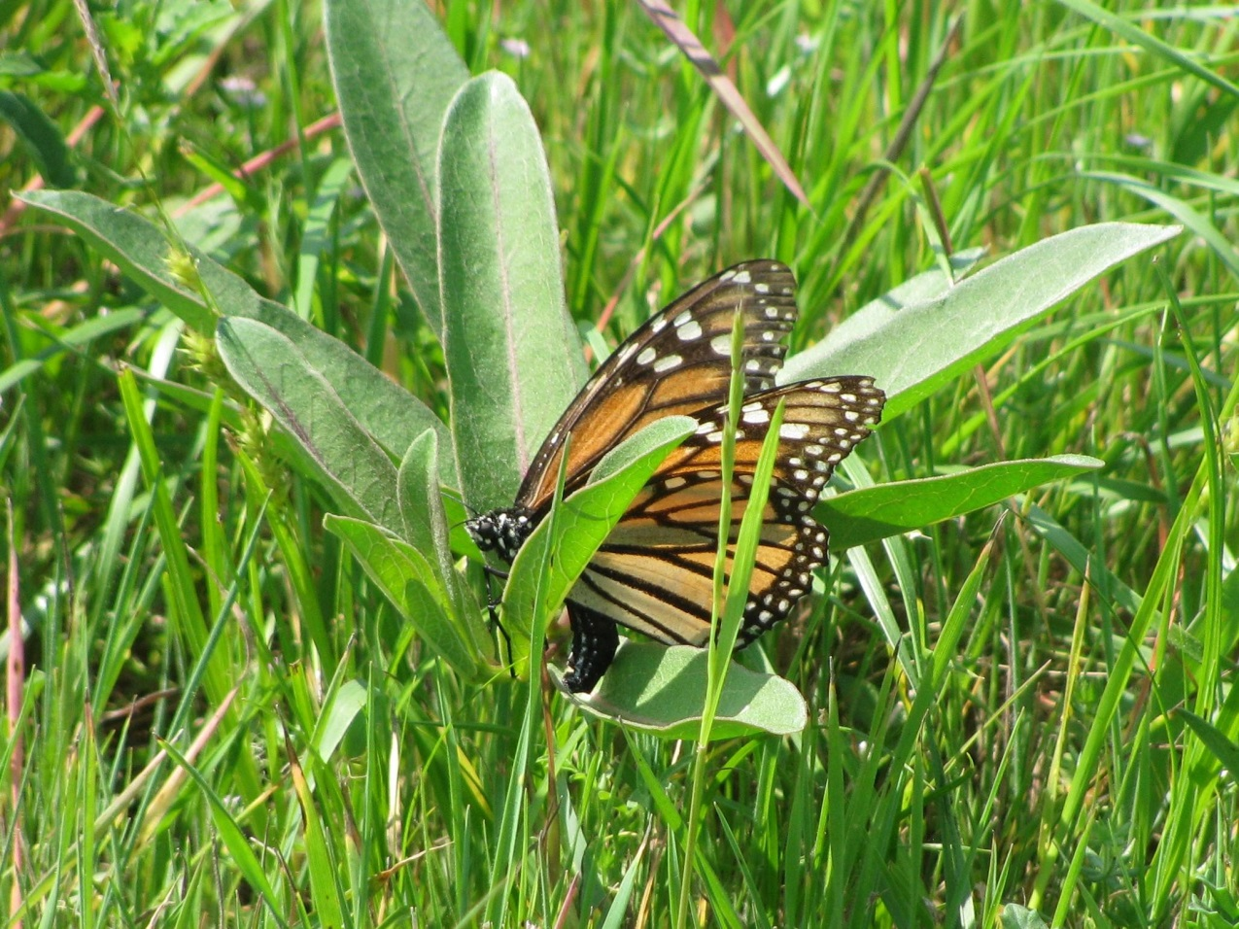
Metropolitan Monarch Alliance
Funded Through an EPA Environmental Education Grant www.qc.cuny.edu/mma
Monarch Butterflies and Milkweed:
If you Plant It They Will Come
Kathy Metzger Montgomery, Texas March 20, 2017.

Slide 2
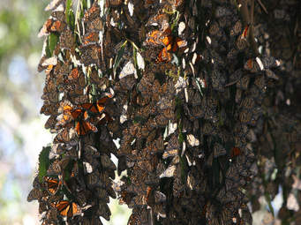
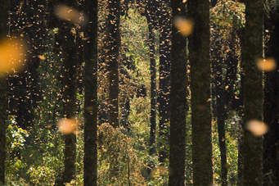
In the Winter the Monarch Butterflies are all in one place:
a small area high in the mountains of central Mexico.

Slide 3
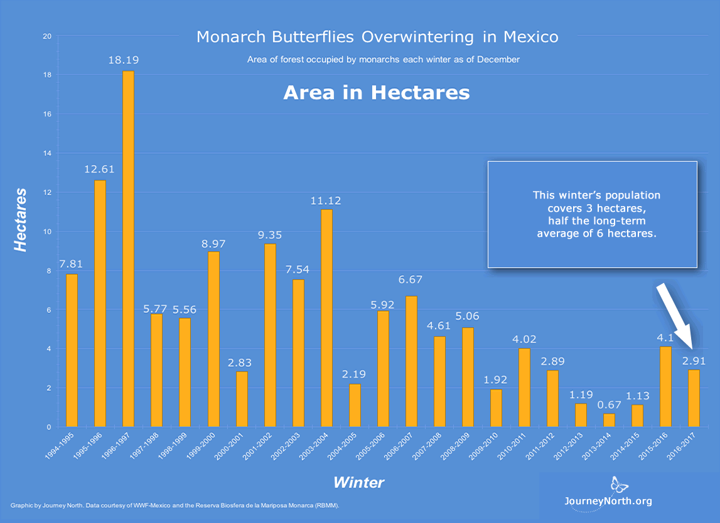
Monarch Butterflies are in trouble!

Slide 4
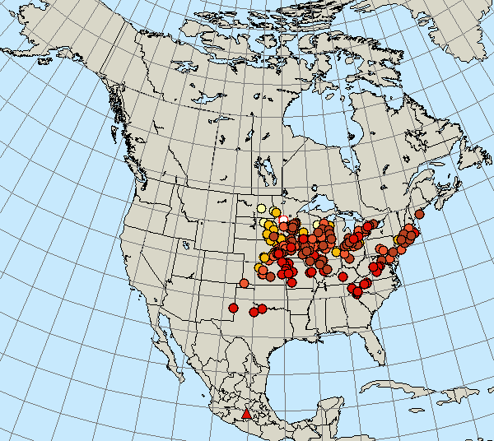
Two Major Migration Routes
This map, from the “Journey North” website, is based on reports from Citizen Scientists observing the Fall 2016 migration

Slide 5
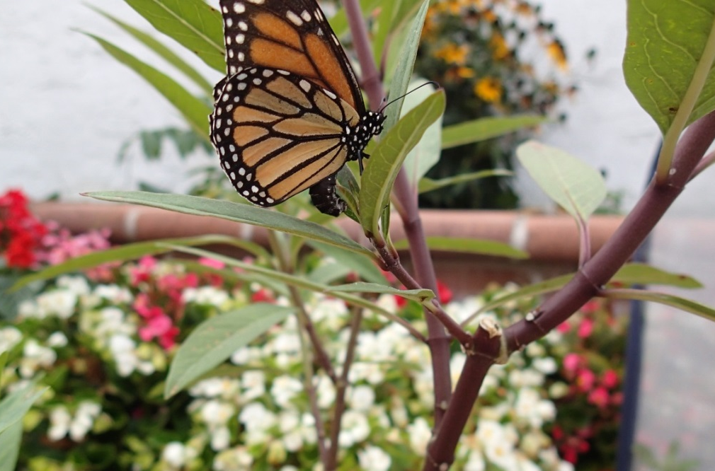
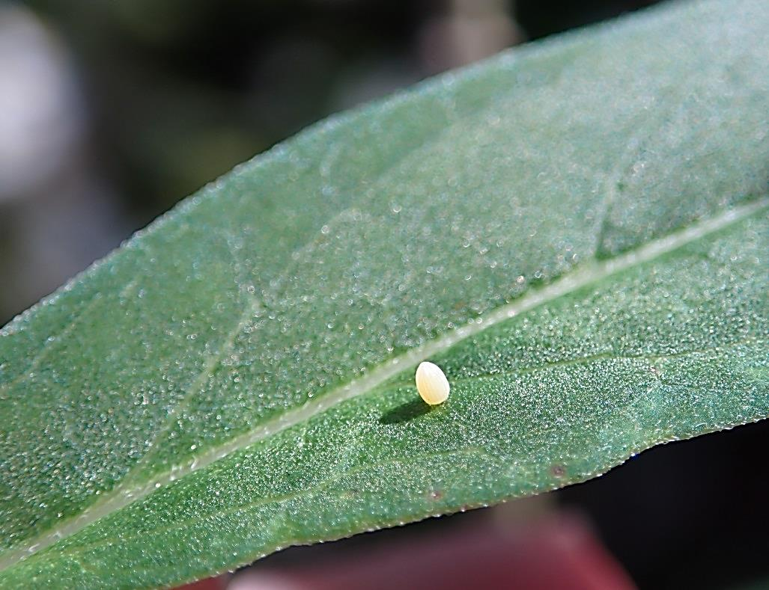
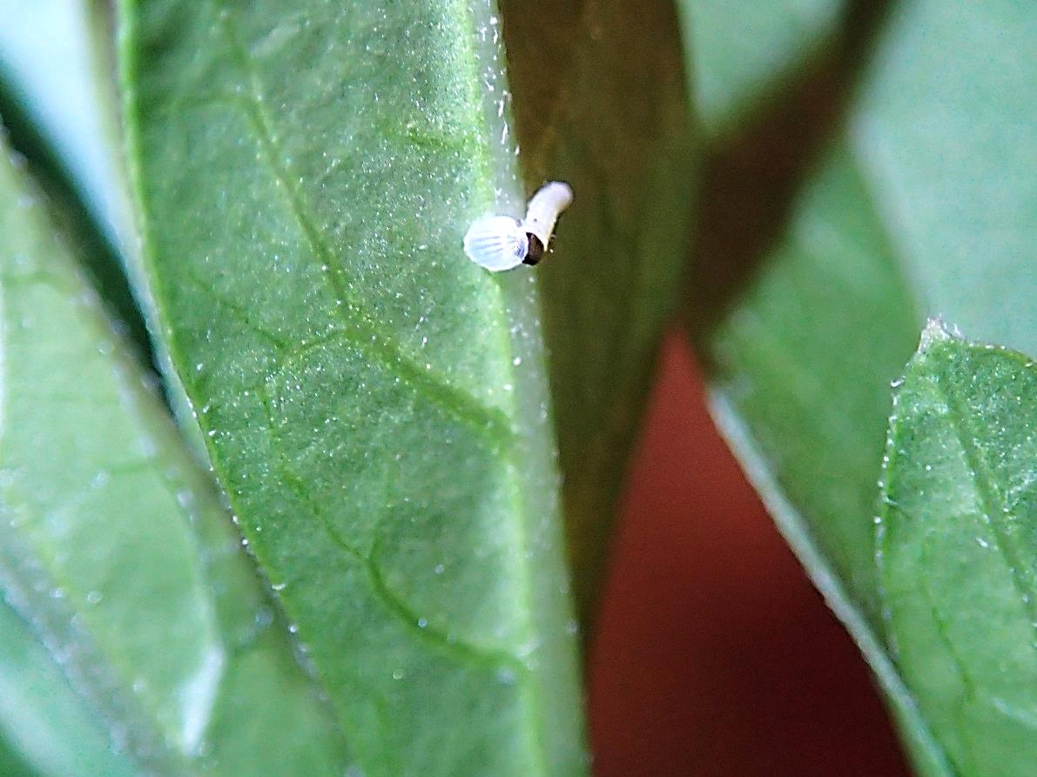
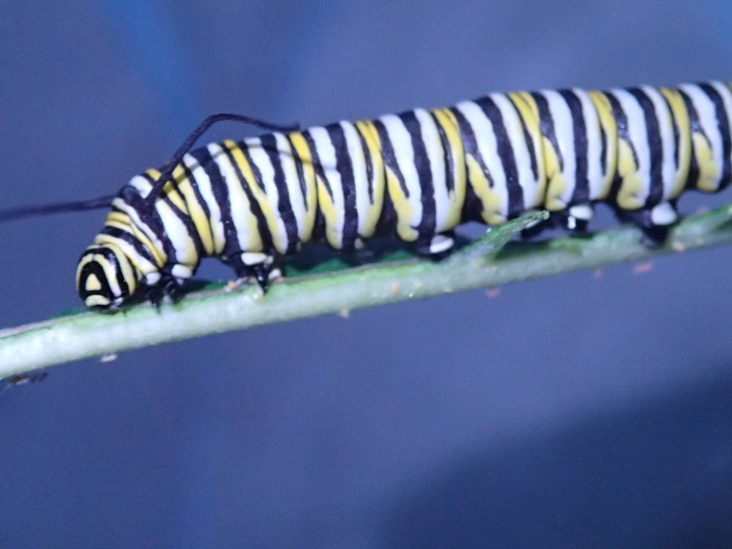
Life Cycle
Egg
Just hatched
Fat and Happy 4th Instar

Slide 6
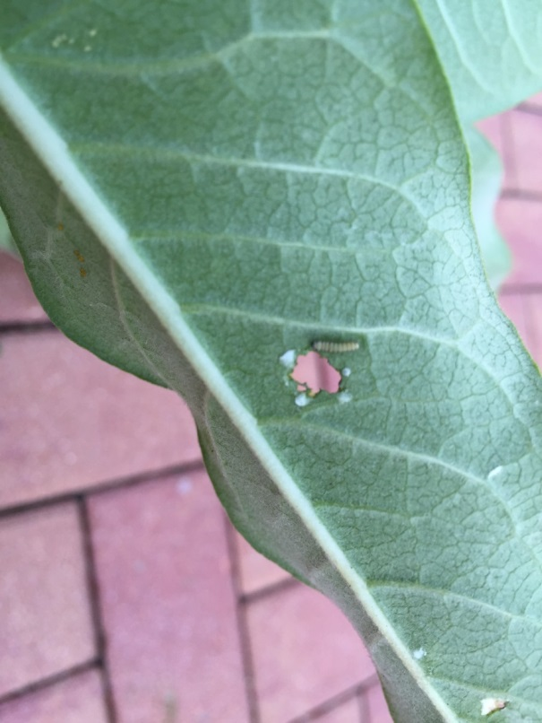
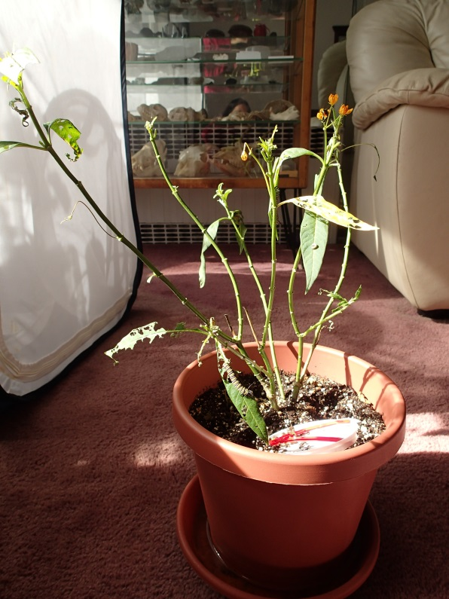
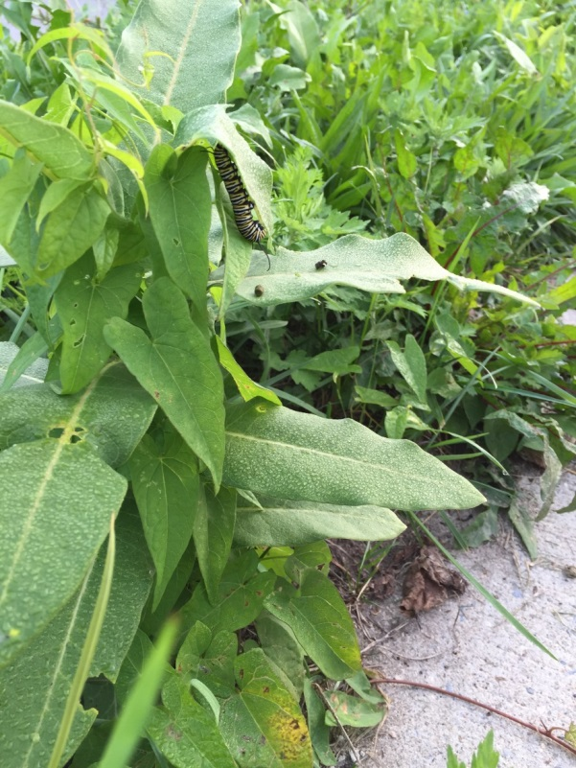
Lots of Eating and Growing

Slide 7
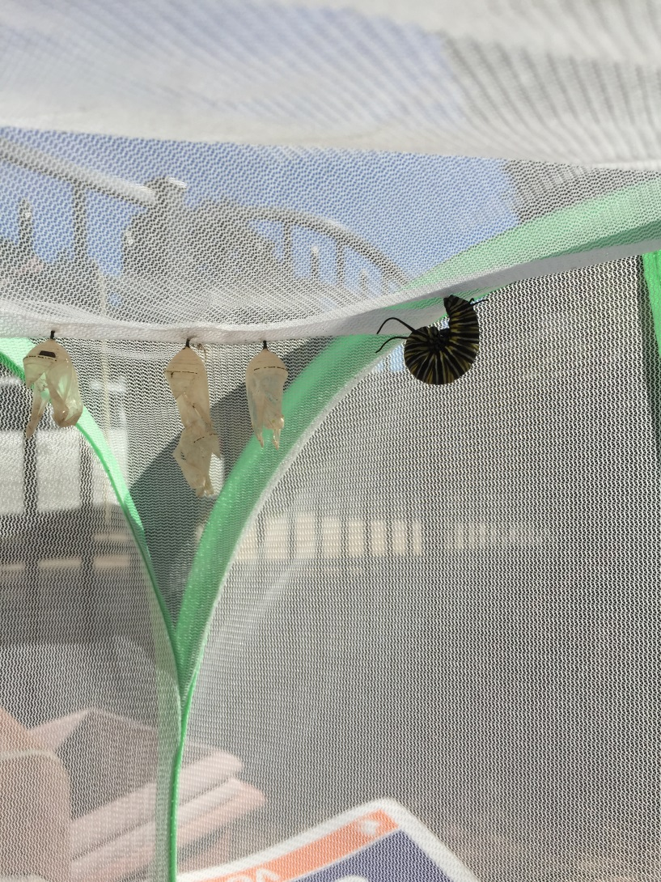
J Stage

Slide 8
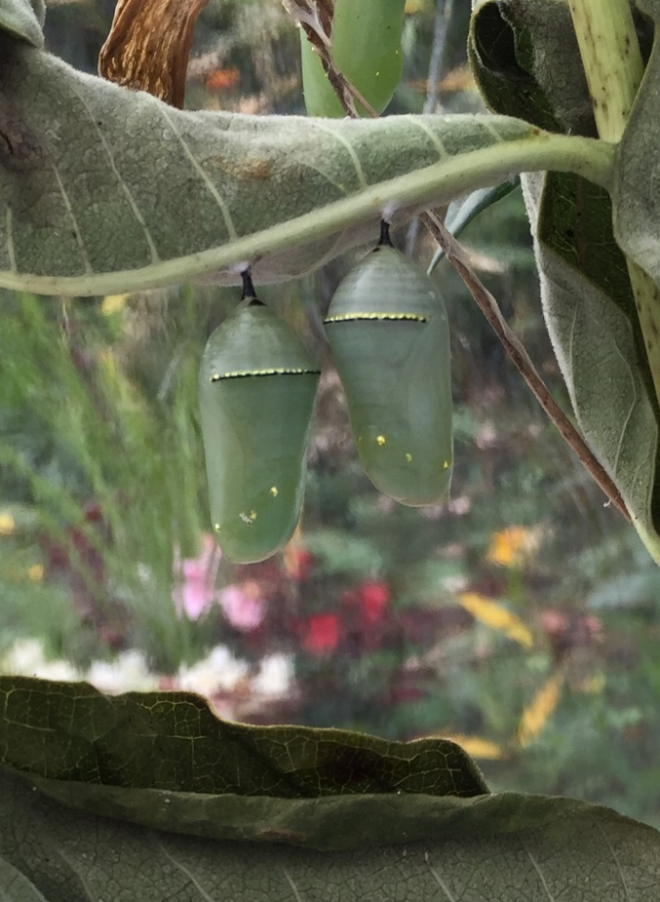
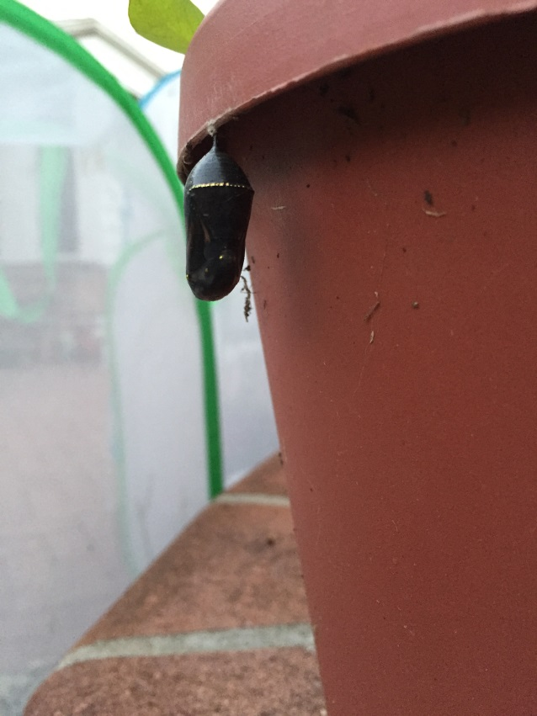
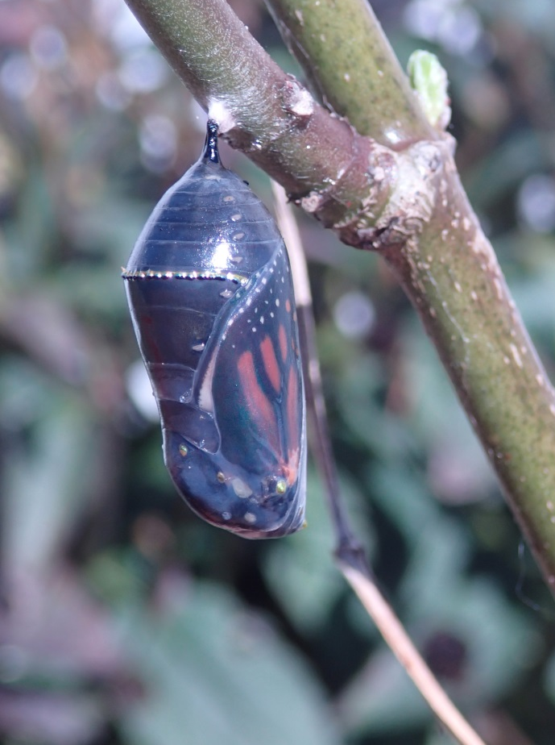
Pupa Chrysalis

Slide 9
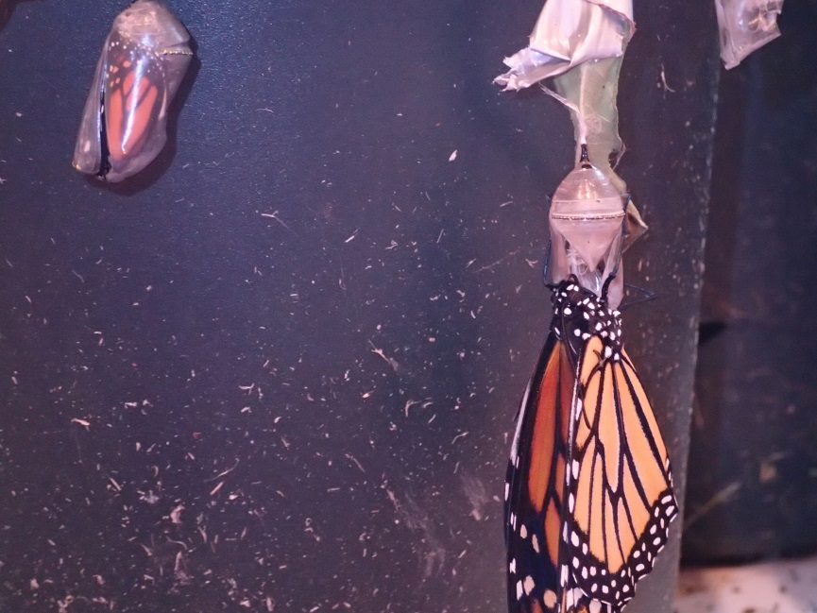
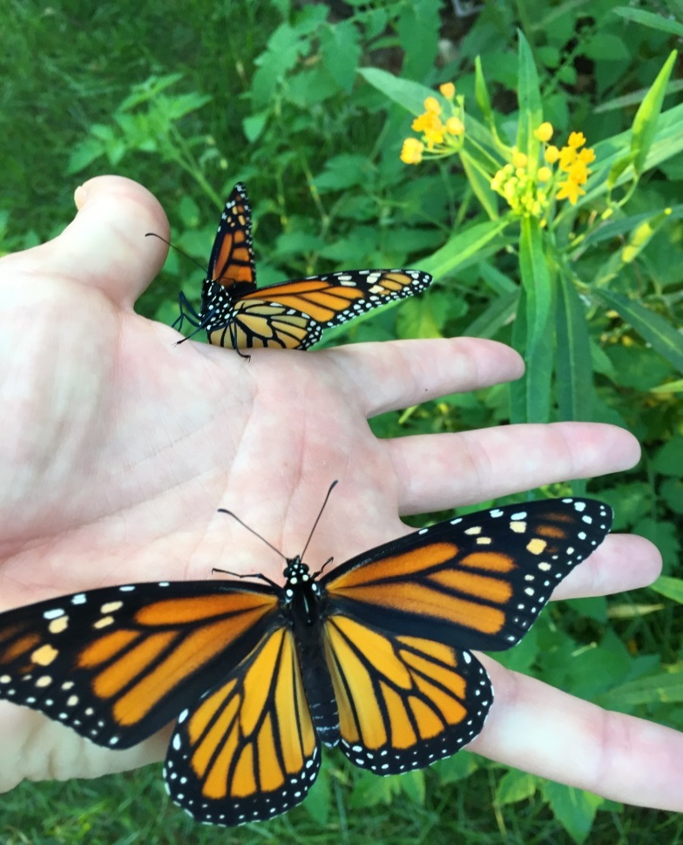
Adult
All that in thirty days. Wow!

Slide 10
Threats to Monarch Biodiversity
Habitat Loss (Meadows, Roadsides, Gardens, Planters, Classroom)
Development, Agriculture, Lawns, Overwintering
Habitat Fragmentation
Lawns/Landscaping
Overwintering Grounds
Invasive Species (Plants & Diseases)
Pollution
Pesticides
Climate Change
Change in growing season, temperatures, rainfall & frosts, milkweed composition
Phenology: Science of Seasonal changes and their affect on the natural world
Population
Carbon Footprint
Overharvesting
Showy milkweeds, logging

Slide 11
Measures to Protect Monarchs Butterflies
& Their Habitat
Habitat Loss (Meadows, Roadsides, Gardens, Planters, Classrooms)
Creating monarch oases: Gardens, Planters, Meadow Plantings
Restoring habitat in the midwest
Raise Monarchs in the Classroom for Release
Alter mowing regimes
Restore fragmented/degraded habitats with plantings
Invasive Species (Plants & Diseases)
Use local plants. Manage habitats for invasives
Pollution
Reduce use of Pesticides
Use best practices for raising monarchs indoors
Climate Change
Raise awareness & educate
Reduce carbon footprint
Lobby for the reduction of fossil fuels
Population
Carbon Footprint: Garden for food, compost, reduce use of materials
Overharvesting
Protect habitats with milkweed
Advocate for the protection of critical habitats

Slide 12
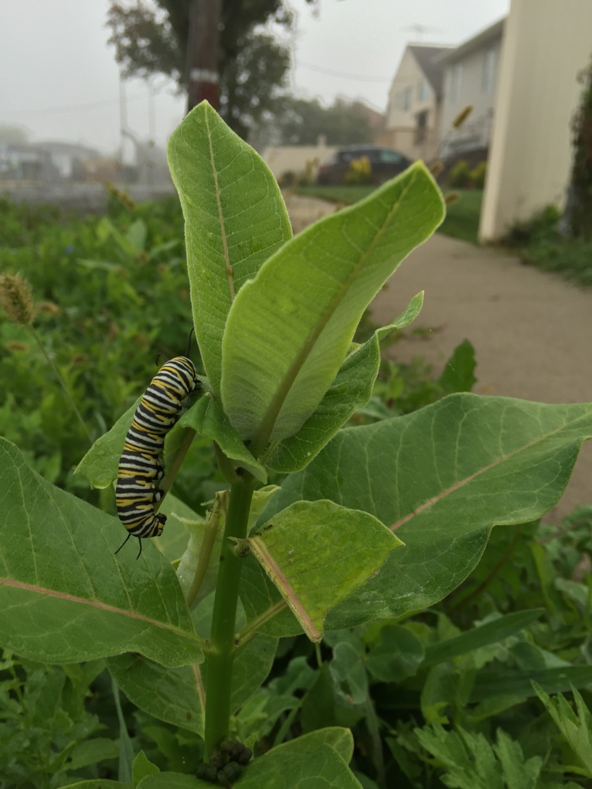
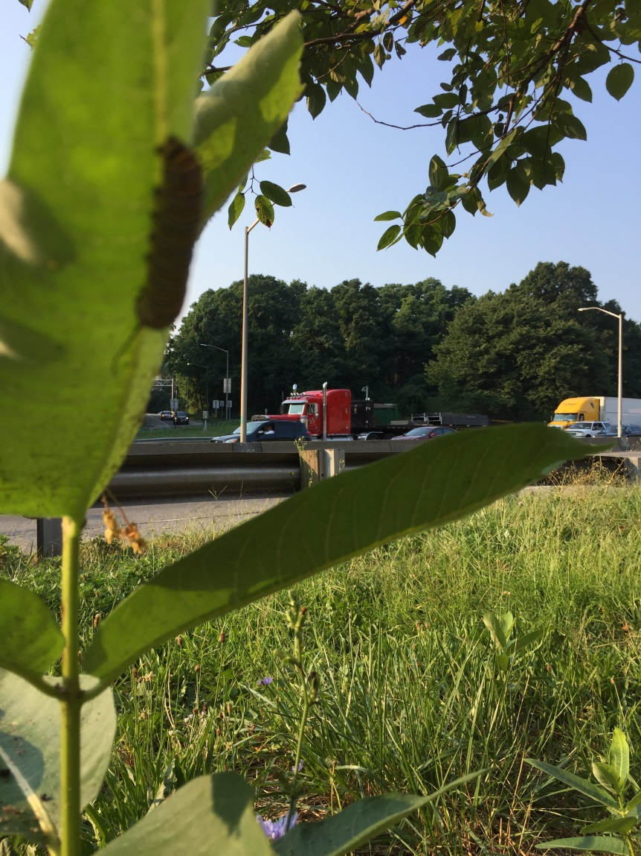
Milkweed:
If you plant it they will come.

Slide 13
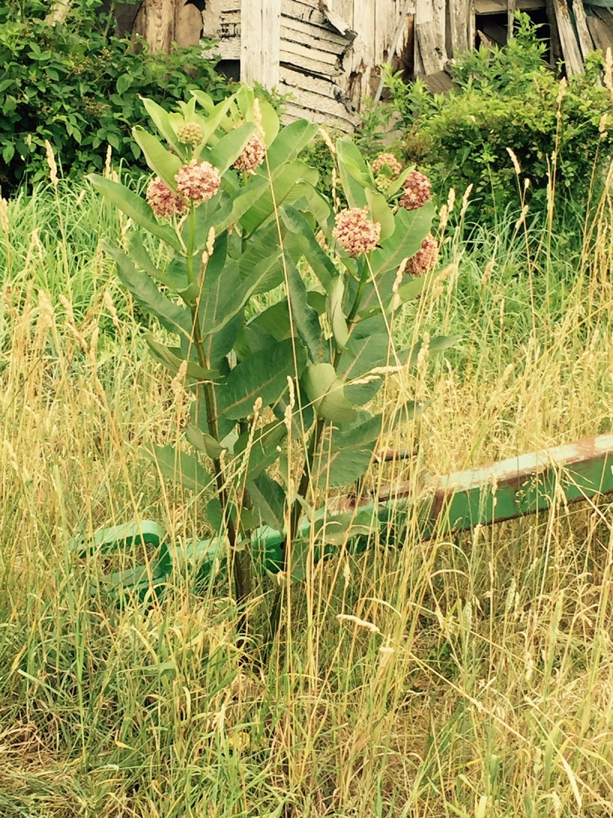
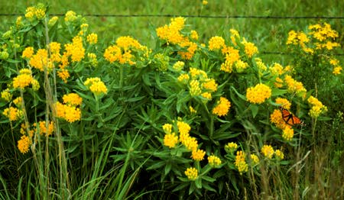
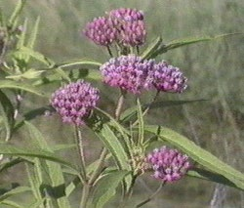
Milkweed doesn’t look like a weed.
Common Milkweed (a. syriaca), above, Butterfly Weed (a. tuberosa), Swamp Milkweed (a. incarnata)

Slide 14
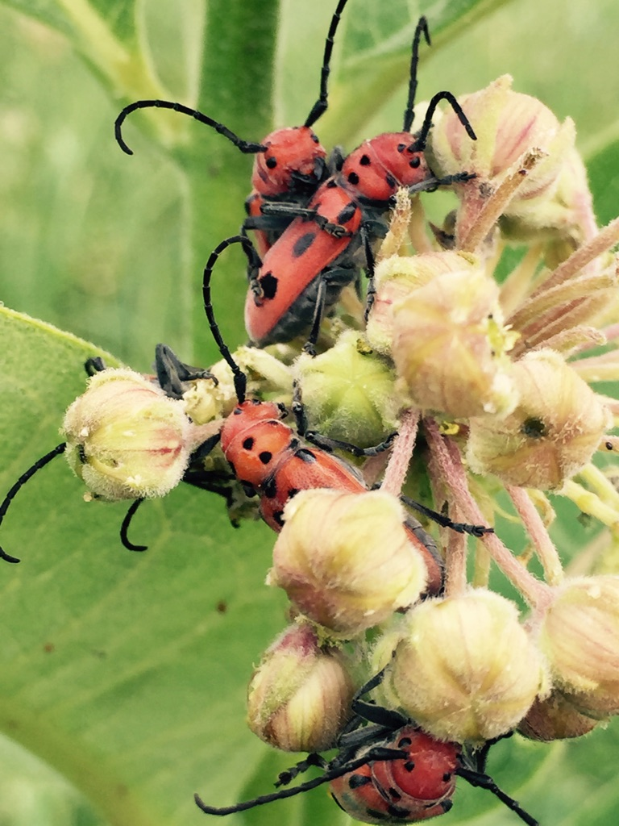
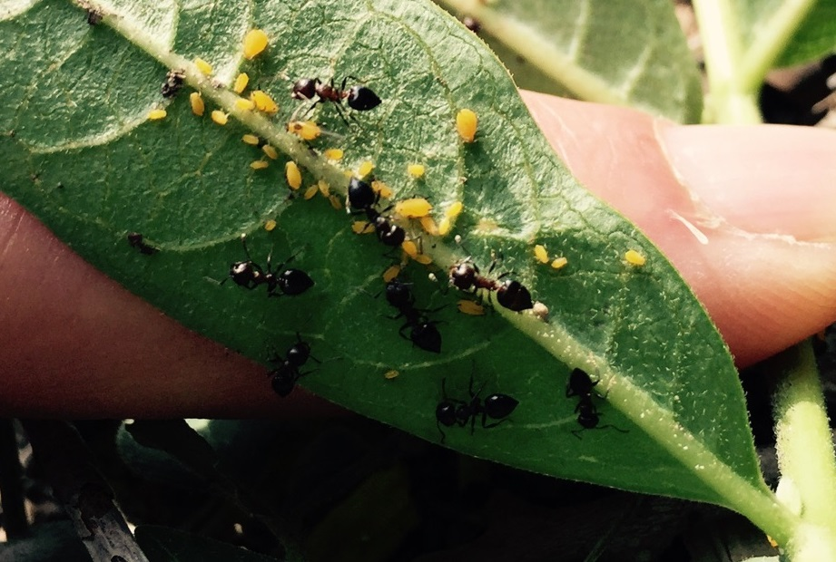
Milkweed: not just for Monarchs.
Here are some ants caring for a group of aphids.
The aphids exude a sweet liquid that the ants like to eat. The ants enjoy it so much that they take turns guarding the aphids and protect them from predators.
A gang of Milkweed Beetles

Slide 15
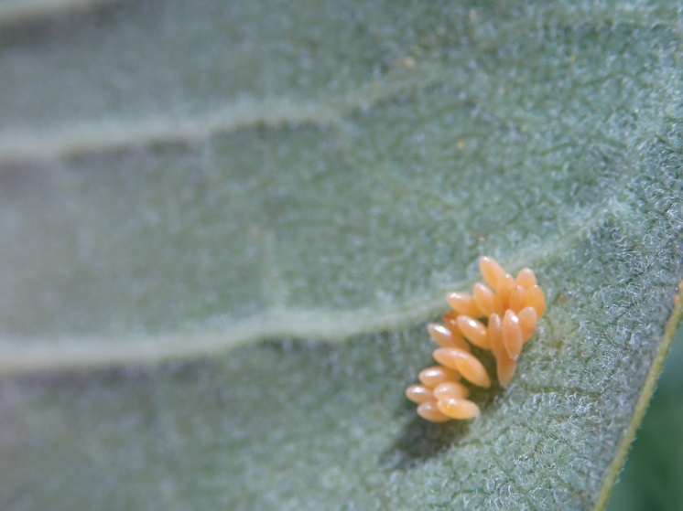
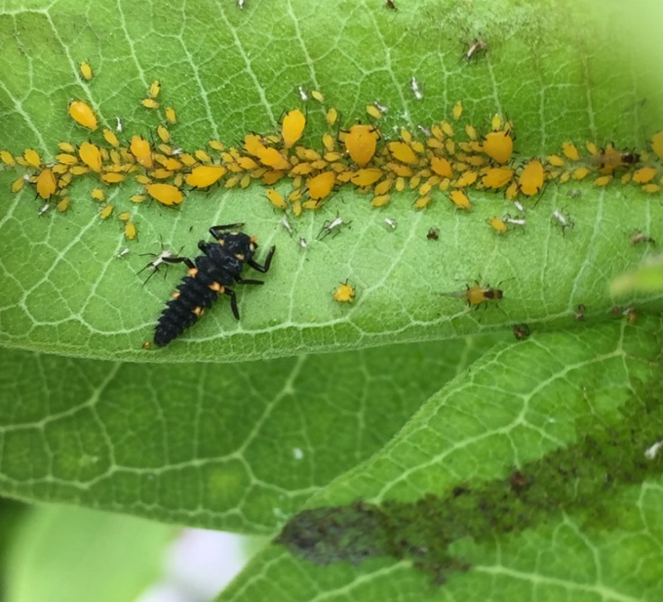
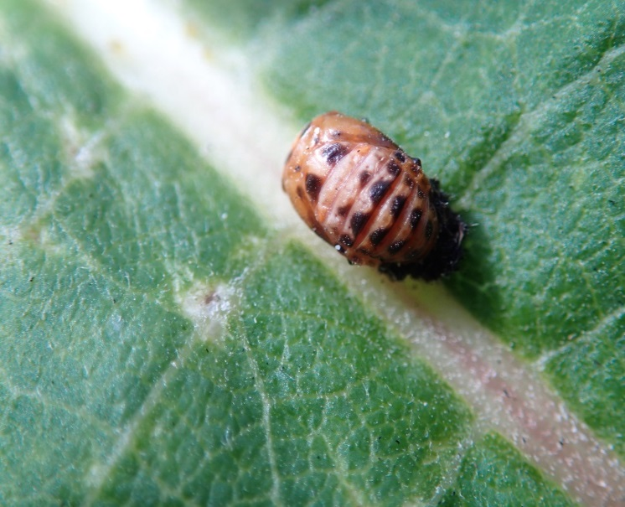
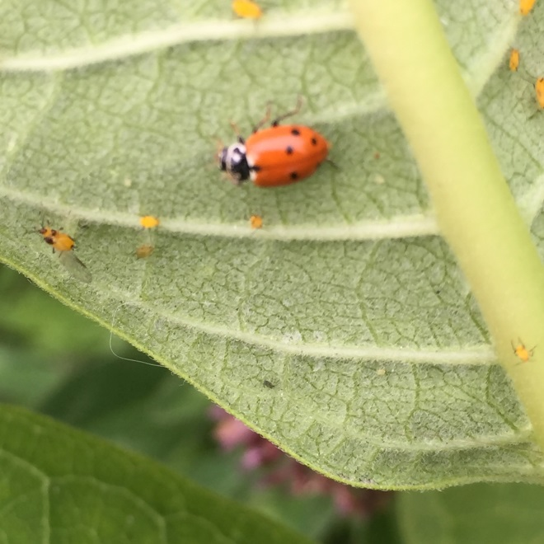
Where there are aphids there will be ladybugs.
Ladybug eggs
Ladybug larva
Ladybug Pupa
Adult Ladybug

Slide 16
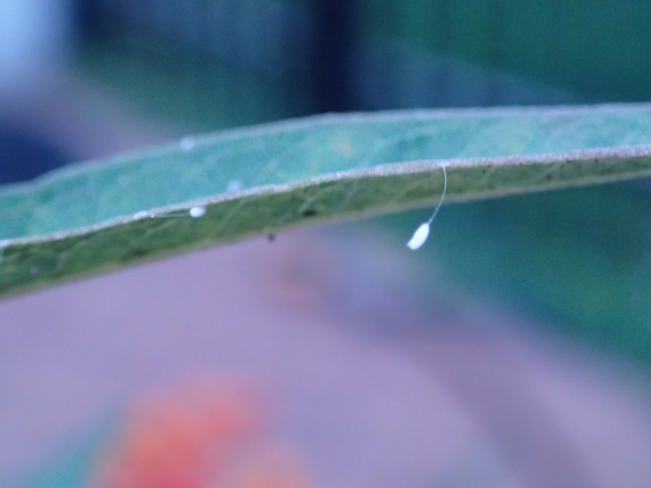
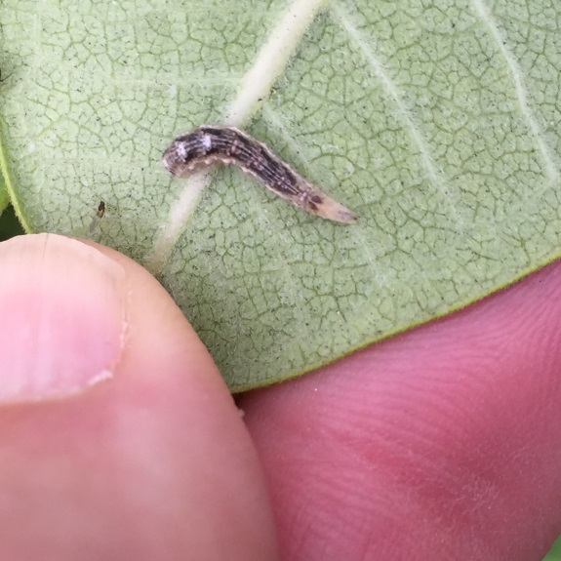
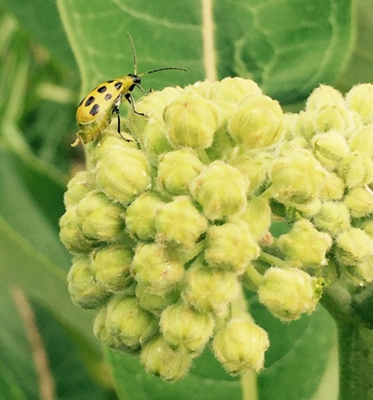
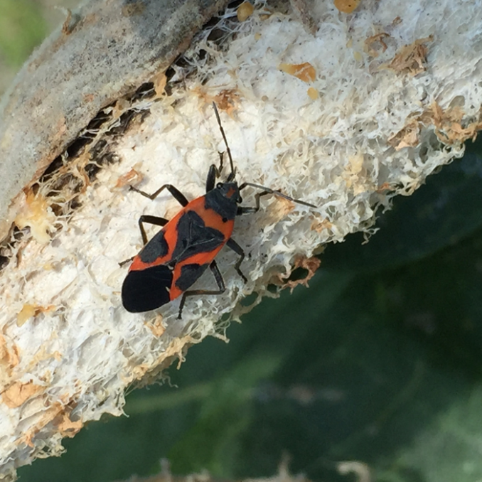
Other Neighbors
Egg of a Lace Wing
Lace Wing Larva
Potato Beetle
Milkweed Bug

Slide 17
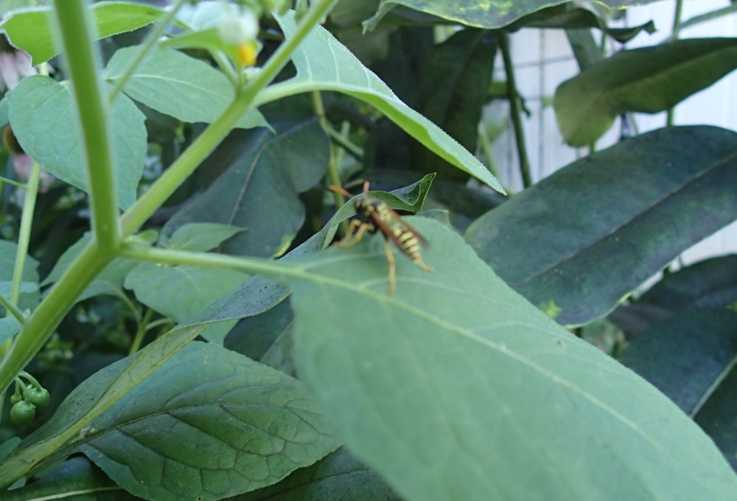
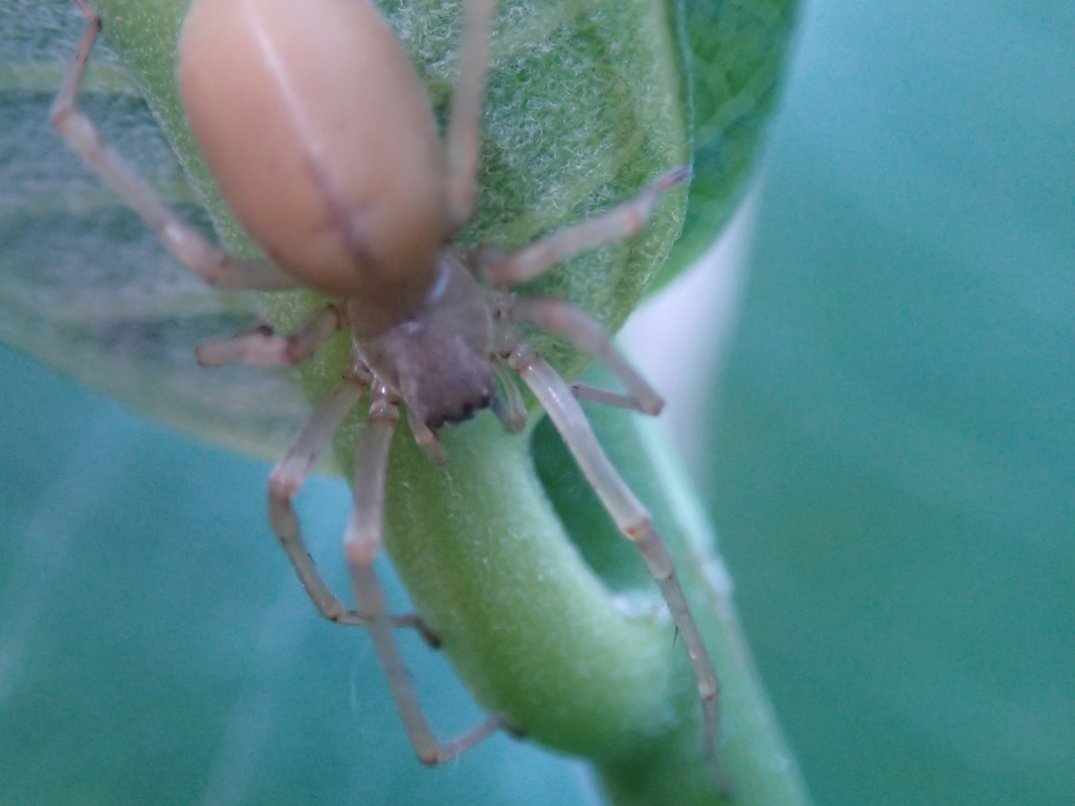
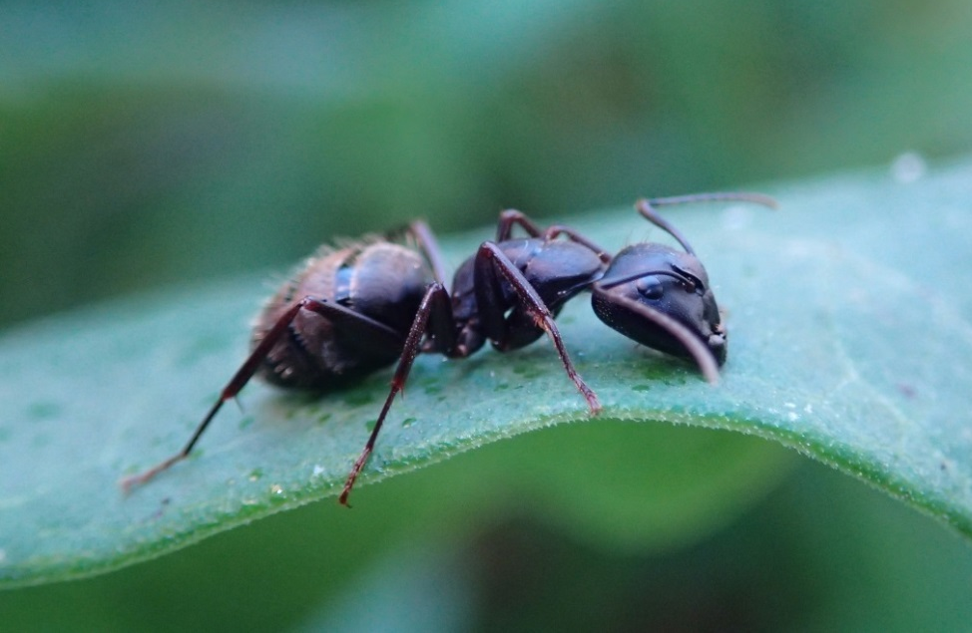
Predators

Slide 18
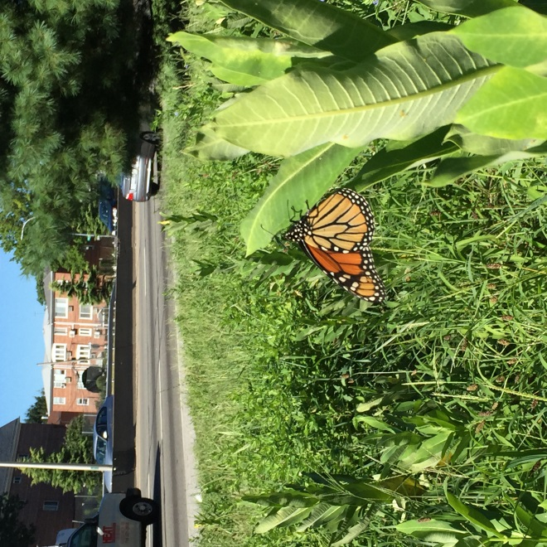
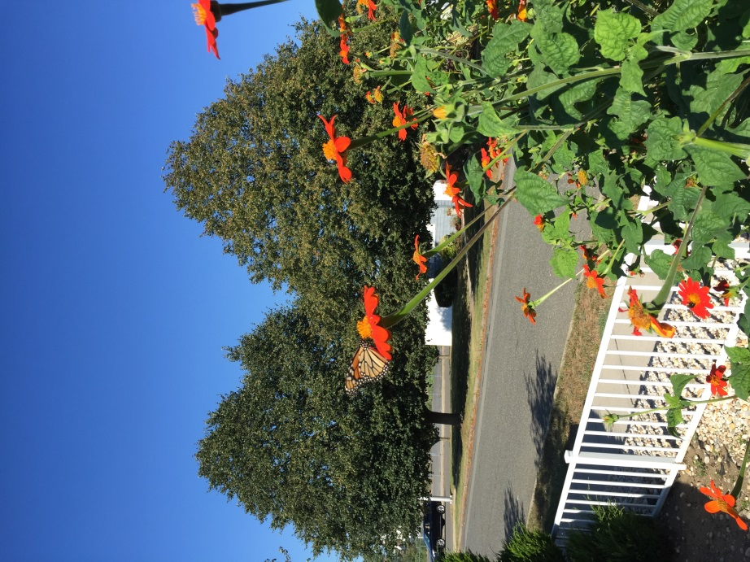
Attracting Butterflies
Monarch Butterflies aren’t picky about where they find Milkweed. This one is laying an egg on a Milkweed plant along the Long Island Expressway in Queens.
Planting big, colorful flowers in the front yard also works. These orange beauties are called Blanket Flowers . They will have showy, nectar filled flowers throughout the summer.

Slide 19
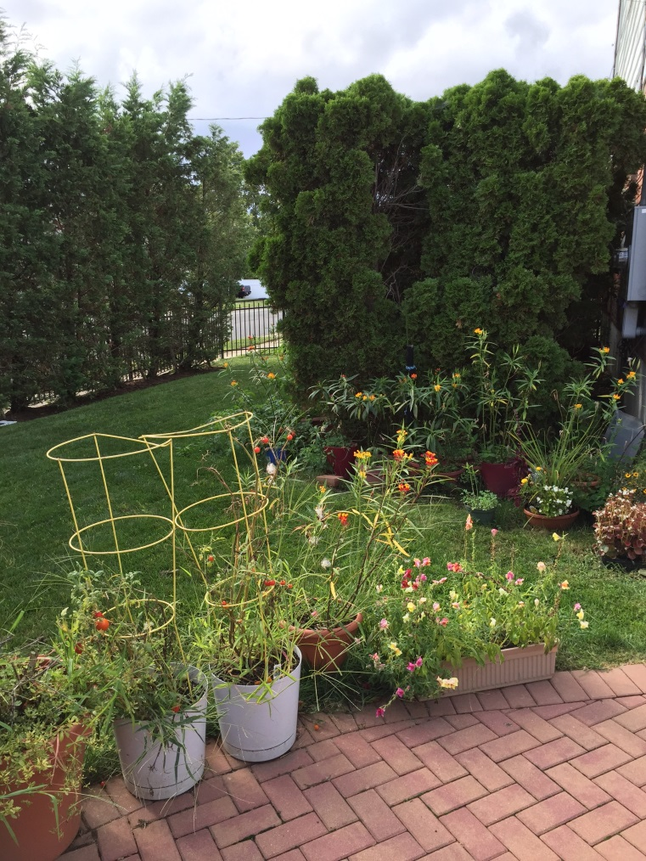
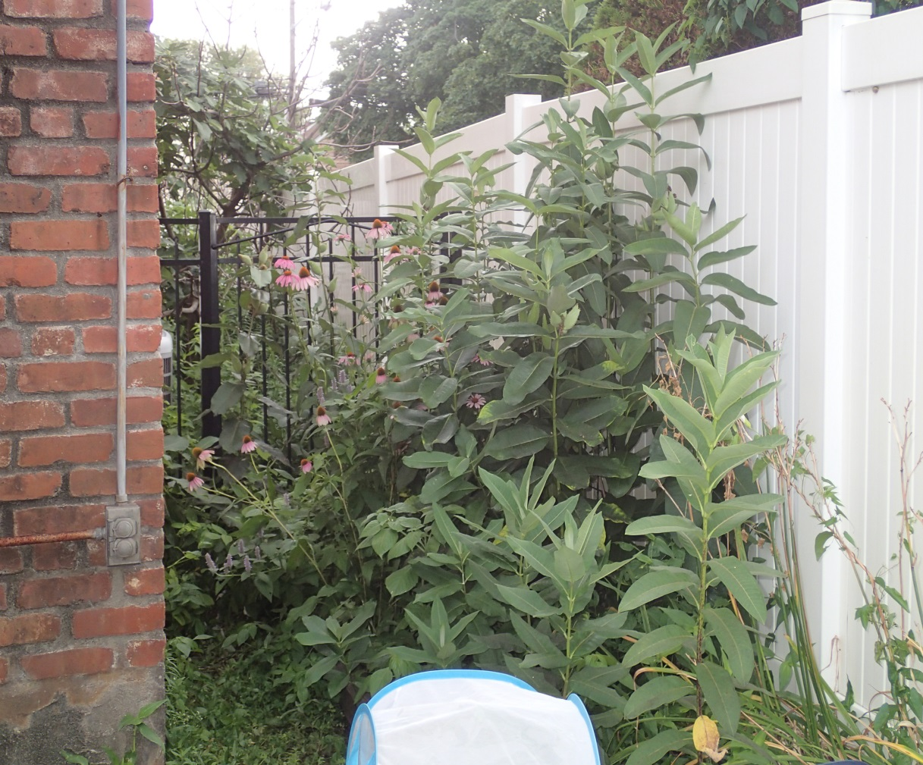
Attracting Butterflies
The colorful flowers here were planted in portable planters and pots, they were from a seed packet of mixed native wildflowers.
The plants in the foreground are Common Milkweed, the flowers in the background are Cone Flowers. Even though these are planted between a house and a tall fence butterflies have had no trouble finding them.
Notes:
Attracting butterflies is very straight forward. Just provid3e the food they are looking for. Adults will be looking for nectar, so colorful plants that are know n for producing nectar will work for all species. To attract Monarchs n particular you need to plant Milkweed.

Slide 20
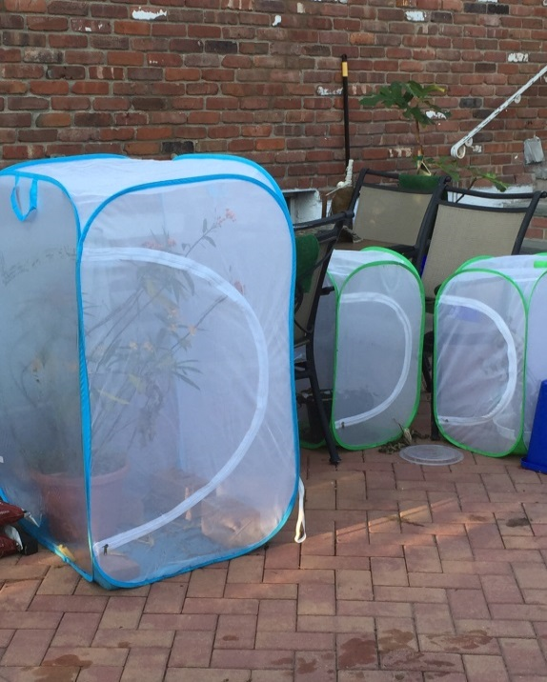
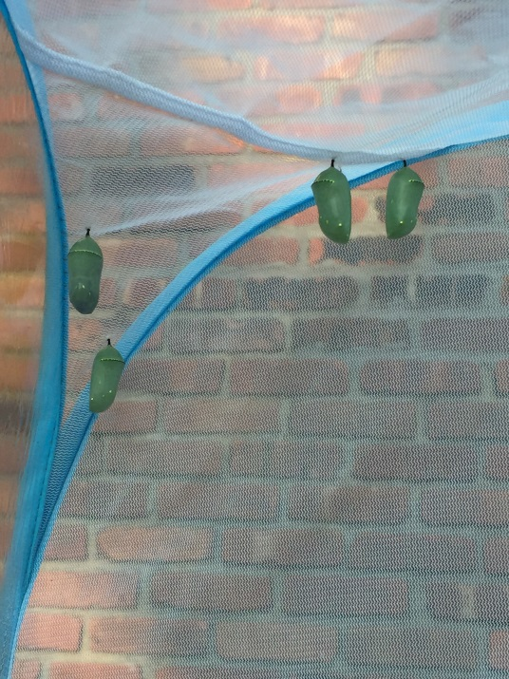
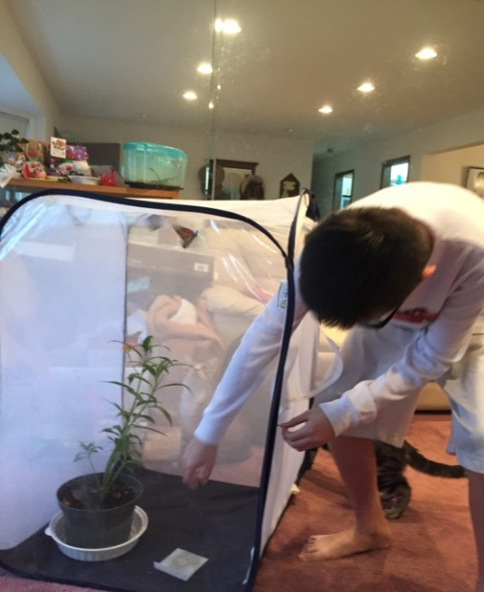
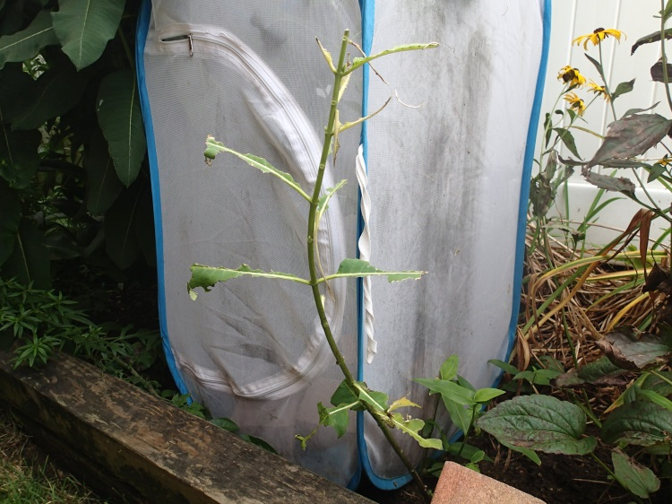
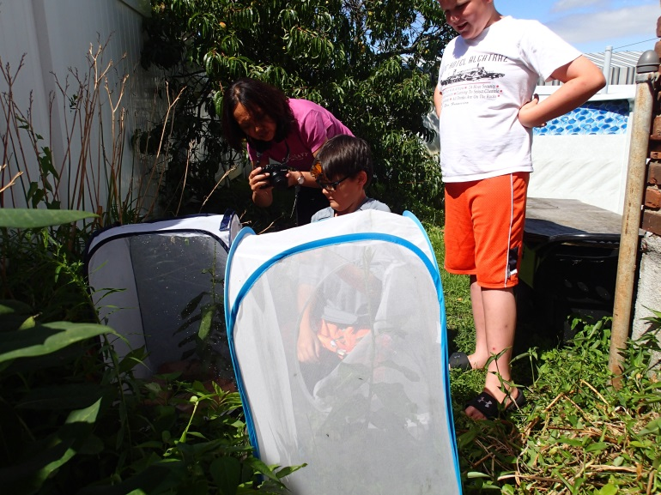
Protecting the caterpillars: enclosures
Indoors or out, you can put potted milkweed plants in them or cut a hole in the bottom and place them over a plant.

Slide 21
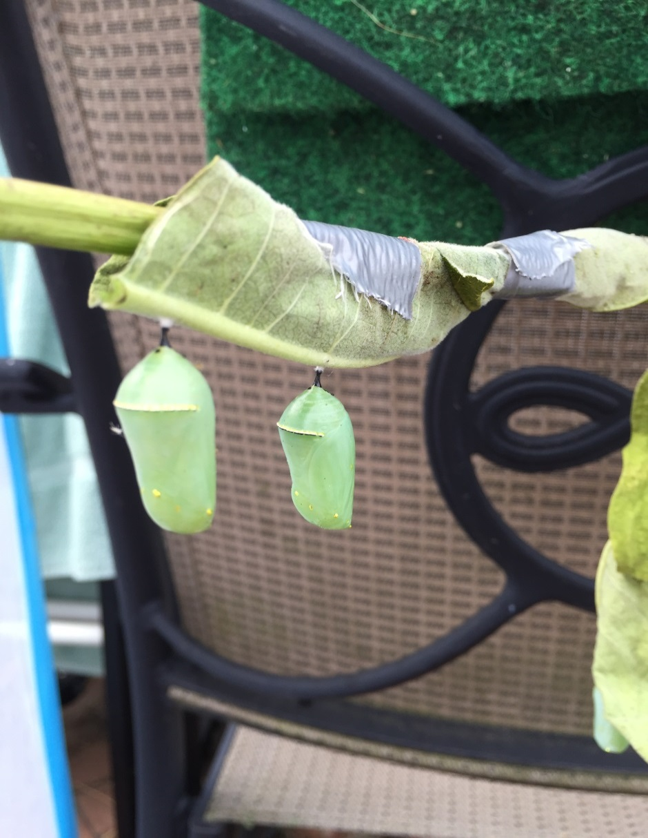
You don’t have to be fancy.
These were collected along side the LIE. I got them just ahead of the mowers. I don’t think they even noticed the duct tape when they emerged as adults.

Slide 22
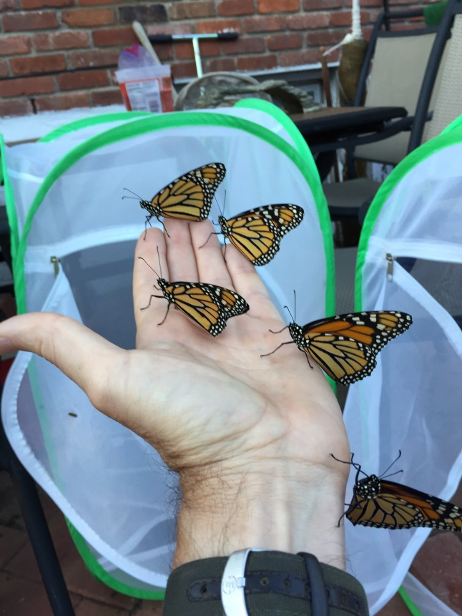
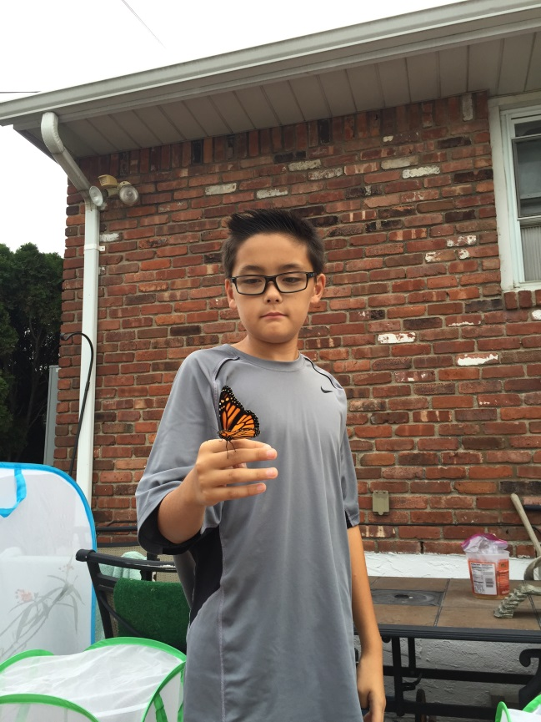
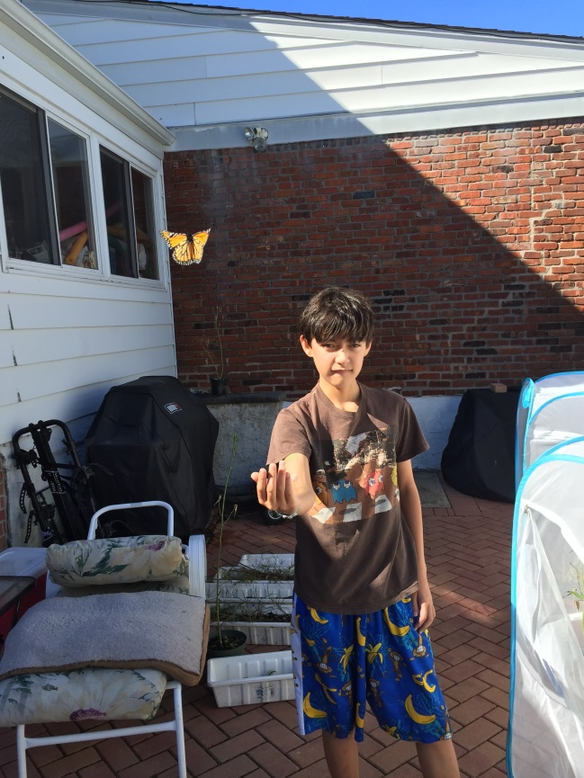
Success!

Slide 23
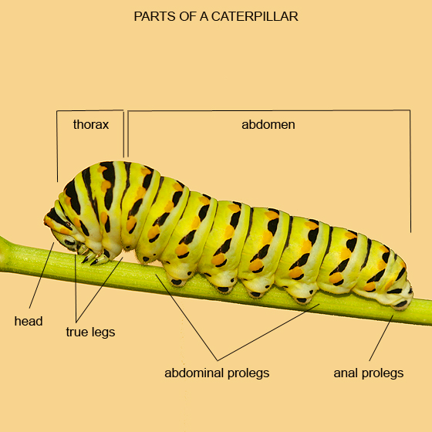

Slide 24


