Slide 1
Urban Farming
& Sustainability
Klaudia Dziekonska

Slide 2
Urban Agriculture
the growing, processing, and distribution of food and nonfood plant and tree crops and the raising of livestock, directly for the urban market, both within and on the fringe of an urban area (Lovell)
Community Gardening
Urban Farming
Hydroponics and Aquaculture (USDA)

Slide 3
Urban Farming
revitalize abandoned land, foster community well-being, and improve the urban landscape
U.S. Department of Agriculture : “science and art of promoting the successful growth and development of ornamental plants, turf, vegetables, and fruit in the urban environment”
Revives deserted areas, improves urban landscape, and benefits the community
Brings awareness about fresh foods

Slide 4
Agriculture vs Horticulture
Horticulture:
Organic agriculture- rotating crops, composting, recycling rain water
Survive through internal (pop. increase) and external (extreme weather) pressure
Long-term solution - sustainable
Agriculture:
Large-scale industrial agriculture
Resource-intensive - fossil fuels & other materials
Imbalance b/w inputs (water and land) and outputs (amount of food production)
Short-term solution- unsustainable

Slide 5
Farm Bill
Subsidizing poor farmers
Chemical agriculture, synthetic fertilizers, hormone-fed livestock
Few support systems for small-scale farmers
Organic Farming : application fee ($1,200) and yearly inspection + recertification fee ($900)
People rely on industrial agriculture - our food supply
Issues :
Transportation
Exposure to foodborne disease
Chemicals
Hormones

Slide 6
Land
The Food and Agriculture Organization of the United Nations (2011) :
Recommended to increase agriculture productivity, favor resilient food & agriculture systems, and support small-scale farming
Brownfields and vacant lots
Can be costly but better alternative than to search for suitable land
Non-profits have advantage over other sectors
Historical, cultural, and community presence - connections w/ businesses, foundations, etc.
Stakeholders - opportunity to buy land, access to buy land, and networking

Slide 7
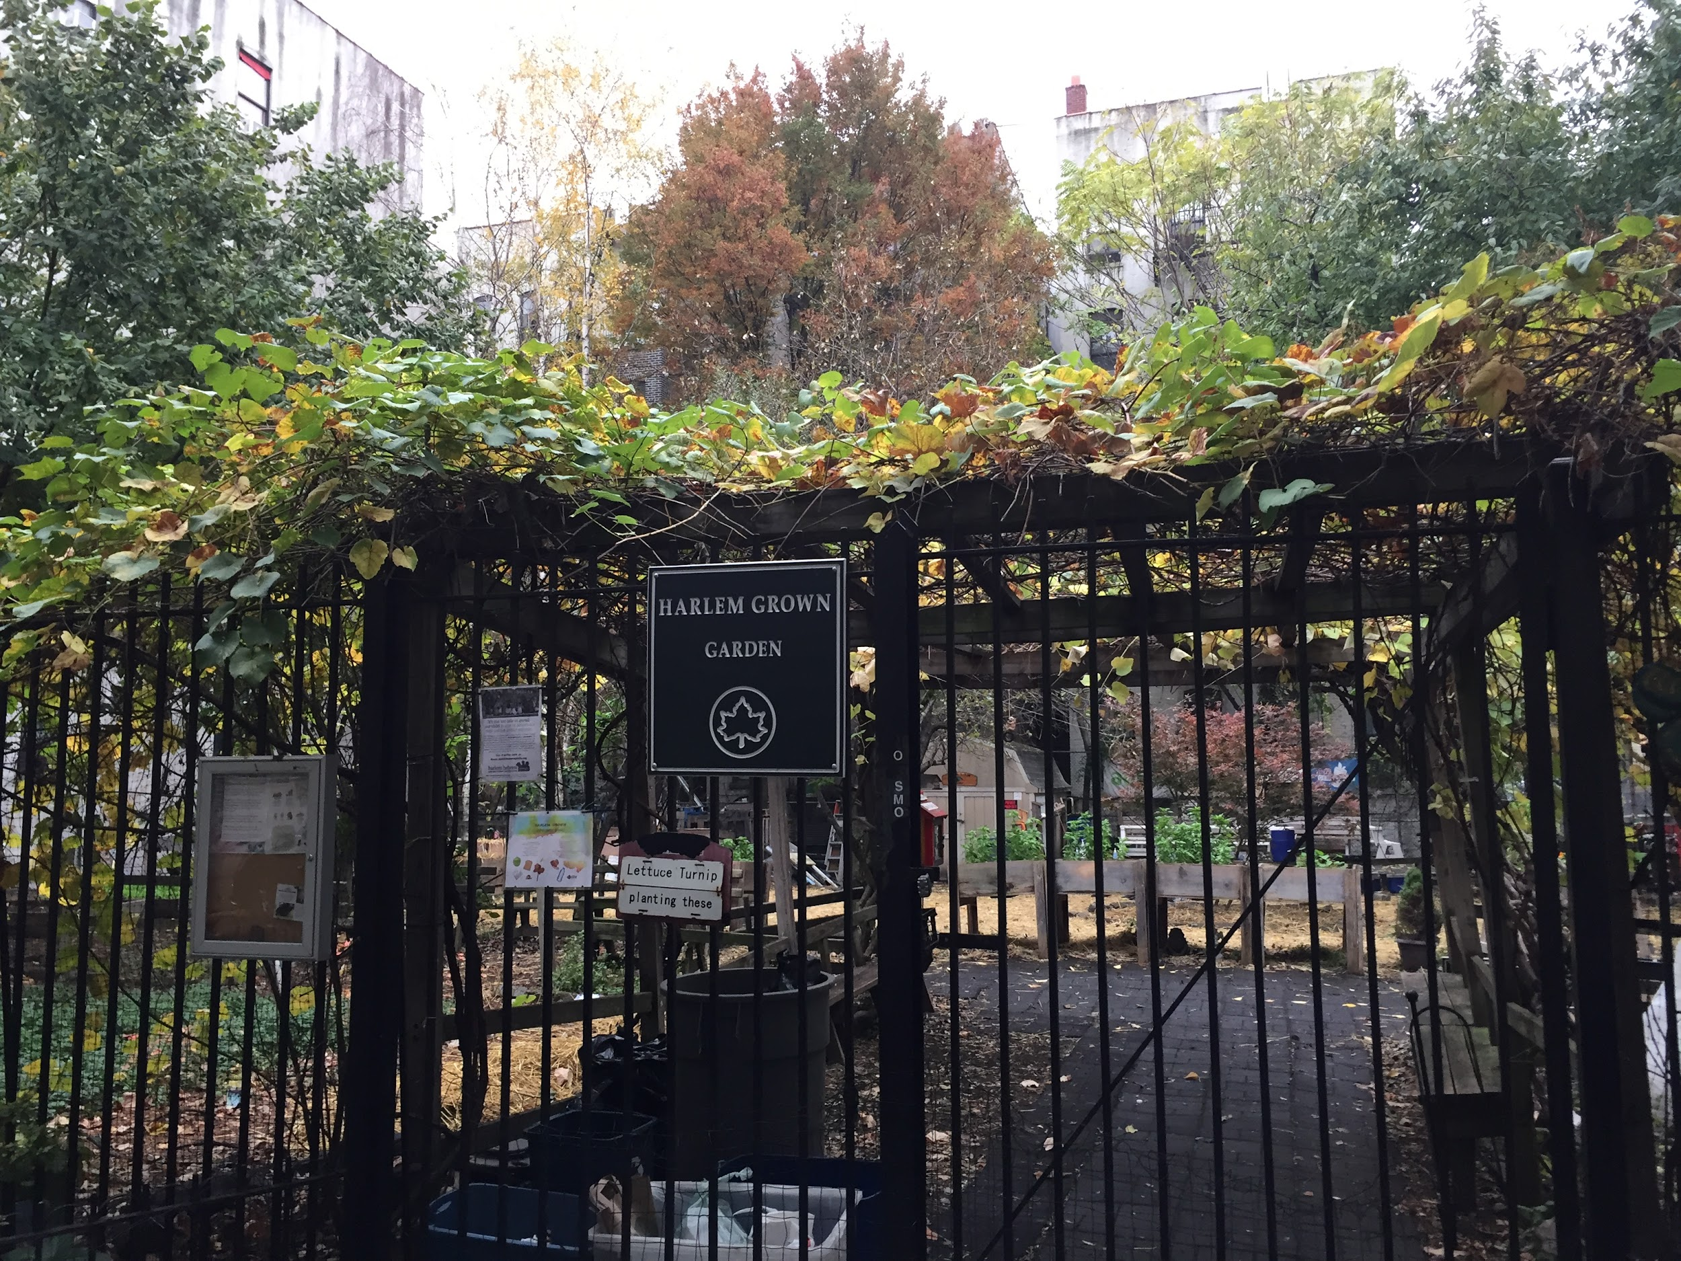
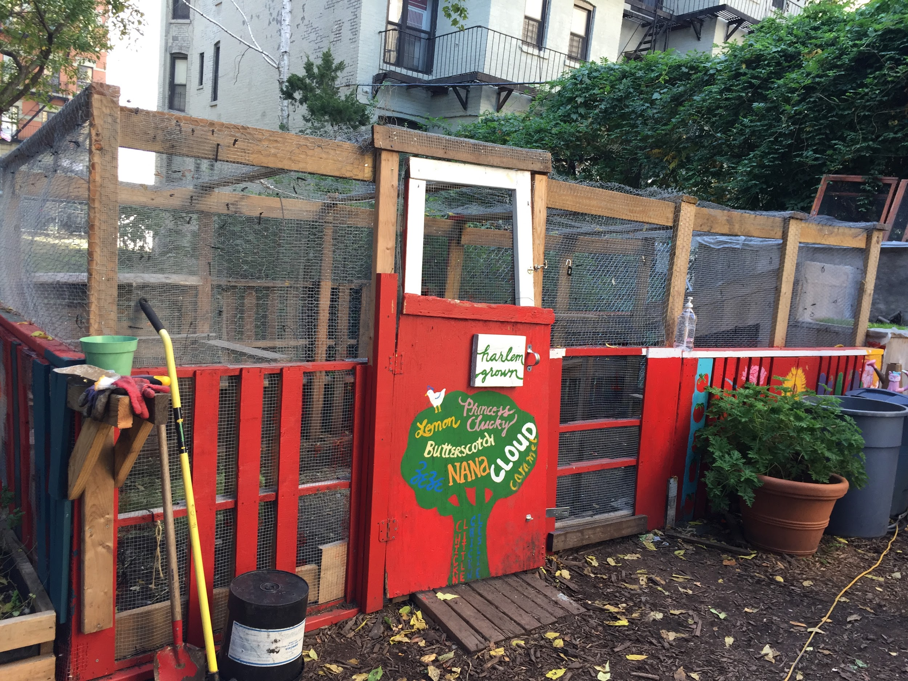
Harlem Grown

Slide 8
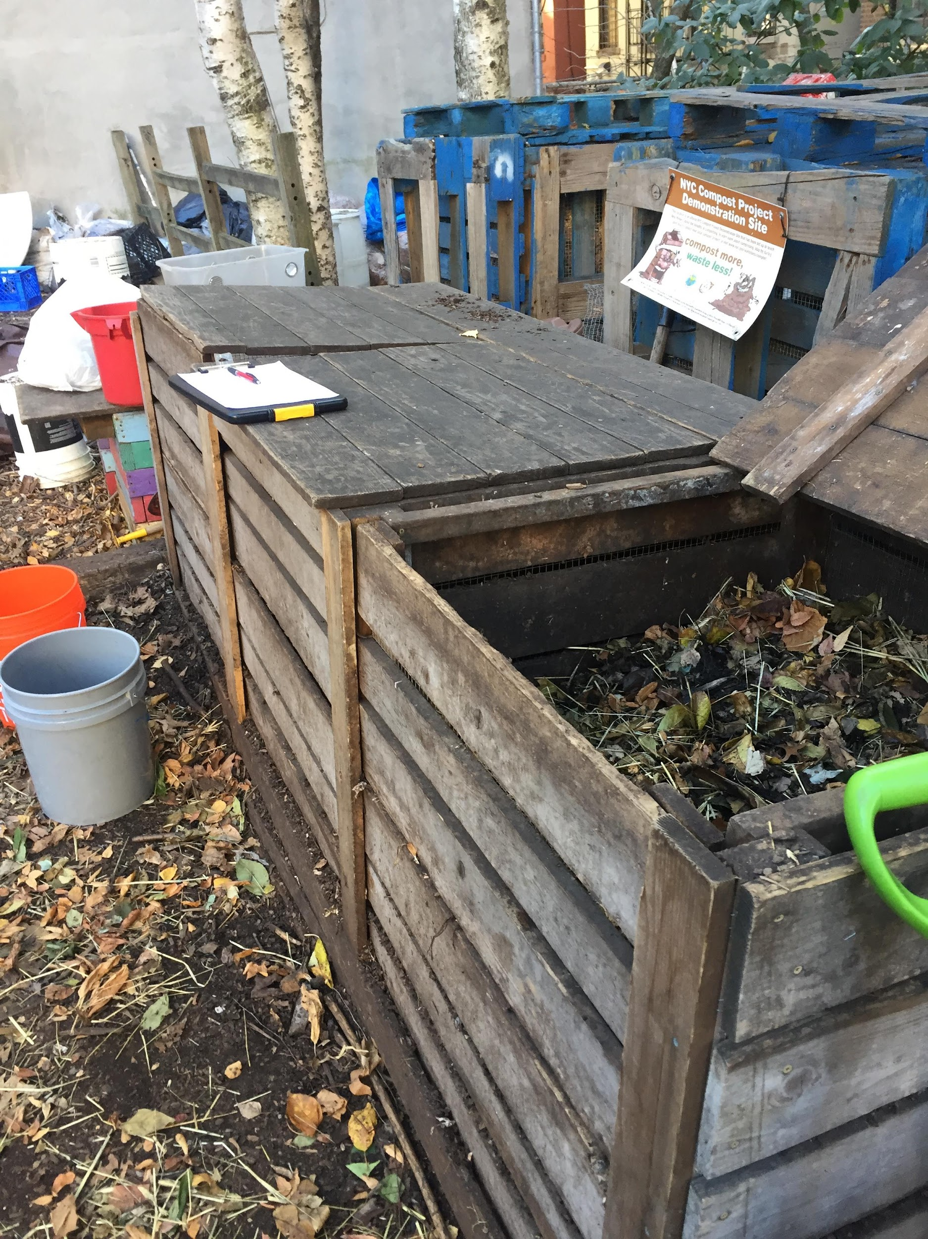
Composting
Organic foods and materials
Greens (fruits, veg, grass): Nitrogen
Browns (leaves, brown bags, straw); Carbon
Recycling system
Harlem Grown
Drop-off from community
Kids partake in care
Chopping foods, mixing, sifting

Slide 9
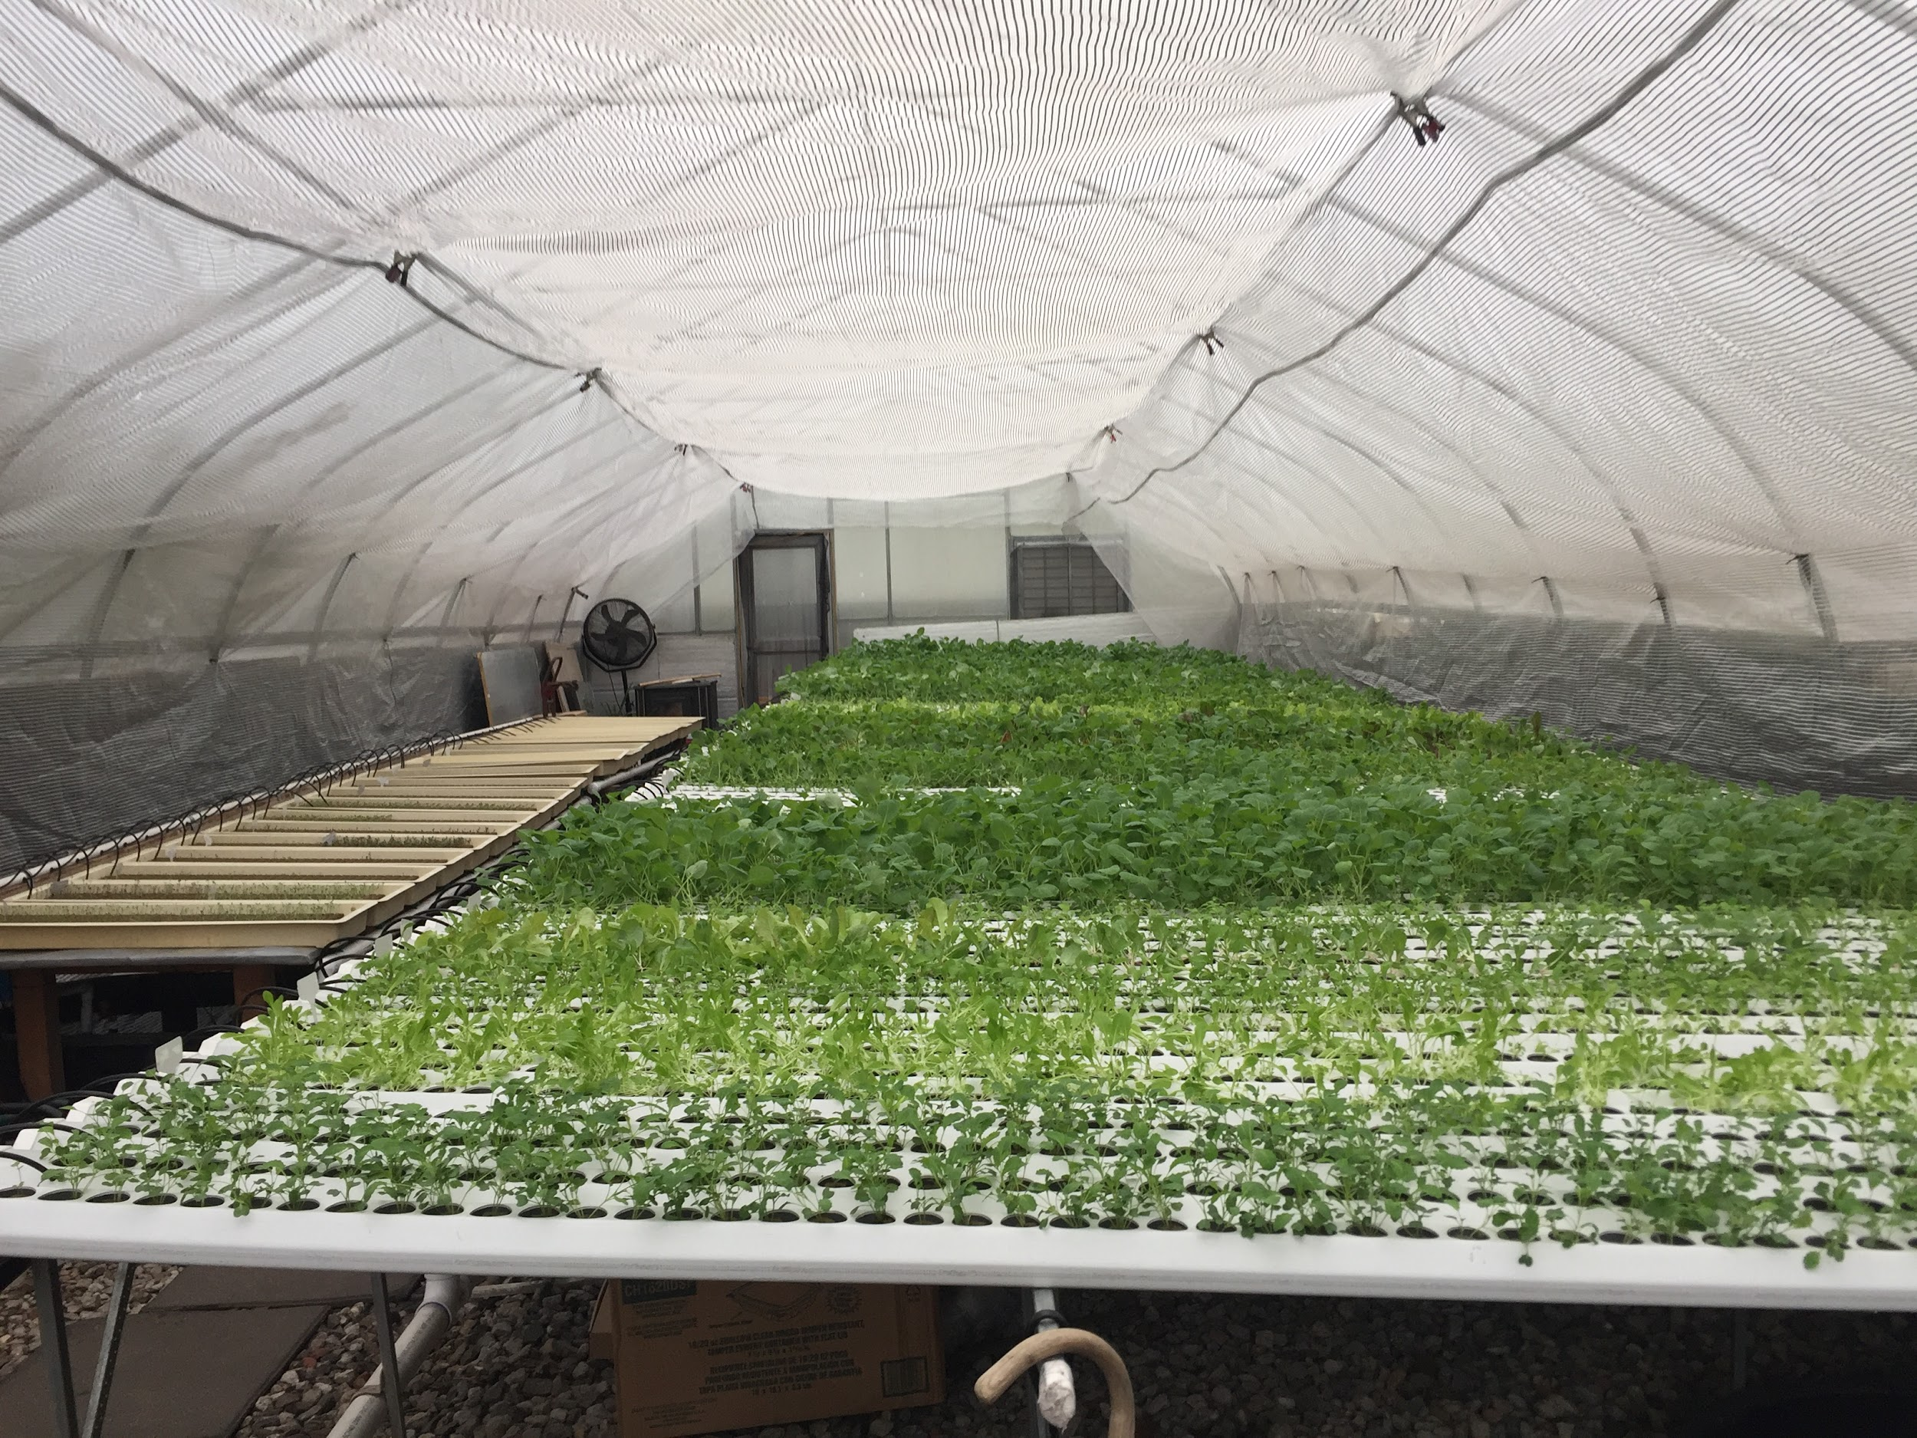
Hydroponics
Growing plants w/o soil
Minerals in water
Stable and high production
Less water - stays in system and is reused
Harlem Grown
9, 360 cells
Arugula, basil, swiss chard

Slide 10
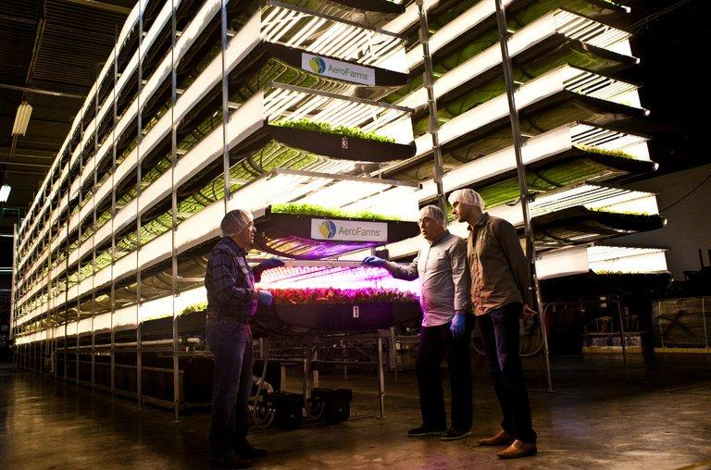
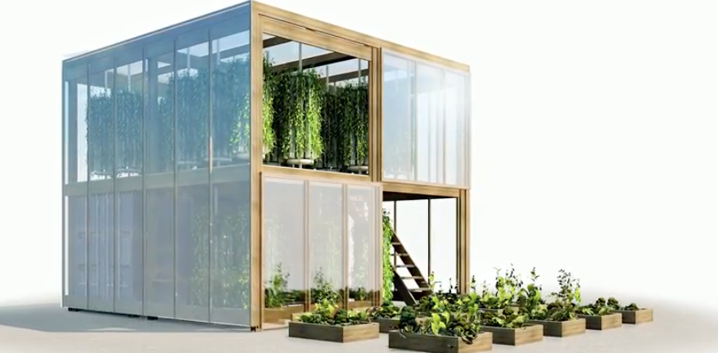
Vertical Farming

Slide 11
Education Tours
Showing children (K-12) different aspects of the farm
Compost, chickens, hydroponics
Teaching them where food comes from and where it can go
Important for them to understand the process
Can start practicing sustainability from young age

Slide 12
Sustainability
Brundtland’s Food Policy Theory:
United Nation’s document Our Common Future - food security (1980’s)
Theory :
Need new food policies to help food crisis
Short-term solutions (commercial agriculture) will end in starvation
Sustainability- a process to grow food for present and future generations
Sustainable development ( UN World Commission on Environment):
“development that meets the needs of the present without compromising the ability of future generations to meet their needs”

Slide 13
Sustainability of Urban Farms
Composting
- reusing foods, sending less to landfills
Growing edible plants
Smaller carbon footprint
Organic foods
Hydroponics
Minimal materials used (less water, no soil)

Slide 14
Challenges
Not enough food to feed whole community
People are uninformed/ uncomfortable
Communities of color have less choices
Hard to get land for individual farmers
Costs a lot of money to convert brownfields to usable land

