Slide 1

CETLL Faculty Orientation
Office for Students with Disabilities and Access
August 28, 2026

Slide 2
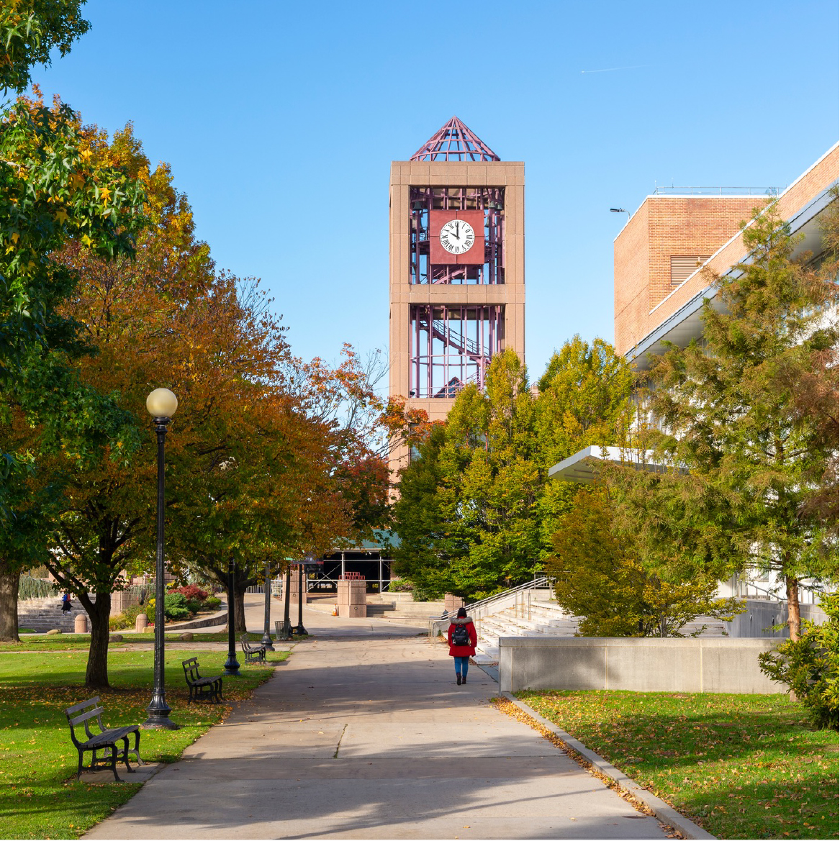
Our Mission
Our Mission
Welcome to the Office for Students with Disabilities and Access at Queens College! Our office is dedicated to supporting students with qualifying disabilities under the Americans with Disabilities Act (ADA) by providing reasonable accommodations to ensure equitable access to all academic programs at Queens College.
We encourage you to visit our website for information about our services and processes. Should you have any questions or require assistance, please do not hesitate to contact us.

Slide 3
CUNY Accommodate
CUNY Accommodate
What Faculty Should Know
  Students must register with OSDA through CUNY Accommodate.
  Students must submit semester requests before accommodation letters are sent to instructors.
  Faculty should regularly review accommodation letters in CUNY Accommodate.
  Faculty have the right to request and review an accommodation letter before providing accommodations.
  If a student requests accommodations but does not have an accommodation letter, refer the student to OSDA.
  Accommodations are not retroactive.
When in Doubt
  Contact OSDA before making decisions regarding accommodations.

Slide 4
Syllabus
Syllabus
Recommended Statement
  “The Office for Students with Disabilities and Access (OSDA) is committed to supporting students with disabilities by providing reasonable accommodations to ensure equal access. If you need accommodations or are unsure if you qualify, please visit their website for further information. Accommodations are not retroactive, so you are encouraged to get registered sooner rather than later.
  OSDA Website Link: https://www.qc.cuny.edu/osda”
Best Practice
  Post your syllabus as early as possible.
  Announce disability services during the first week of class.
  Encourage students to register early if they may need accommodations.

Slide 5
Accessibility
Accessibility
Creating an Accessible Environment
  Upload materials early
  Use properly formatted Word documents.
  Create accessible PDFs.
  Add alternative text to images.
  Caption video content.
  Use heading styles and meaningful document structure.
  Select accessible digital textbooks and learning materials.
Accessibility Resources
  CISTraining Technology Training Resources
  OSDA: Accessibility Checklist & Guidelines
  Faculty Guide for Teaching Students with Disabilities

Slide 6
Accommodation Guidelines
Accommodation Guidelines
Accommodation Letters May Include
  Extended testing time
  Reduced-Distraction Testing
  Note-Taking/Recording Accommodations
  Flexible Attendance
  Alternative Format Materials
  Assistive Technology
  Reading/Writing Software
  Preferential Seating
  Accessible Furniture
  CART Captioning Services
  ASL Interpreting Services
Important Reminder
  Do not modify, deny, or negotiate accommodations independently.

Slide 7
Rights and Responsibilities
Rights and Responsibilities
Faculty Responsibilities
  Review accommodation letters.
  Implement approved accommodations.
  Maintain confidentiality.
  Speak privately with students regarding accommodations.
  Contact OSDA when concerns arise.
Student Responsibilities
  Register with OSDA.
  Request accommodation letters each semester.
  Follow OSDA procedures.
  Communicate with faculty in a timely manner.
  Meet the same academic and conduct standards as all students.

Slide 8
Contact Us
Contact Us
Main Desk/Reception
Associate Director: Wahidur Roni
Location: Kiely Hall 104
Phone: 718-997-5870
Email: osda@qc.cuny.edu
Walk In Hours: 11:00 AM – 2:00 PM
Office Hours (By appointment only):
Monday – Thursday: 9:00 AM – 4:00 PM
Friday: 9:00 AM – 4:00 PM
** Summer and Winter hours are subject to change.
Assistive Technology Lab / Testing Center
Testing Coordinator: Susan Oh
Location: Kiely Hall 220
Phone: 718-997-3775
Email: osda.testing@qc.cuny.edu
** All tests are by appointment only
Regular Testing Hours:
Monday – Thursday: 9:00 AM – 6:00 PM
Friday: 9:00 AM – 4:00 PM
Winter & Summer Testing Hours:
Monday – Thursday: 9:00 AM – 5:00 PM
Friday: 9:00 AM – 4:00 PM

Slide 9
Equal access and equal opportunity

