Slide 1

Queens College Library
Information for Faculty

Slide 2
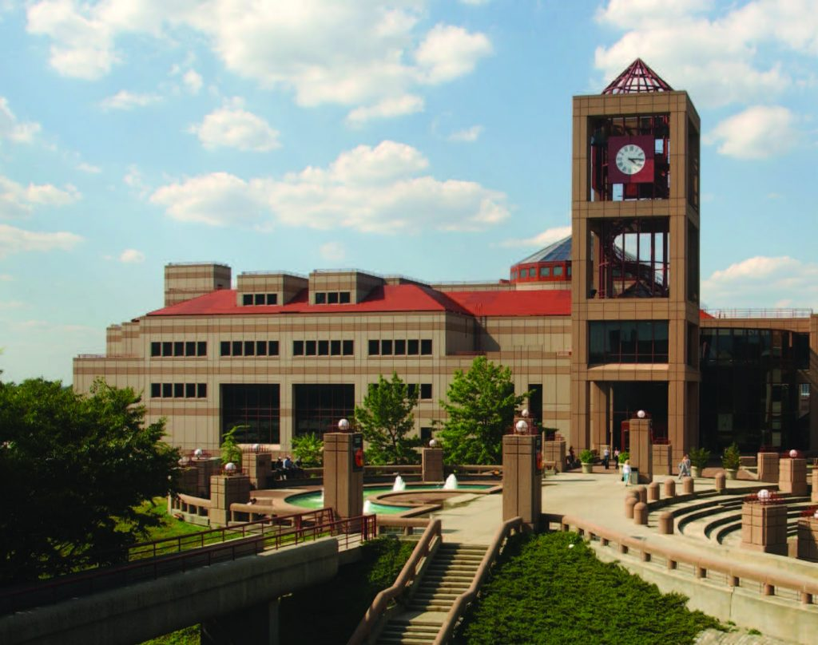
Welcome
Welcome
Queens College Library (QCL) had its first dedicated home when Klapper Library (now Klapper Hall) opened in 1955. The Library moved to its current location in 1988.
The library, a hub of student and faculty research, contains over 840,000 volumes, one million plus e-books, over 59,000 e-journals, and more than 86,000 streaming videos.
Library services include:
Lending library materials
Research support
Library instruction sessions
Teaching & learning resources
Specialized resources

Slide 3
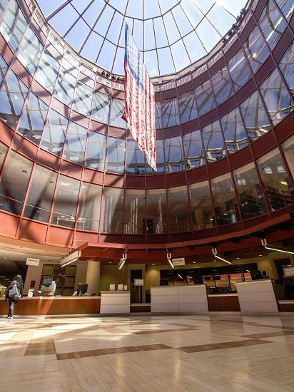
Borrowing
Borrowing
Queens College Library books, media items, and Course Reserve materials can be checked out from the Circulation/Borrowing Desk on the 3rd floor during normal service desk hours.
Databases
225 databases to support research in every academic subject.
https://qc-cuny.libguides.com/az/databases
Interlibrary Loan (ILL)
Request books, articles, and more from libraries nationwide.
qc.illiad.oclc.org/illiad/logon.html
CUNY/SUNY Resource Sharing
Request and borrow physical books across CUNY & SUNY
qc.cuny.edu/library

Slide 4

Newspaper Access
Newspaper Access
All CUNY students and faculty are invited to claim their free subscriptions to The New York Times and The Wall Street Journal.
Register through links in the Databases:
qc-cuny.libguides.com/az/databases

Slide 5
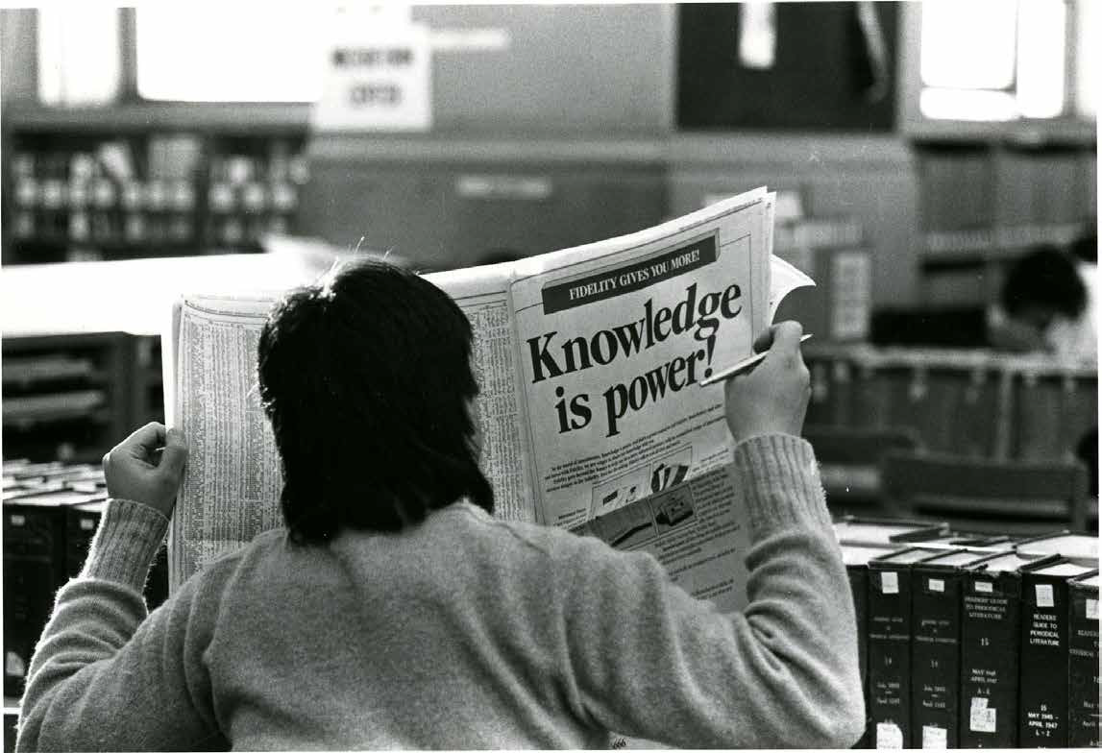
Advancing Your Research
Advancing Your Research
One-on-One Consultations
Schedule a personalized session with a librarian to develop effective search strategies and find resources. Walk-in research consultations are available next to the Borrowing Desk. Online support is available 24/7 on the Ask Us! widget.
qc.cuny.edu/library/research/specialists
Research Data Management
Get support in managing, organizing, and analyzing your research data with popular data analysis tools. We also offer in-class data literacy instruction and hands-on data analytics and management workshops.
https://qc-cuny.libguides.com/data-services
CUNY Academic Works
CUNY’s institutional repository hosts your scholarly and pedagogical materials, making them discoverable and available to a wider audience.
academicworks.cuny.edu

Slide 6
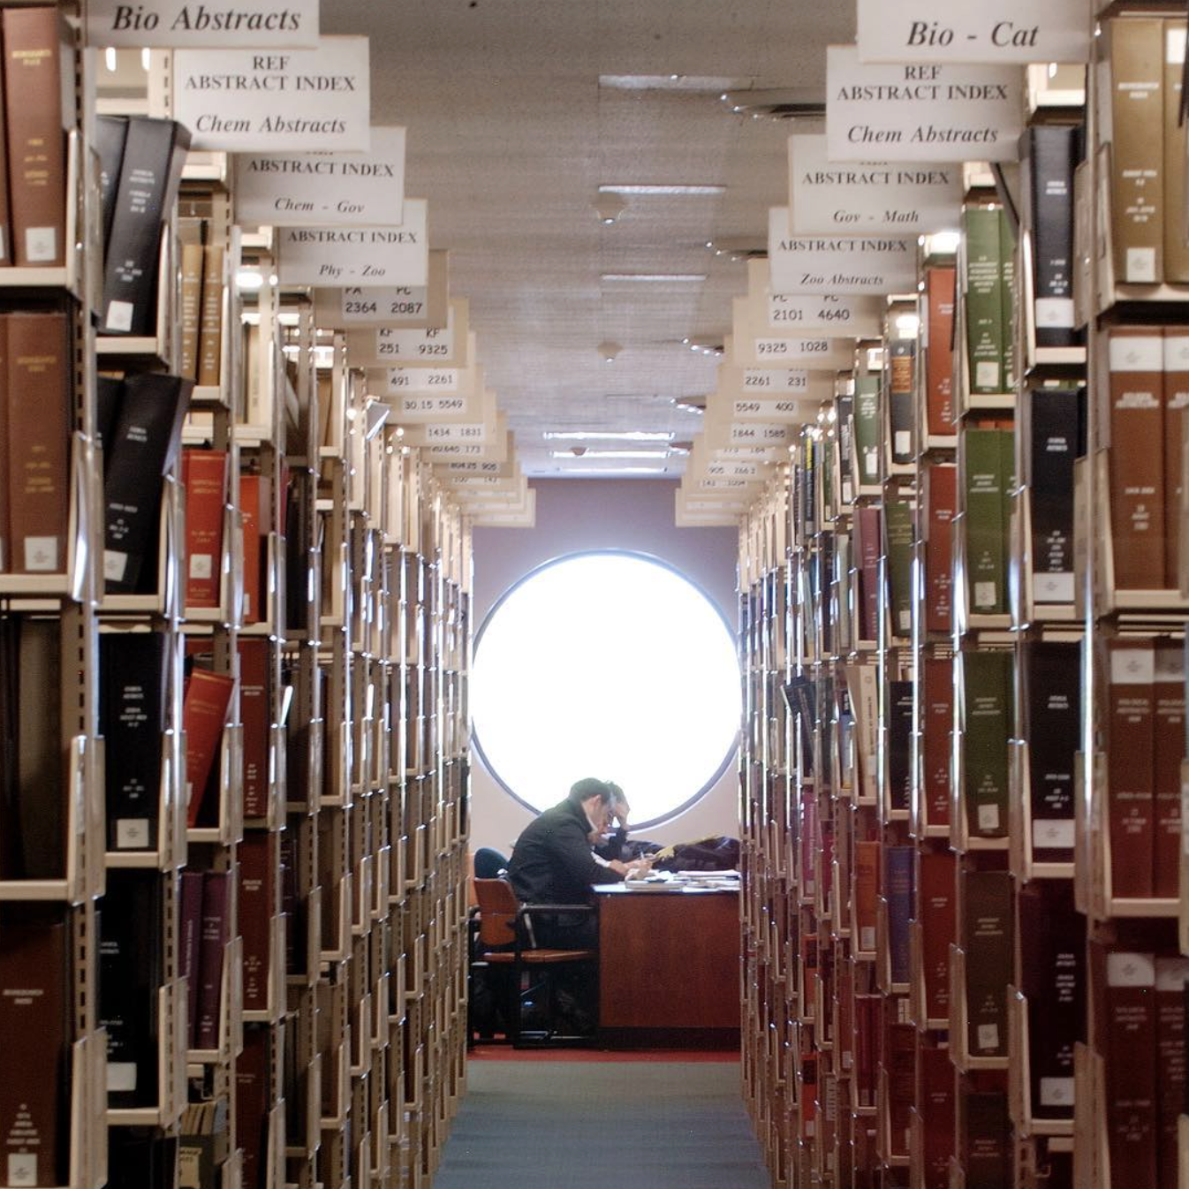
Library Research Instruction
Library Research Instruction
Partner with our librarians to design a custom workshop that teaches your students to become more confident and critical researchers.
We host sessions in the library, on Zoom, or with asynchronous materials.
Introduction to library research and information literacy.
Key resources and research methods in a specific discipline.
Analyze and visualize data.
Primary source research with the library’s Special Collections & Archives.
qc.cuny.edu/library/instruction

Slide 7
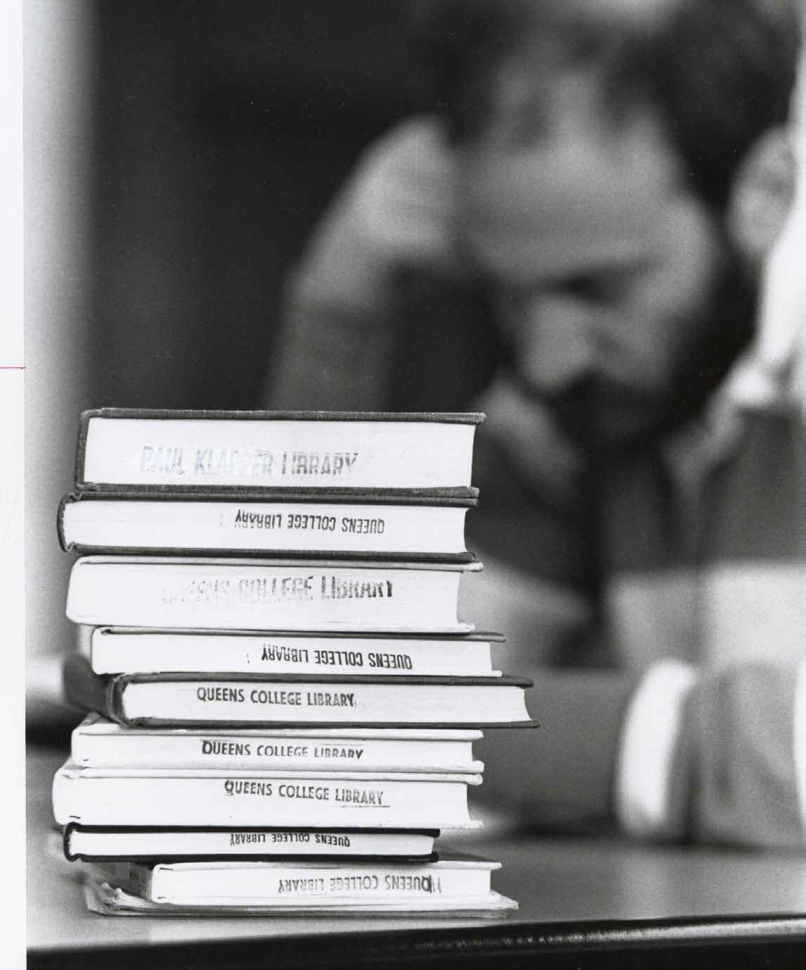
Course Reserves
Course Reserves:
Required Reading Made Easy
At the request of an instructor, the library's Course Reserves unit purchases required course materials and creates a dedicated e-reserves site for each course, making it easy to share books, e-books, articles, and physical or streaming video with your students. Scanning services are available within the bounds of copyright. We also post journal articles, instructor materials, as well as student papers (with the student’s permission).
qc.cuny.edu/library/reserves

Slide 8

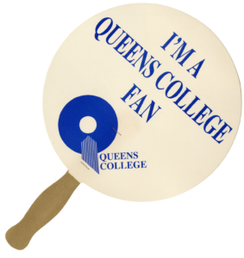
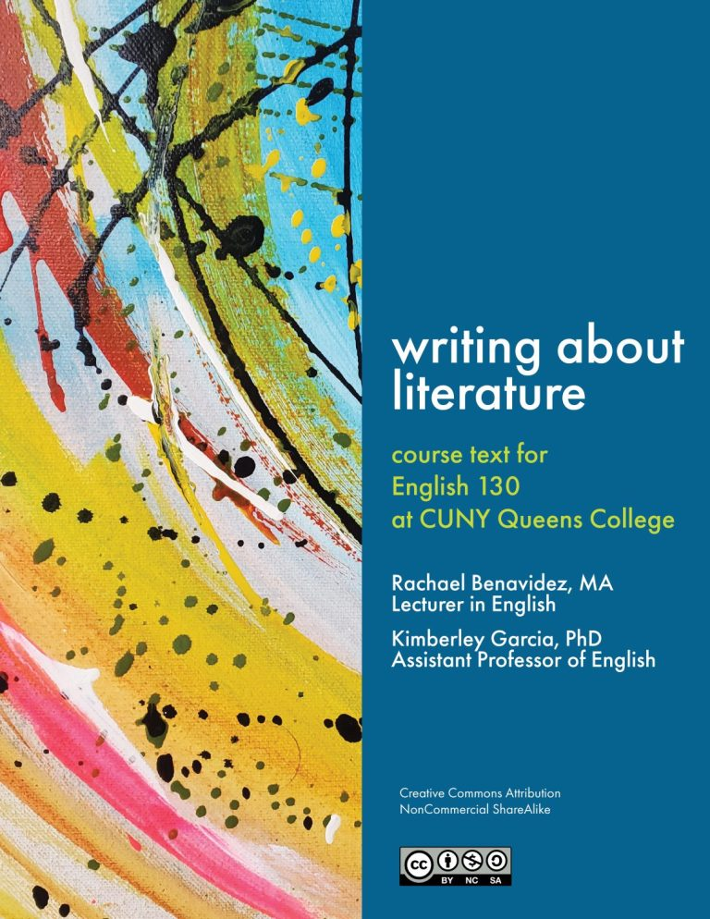
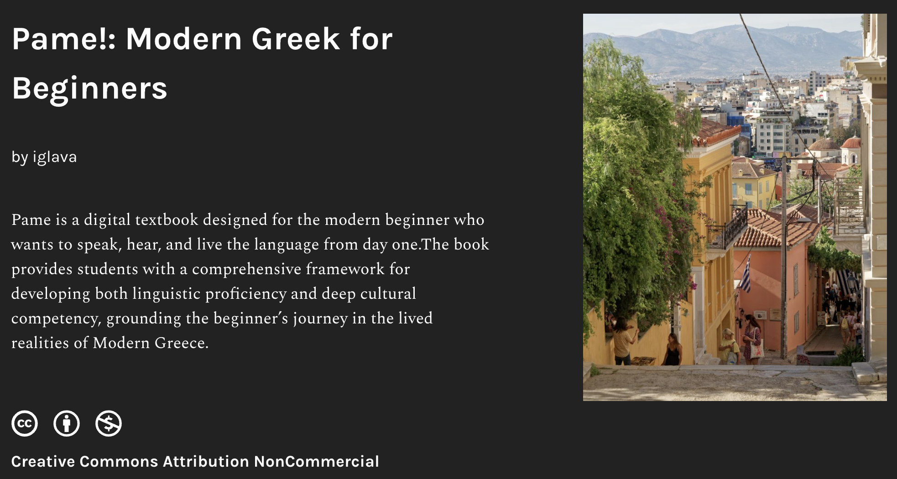
OER and ZTC
Open Educational Resources & Zero Textbook Cost
The cost of textbooks can be a steep barrier to academic success. Students who cannot afford expensive textbooks report going into debt, choosing between books and other necessities, registering for fewer classes, or trying to make do without required texts. These patterns can lead to increased time to degree and lower graduation rates.
The OER Initiative and Faculty Fellowship Program offer training and funding for faculty to develop and use openly licensed and zero-textbook-cost materials.
Since 2018, QC faculty have created nearly 200 resources, saving our students nearly $3 million in textbook fees.
https://qc-cuny.libguides.com/oer-ztc

Slide 9
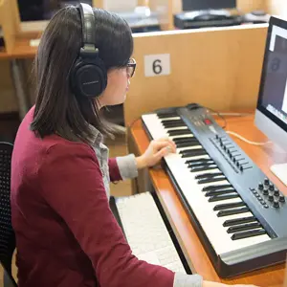
Music Library
Music Library
The Rorick Music Library, located in the Music Building, is the largest of its kind in CUNY and holds all of QC’s music-related materials, including books, scores, and audio recordings (LPs & CDs), and a large Vinyl LP Collection.
A large seating area, two study rooms, and a media lab with computers and turntables make it a great place to get work done and engage with music in multiple ways.
Research assistance in the performing arts and workshops on the use of audio gear can be scheduled with the music librarian.
https://www.qc.cuny.edu/library/music/

Slide 10
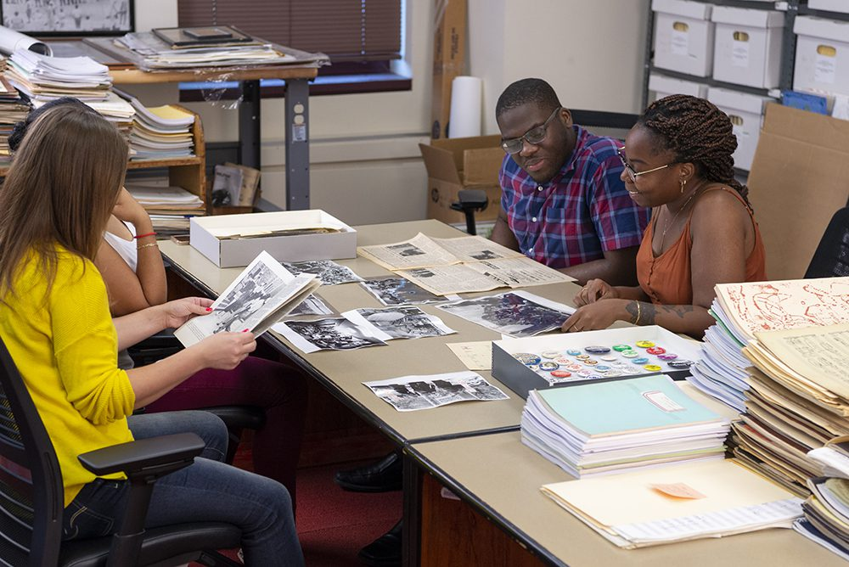
Special Collections and Archives
Special Collections & Archives
Queens College Special Collections and Archives (SCA) is the repository for over 4,000 linear feet of college records, special collections, and rare books.
Our mission is to collect, preserve, and provide access to special collections and archives for discovery, teaching, scholarship, creativity and critical thinking.
Our priority is the safekeeping of the historical and cultural record of Queens College. Additional collecting areas – civil rights, social justice, politics, and music and the arts – reflect areas of excellence in our institution and among our faculty, staff, students, and alumni.
https://www.qc.cuny.edu/library/archives/

Slide 11
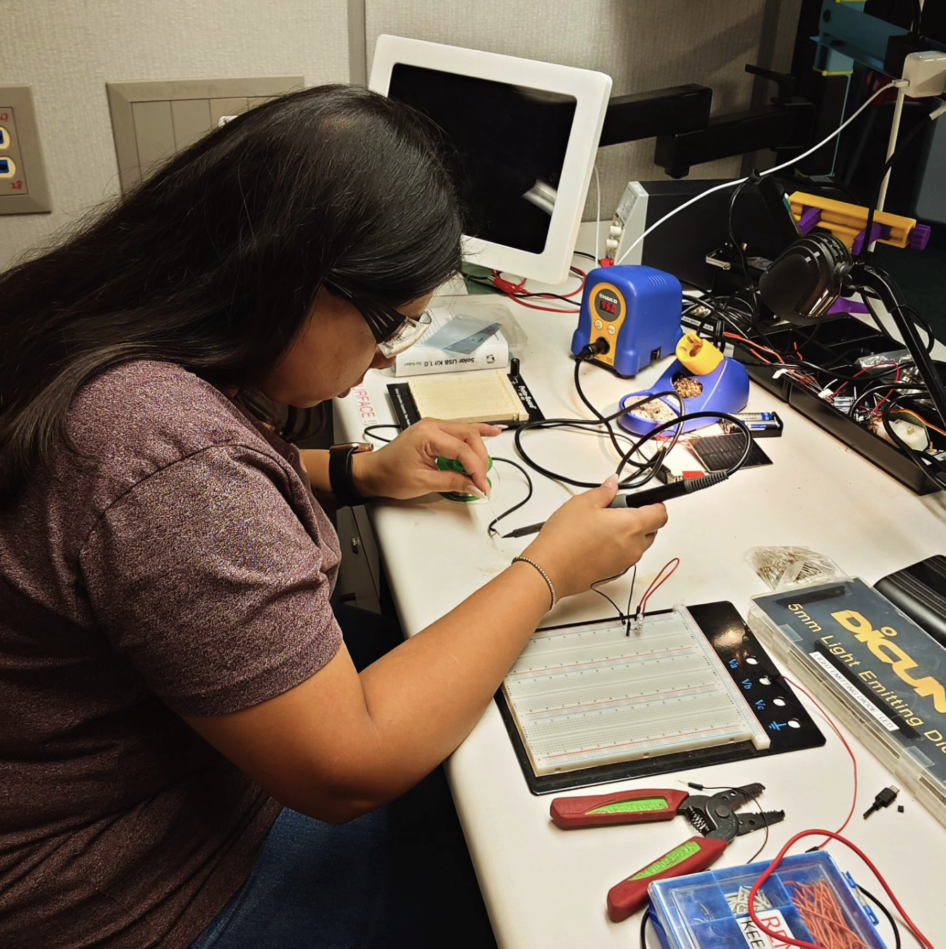
Makerspace
Makerspace
Located on the 1st Floor of the Rosenthal Library, the Makerspace is place for all to tinker, craft, make, design, and learn.
3D Printing
Plotter
Electronics equipment and assembly
Sewing and embroidery machines
Shop facilities
Design PCs
Orientation required for all new users.
QC Faculty can request a class orientation, instruction, or brief tour of the QC Makerspace.
https://www.qc.cuny.edu/library/makerspace/

