Slide 1


CETLL Faculty Orientation
August 28, 2026
9:30 am – 12:00 pm
Music Building Atrium

Slide 2

Special Thanks to
PSC-CUNY for providing breakfast & co-sponsoring this event!

Slide 3
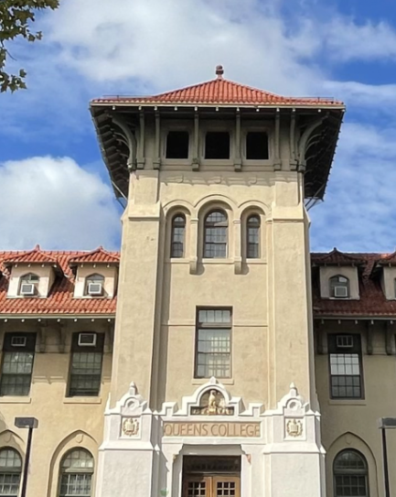
Welcome
President Betsy Hendrey
Interim President
Queens College, CUNY

Slide 4
Pair Share Icebreaker
Turn to the person sitting next to you and take turns sharing (2 minutes each):
Share your name, department, and title(s) of course(s) you’re teaching this fall.
What are you looking forward to about your teaching (or any other work at QC) this semester?
What are you hoping to take away from the Orientation today?

Slide 5
Center for Excellence in Teaching, Learning, & Leadership (CETLL)
Susan A. Davis, Ph.D.
CETLL Director
Professor of Music Education
Meagan Sullivan
Administrative Coordinator

Slide 6
CETLL Professional Development
Pedagogy
Generative AI
Collaborative Community
Universal Design for Learning (UDL)
Accessibility
Teaching & Learning Showcases
Semester Basics
Semester Checklist
Syllabus Template
Notes:
Jean

Slide 7
CETLL Upcoming Events
CUNY's Digital Accessibility Initiative (DAI) Speaking Tour with Laura Todd
Monday, September 28, 2026, 12:15pm-1:30pm, Hybrid: in-person location TBD
Learn more about CUNY's DAI and the new self-paced DAI course in Brightspace
Co-hosted by CETLL and the Rosenthal Library
Pedagogy Pop-Ups: Poetry is Not a Luxury with Susan Bernstein
Monday, October 05, 2026, 12:15pm-1:15pm, QC Makerspace
Learn more about experiential learning through a collective poetry quilt class project done in collaboration with QC Makerspace
Career-Connected Learning in the Curriculum with Cristina Di Meo & Friends
Thursday, October 15, 2026, 12:00pm-2:00pm, Muyskens Conference Room
Learn more about Career-Connected Learning in the Curriculum: Best Practices at QC and Across CUNY
Notes:
Jean
Laura Todd, CUNY Central
Susan Bernstein from the English Department; experiential learning through a collective poetry quilt project

Slide 8
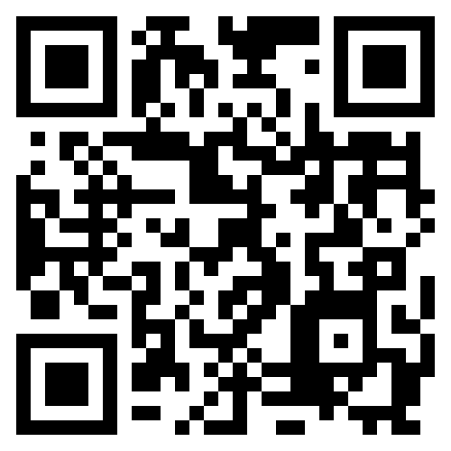
CETLL Website
Notes:
Jean

Slide 9
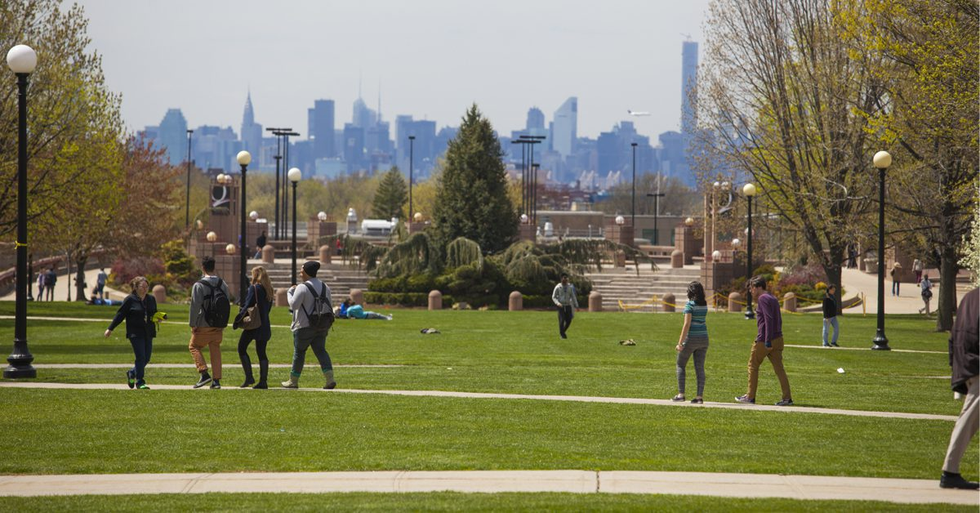
Enrolled Student Profile

Slide 10
Financial Aid
& Registrar
Walter Velas
Financial Aid Services
Jomy George
Registrar Director

Slide 11
Office for Students with Disabilities and Access (OSDA)
Wahidur Roni
Interim Associate Director

Slide 12
Office of Innovation and Student Success
Dr. Ahmad Sims
Associate Provost for Innovation and Student Success
Melissa Faulkner
Executive Director for Student Success and Career Outcomes

Slide 13
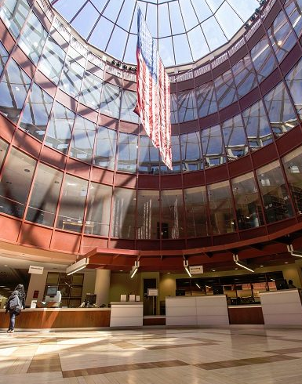
The Library
Dr. Leila Walker
Humanities & Digital Scholarship Librarian
Assistant Professor

Slide 14
Information Technology Services (ITS)
Theo Nicolaou
ITS Service Desk Staff

Slide 15
PSC-CUNY
QC Chapter
Dr. Erica Doran
Chapter Chair

Slide 16
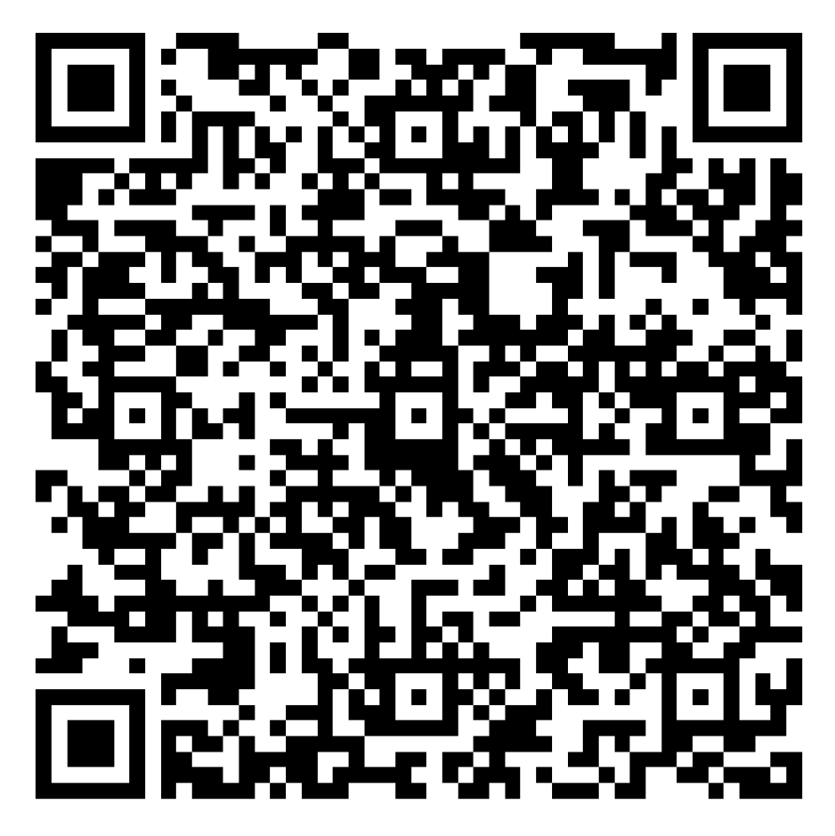
FEEDBACK
FORM
Thank you for participating in the event! We welcome your feedback so that we can learn what was most important and helpful for you and improve for the future.
Scan the QR Code to access the feedback form.

