Slide 1

Office of Innovation and Student Success

Slide 2
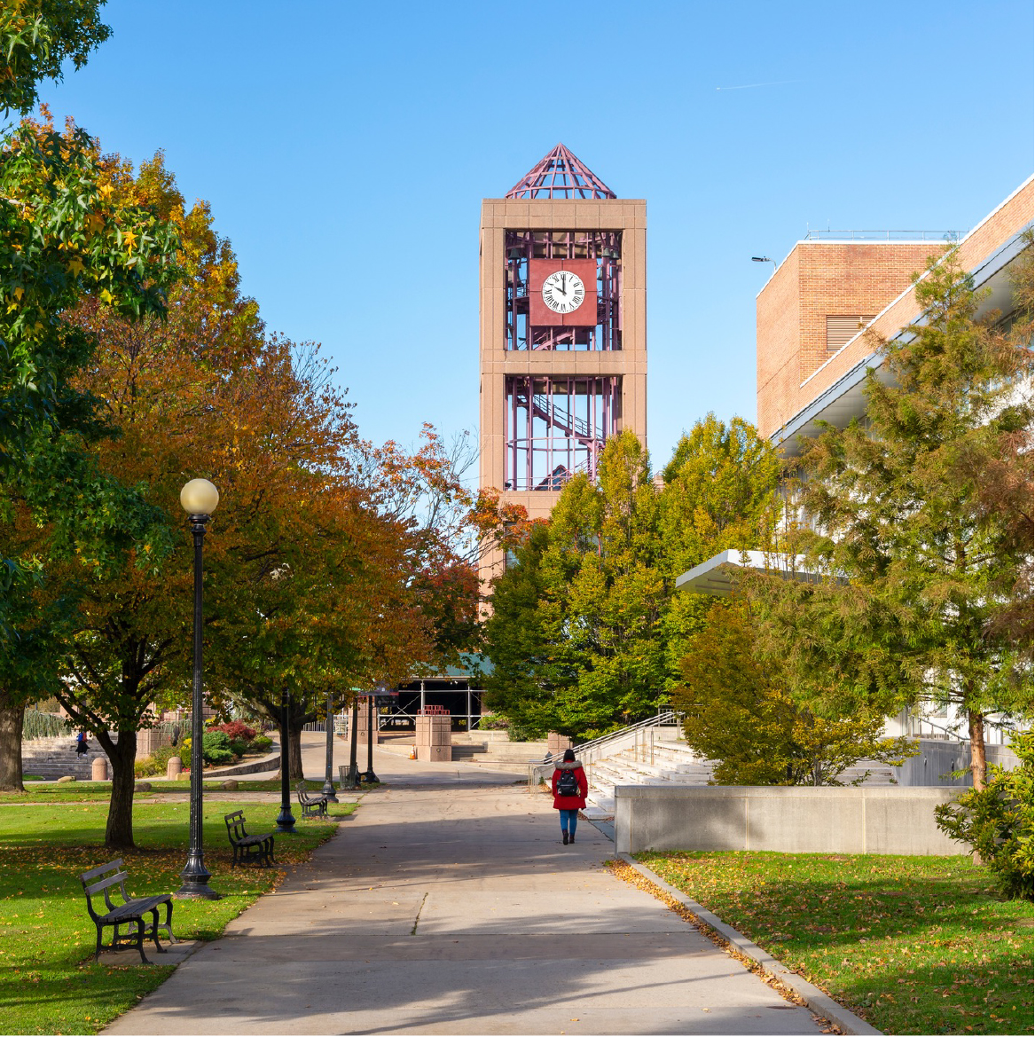
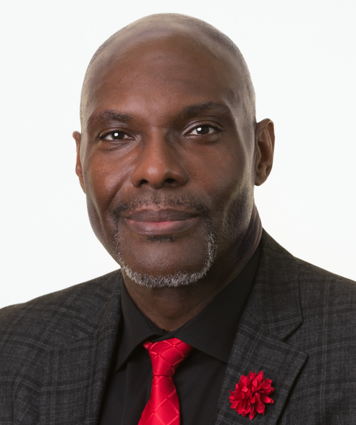
Ahmad Sims, EdD.
Associate Provost for Innovation & Student Success
www.qc.cuny.edu/ (URL is optional)

Slide 3
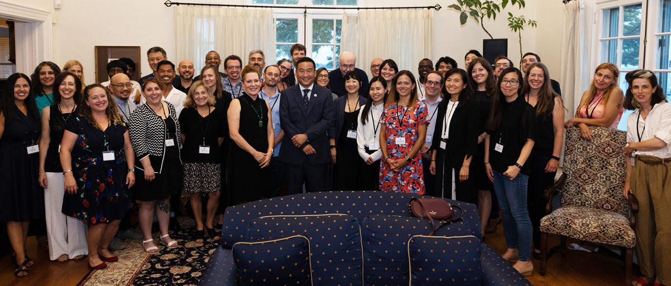
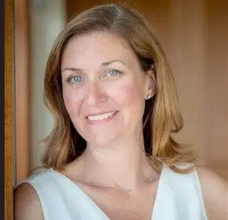
Melissa Faulkner
Executive Director, Student Success & Career Outcomes
www.qc.cuny.edu/ (URL is optional)

Slide 4
Student Success Areas

Slide 5
Honors & Scholarships
Honors & Scholarships
Taruna Sadhoo, Director of Honors &Scholarships and Macaulay Honors College
The Office of Honors and Scholarships and Macaulay Honors College at Queens College offers students transformative opportunities and experiences, in and out of the classroom, that challenge students to grow and foster their intellectual curiosity and service to make positive change in the world.
Freshmen Honors
Transfer Honors
Kessler Scholars Program
Mellon Mays Fellowship Program
Macaulay Honors College
Office of Honors and Scholarships | Queens College, CUNY

Slide 6
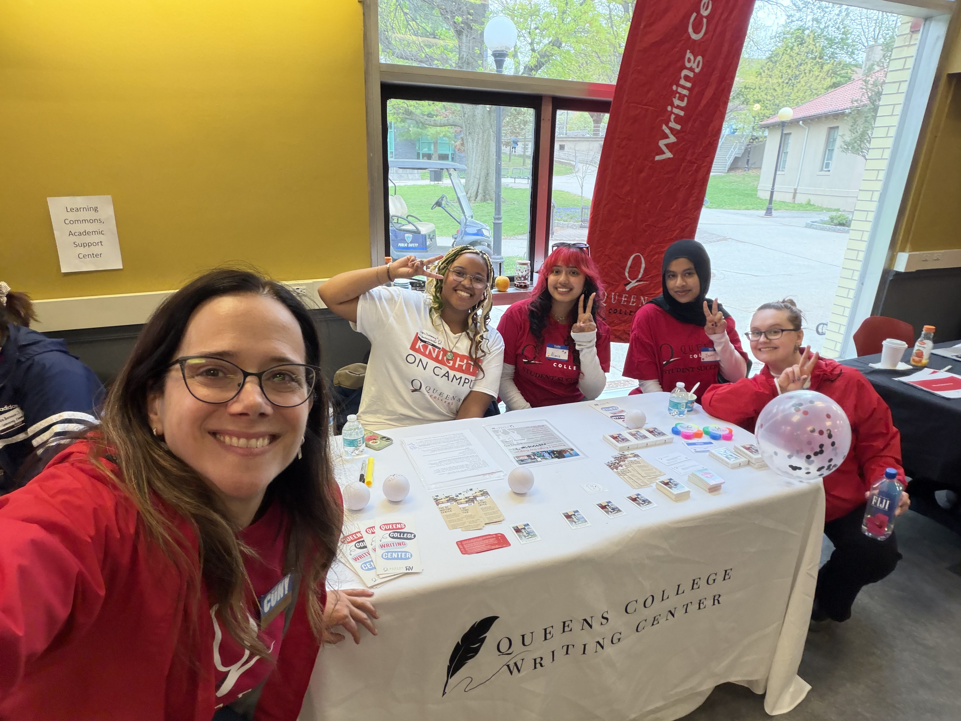

The Writing Center
The Writing Center, Dr. Andrea Rosso Efthymiou, Director
The Queens College Writing Center (QCWC) is the college's hub for writing support!
Over 2,000 peer-to-peer consultations a year, supporting student writing from all classes & contexts
Writing at any stage welcome—even if a student has yet to start
In-person & online appointments 5 days a week + evening hours
Multilingual & AI-informed staff
OUR IMPACT:
QCWC users have significantly higher retention rates than non-users
Undergrads who use QCWC also have higher semester & cumulative GPAs than non-users
Voted BEST STUDENT SUPPORT OFFICE by the Student Association
Fall 2026 writing support resumes Tuesday, September 8th.
[Above: Andrea with QCWC staff at Become a Knight Day 2026]
Room: Kiely 229
Email: qc.writing.center@qc.cuny.edu
Phone: 718-997-5676
Instagram: @theqcwritingcenter
Website: www.qc.cuny.edu/academics/wc/
Appointments: www.qccuny.mywconline.com

Slide 7
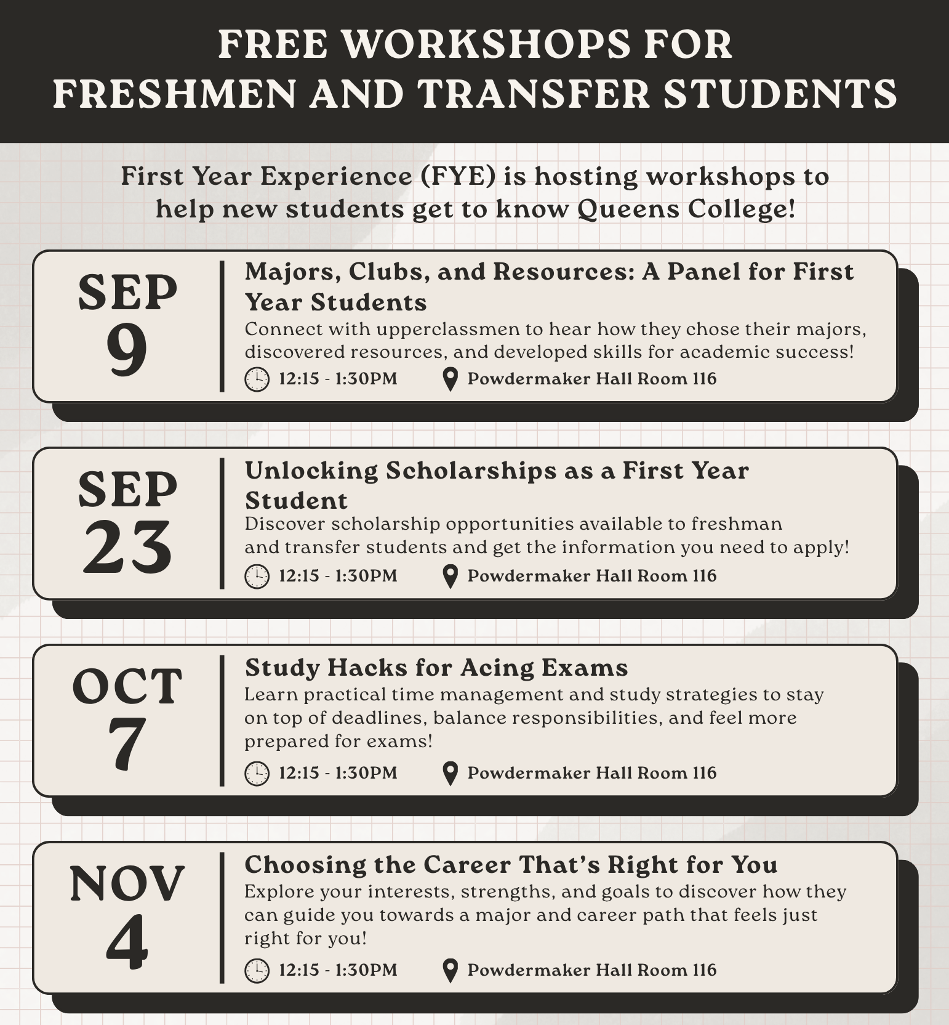
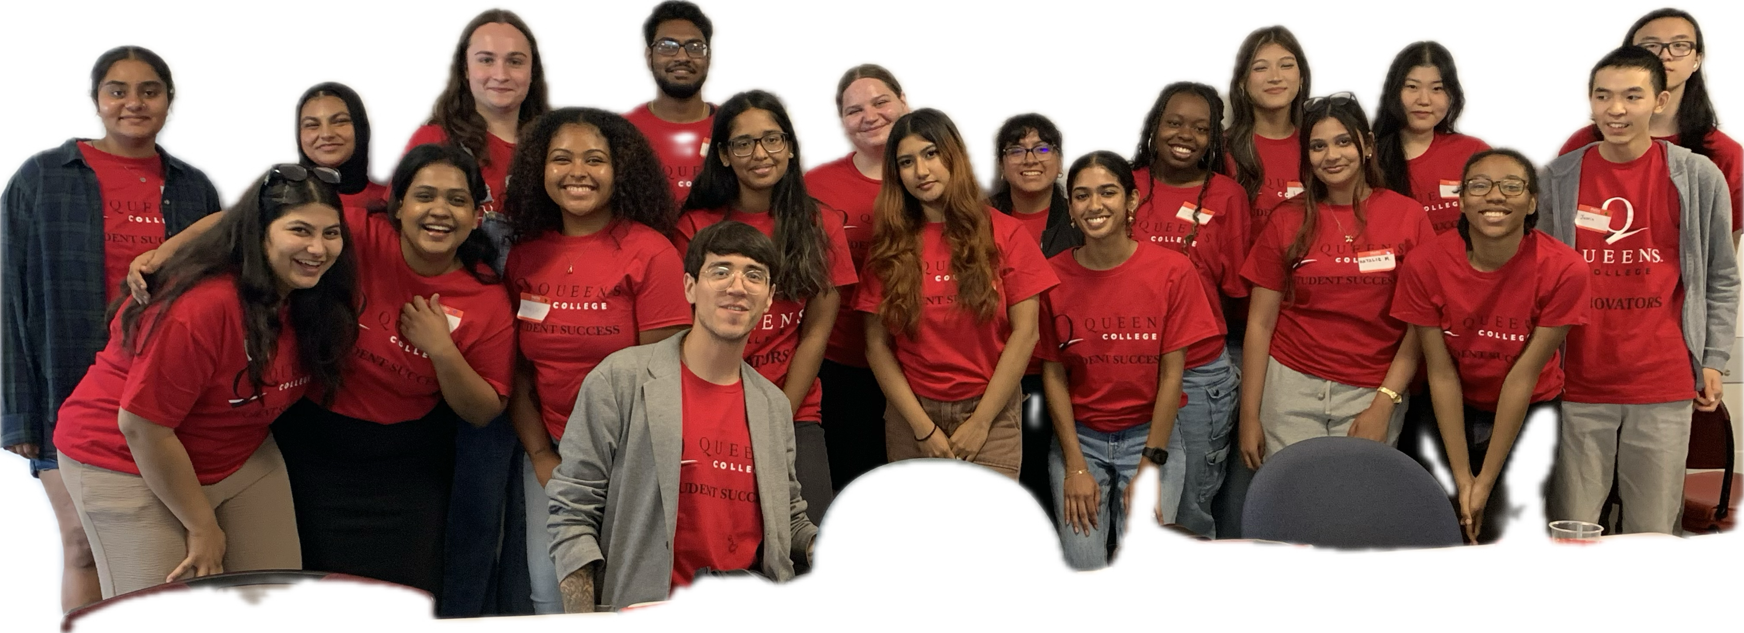

First Year Experience, Jorge Velez, Assistant Director
First Year Experience provides free support for freshmen and transfer students.
Peer Mentoring | Monday-Thursday 11 AM – 4 PM
  Ask any questions about QC
  Discuss time management, study skills and different majors
  In-person and online, by appointment or walk-in
Workshops | Wednesdays, 12:15 PM – 1:30 PM
  Connect with resources
  Explore opportunities
  Lunch provided
Study Space | Monday-Thursday, 9:00 AM – 5:00 PM
  Honors Hall 05
  Exclusive, quiet workspace
  Mac Computer lab and printing
Room: Honors Hall 05
Email: fye@qc.cuny.edu
Phone: 718-997-5567​
Instagram: @qcfye
www.qc.cuny.edu/fye

Slide 8
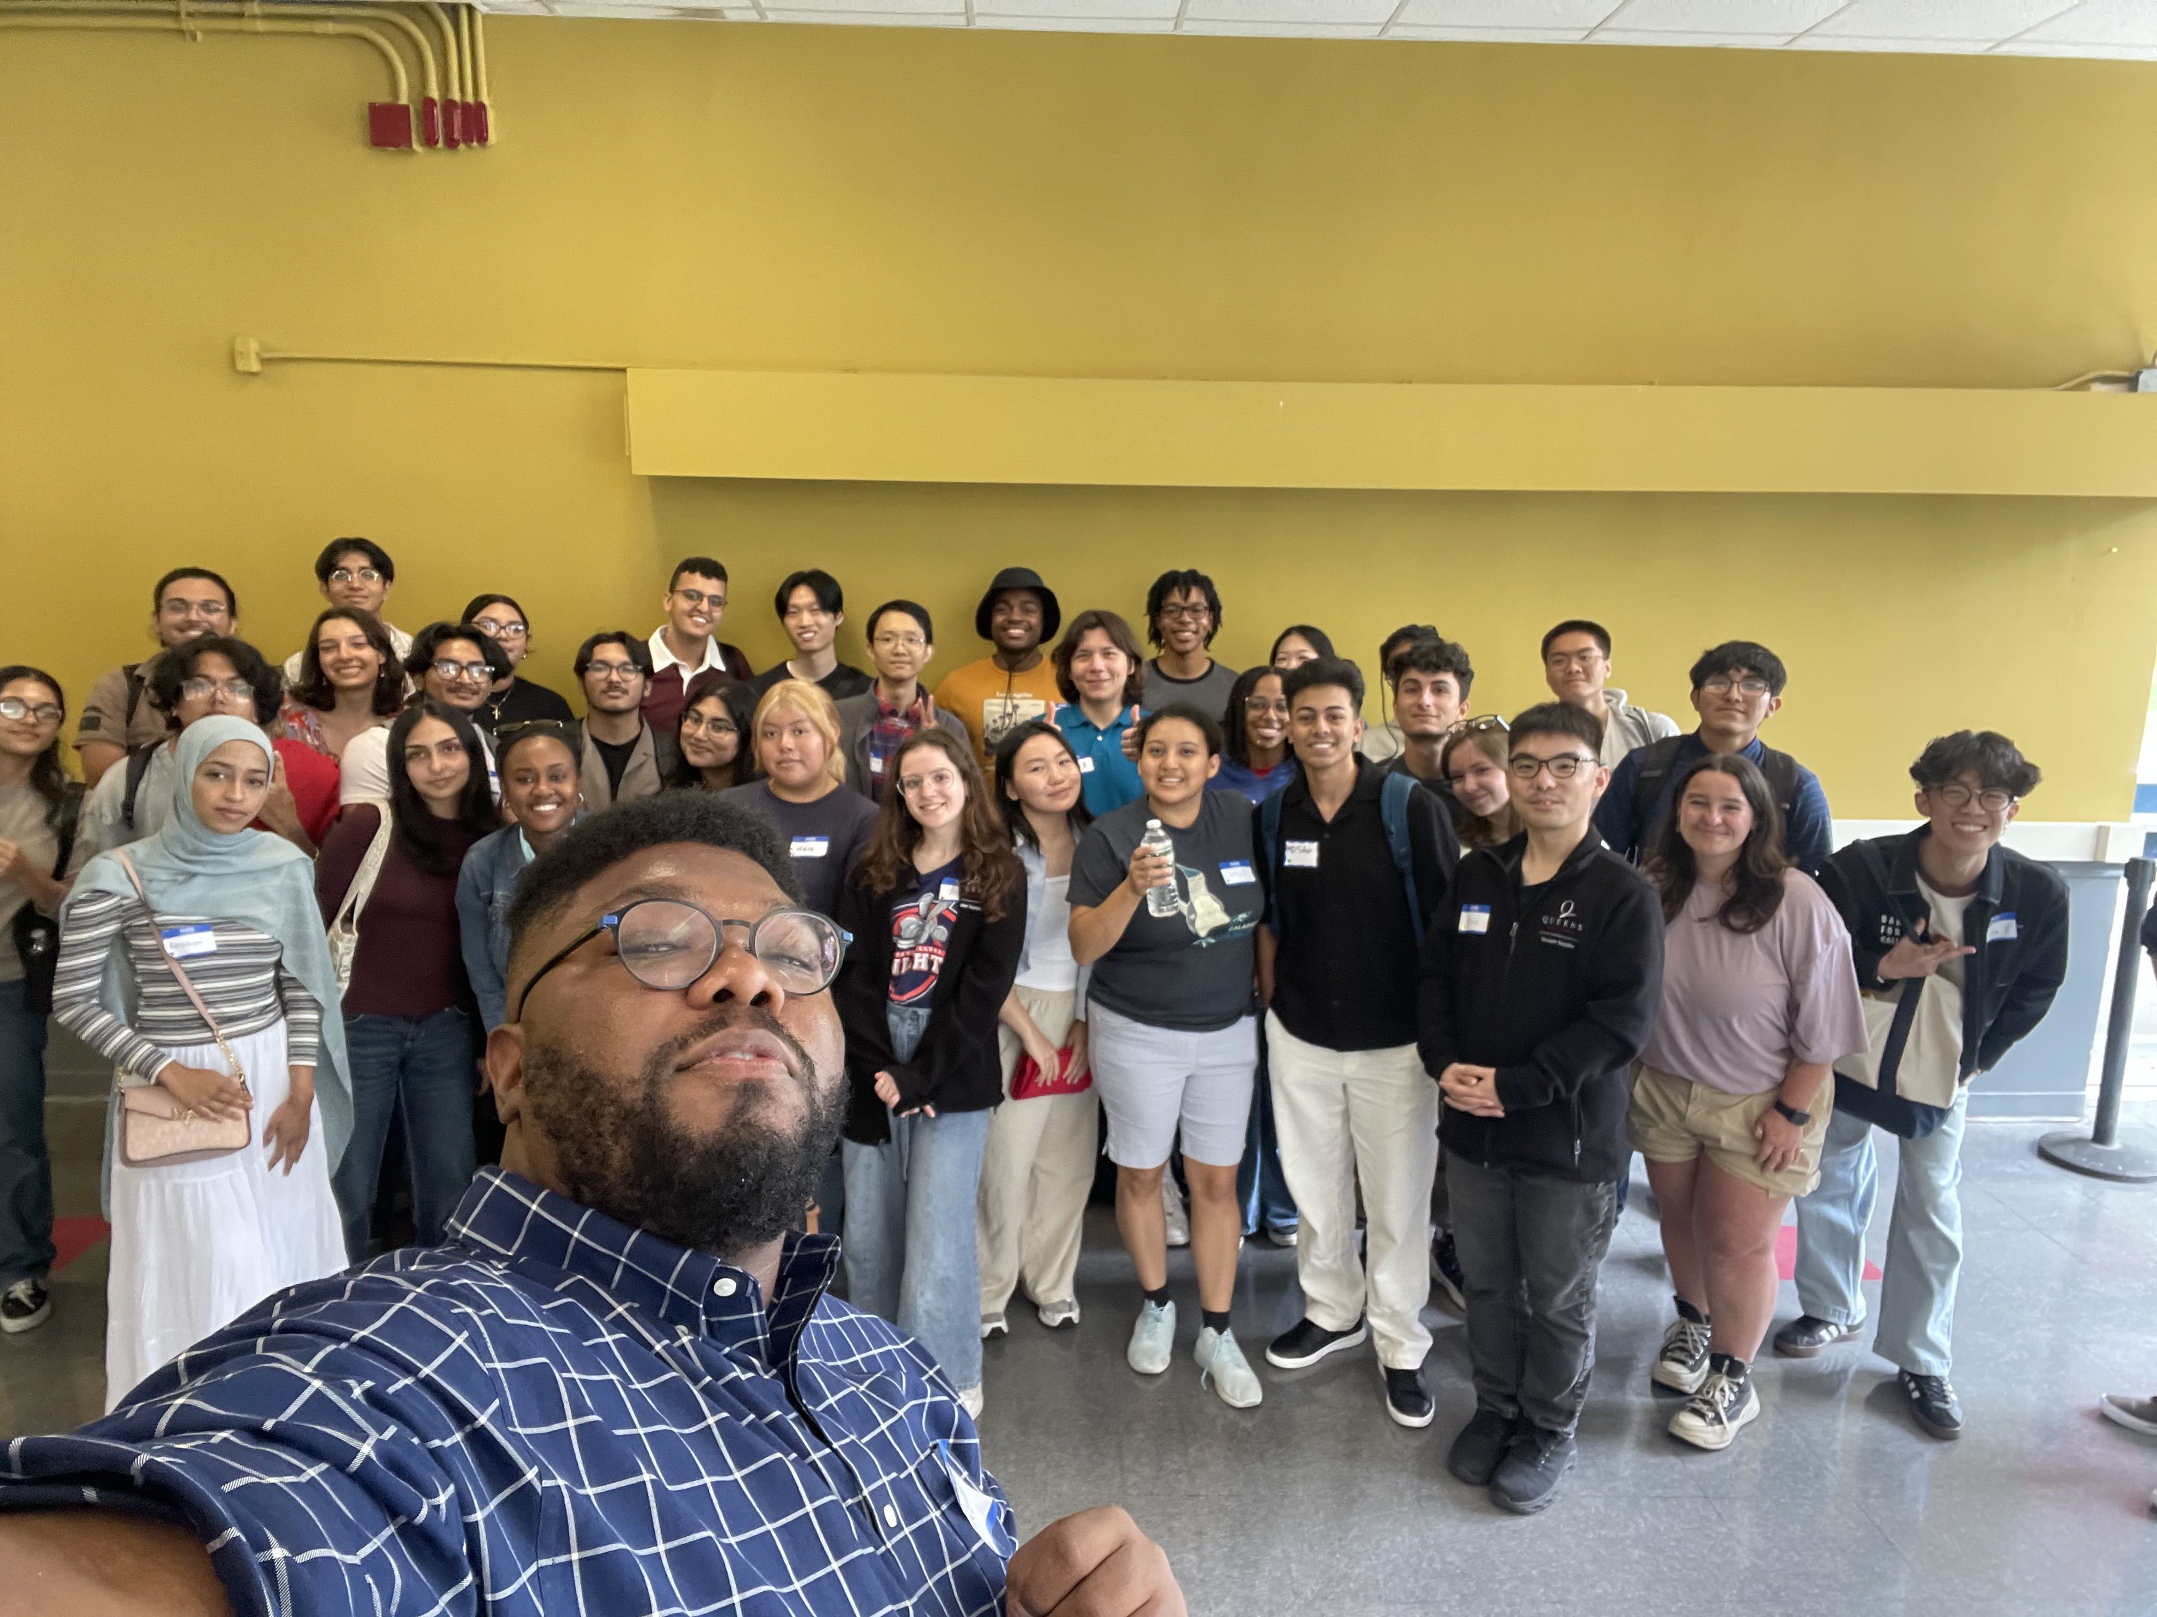
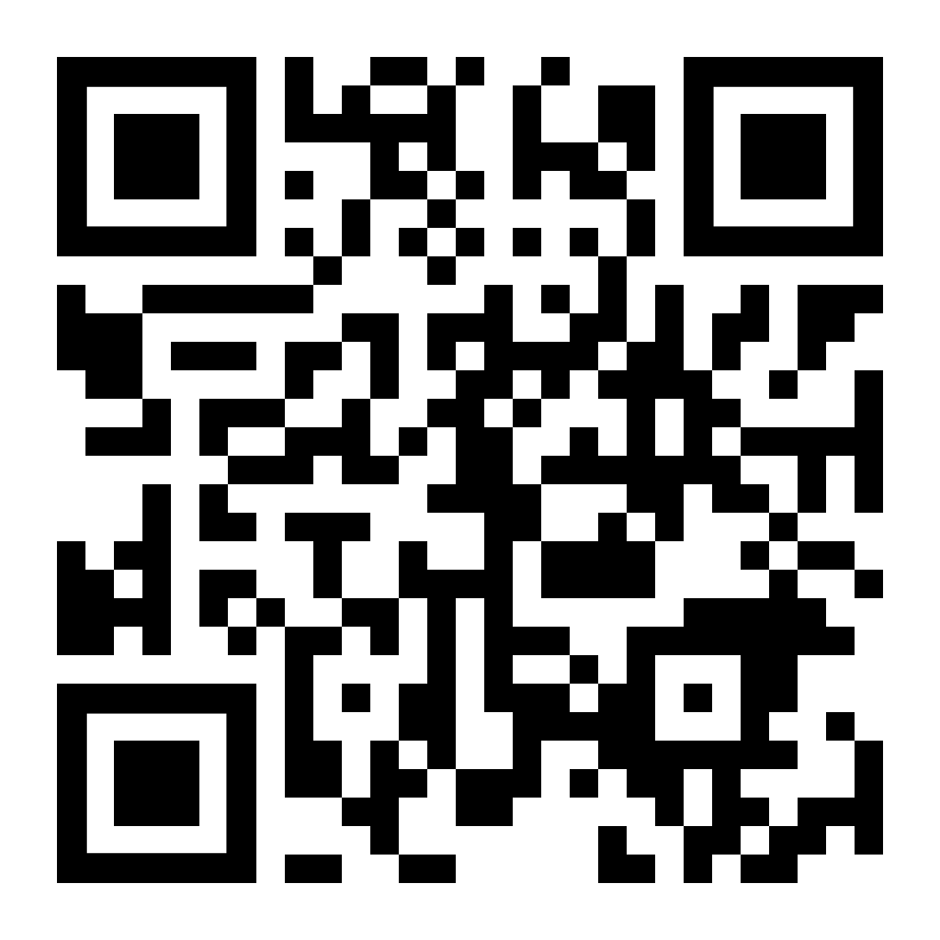
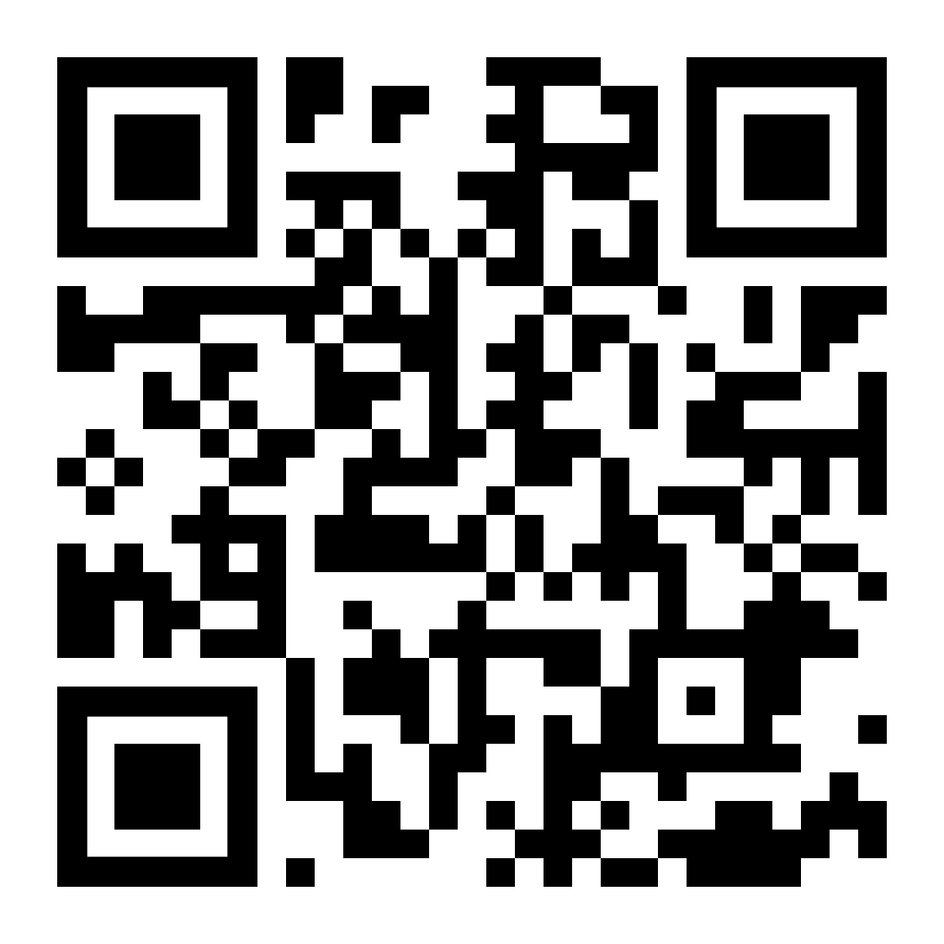
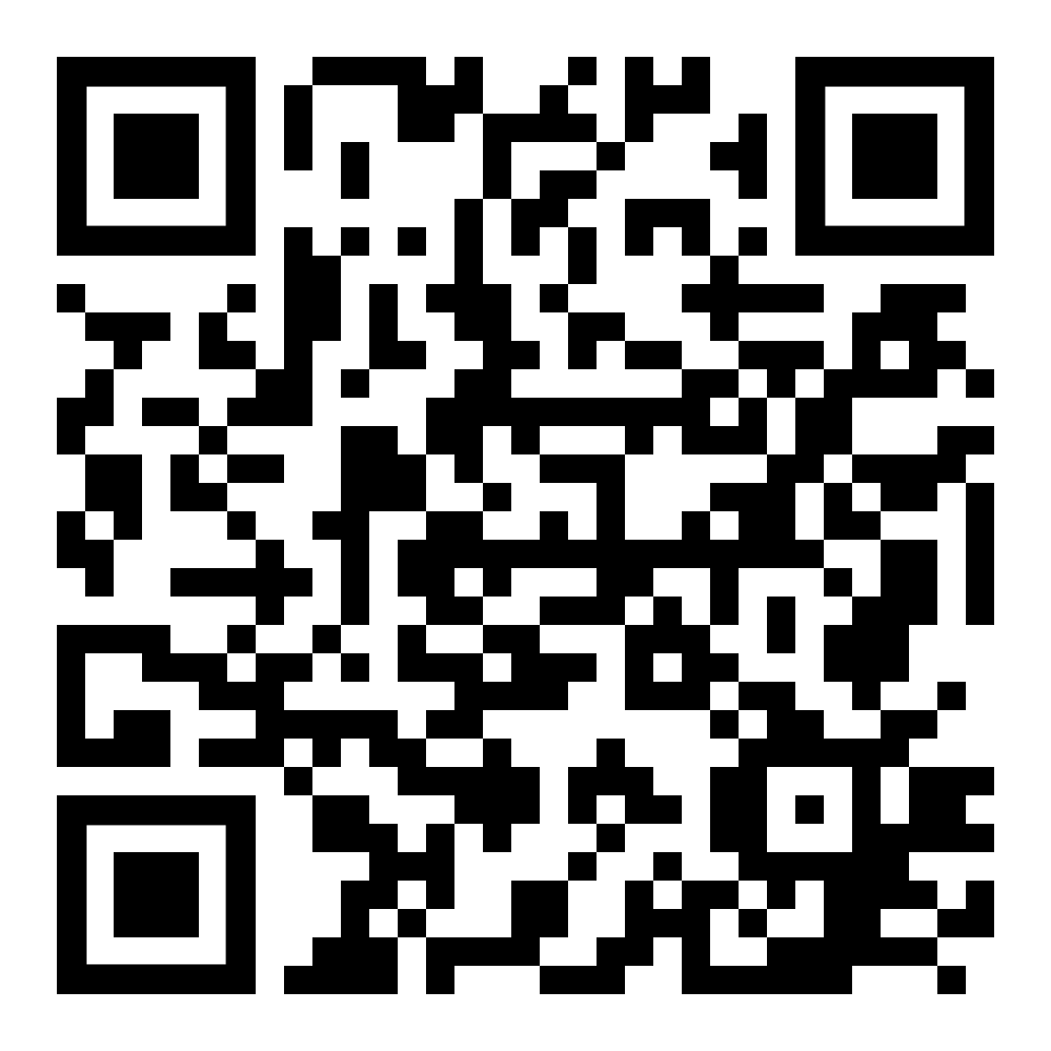

The Learning Commons, Allan Edmond, Assistant Director
The Learning Commons is Queens College's primary Academic Support Center.
Services Offered:
  1-1 and Small Group Tutoring
  Academic Workshops
  Study Space
  Printing Services
Location: Kiely Hall, Room 131
Fall 2026 Hours of Operation:
  Monday – Thursday, from 10AM - 6PM
Study Space Opening Date:
  Tuesday, September 8th, 2026
First Day of Tutoring:
  Monday, September 14th, 2026
Pictured above: Allan Edmond and the FA25 Tutor Cohort
Website
Appointments
Instagram
Contact Us: LCommons@qc.cuny.edu

Slide 9

Transfer Hub​
Ivan Scott Lee, EdD
Senior Director for Transfer Success and Partnerships​
Located on the Lower Level of Frese Hall and equipped with computer stations, the Transfer Hub provides a dedicated space for transfer student engagement and connects students to campus resources and opportunities.
Serves as an administrative unit for several transfer-focused programs and initiatives, including Accelerated Study in Academic Programs (ASAP), Accelerate Complete Engage (ACE), Q-STEM Academy, NSF-S-STEM, Transfer to STEM Student Success (TS3), and CUNY Transfer Explorer (T-Rex), and The Aspen Institute-AASCU Transfer Student Success Intensive (in partnership with LaGuardia and Queensborough Community Colleges).
https://www.qc.cuny.edu/transfer/ | Frese Hall, Lower Level

Slide 10
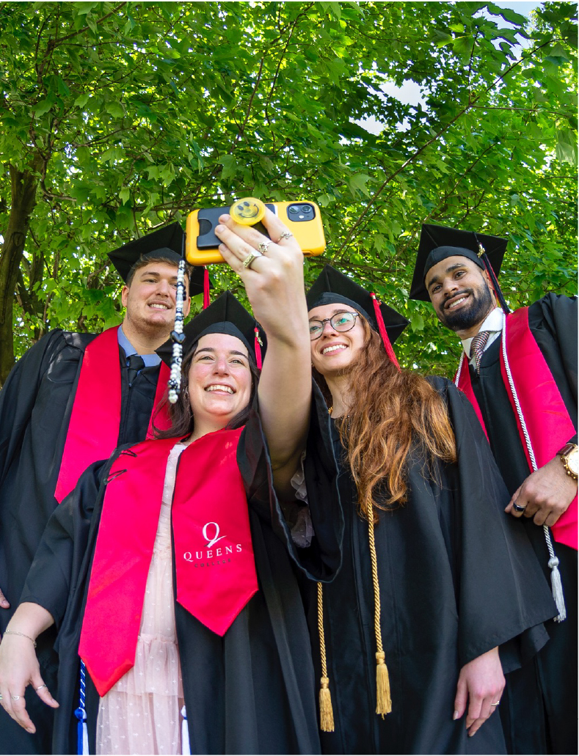

Academic Advising Center, Laura Silverman, Director
The Academic Advising Center is one of the many resources at Queens College committed to providing an educational environment focused on student success.
We provide centralized and integrated academic advising to incoming, continuing, and returning undergraduate students through the articulation and navigation of degree requirements to foster successful completion of the baccalaureate degree.
Advising appointments may be made online via Navigate (navigate.qc.cuny.edu), in person, or via phone. Students have the option to select their preferred meeting modality (in-person or virtual).
(718) 997-5599; Kiely Hall, Room 217; advising@qc.cuny.edu; https://www.qc.cuny.edu/aac/

Slide 11
Center for Career Engagement & Internships
Center for Career Engagement & Internships, Melissa Faulkner, Executive Director
Career Planning & Preparation Workshops:
Identify your skills, interests, and opportunities
Resume, cover letter, & job search
Networking and Interviewing
Prepare and attend recruitment and networking events:
Employer and alumni career panels & information sessions
Career & internship fairs
Career Coaching appointment scheduled on QC Navigate:
Review resume and cover letters
Prepare for interviews using STAR method
Review the FOCUS 2 assessment and explore career opportunities
Review career maps & create an action plan
Search for and apply to internships and jobs
Utilize career resources: Handshake, Vault, and LinkedIn
Meet with a LEADS advisor to discuss disability advocacy
Apply for a $2,700 internship stipend (based on funding & application review)
Enroll in an academic course: World of Work Class COOP 201 (1, 2, or 3 Credits)
www.qc.cuny.edu/career

Slide 12


Experiential Education
Experiential Education
Cristina Di Meo, Director
Students: The office connects students to experiential learning opportunities, including internships, community-engaged learning, community service, and more.
Faculty: The office supports faculty in integrating community-engaged and career-connected learning into the classroom.
Website: www.qc.cuny.edu/academics/ee/
Email: experientialeducation@qc.cuny.edu
Room: Frese Hall, First Floor, Room 102
Phone: 718-570-0565
Instagram: @qcexped

Slide 13
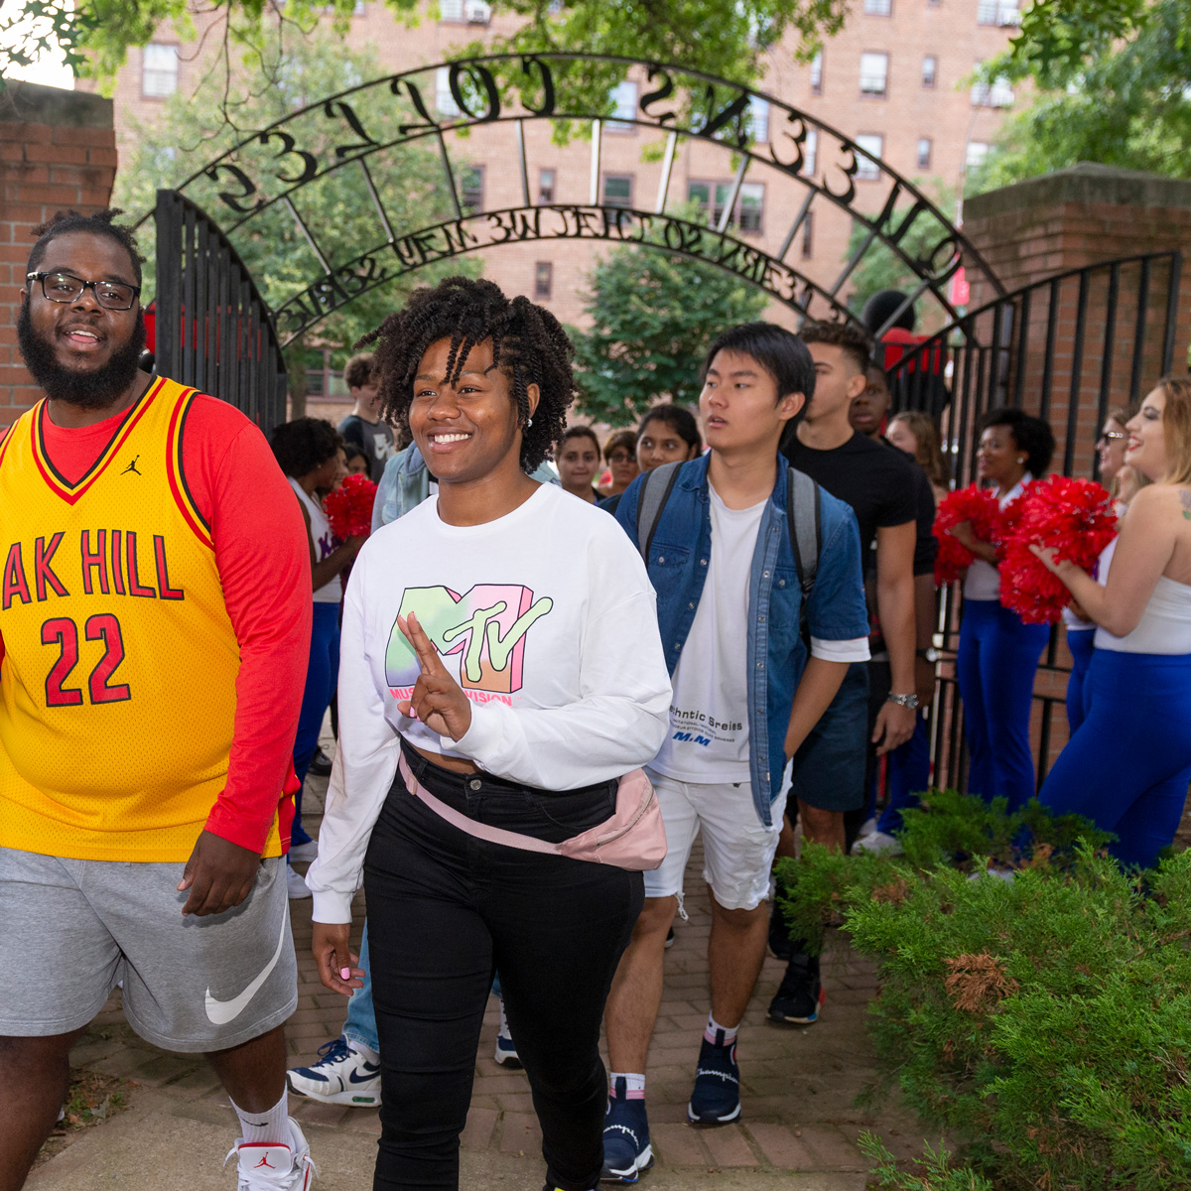
Prelaw Advising
Prelaw Advising, Keena Lipsitz, PhD., Professor & Advisor
Over 500 prelaw students with the largest number coming from Political Science, Computer Science, Psychology, Accounting, and Economics
The QC Prelaw Program hosts ~15 events per year, including lunches with lawyers and judges, and workshops to help with law school applications
One-on-one advising with Prof. Lipsitz is available year-round for students and alumni
Students can contact Prof. Lipsitz at klipsitz@qc.cuny.edu or through the prelaw website (https://www.qc.cuny.edu/academics/pre-law/)
Pre-Law Advising | Queens College, CUNY

Slide 14
Health Professions Advisory Services Program
Health Professions Advisory Services Program, Valli Cook, MBA, MS.ED, Director & Advisor
Mika Vesanen, PhD Biology, Part Time Advisor
Ms. Xiomara GuzmanAcha, Office Staff
SB B338 718 997-3470
Health.prof@qc.cuny.edu
The Queens College Health Professions Advisory Services Office provides information and advice to students who plan to apply to one of the following health professional schools:
dental, medicine, optometry, pharmacy, podiatry, and/or veterinary medicine.
Many of these professional schools prefer a Queens College applicant to have more than the minimum requisites posted on their webpage. The HPAS Office advises students on all areas of the application process which will assist the student in being a strong applicant.
Health Professions Advisory Services - Health Professions Advisory Services

Slide 15
Questions?

