Slide 1
Title
^{Date}

Slide 2
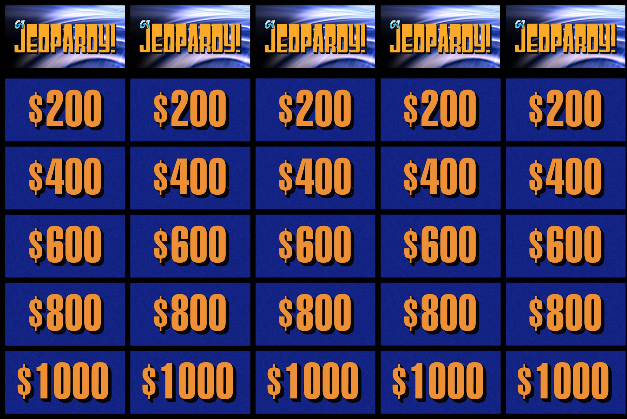
Topic 1
Topic 2
Topic 3
Topic 4
Topic 5
Topic 6

Slide 3
Topic 1:
$200
Question Here
[Delete this]
Use your arrow key
to reveal the answer on the next slide

Slide 4
Answer Here
[Delete this]
This image will hyperlink
back to your homepage

Slide 5
Topic 1:
$400
Question Here

Slide 6
Answer Here

Slide 7
Topic 1:
$600
Question Here

Slide 8
Answer Here

Slide 9
Topic 1:
$800
Question Here

Slide 10
Answer Here

Slide 11
Topic 1:
$1000
Question Here

Slide 12
Answer Here

Slide 13
Topic 2:
$200
Question Here

Slide 14
Answer Here

Slide 15
Topic 2:
$400 Question Here

Slide 16
Answer Here

Slide 17
Topic 2:
$600
Question Here

Slide 18
Answer Here

Slide 19
Topic 2:
$800
Question Here

Slide 20
Answer Here

Slide 21
Topic 2:
$1000
Question Here

Slide 22
Answer Here

Slide 23
Topic 3:
$200
Question Here

Slide 24
Answer Here

Slide 25
Topic 3:
$400
Question Here

Slide 26
Answer Here

Slide 27
Topic 3:
$600
Question Here

Slide 28
Answer Here

Slide 29
Topic 3:
$800
Question Here

Slide 30
Answer Here

Slide 31
Topic 3:
$1000
Question Here

Slide 32
Answer Here

Slide 33
Topic 4:
$200
Question Here

Slide 34
Answer Here

Slide 35
Topic 4:
$400
Question Here

Slide 36
Answer Here

Slide 37
Topic 4:
$600
Question Here

Slide 38
Answer Here

Slide 39
Topic 4:
$800
Question Here

Slide 40
Answer Here

Slide 41
Topic 4:
$1000
Question Here

Slide 42
Answer Here

Slide 43
Topic 5:
$200
Question Here

Slide 44
Answer Here

Slide 45
Topic 5:
$400
Question Here

Slide 46
Answer Here

Slide 47
Topic 5:
$600
Question Here

Slide 48
Answer Here

Slide 49
Topic 5:
$800
Question Here

Slide 50
Answer Here

Slide 51
Topic 5:
$1000
Question Here

Slide 52
Answer Here

Slide 53
Topic 6:
$200
Question Here

Slide 54
Answer Here

Slide 55
Topic 6:
$400
Question Here

Slide 56
Answer Here

Slide 57
Topic 6:
$600
Question Here

Slide 58
Answer Here

Slide 59
Topic 6:
$800
Question Here

Slide 60
Answer Here

Slide 61
Topic 6:
$1000
Question Here

Slide 62
Answer Here

