Slide 1

Slide 1
Brightspace Discussions Guide
A note about Brightspace Discussions
In Brightspace, unlike Blackboard, topics must be part of a Forum. If you create a Topic without first creating a Forum, a Forum will automatically be created and take the name of the topic.
Brightspace Discussions © 2024 by CETLL at Queens College CUNY is licensed under CC BY-NC-SA 4.0.
To view a copy of this license, visit ATTRIBUTION-NONCOMMERCIAL-SHAREALIKE 4.0 INTERNATIONAL

Slide 2
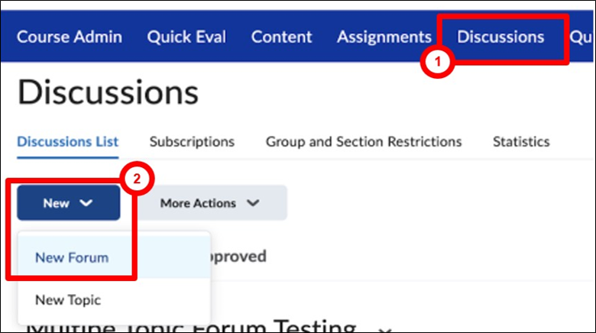
Slide 2
Create a new Discussion Forum
In your Brightspace course, click on Discussions in the Navigation Bar.
Click New and select New Forum from the drop-down menu.

Slide 3
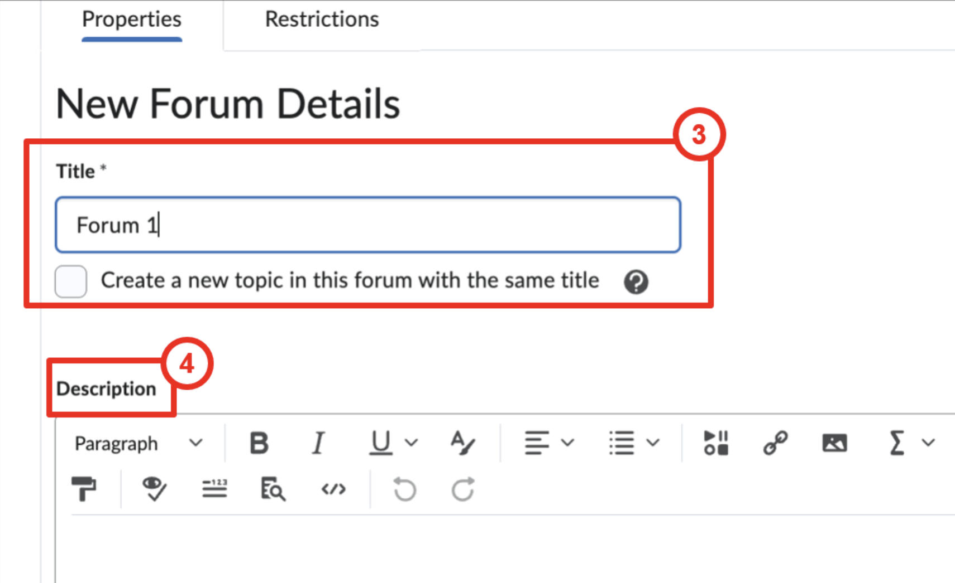
Slide 3
Enter a title and click Create a new topic in this forum with the same title.
Enter a description or instructions.

Slide 4
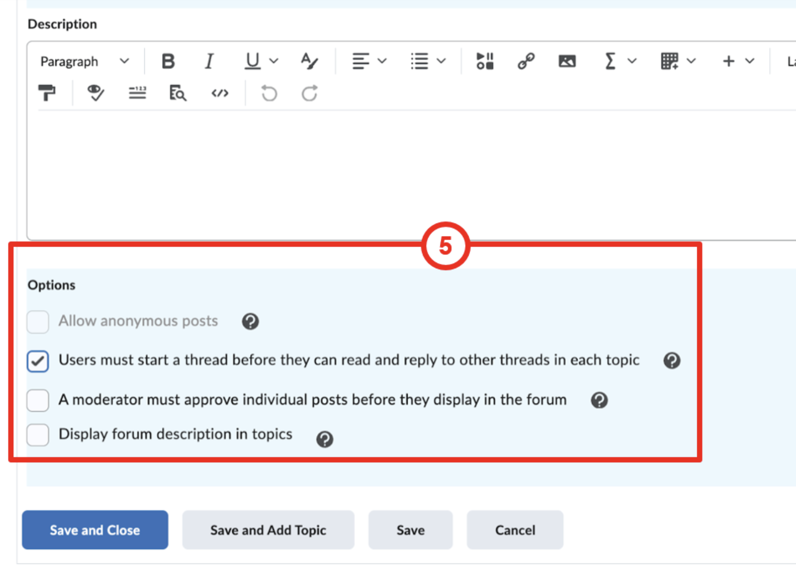
Slide 4
Select desired Forum Options. You can skip this step and select your options on individual topics.

Slide 5
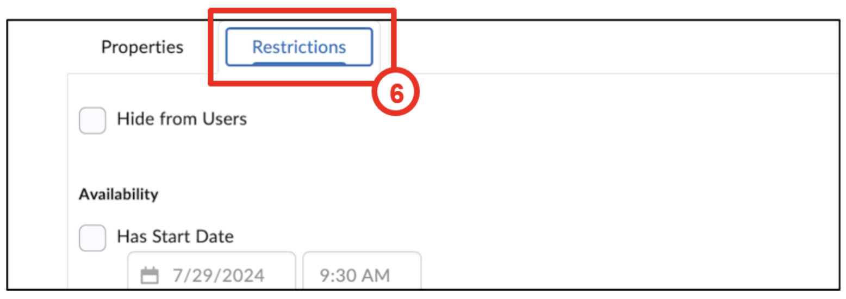
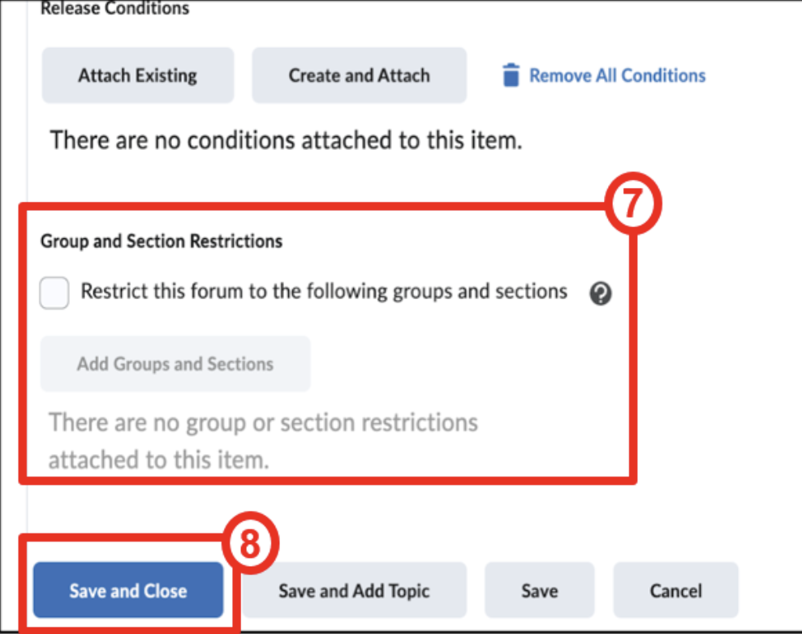
Slide 5
Click on the Restrictions tab to set Availability dates. Note: You can skip steps 6-7 if you prefer to set restrictions on individual topics.
Set additional restrictions as desired.
Click Save and Close

Slide 6
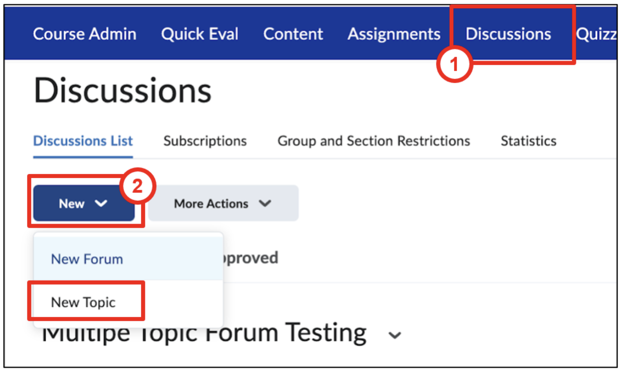
Slide 6
Create a New Topic
If you didn’t select Create a new topic when you created the Forum, create one now:
Click on Discussions in the Navigation Bar.
Click New then select New Topic from the drop-down menu.

Slide 7
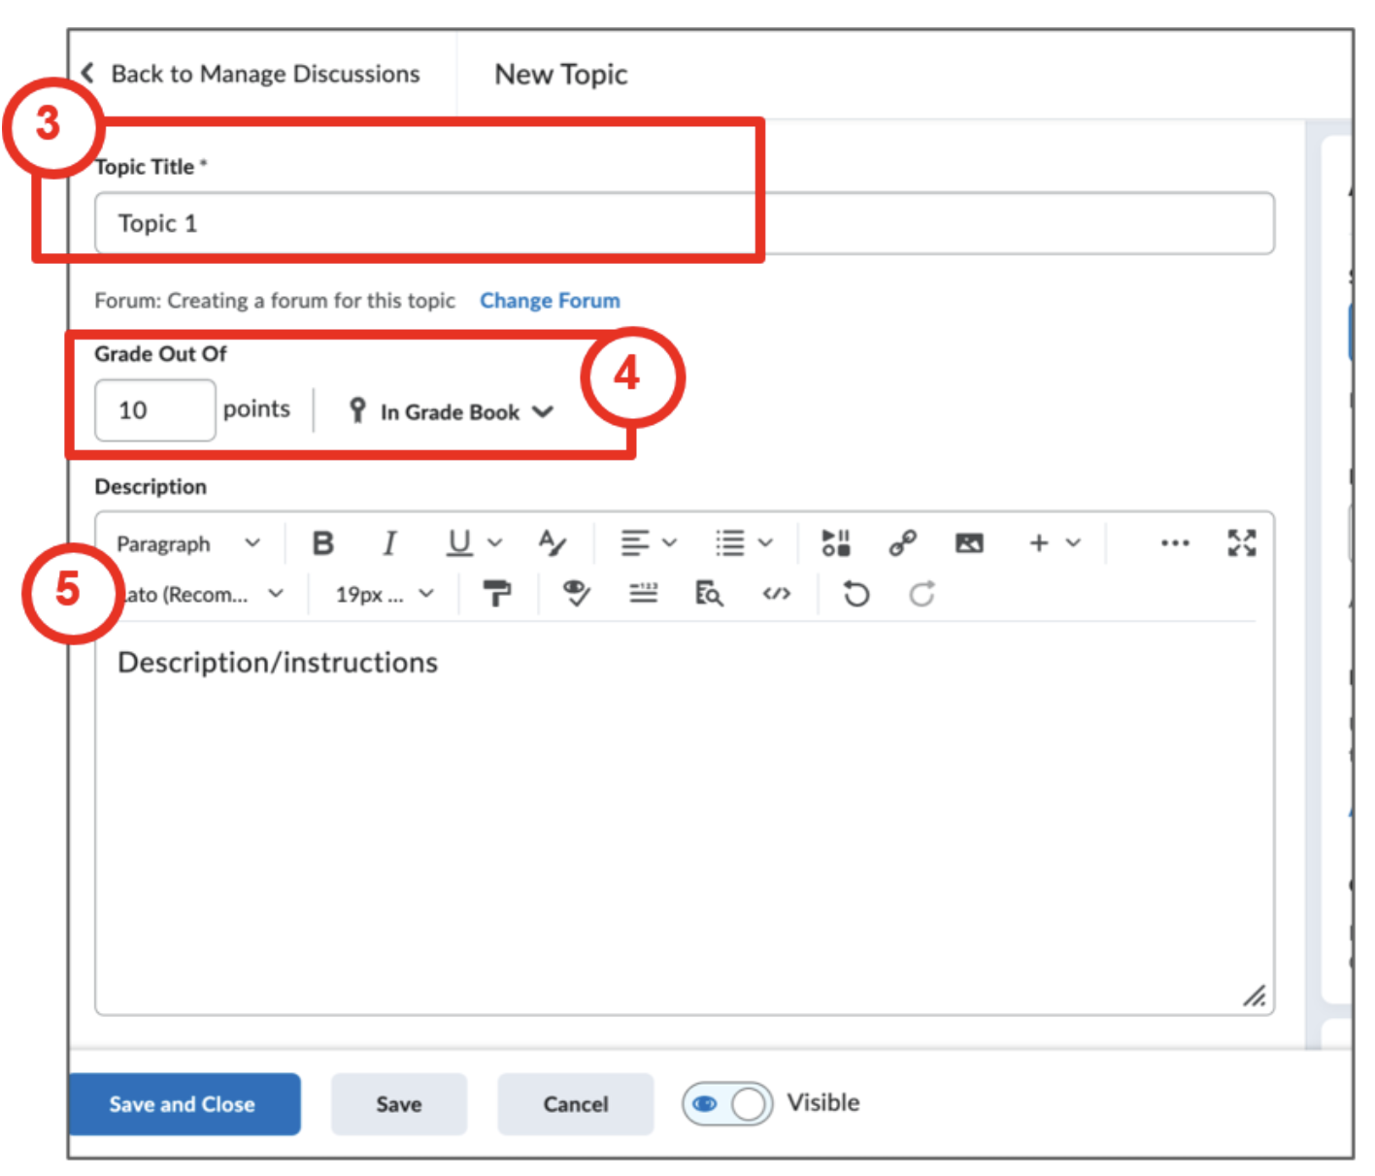
Slide 7
Enter a topic title
Enter Grade points and add it to the Grade Book
Enter a description/instructions or prompt

Slide 8
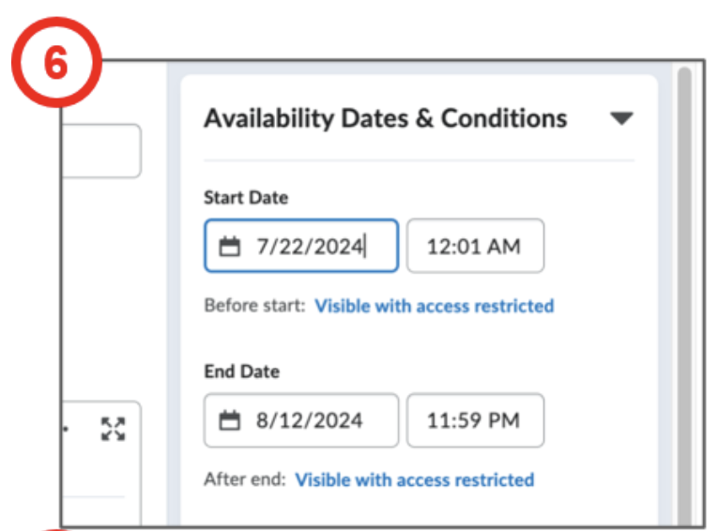
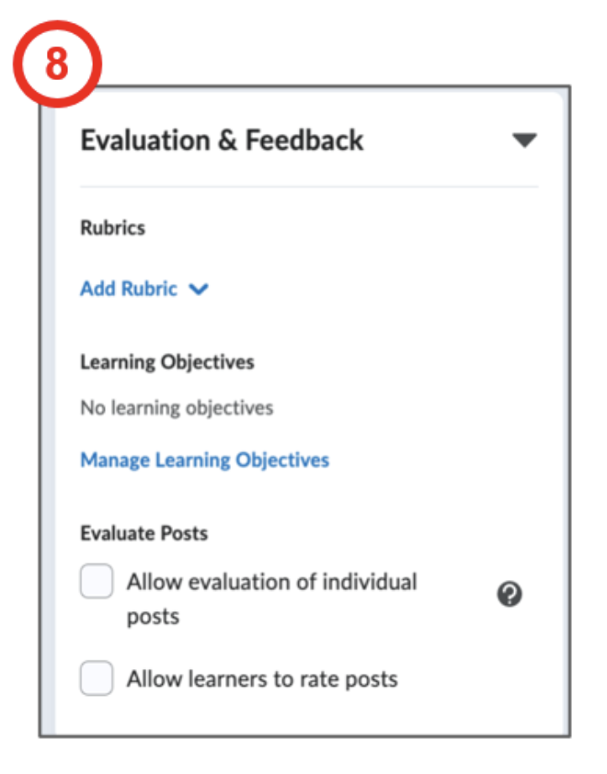
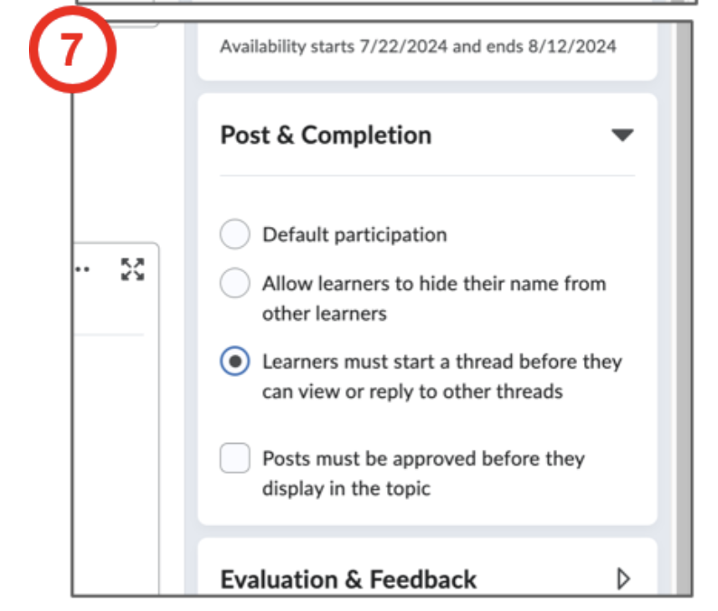
Slide 8
Set availability dates
Select Post & Completion options
Select Evaluation & Feedback options

Slide 9
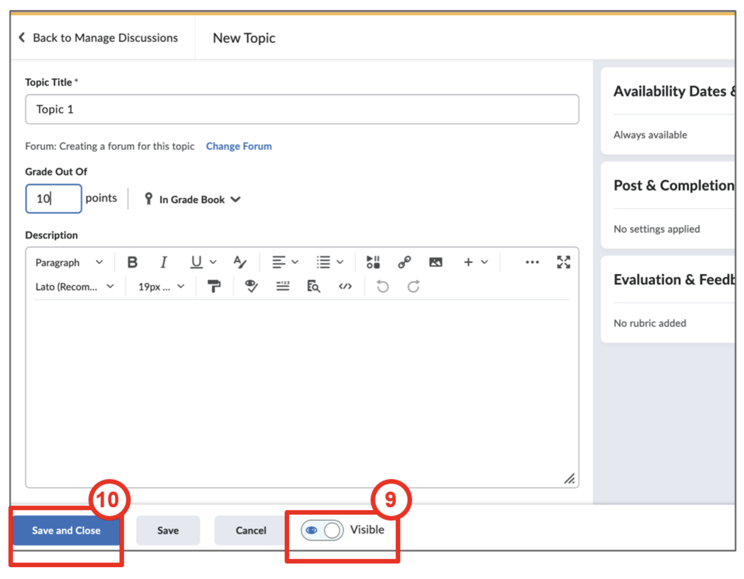
Slide 9
Click the toggle button to make the topic Visible
Click Save and Close

Slide 10
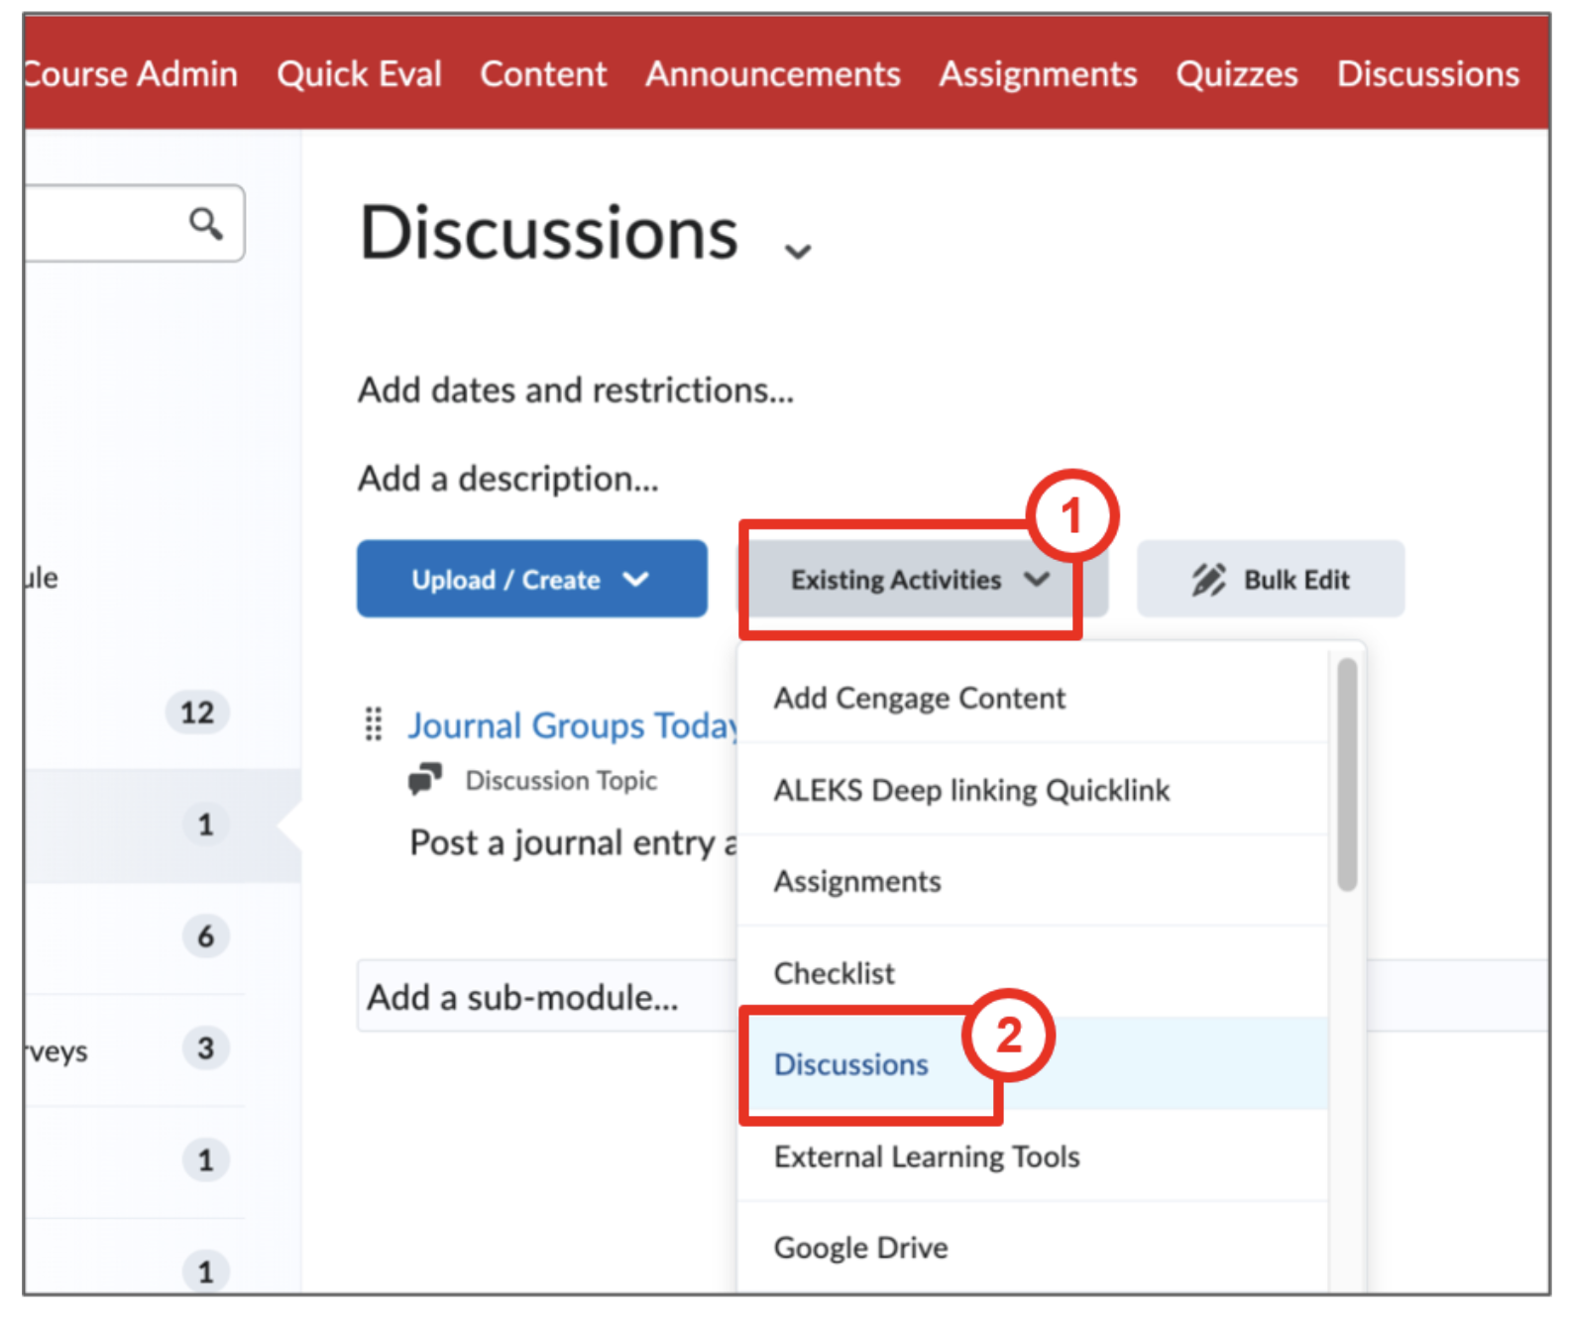
Slide 10
Add the topic to a Content Module
Go to a Content Module and click on the Existing Activities dropdown menu
Click on Discussions

Slide 11
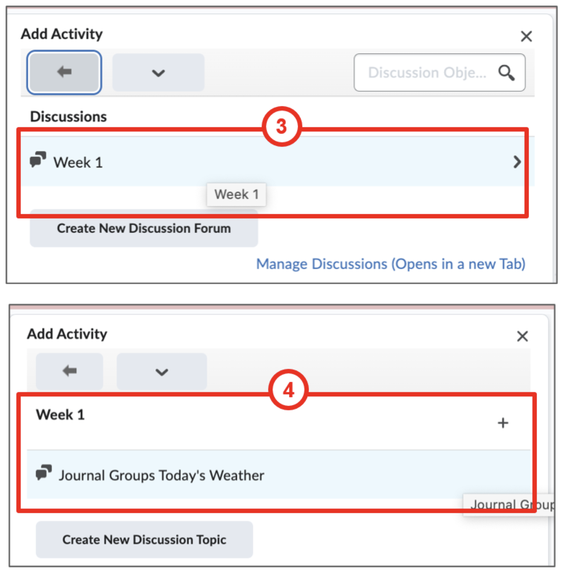
Slide 11
Select a Forum
Select a Topic

Slide 12
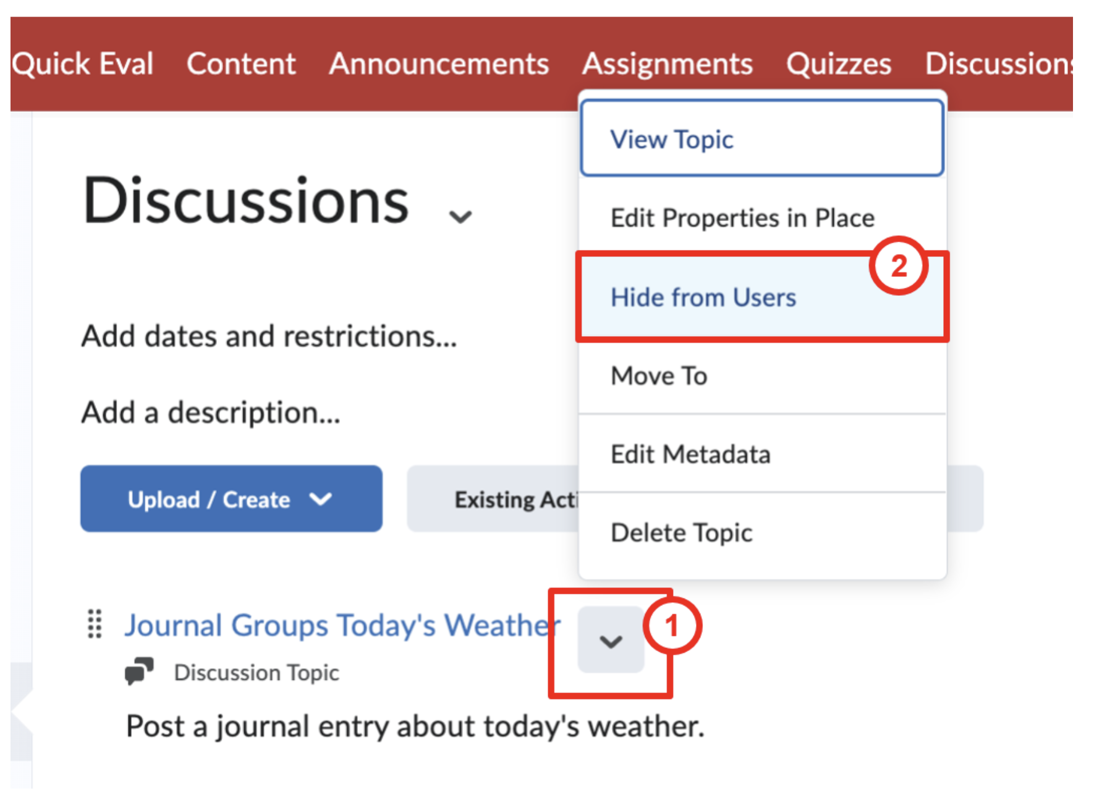
Slide 12
The Discussion has been added to the Content Module and is visible to learners.
To hide it from learners:
click on the chevron (arrow) next to the Discussion name
and select Hide from Users

