Slide 1
Pre-Title (Optional)
(Helvetica Regular 28 pt White)
Title (Helvetica Bold 38 pt White)
September 14, 2024
(Date is optional) Helvetica Regular 28pt White

Slide 2
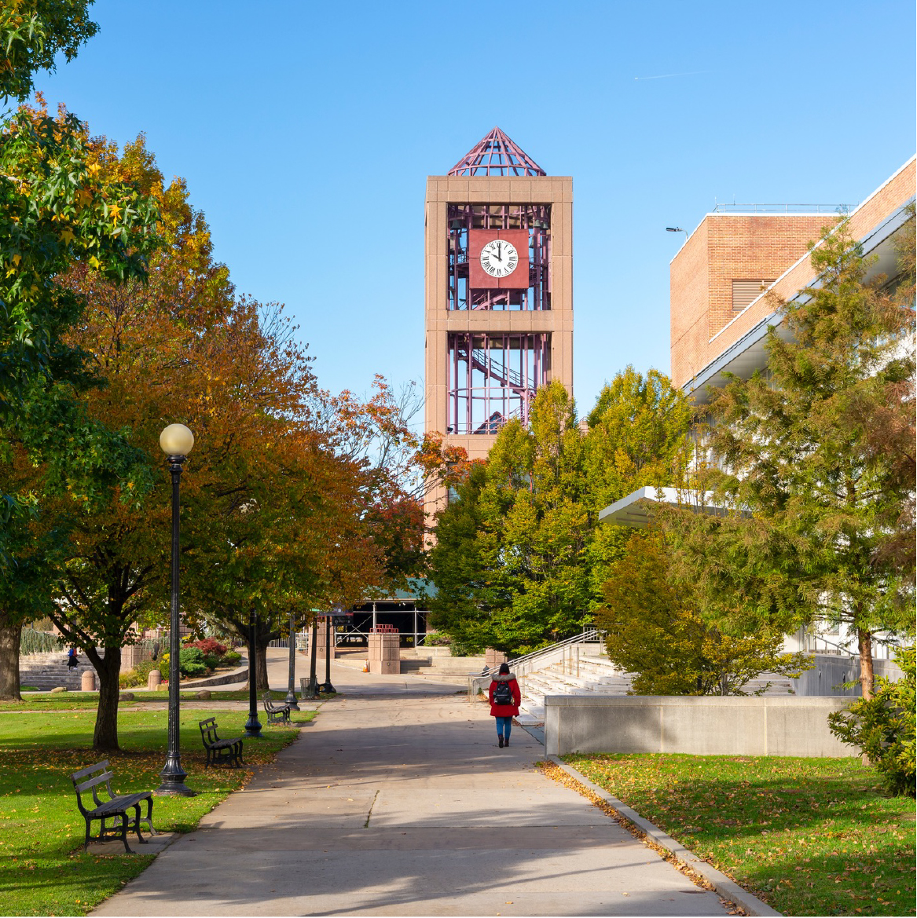
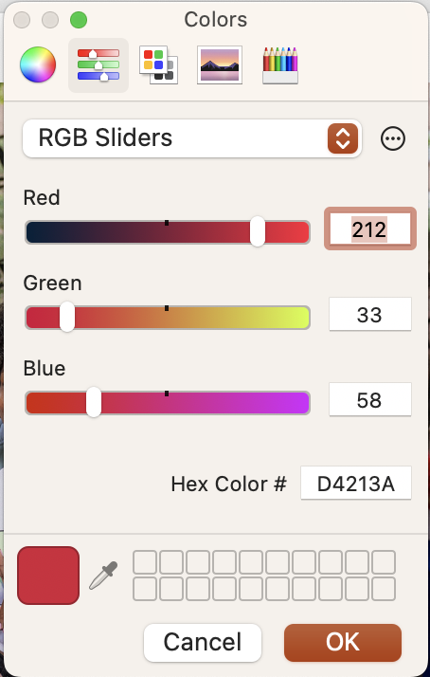
Heading
(Helvetica Bold 20pt - red)
Helvetica regular 18pt. Maintain same size text throughout presentation, editing copy as needed.
Helvetica regular 18pt. Maintain same size text throughout presentation, editing copy as needed.
Helvetica regular 18pt. Maintain same size text throughout presentation, editing copy as needed
Red color value
www.qc.cuny.edu/ (URL is optional)

Slide 3



Heading – 2-Column Text Layout
(Helvetica Bold 20pt - red)
Sub-heading (Helvetica 18pt Bold)
Helvetica regular 18pt. Maintain same size text throughout presentation, editing copy as needed.
Helvetica regular 18pt. Maintain same size text throughout presentation, editing copy as needed.
Sub-heading (Helvetica 18pt Bold)
Helvetica regular 18pt. Maintain same size text throughout presentation, editing copy as needed.
Helvetica regular 18pt. Maintain same size text throughout presentation, editing copy as needed.
Name
12 pt Helvetica Regular
Name
12 pt Helvetica Regular
Name
12 pt Helvetica Regular
www.qc.cuny.edu/ (URL is optional)

Slide 4

Heading – 1-Column Layout (Helvetica Bold 20pt - red)
Helvetica regular 18pt. Maintain same size text throughout presentation, editing copy as needed.
Helvetica regular 18pt. Maintain same size text throughout presentation, editing copy as needed.
Helvetica regular 18pt. Maintain same size text throughout presentation, editing copy as needed.
Helvetica regular 18pt. Maintain same size text throughout presentation, editing copy as needed.
www.qc.cuny.edu/ (URL is optional)

Slide 5



Heading – 3-Column Layout (Helvetica Bold 20pt - red)
www.qc.cuny.edu/ (URL is optional) Helvetica Regular default link color

Slide 6


Heading – 3-Column Layout (Helvetica Bold 20pt - red)
Helvetica regular 18pt. Maintain same size text throughout presentation, editing copy as needed.
Helvetica regular 18pt. Maintain same size text throughout presentation, editing copy as needed.
Helvetica regular 18pt. Maintain same size text throughout presentation, editing copy as needed
www.qc.cuny.edu/ (URL is optional) Helvetica Regular default link color

Slide 7
2-Column Text Layout
(Helvetica Bold 20pt - red)
We recommend using a red bar between blocks of text when using a 2-column text layout
Sub-heading (Helvetica 18pt Bold)
Helvetica regular 18pt. Maintain same size text throughout presentation, editing copy as needed.
Helvetica regular 18pt. Maintain same size text throughout presentation, editing copy as needed.
Sub-heading (Helvetica 18pt Bold)
Helvetica regular 18pt. Maintain same size text throughout presentation, editing copy as needed.
Helvetica regular 18pt. Maintain same size text throughout presentation, editing copy as needed.
Sub-heading (Helvetica 18pt Bold)
Helvetica regular 18pt. Maintain same size text throughout presentation, editing copy as needed.
Helvetica regular 18pt. Maintain same size text throughout presentation, editing copy as needed.
Sub-heading (Helvetica 18pt Bold)
Helvetica regular 18pt. Maintain same size text throughout presentation, editing copy as needed.
Helvetica regular 18pt. Maintain same size text throughout presentation, editing copy as needed
www.qc.cuny.edu/ (URL is optional)

Slide 8
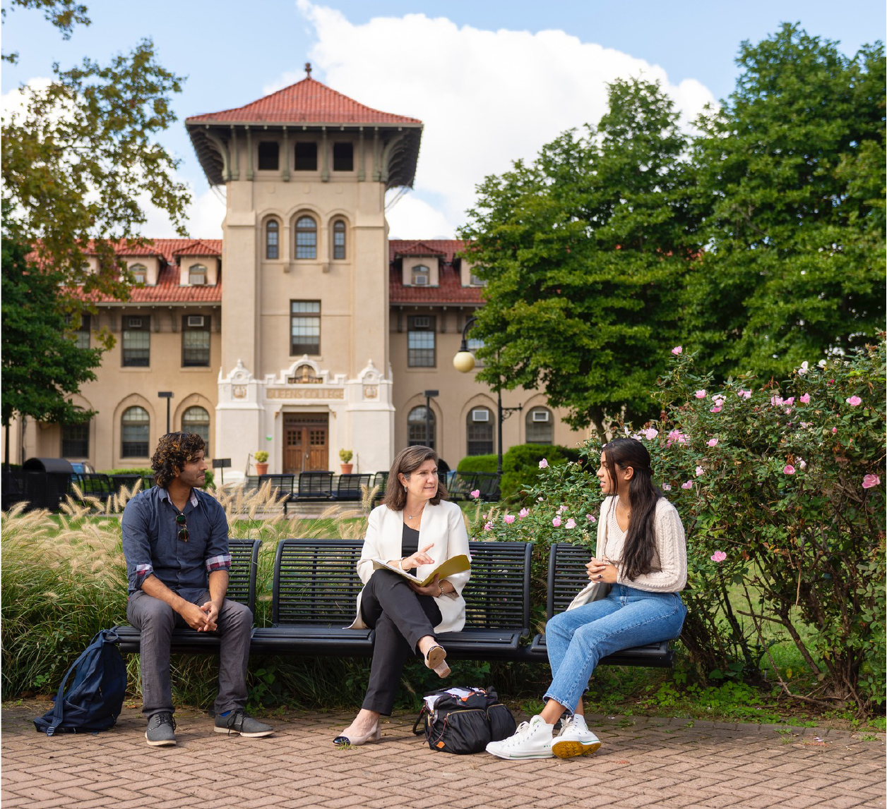
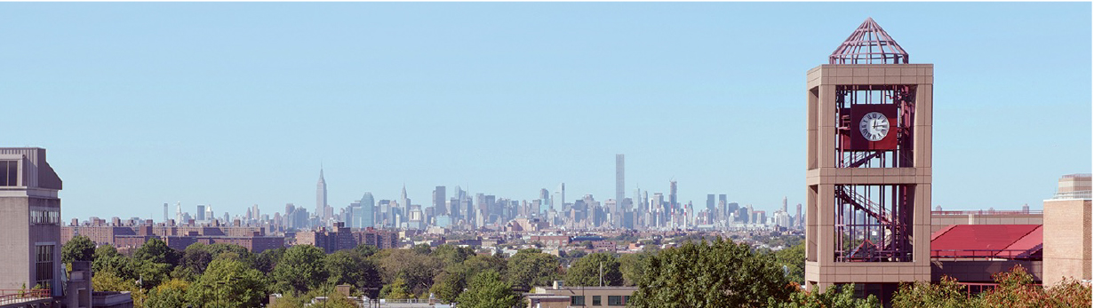
Images
When adding images to your presentation please make sure the images are clear and sharp. The Office of Communications and Marketing has general campus and student photos. If you need these types of images for your presentation please contact Adrian.partridge@qc.cuny.edu or Pablo.Flores@qc.cuny.edu. Please enter “Photo Request” in subject line, let us know the type of image required and approximate size, (large, medium, small, rectangle, square etc.
www.qc.cuny.edu/ (URL is optional)

Slide 9

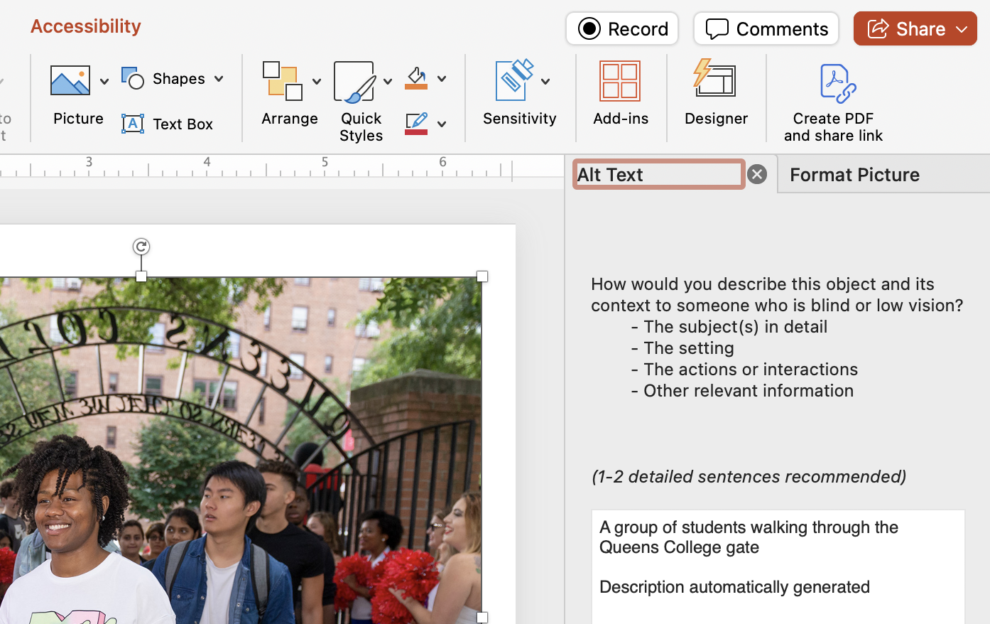
Images
To comply with ADA standards, please add “Alt Text” descriptions for every image
Click on image
The “Accessibility tag” can be found on the far right
Fill in the “Alt text” box
www.qc.cuny.edu/ (URL is optional)

Slide 10
Chart Heading
Chart Layout. Text for charts should not be smaller than 12pt. Please limit you color selection to the group below
Chart Colors
RGB (112, 48, 160) | RGB (0, 176, 80) | RGB (0, 176, 240) | RGB (112, 48, 160) | RGB (255, 255, 0)
www.qc.cuny.edu/ (URL is optional)

Slide 11
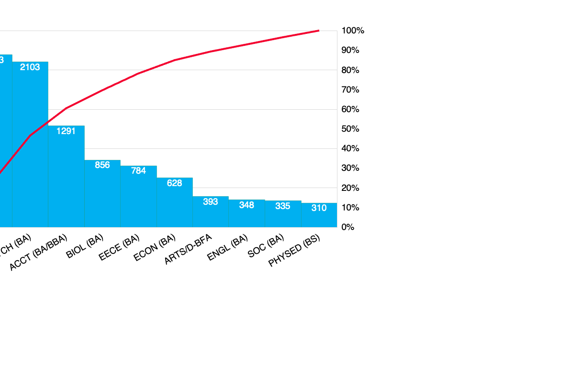
Enrollment for Top Majors at Queens College (Helvetica Bold 20pt - red)
Frequency of
Student Enrollees
(18pt)
Chart Text 14pt Helvetica Regular
Undergraduate Majors (18pt)
www.qc.cuny.edu/ (URL is optional)

Slide 12
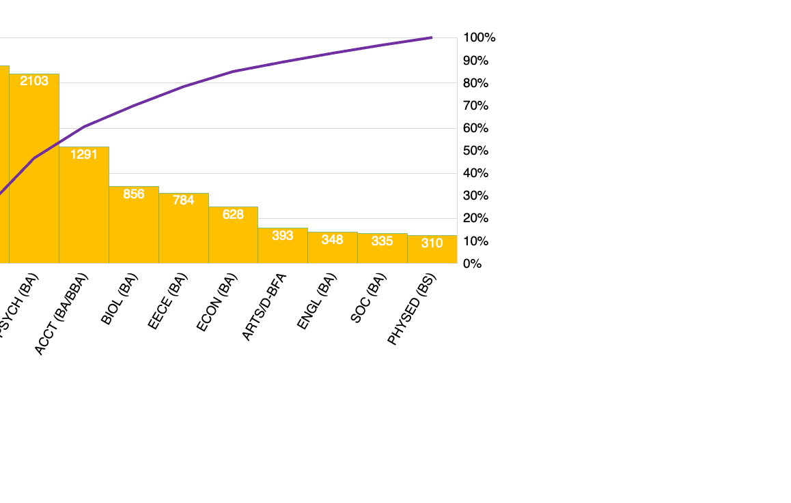
Enrollment for Top Majors at Queens College (Helvetica Bold 20pt - red)
Frequency of
Student Enrollees
(18pt)
Chart Text 14pt Helvetica Regular
Undergraduate Majors (18pt)
www.qc.cuny.edu/ (URL is optional)

Slide 13
Queens College (Helvetica Bold 20pt - red)
www.qc.cuny.edu/ (URL is optional)

Slide 14
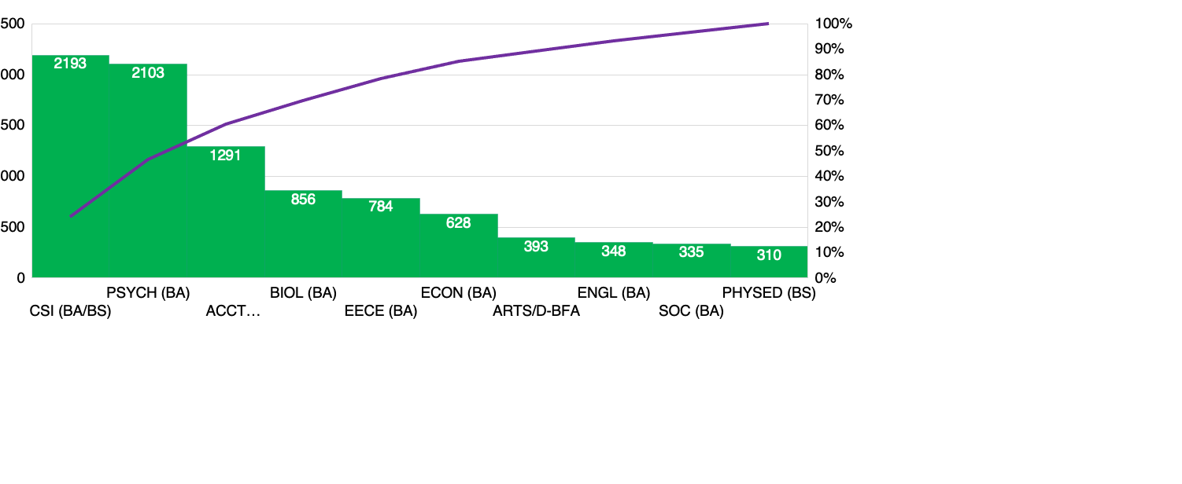
Enrollment for Top Majors at Queens College (20pt Heading on Red Background)
Frequency of Student Enrollees (18pt) Chart Text 14pt Helvetica Regular Undergraduate Majors (18pt)
www.qc.cuny.edu/ (URL is optional)

Slide 15
Closing message/line (Helvetica 32pt)

