Slide 1
Student Success Collaborative
Navigate
Quick Start Guide for Navigate
Queens College has launched the Navigate platform for advisors and others, with the goal of helping students explore a path to timely graduation completion with data, services, and supportive connections. Use this Quick Start Guide to make the most of your experience.
GETTING STARTED
Login to Navigate using your university credentials!
https://qc-cuny.navigate.eab.com/staff
Configure Availability and Calendar for Appointment Scheduling
Set Up Your Availability - This is an important first step that will allow you to then create appointments with students by selecting the ‘Add Time’ from your Staff home screen - see Appendix A for detailed instructions on setting up your Availability.
KEY PLATFORM FEATURES
Perform These Key Actions to Identify, Communicate With, and Support Students
Reference the Student Profile – After clicking on a student’s name through the search results, your Staff Home, or the Quick Search, note their Academic progress and any areas of concern with the various tabs on a student’s profile
Add Notes or Advising Summary Reports – Record your interactions and follow-ups from student meetings by adding an Advising Summary Report (record associated with an appointment) or a Note (general record not associated with a specific meeting)
Both are accomplished through the ‘Actions’ menu on your Staff home or search results, or from a student’s profile.
Reminder! For scheduled appointments, add summary reports from the “Upcoming Appointments” tab of the staff home.
Mass Email a Group of Students – Use ‘Send a Message’ from the ‘Actions’ drop-down to contact your Assigned Advisees list or other lists you’ve created in the platform.
Create an Appointment Campaign - Use this to invite students set up an advising appointment during times you have designated –
From the ‘Actions’ menu on your list, select ‘Appointment Campaign’ – See Appendix C for detailed instructions on creating a campaign.

Slide 2
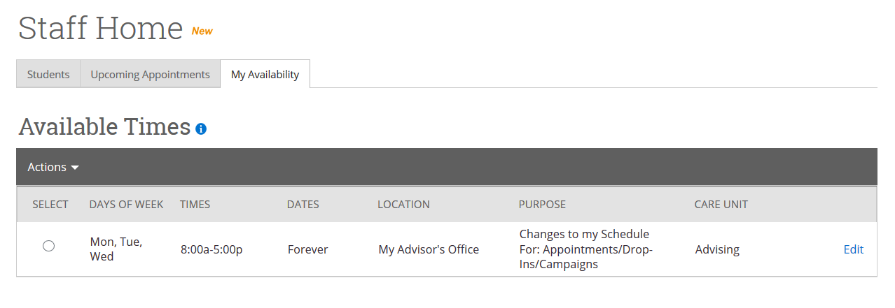
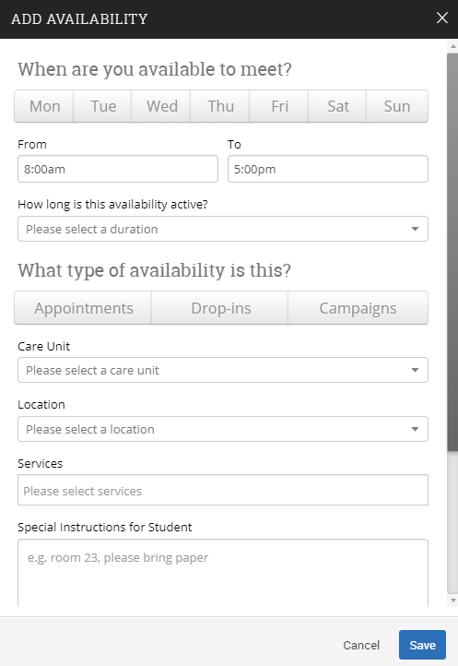
Appendix A: Setting Up Your Availability
Availability
As a new user, the first thing you need to do is set up availability so that students can schedule appointments to see you. It is important to note that locations and services are created by university administrators.
Add Time -
Step 1: Click the Add Time button in the Actions Menu
Step 2: Select the days and times when you are available to meet with students.
Step 3: Select whether you will meet with students via appointments or drop-ins during that time. The campaign option is availability reserved specifically as dedicated time for targeted students to make appointments with you.
Step 4: Choose the location where you will be available.
Step 5: Lastly, select which student services you can provide to students during this time.

Slide 3
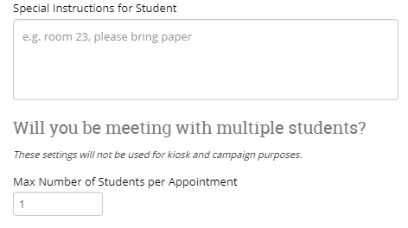
Appendix A: Setting Up Your Availability
Step 6: Click the Save button.
Repeat this process until all of your availabilities have been defined.
Note: You can have as much availability as needed.
There are two other options when adding Times Available.
Copy Time - to copy a time, select the time you would like to copy and then click the Copy Time button. The availabilities will be copied and a dialog will open allowing you to make edits or to save your newly created availability.
Delete Time- to delete your time, simply select the time and click the Delete Time button.
Note: Inactive availabilities are highlighted in red in the Times Available grid.
Tip –
Use the Special Instructions box under “Add Availability” to include personalized information, such as your office room number and location.
Tip –
You are now able to create availability for group appointments by indicating how many students are able to schedule into the same appointment.

Slide 4
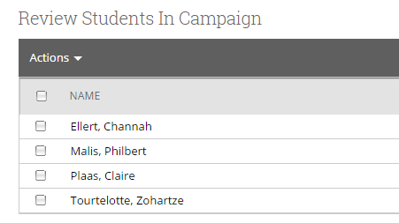
Appendix C: Creating an Appointment Campaign
Navigating to Campaigns: While on the staff home screen, select “Appointment Campaigns” from the left hand side Quick Links section. This will take you to the Campaigns tab. From there, select Appointment Campaign from the right hand side, under Actions.
Define Campaign:
Name your campaign (Students will not see the name of the campaign)
Select “Advising” as the Care Unit (or the applicable Care Unit for your campaign)
Location- Choose your location. NOTE: Ensure that for the campaign availability you have created under “My Availability” you have selected that you will be available in the same location (Advisor’s office).
Under “Service”, choose the services for which you are available. NOTE: This must match the availability you have set up on your staff home page, under “My Availability”. In that screen, you must have selected matching appointment reasons. For example, if in your advising campaign you say you will be available for “Registration”, you must also have chosen “Registration” as a service you are available for in your campaign appointment availability.
Begin Date and End Date- choose the date range for which you want the campaign to run. If a student tries to schedule outside of that time period, they will receive a message stating that the campaign has expired. NOTE: This must match the availability you have set up on your staff home page, under “My Availability”. Ensure that you have created CAMPAIGN availability (as opposed to appointment or drop in availability) during the timeframe that you would like your campaign to run.
Appointment Limit- how many appointments can the student schedule for the campaign? (default is 1)
Appointment Length- how long do you want the appointment to last?
Select 1 slot per time (select more if you’d like more than 1 student to select the same time slot)
Adding Students: Use the advanced search feature to search for students you would like to participate in the campaign. Or, choose one of your saved searches by clicking the drop down arrow beside “Saved Searches”. If you want to ensure that you only return a list of students assigned to you, also click the box beside “My Students Only) next to the Search button. Select the students you wish to include in your campaign. Confirm the list of students included and remove or add students as needed.

Slide 5
Appendix C: Creating an Appointment Campaign
Adding Staff: If you have correctly set up your availability for Campaigns then you should see your name on the next page under “Add Advisors to Campaign”. If applicable, select other advisors to join your campaign.
Compose Your Message:
Create a Subject Line for your email
In the next box, edit the text for the email. Default is “Please schedule your advising appointment”. NOTE: Always be sure to keep the Schedule Link in your email body, if that is removed students will be unable to schedule appointments.
In the instructions and notes box, add any details about the appointment that you would like to display on the scheduling landing page. For example, “This is a registration appointment to ensure you register for Fall 2018 classes. Please bring a list of courses you are interested in.”
As you edit these fields, the text in the box below will show how your edits will appear in the message.
Scroll down to the bottom of the screen. On the left tab, you will see a snapshot of what the email the student receives will look like.
On the right tab, you will see the scheduling landing page. This is where the student will be directed to choose a time for their appointment when they click the link in their email.
Confirm & Send: Review the details of your campaign. When you are ready, click send to issue the email to students on the list.

Slide 6
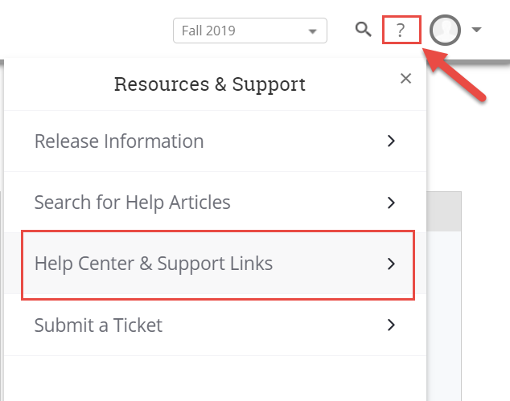
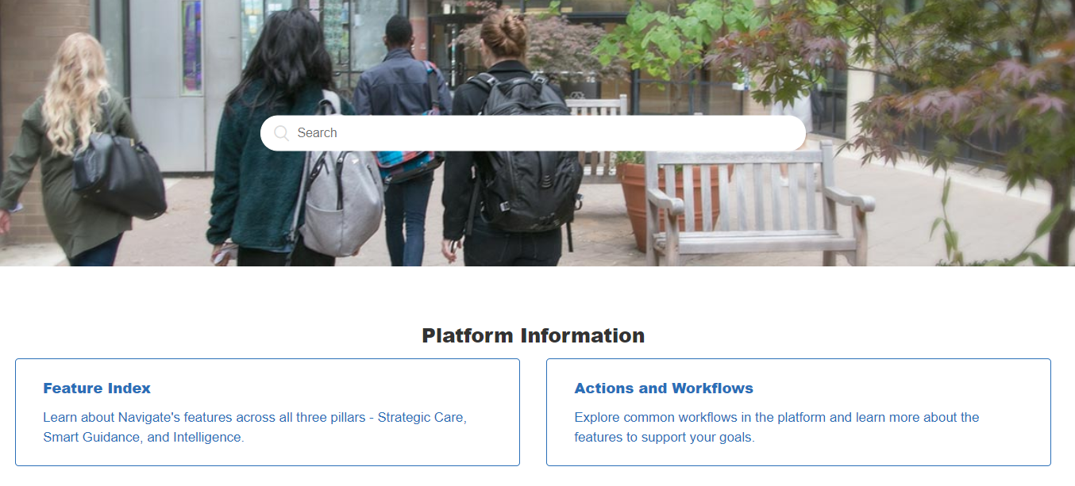
Need Help? Access EAB’s Help Center
Visit the Navigate Help Center for articles and how-to instructions on all Navigate Features and Workflows.
Accessing the Help Center -
Step 1: Log in to Navigate
Step 2: Click on the question mark icon in the top right hand corner.
Step 3: Click Help Center & Support Links from the drop down menu
Step 4: Select Help Center to be taken to articles and step by step instructions for Navigate features and workflows

