Slide 1



UNDERSTANDING
STUDENT
LOANS
Responsibly Financing Your Education

Slide 2

PRESENTATION OBJECTIVES
1
Types of Direct Loans
2
Loan Limits, Interest Rates, Fees
3
Eligibility Requirements
4
How To Apply For A Loan
5
Private Loans

Slide 3



TYPES OF
DIRECT LOANS
We will cover:
Subsidized Loans
Unsubsidized Loans
PLUS Loans

Slide 4
Description
SUBSIDIZED DIRECT LOANS
A Direct Subsidized Loan is a type of federal student loan specifically for undergraduate students who demonstrate financial need, which is determined by the Free Application for Federal Student Aid (FAFSA).
Key Features
The U.S. Department of Education pays the interest during the following periods:
While you're in school: Enrolled at least half-time (Generally 6 credits).
During your grace period: The six-month period after you leave school or drop below half-time enrollment.
During a period of deferment: A temporary postponement of your loan payments.
This prevents the loan's principal balance from growing while you are not required to make payments, which can save you a significant amount of money over the life of the loan

Slide 5

UNSUBSIDIZED DIRECT LOANS
Description
Key Features
Interest begins to accrue the moment the loan is disbursed. You are responsible for all interest accrued.
You can pay the interest while in school or allow it to accumulate and be added to the principal balance (capitalized).
Undergraduate students who are not eligible for the Subsidized loans (they do not have remaining need) are eligible to borrow Unsubsidized loans
Direct Unsubsidized Loans are a type of federal student loan provided to both Undergraduate and Graduate students. These loans are not based on remaining need.

Slide 6
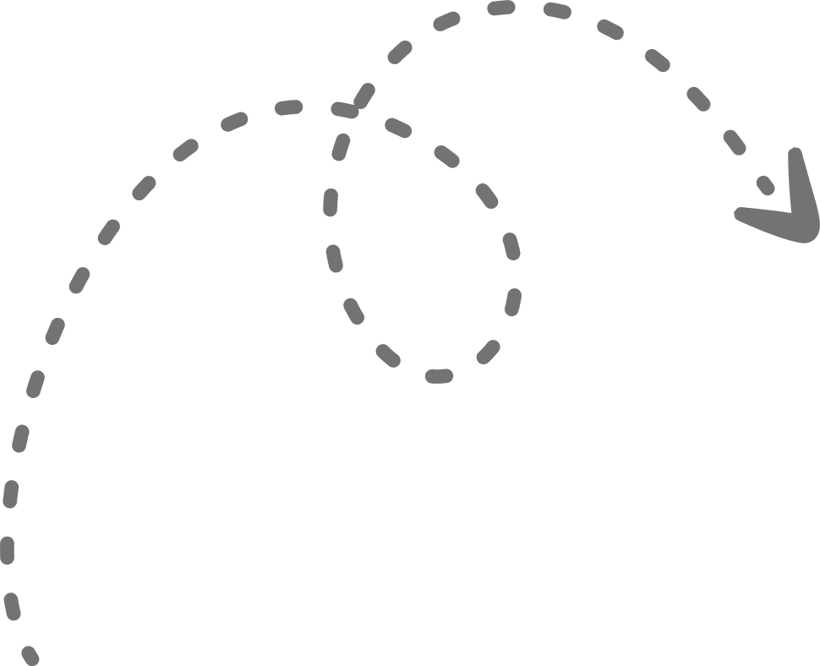
PARENT PLUS LOANS
Description
PLUS Loans are federal loans that parents of dependent undergraduate students can use to help pay for college after students have utilized their Pell Grants/Federal Direct Loans.
Overview
The U.S. Department of Education is your lender.
You must not have an adverse credit history. A credit check will be conducted. If you have an adverse credit history, you may still be able to receive a PLUS loan if you meet additional requirements.
The maximum PLUS loan amount you can receive is the cost of attendance (determined by the school) minus any other financial aid received.
To receive a Parent PLUS loan, you must be the biological or adoptive parent (or in some cases, the stepparent) of a dependent undergraduate student enrolled at least half-time at an eligible school

Slide 7
PARENT PLUS LOANS
A credit check will be performed during the application process. If you have an adverse credit history, you may still receive a parent PLUS loan through one of these two options:
Obtaining an endorser who does not have an adverse credit history. An endorser is someone who agrees to repay the parent PLUS loan if you do not repay it.
The endorser cannot be the child on whose behalf you are borrowing.
Documenting to the satisfaction of the U.S. Department of Education that there are extenuating circumstances relating to your adverse credit history (Appeal)
Dependent students whose parents were denied a PLUS loan may borrow additional funds in Unsubsidized Direct Loans
Note
Effective July 1st, 2026 the Graduate PLUS loan will no longer be available for new borrowers

Slide 8





LOAN LIMITS
INTEREST RATES
FEES

Slide 9
LOAN LIMITS -
DEPENDENT STUDENTS
Dependent Student Annual Limits
(Aid Year 2025 - 2026)
Year In School | Total Limit (Subsidized + Unsubsidized) | Maximum Subsidized Portion
First Year | $5,500 | $3,500
Second Year | $6,500 | $4,500
Third Year & Beyond | $7,500 | $5,500
For dependent undergraduates, there is a combined limit on Subsidized + Unsubsidized loans per year.
Part of that combined amount is the maximum that can be in subsidized
These are the maximum amounts you can have in outstanding Direct Subsidized + Unsubsidized Loans over all years as an undergraduate (while dependent) before you can no longer borrow more under those programs:
Total (Subsidized + Unsubsidized): $31,000
Maximum Subsidized Portion of that: $23,000

Slide 10
LOAN LIMITS -
INDEPENDENT STUDENTS
Independent Student Annual Limits
(Aid Year 2025 - 2026)
Year In School | Total Limit (Subsidized + Unsubsidized) | Maximum Subsidized Portion
First Year | $9,500 | $3,500
Second Year | $10,500 | $4,500
Third Year & Beyond | $12,500 | $5,500
Graduate (Master) | $20,500 | ---
For independent undergraduates, there is a combined limit on Subsidized + Unsubsidized loans per year.
Part of that combined amount is the maximum that can be in subsidized
These are the maximum amounts you can have in outstanding Direct Subsidized + Unsubsidized Loans over all years as an undergraduate (while dependent) before you can no longer borrow more under those programs:
Total (Subsidized + Unsubsidized): $57,500
Maximum Subsidized Portion of that: $23,000
Graduate Students: $138,500

Slide 11

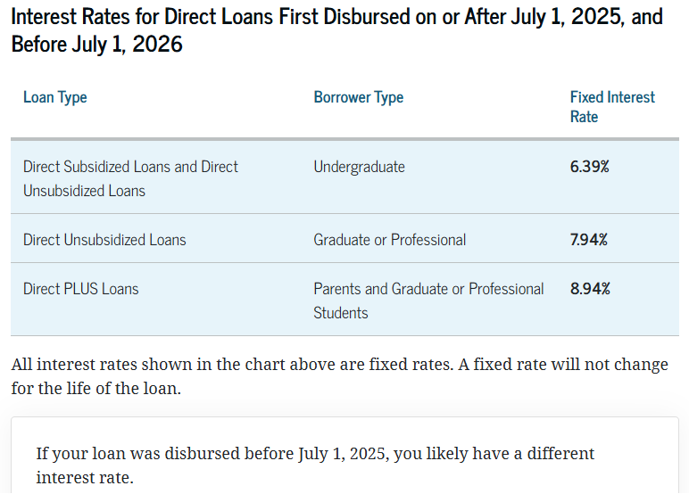
INTEREST RATES
Description
Interest is additional money that you pay to a lender as a cost of borrowing money. Interest is calculated as a percentage of the unpaid principal amount that you borrowed.

Slide 12

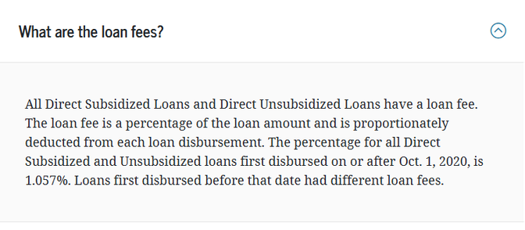
FEES
Most federal student loans have loan fees. These fees are a percentage of the total loan amount.
A loan fee comes out of the amount of money that is disbursed (paid out) to you while you’re in school. This means the money you receive will be less than the amount you actually borrow.
You’re responsible for repaying the entire amount you borrowed and not just the amount you received.
Description

Slide 13
ELIGIBILITY
REQUIREMENTS

Slide 14

GENERAL ELIGIBILITY REQUIREMENTS
Complete the Free Application For Student Aid (FAFSA)
Be a U.S citizen or eligible non-citizen, and have a valid SSN
Be enrolled at least half time (6+ credits) in an eligible degree/certificate program
Maintain satisfactory academic progress (SAP) as defined by your school
Not be in default on any existing federal student loan or owe a refund on a federal grant
Have remaining eligibility for direct loans
Sign a Master Promissory Note (MPN) and complete Entrance Counseling

Slide 15
ENTRANCE COUNSELING
Overview
Entrance counseling is a mandatory information session that helps federal student loan borrowers understand their responsibilities and obligations before receiving a Direct Subsidized Loan or Direct Unsubsidized Loan for the first time. It is required by the U.S. Department of Education.
Entrance counseling ensures that you:
Understand what a federal student loan is.
Know how interest works.
Learn your repayment options.
Are aware of the consequences of not repaying your loans.
You only need to complete an Entrance Counseling once.
https://studentaid.gov/entrance-counseling/

Slide 16
MASTER PROMISSORY NOTE
A Master Promissory Note (MPN) is a legally binding agreement between the borrower and the U.S. Department of Education, stating that you promise to repay your federal student loans, plus any interest and fees.
It also explains the terms and conditions of your loans—like interest rates, repayment plans, and deferment options.
A MPN is valid for 10 years
Visit
https://studentaid.gov/mpn/

Slide 17
EXIT COUNSELING
Overview
Exit counseling is a mandatory online session for federal student loan borrowers who are:
Graduating
Leaving school (temporarily or permanently)
Dropping below half-time enrollment
It helps you understand your repayment responsibilities, loan terms, and repayment options now that you're leaving school and repayment is approaching.
It ensures you understand:
How much you owe
When repayment starts
How interest works
Your monthly payment options
What to do if you can’t pay
Loan forgiveness, deferment, and forbearance options
Visit: https://studentaid.gov/exit-counseling/

Slide 18
REPAYMENT

Slide 19
REPAYMENT
Understanding what you owe
You can find your personal loan details and monthly payment amount through your loan servicer account and your StudentAid.gov account.
You can pick from repayment plans that base your monthly payment on your income or plans that give you a fixed monthly payment.
Repayment plans based on your income are a smart choice to lower your payment. The lower your income—or the larger your family size—the less you'll pay per month.
If you don’t pick a repayment plan, your loan servicer will place you on the Standard Repayment Plan (a 10-year fixed repayment plan).
Repayment
You make your payments to your loan servicer.
Missing a payment has consequences, including becoming delinquent (late) and eventually defaulting on your debt.
If you can afford to make your payments, you should enroll in auto pay (also known as auto debit) so you don’t miss payments. Auto pay means that your servicer will automatically deduct your monthly payment from your bank account. You also will earn a discount through a lower interest rate.
Make a payment

Slide 20
REPAYMENT
You always have options if you can't pay. Don't wait to contact your loan servicer to discuss options.
An IDR plan could lower your payment. If your income drops (for example, if you become unemployed), your payment could be as low as $0 per month.
You can request a temporary pause of payments (deferment or forbearance).
If You Can’t Afford Your Payments
There are several loan forgiveness options, but most programs have strict eligibility requirements. Student loans can be forgiven under programs such as the following:
Public Service Loan Forgiveness for people who work for eligible government and nonprofit employers
Teacher Loan Forgiveness for people who work in eligible teaching jobs
Income-driven repayment (IDR) forgiveness for people who repay their loans on an eligible IDR plan
Total and permanent disability discharge for people with a disability that severely limits their ability to work
Learn About Loan Forgiveness Options
https://studentaid.gov/manage-loans/repayment/repaying-101
Visit

Slide 21
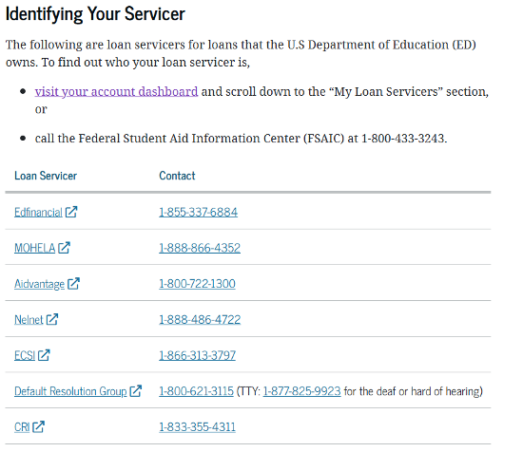
REPAYMENT
Your Loan Servicer Explained
Loan servicers provide federal student loan support on behalf of the government at no cost to you. Your loan servicer can help you with payments, repayment plans, and loan forgiveness programs. If you have issues managing your loans or making payments, reach out to your loan servicer
The U.S. Department of Education’s office of Federal Student Aid still manages your student loan records and oversees the work done by loan servicers.
Call, email, or chat with the Federal Student Aid Information Center. Representatives can help you with your StudentAid.gov account.
https://studentaid.gov/manage-loans/repayment/servicers
Visit

Slide 22
SMART BORROWING STRATEGIES
Borrow Minimally: Only accept the amount necessary for tuition, fees, and essential living expenses.
What are my actual tuition + living costs?
Can I reduce housing, food, or book expenses?
Understand Subsidized vs. Unsubsidized: Subsidized loans do not accrue interest while you are in school, making them preferable to unsubsidized loans, where interest accrues immediately.
Direct PLUS Loans –higher interest rates.
Research Earnings Potential: Use the Bureau of Labor Statistics Occupational Outlook Handbook to estimate future income. Research: Average starting salary in your field, Job placement rates, Typical debt-to-income ratio
A general rule of thumb: Try not to borrow more in total than your expected first-year salary.
Utilize Other Aid First: Exhaust scholarships, grants, and work-study opportunities before resorting to loans.
Complete the FAFSA every year.
Accept grants (like the U.S. Department of Education Pell Grant) and scholarships first.
Consider work-study options.
Loans should be your last funding source, not your first.

Slide 23
SMART BORROWING STRATEGIES -
MANAGEMENT & REPAYMENT
Pay Interest Early: For unsubsidized loans, make payments on interest while in school, even if not required, to prevent it from being added to the principal balance (capitalization). Making small monthly interest payments prevents capitalization. Even $25–$50/month can save thousands long-term.
Leverage Auto-Pay: Enroll in automatic payments to ensure on-time payments and potentially secure a small interest rate reduction.
Know Your Servicer & Manage your account: Keep your contact information updated with your loan servicer and check your account on the StudentAid.gov website.
Explore Repayment Plans: Investigate income-driven repayment plans to manage monthly payments based on your income.

Slide 24
LOAN APPLICATION PROCESS
&
ACCEPTING/REDUCING YOUR LOAN OFFER

Slide 25



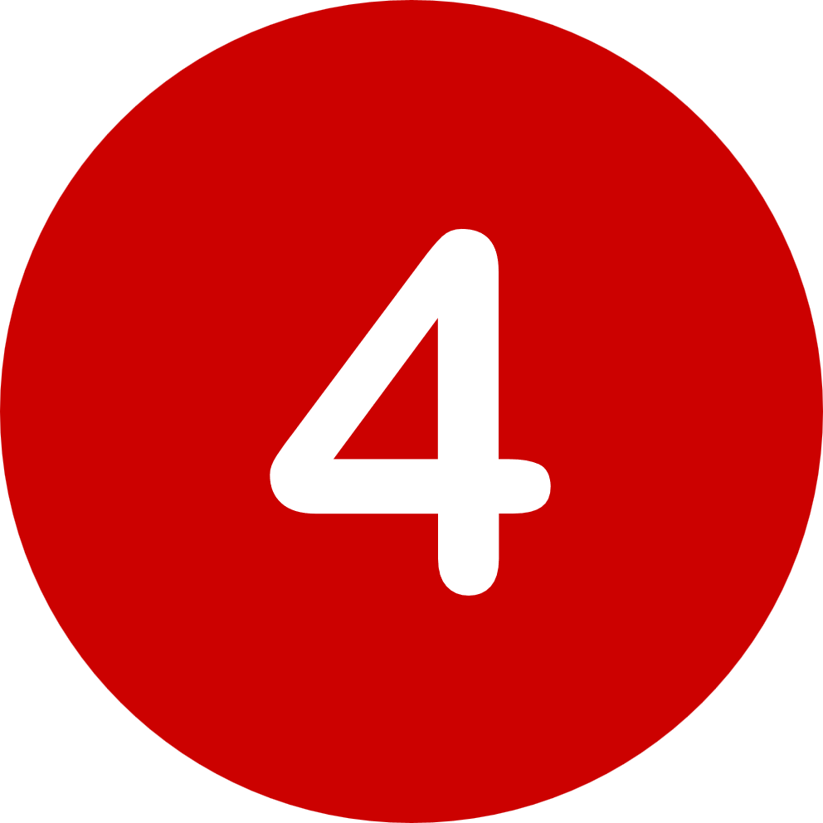

HOW TO SUBMIT A LOAN APPLICATION -
DiRECT LOAN PROCESSING FORM VIA CUNYFIRST
Log in to your CUNYfirst account and go to your ”Student Center”
Click the "Financial Aid" tile.
Be sure the academic year is set to the current year and Queens College (upper left corner)
On the left side, scroll down and click the "Direct Loan Processing Form" link
Read all 12 items carefully
After reviewing, check "The acknowledgment box" and click "Agree"
Complete and submit the form

Slide 26
ACCEPTING - REDUCING - DECLINING
DIRECT LOANS OFFERED BY CUNY
CUNY has been offering students with Direct Loans in the beginning of an academic year
The loans that are being packaged by CUNY are loans that are to be divided into the Fall and Spring semesters, unless the loan indicates Fall or Spring Subsidized/Unsubsidized.
If you wish to request a Summer Loan, you must decline CUNY’s loan offer and instead submit a Direct Loan Processing Form via CUNYFirst.
Can not increase a loan, only Accept, Reduce or Decline
Accepting, Reducing or Declining your offered William D. Ford Federal Direct Loan:
Login to CUNYfirst and click on "Student Center"
Select the "Financial Aid" tile
Confirm the financial aid year that you wish to review at the top left section of the page. Students will only have the option to accept, reduce, or decline Direct Loan offers.
Navigate to Awards on the left sidebar to open the drop-down menu, click on Accept/Decline.
Click on the Edit icon to activate the Submit and Actions buttons.
Click on the drop-down option under the Award Decision Column.
From the drop-down you can choose to accept, decline, or reset.
To reduce the loan, you must choose accept, and then they will be able to reduce the loan amount. Keep in mind, the amount you reduce will be divided into Fall and Spring.

Slide 27
ALTERNATIVE
STUDENT
LOAN OPTIONS

Slide 28
PRIVATE EDUCATION
LOAN PROGRAMS
Alternative Loans (Private Education Loans) are offered through private lenders.
Meant to provide additional educational funding only after a student and his/her family has exhausted all other sources of funding such as federal and state aid or not eligible.
Not guaranteed by the federal government and may carry high interest rates and origination fees. All the loans require a credit check, and most will require a cosigner if the borrower has little or negative credit history.
Key Research Points and Helpful tips for students and parents to consider when looking for an alternative loan lender:
Interest rate & Loan fees (origination, disbursement, and repayment). Carefully read the fine print of each loan offer and know the different types of interest rates available.
Enrollment requirements (half time or less)
Duration and types of deferments offered
Borrower benefits and Repayment terms - Does the loan charge a disbursement fee or a repayment fee? A disbursement fee is a fee that’s charged once your student loan check is cut. A repayment fee kicks in when it’s time to start paying on your loan.

Slide 29
PRIVATE EDUCATION
LOAN PROGRAMS
Students have the right to select the alternative lender of their choice. CUNY does not recommend any one lender in particular.
To better serve our students and their families, a Lender Comparison List is available to assist you in finding a loan that works for you.
https://www.cuny.edu/financial-aid/student-loans/private-education-loan-programs/

Slide 30
THANK YOU
Q+A
Nandy Sukhai – nsukhai@qc.cuny.edu
Office of Financial Aid Website – https://www.qc.cuny.edu/faid/

