Slide 1
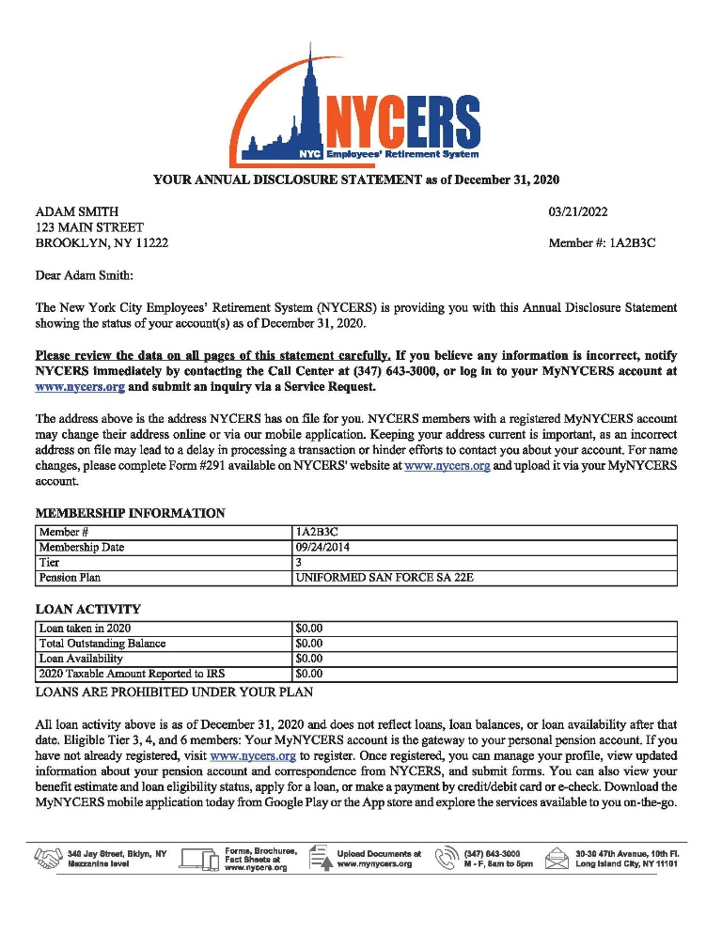
Understanding Your Annual Disclosure Statement (ADS)
Summary of your NYCERS membership activities for the previous calendar year, including:
Work history (Membership Service) as reported by your employer
Contributions
Interest
Estimated benefits
And much more!

Slide 2
Benefits of Reviewing Your ADS
Opportunity to correct inaccurate information which could potentially affect your retirement
Information may help you manage your membership and plan for retirement
Note
Information provided in the ADS is as of December 31.
To see more recent changes to your beneficiaries, log in to your MyNYCERS account.

Slide 3
Important Notes About Your ADS
Service
Credited service may differ on your ADS
NYCERS is continuously working to ensure your service is up-to-date prior to your retirement
Pension-Related Earnings
Account Activity Detail page lists the pension-related earnings you received as reported to NYCERS by your employer during the Annual Disclosure Statement period
The pension-related earnings reported by your employer may not match your W2 earnings
Non-Pension Earnings
The amount in your paycheck other than your regular salary, such as*:
Overtime pay
Longevity pay
Retroactive pay
Some or all of these MAY be excluded when calculating your contribution amount and/or retirement benefits
*Your union contract and your tier determines whether
these are considered pensionable earnings.
Notes:
Service: You may notice a difference in the amount of service you’ve been credited. NYCERS is continuously working to ensure your service is up-to-date prior to your retirement.
Pension-Related Earnings: The information provided on the Account Activity Detail page lists the pension related earnings you received as reported to NYCERS by your employer during the Annual Disclosure Statement period. The pension related earnings reported may not match your W2 earnings.
Non-pension earnings is the amount that is included in your paycheck other than your regular salary. This can include, but is not limited to, overtime, longevity, and retroactive pay. Some or all of these MAY be excluded when calculating your contribution amount and/or retirement benefits. Whether or not these are pensionable earnings depends on your union contract and your tier.

Slide 4
Accessing Your Annual Disclosure Statement
Delivered automatically to your MyNYCERS account during the summer
Only available in your MyNYCERS account – it is not mailed to you
View, print or download your ADS

