Slide 1
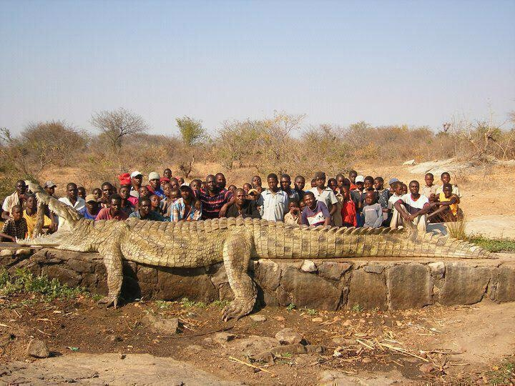
Notes:
Story related to image:
https://www.pinterest.com/pin/6122149463655184/

Slide 2
Notes:
Aguirre (2017)

Slide 3
Notes:
Aguirre (2017)

