Slide 1

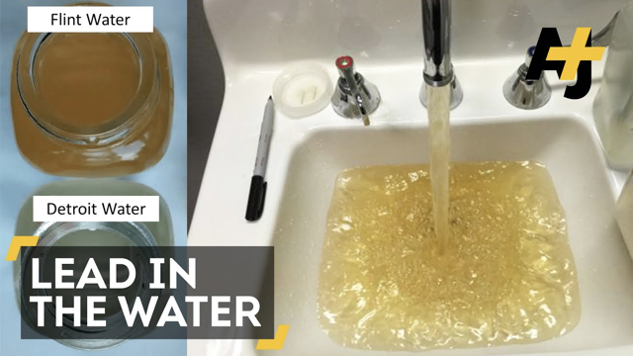
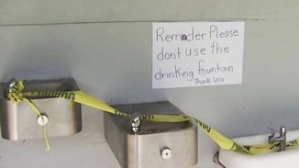
SAFE WATER IN OUR SCHOOLS
Notes:
https://www.opb.org/news/series/lead/portland-public-school-lead-in-water-fountains/

Slide 2
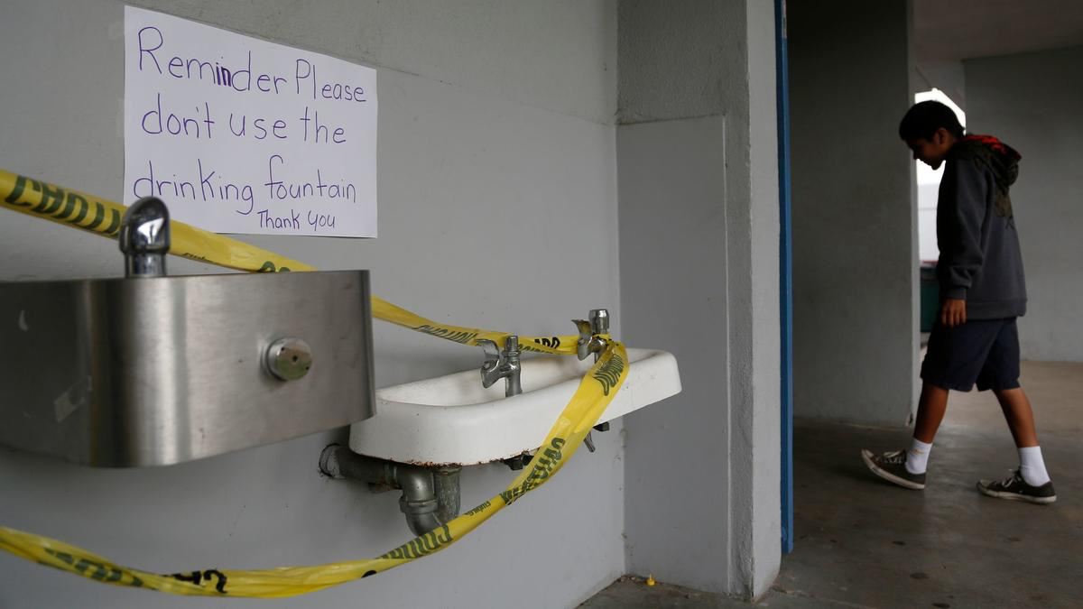
What do you notice?
What do you wonder?

Slide 3
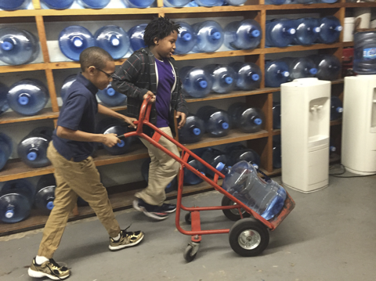
What do you notice?
What do you wonder?
What questions can be answered with mathematics?
Notes:
https://www.npr.org/2016/03/16/470512927/before-flint-lead-contaminated-water-plagued-schools-across-u-s

Slide 4
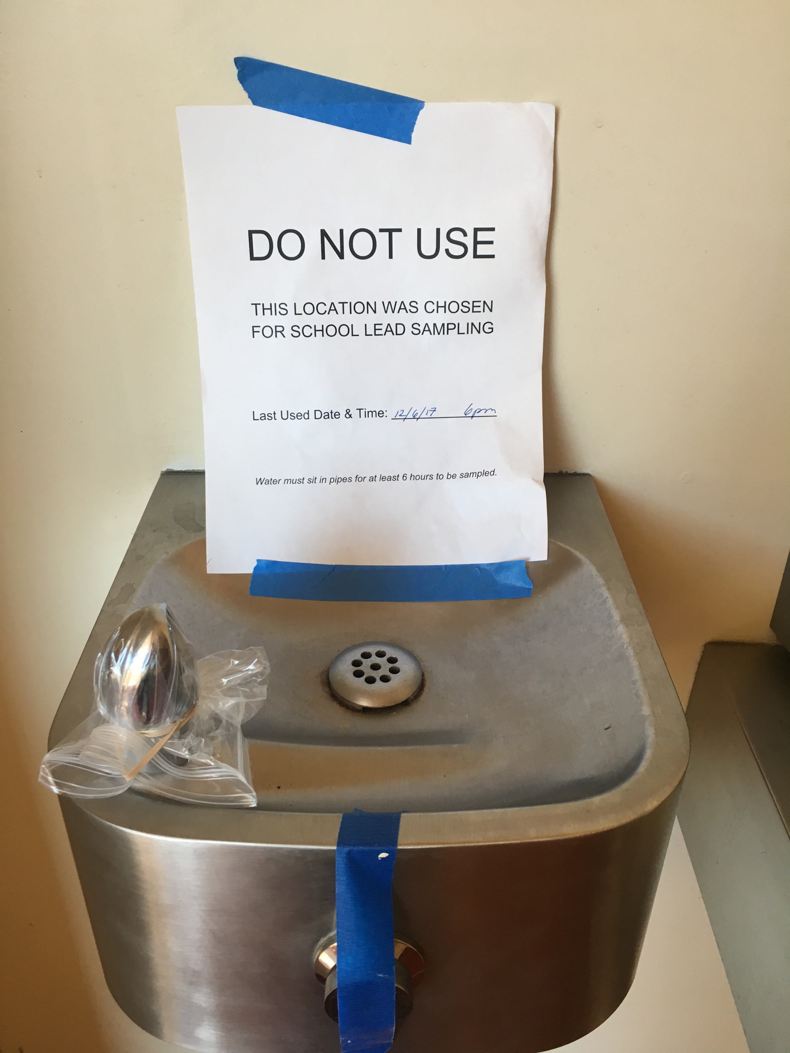
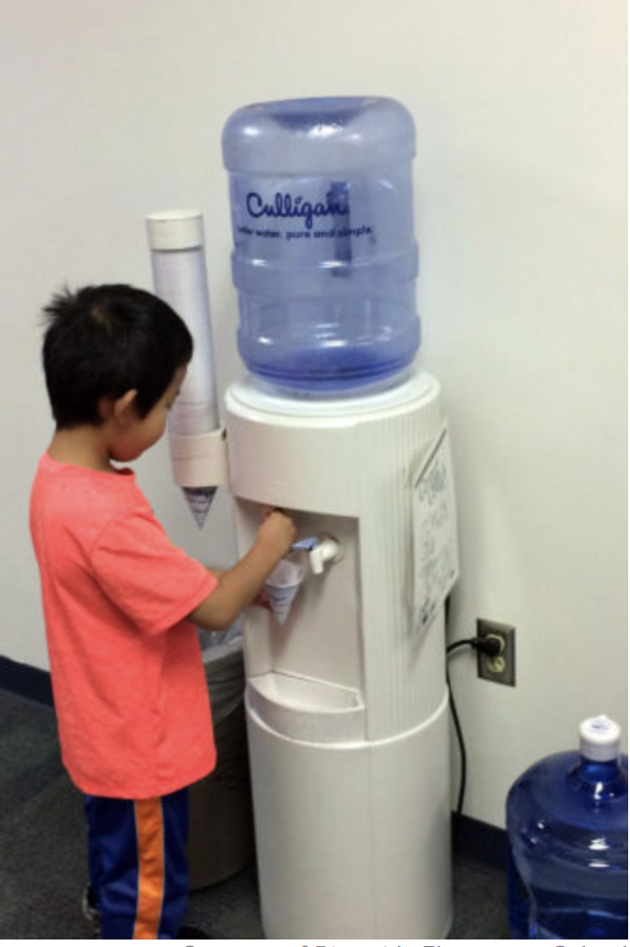
What do you notice?
What do you wonder?
What questions can be answered with mathematics?

Slide 5
If our water fountains were unsafe, how many large jugs of water would we need to make sure that everyone in our class has enough drinking water for 1 (day/week/month)?
What do we KNOW that will help us? | What do we need to know or find out? | What do we need to decide? What assumptions do we need to make?

Slide 6
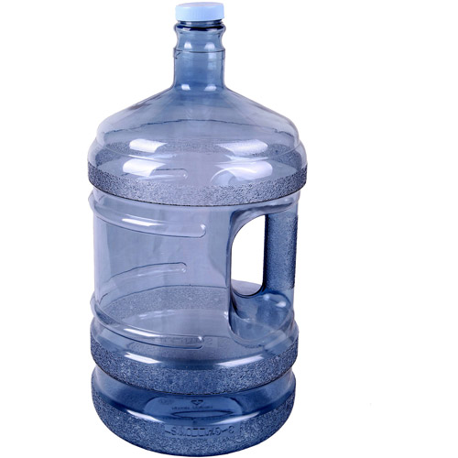
WATER JUGS
A large jug holds 5 gallons of water.
FACT:
There are 16 cups of water in 1 gallon.
HOW MUCH WATER DO WE NEED TO DRINK EACH DAY?
Here are recommendations for how much water people should drink each day.
Age | How many cups of water per day?
4 to 8 years old | 5 cups
9 to 13 years old | 7-8 cups
14-18 years old, and adults | 8-10 cups

Slide 7
Your Plan should include:
your assumptions and decision important to your plan
how many large jugs are needed
how you know you will have enough water for everyone in our class
how others could use your plan help their schools have enough water

Slide 8
Important assumptions and decisions made
Use pictures, numbers, and words to show that your plan will work
What directions would you give a student who wanted to make a plan for their own class?

