Slide 1

SEXUAL MISCONDUCT POLICIES IN ACTION
A review of rights, responsibilities, and upcoming changes for coaches and athletics department administration

Slide 2


WELCOME
Nancy Schick, Compliance & Diversity Training Specialist / Investigator, nancy.schick@qc.cuny.edu
Employment Attorney / Mediator
Result of Title IX / Former College Softball Player
Human Resources Supervisor prior to law school
Plaintiff in sex discrimination lawsuit during law school

Slide 3

OFFICE OF COMPLIANCE AND DIVERSITY
Title IX and Enough is Enough
Diversity, Equity, and Inclusion
Affirmative Action
Accessibility
Training, Investigations, and Conflict Resolution

Slide 4
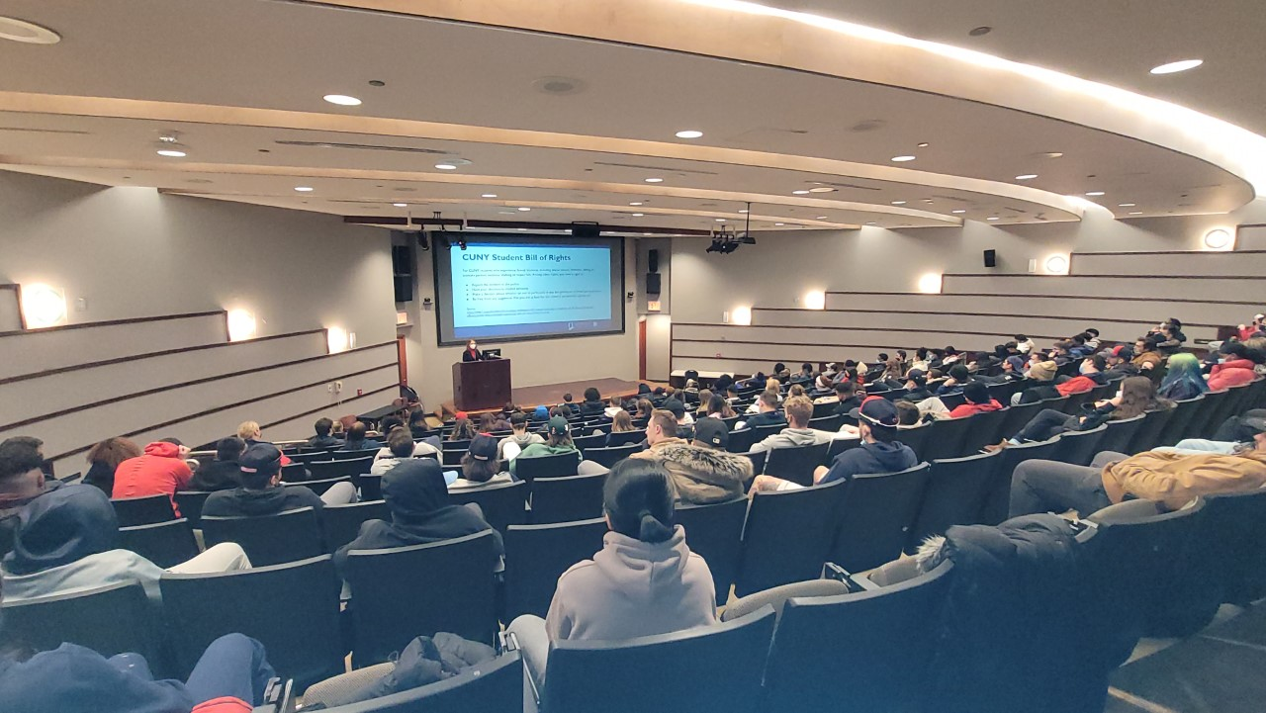
TRAINING GOALS
Reconcile
Reconcile the many laws, rules, regulations, policies, and procedures regarding sexual misconduct that affect your job
Remind
Remind you of your rights and responsibilities when you are exposed to, witness, or are told about sexual misconduct
Answer
Answer some of your questions about pending changes to Title IX and NCAA transfer rules

Slide 5

DISCLAIMER
This course provides a general overview of non-discrimination policies and laws, as well as how they might affect your time at Queens College.
It is not legal advice, and I am not your attorney. If you require information or advice applied to your unique situation, please make an appointment with the Office of Compliance and Diversity (OCD).
Vivian Cheung, Executive Assistant, Vivian.Cheung@qc.cuny.edu

Slide 6
THIS IS A MANDATORY TRAINING
To ensure your attendance is properly recorded and reported, complete all fields and sign the attendance sheet.

Slide 7
PARTICIPATION AGREEMENTS
We are here to learn and contribute.
We respect the diversity of each other's experiences.
We will maintain the confidentiality of what others share.
If you prefer to discuss your situation privately, you can make an appointment with the OCD: Vivian.Cheung@qc.cuny.edu

Slide 8

KEY SOURCES
Title IX of the US Education Amendments
Title VII of the US Civil Rights Act
Section 129-b of the NYS Education Law
The Jeanne Clery Disclosure of Campus Security Policy and Campus Crime Statistics Act
CUNY's Policy on Sexual Misconduct
CUNY's Equal Opportunity and Non-Discrimination Policy
CUNY's Drug and Alcohol Amnesty Policy
NCAA Board of Governors Policy on Campus Sexual Violence

Slide 9
TITLE IX (37 words)
No person in the United States shall, on the basis of sex, be excluded from participation in, be denied the benefits of, or be subjected to discrimination under any education program or activity receiving Federal financial assistance.

Slide 10
TITLE IX COVERAGE
Sexual harassment, including harassment based on sexual preference and gender identity
Sexual violence (e.g., rape, sexual assault, sexual battery)
Sexual coercion, or quid pro quo sexual harassment

Slide 11
NYS EDUCATION LAW 129-b COVERAGE
(ENOUGH IS ENOUGH LAW)
On college campuses:
Sexual assault
Dating violence
Domestic violence
Stalking

Slide 12
CUNY POLICY ON SEXUAL MISCONDUCT
CUNY employee conditioning the provision of an aid, benefit, or service of CUNY on an individual’s participation in unwelcome sexual conduct
Unwelcome conduct determined by a reasonable person to be so severe, pervasive, and objectively offensive that it effectively denies a person equal access to CUNY’s education program or activity
Sexual Assault, Dating Violence, Domestic Violence, or Stalking as defined in this Policy.

Slide 13
CUNY POLICY (CONT.)
Non-Title IX Sexual Misconduct matters do not require the same, strict process as Title IX matters. These matters are also governed by CUNY Policies on:
Equal Opportunity and Nondiscrimination
Campus and Workplace Violence Prevention
Domestic Violence and the Workplace
Implementing Reasonable Accommodations and Academic Adjustments

Slide 14
COMPLAINT PROCESS
Report
Whether formal or informal, all reports of discrimination on the basis of sex must be investigated
Distinguish
The Title IX Coordinator or designee determines whether the allegations fall under TIX jurisdiction
Investigate
An investigator will privately gather evidence, such as witness statements and many forms of documentation

Slide 15
SUPPORTIVE MEASURES FOR ALL PARTIES
Academic
Schedule changes, deadline adjustments, tutoring, distance learning, and other accommodations
Residential
Changes to housing situations, assistance in finding alternative housing, and other accommodations
Employment
(Campus employees) Schedule changes, work assignments, remote work, and other accommodations

Slide 16
SUPPORTIVE MEASURES (CONT.)
Counseling
Student Counseling, Employee Assistance Program, referrals to community organizations
Safety
Public Safety escorts, orders of protection, no contact orders, and other accommodations
Due Process
Trauma-informed interviewing, presumptions in favor of parties, fairness

Slide 17
QUESTIONS?

Slide 18

COACHES' RIGHTS AND RESPONSIBILITIES
Rights:
Title VII of the US Civil Rights Act
Responsibilities:
Title IX and Section 129-b
NCAA Board of Governors Policy on Campus Sexual Violence
Both:
CUNY's Policy on Sexual Misconduct
CUNY's Equal Opportunity and Non-Discrimination Policy
CUNY's Drug and Alcohol Amnesty Policy

Slide 19
RESPONSIBLE EMPLOYEES
Duty to report allegations of Sexual Misconduct, including all relevant details, to the Title IX Coordinator
Not permitted to maintain a complainant’s confidentiality but will maintain a complainant’s privacy to the greatest extent possible
Information reported to them will be shared only with the Title IX Coordinator and other people responsible for handling the college’s response to the report

Slide 20
IMPORTANT
To the extent possible, before a complainant reveals any information to a responsible employee, the employee should advise the complainant of the employee’s reporting obligations.
If the complainant wants to maintain confidentiality, direct the complainant to confidential resources, such as the counseling center or a community resources.

Slide 21
NCAA Board of Governors Policy on Campus Sexual Violence
Sexual discrimination, sexual harassment, and sexual and interpersonal violence violate human decency and the NCAA's core values:
Well-being
Fairness
Integrity
Teamwork

Slide 22
NCAA POLICY KEY FEATURES
Athletics department informed on and integrated in overall campus policies and processes
Review annually the most current Checklist Recommendations of the NCAA Sexual Violence Prevention Toolkit
Involving student-athletes in prevention efforts
Annual compliance attestation

Slide 23
ANNUAL ATTESTATION
Training (e.g., ESPARC, SPARC, targeted topics)
Title IX information and coordinator readily available
Annual transfer student-athlete disclosure
  CUNY still finalizing its policies
  Balance compliance with respondent's privacy and due process rights

Slide 24
COMMON ATHLETICS PROGRAM VIOLATIONS
Failing to actively take steps to protect students from sexual assault
Discriminating or retaliating against students who've reported violations
Ignoring a history of complaints against a coach or athlete
Denying a student participation based on their sex or gender
Not providing equal resources and programs to all genders

Slide 25
QUESTIONS?

Slide 26
WHAT'S COMING?
More training on Title IX changes (e.g., formal complaint requirement, pregnancy protections, "effectively denied access")
More training on NCAA transfer rule, including how to complete the form

Slide 27
QUESTIONS?

Slide 28
THANK YOU
Nancy Schick, Esq.
Compliance & Diversity Training Specialist / Investigator
Kiely Hall, Room 137 (for now)
nancy.schick@qc.cuny.edu

