Slide 1

SEXUAL MISCONDUCT POLICIES IN ACTION
A review of rights, responsibilities, and upcoming changes for student-athletes.

Slide 2


WELCOME
Nancy Schick, Compliance & Diversity Training Specialist / Investigator, nancy.schick@qc.cuny.edu
Employment Attorney / Mediator
Result of Title IX / Former College Softball Player
Human Resources Supervisor prior to law school
Plaintiff in sex discrimination lawsuit during law school
Survivor of abuse and sexual assault

Slide 3

OFFICE OF COMPLIANCE AND DIVERSITY
Title IX and Enough is Enough
Diversity, Equity, and Inclusion
Affirmative Action
Accessibility
Training, Investigations, and Conflict Resolution

Slide 4
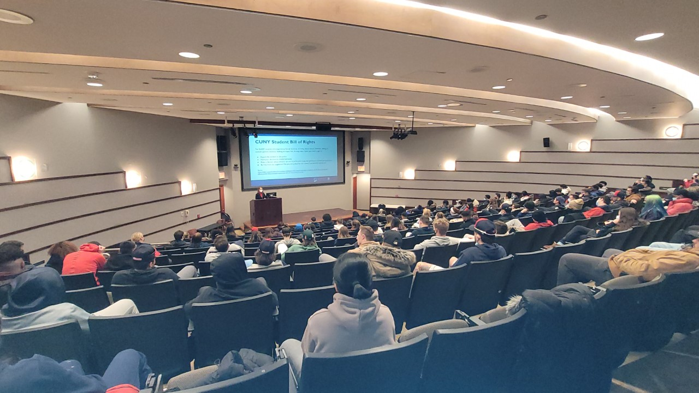
TRAINING GOALS
Reconcile
Reconcile the many laws, rules, regulations, policies, and procedures regarding sexual misconduct that protect you on campus and in QC programs and activities
Remind
Remind you of your rights and responsibilities when you are exposed to, witness, or are told about sexual misconduct
Answer
Answer some of your questions about Title IX, Enough is Enough, Student Bill of Rights, NCAA transfer rules, and more

Slide 5

DISCLAIMER
This course provides a general overview of non-discrimination policies and laws, as well as how they might affect your time at Queens College.
It is not legal advice, and I am not your attorney. If you require information or advice applied to your unique situation, please make an appointment with me: nancy.schick@qc.cuny.edu

Slide 6
THIS IS A MANDATORY TRAINING
To ensure your attendance is properly recorded and reported, complete all fields and sign the attendance sheet.

Slide 7
PARTICIPATION AGREEMENTS
We are here to learn and contribute.
We respect the diversity of each other's experiences.
We will maintain the confidentiality of what others share.
If you prefer to discuss your situation privately, you can make an appointment with me: nancy.schick@qc.cuny.edu

Slide 8

KEY SOURCES
Title IX of the US Education Amendments
Title VII of the US Civil Rights Act
Section 129-b of the NYS Education Law
The Jeanne Clery Disclosure of Campus Security Policy and Campus Crime Statistics Act
CUNY's Policy on Sexual Misconduct
CUNY's Equal Opportunity and Non-Discrimination Policy
CUNY's Drug and Alcohol Amnesty Policy
NCAA Board of Governors Policy on Campus Sexual Violence

Slide 9
TITLE IX (37 words)
No person in the United States shall, on the basis of sex, be excluded from participation in, be denied the benefits of, or be subjected to discrimination under any education program or activity receiving Federal financial assistance.

Slide 10
TITLE IX COVERAGE
Sexual harassment, including harassment based on sexual preference and gender identity
Sexual violence (e.g., rape, sexual assault, sexual battery)
Sexual coercion, or quid pro quo sexual harassment

Slide 11
NYS EDUCATION LAW 129-b COVERAGE
(ENOUGH IS ENOUGH LAW)
On college campuses:
Sexual assault
Dating violence
Domestic violence
Stalking

Slide 12
CUNY POLICY ON SEXUAL MISCONDUCT
CUNY employee conditioning the provision of an aid, benefit, or service of CUNY on an individual’s participation in unwelcome sexual conduct
Unwelcome conduct determined by a reasonable person to be so severe, pervasive, and objectively offensive that it effectively denies a person equal access to CUNY’s education program or activity
Sexual Assault, Dating Violence, Domestic Violence, or Stalking as defined in this Policy.

Slide 13
CUNY POLICY (CONT.)
Non-Title IX Sexual Misconduct matters do not require the same, strict process as Title IX matters. These matters are also governed by CUNY Policies on:
Equal Opportunity and Nondiscrimination
Campus and Workplace Violence Prevention
Domestic Violence and the Workplace
Implementing Reasonable Accommodations and Academic Adjustments

Slide 14

IMPORTANT
To the extent possible, before you reveal any information to a responsible employee, that employee should advise you of their reporting obligations.
If you want to maintain confidentiality, speak to a confidential resource, such as the counseling center or a community resources.

Slide 15
COMPLAINT PROCESS
Report
Whether formal or informal, all reports of discrimination on the basis of sex must be investigated
Distinguish
The Title IX Coordinator or designee determines whether the allegations fall under TIX jurisdiction
Investigate
An investigator will privately gather evidence, such as witness statements and many forms of documentation

Slide 16
SUPPORTIVE MEASURES FOR ALL PARTIES
Academic
Schedule changes, deadline adjustments, tutoring, distance learning, and other accommodations
Residential
Changes to housing situations, assistance in finding alternative housing, and other accommodations
Employment
(Campus employees) Schedule changes, work assignments, remote work, and other accommodations

Slide 17
SUPPORTIVE MEASURES (CONT.)
Counseling
Student Counseling, Employee Assistance Program, referrals to community organizations
Safety
Public Safety escorts, orders of protection, no contact orders, and other accommodations
Due Process
Trauma-informed interviewing, presumptions in favor of parties, fairness

Slide 18
What QUESTIONS do you have?

Slide 19

STUDENT-ATHLETES' RIGHTS AND RESPONSIBILITIES
Rights:
Title VII of the US Civil Rights Act
Title IX of the Education Amendments
Responsibilities:
Title IX and Section 129-b
NCAA Board of Governors Policy on Campus Sexual Violence
Both:
CUNY's Policy on Sexual Misconduct
CUNY's Equal Opportunity and Non-Discrimination Policy
CUNY's Drug and Alcohol Amnesty Policy

Slide 20
NCAA Board of Governors Policy on Campus Sexual Violence
Sexual discrimination, sexual harassment, and sexual and interpersonal violence violate human decency and the NCAA's core values:
Well-being
Fairness
Integrity
Teamwork

Slide 21
NCAA POLICY KEY FEATURES
Athletics department informed on and integrated in overall campus policies and processes
Review annually the most current Checklist Recommendations of the NCAA Sexual Violence Prevention Toolkit
Involving student-athletes in prevention efforts
Annual compliance attestation

Slide 22
ANNUAL ATTESTATION
Training (e.g., ESPARC, SPARC, targeted topics)
Title IX information and coordinator readily available
Annual transfer student-athlete disclosure
  CUNY still finalizing its policies
  Balance compliance with respondent's privacy and due process rights

Slide 23
COMMON ATHLETICS PROGRAM VIOLATIONS
Failing to actively take steps to protect students from sexual assault
Discriminating or retaliating against students who've reported violations
Ignoring a history of complaints against a coach or athlete
Denying a student participation based on their sex or gender
Not providing equal resources and programs to all genders

Slide 24
What's not clear?

Slide 25
WHAT'S COMING?
More training on Title IX changes (e.g., formal complaint requirement, pregnancy protections, "effectively denied access")
More training on bystander intervention, healthy relationships, and recognizing bias

Slide 26
WHAT DO YOU THINK IS STILL NEEDED?

Slide 27
THANK YOU
Nancy Schick, Esq.
Compliance & Diversity Training Specialist / Investigator
Kiely Hall, Room 134 (We moved on August 1st)
nancy.schick@qc.cuny.edu

