Slide 1
Academic Renewal Initiative
Fall 2025 – Spring 2026

Slide 2
Academic Renewal Initiative: What
Holistic assessment of our academic offerings to shape them based on mission, student demand, projected employment growth
Many institutions have undergone “program prioritization” exercises in the past 10-15 years

Slide 4
Academic Renewal Initiative: Why
To meet current student needs
To adjust for enrollment at 15,000
To focus scarce resources on healthy programs
To allow us to invest in desired programs
To align hiring with programs we want to grow
To address structural deficit ($1.9M)

Slide 5

QC is a college of
“Let a thousand flowers bloom”

Slide 6
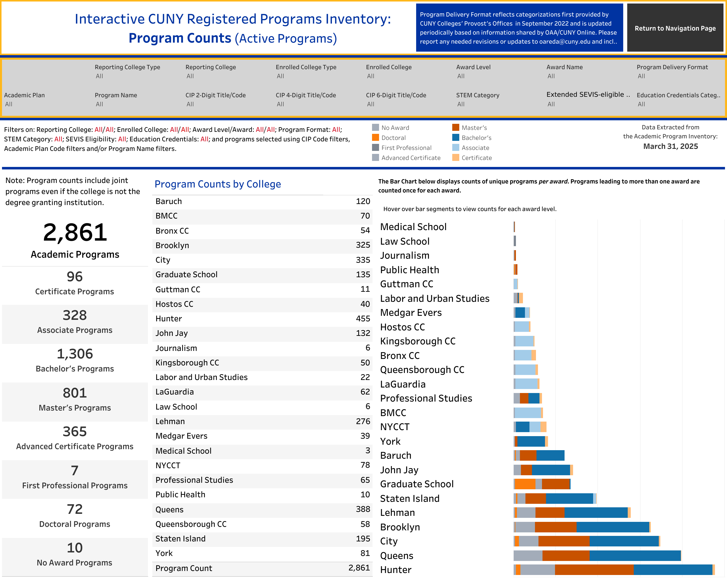

Slide 7
Academic Renewal Initiative: Who
Provosts typically lead these efforts
Provide overall guidance regarding metrics and desired outcomes
Faculty must be central players
You know the academic landscape in your area(s)
Shared governance partnership
Operations and budget: administration
Curriculum, hiring, promotion: faculty

Slide 8
Academic Renewal Initiative: Who (con’t)
Working group
Report to Provost and President with recommendations
Great examples of thoughtful processes
Juniata College
Ithaca College

Slide 9
Academic Renewal Initiative
Working Group
President Wu will formally convene and charge a working group comprised of faculty and administrators
7 faculty from a variety of disciplines and at different career stages
4 administrators, including the Provost who will chair this Working Group
Work begins in Fall 2025
Fall: meetings, discussion, data
Spring: report with recommendations to President and Provost

Slide 10
Academic Renewal Initiative: When & How
now
“T-0” work occurring now
Identify and de-register programs currently with no majors/minors
Remove from Bulletin courses that haven’t been taught for 5+ years (n=1,332)
Spring 2025
Initial conversations: P&B, Academic Senate
Appoint Working Group
Summer 2025
Background reading
Fall 2025
Working Group meets
Spring 2026
Report due

Slide 11
Goals
We (QC) drive this process
Opportunity to sharpen our identity
Set a vision for academics
Foundational work for 2027 QC Strategic Plan

